Slide 1
CS375
Design & Analysis of Algorithms
Spring 2016
Lecture 4
Lei Yu
Department of Computer Science
State University of New York at Binghamton
lyu@cs.binghamton.edu
www.cs.binghamton.edu/~lyu

Slide 2
Today’s Topics
Θ-notation (Theta)
o-notation (little o)
ω-notation (little ω)
Classifying examples using limits
Properties of asymptotic notations

Slide 3
Θ-notation (Theta) (1)
This notation is used to define a class of cost functions that can be asymptotically tight (both lower and upper) bounded by a given function.
The above statement can be more rigorously expressed below:
Θ(g(n)) = { f(n) : there exist positive constants c₁, c₂ and n₀
such that 0 ≤ c₁ g(n) ≤ f(n) ≤ c₂ g(n) for all n ≥ n₀ }
Example: n²/2 – 3n ∈ Θ(n²), with c₁ = 1/4, c₂ = 1/2, and n₀ = 12.
For a given function g(n), Θ(g(n)) denotes a set of functions f(n)
such that after n becomes sufficiently large, f(n) is lower and upper bounded by g(n) subject to some constant factors.

Slide 4
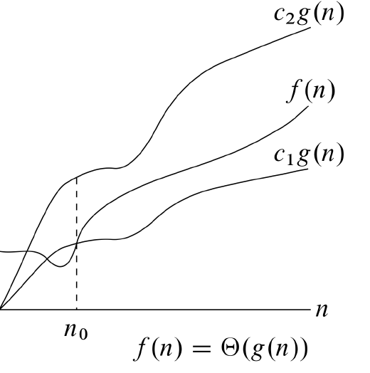
Θ-notation (Theta) (2)
The relationship between g(n) and f(n), a function in Θ(g(n)), can be graphically illustrated by:
Θ essentially defines an “equivalence” relationship between cost functions.
All functions in Θ(g(n)) have the same highest-order term.
Theorem: f(n) ∈ Θ(g(n)) if and only if f(n) ∈ O(g(n)) and f(n) ∈ Ω(g(n)).

Slide 5
Θ-notation (Theta) (3)
Exercises: Is each of the following relationship true or false?
Why or why not?
1000000n² ∈ Θ(n²)
(n – 1)n / 2 ∈ Θ(n²)
n / 2 ∈ Θ(n²)
lg n² ∈ Θ(lg n)
lg²n ∈ Θ(lg n)
n² ∈ Θ(n)
Notes:
Answer: true. True, false, true, false, false

Slide 6
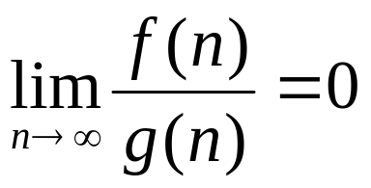
o-notation (little o)
This notation is used to define a class of cost functions that are strictly asymptotically upper bounded by a given function, i.e., the upper bound is not asymptotically tight.
Formally,
o(g(n)) = { f(n) : for any positive constant c, there exists a
constant n₀ >0, such that 0 ≤ f(n) < cg(n) for all n ≥ n₀ }
  Pay attention to the differences between the formal definitions of o(g(n)) and O(g(n)).
  Example: 5n = o(n²), but 5n² ≠ o(n²), although 5n² = O(n²).
If f(n) = o(g(n)), then f(n) becomes more and more insignificant or negligible when n becomes larger and larger.
➔
Exercise: prove the relationships above based on definition

Slide 7
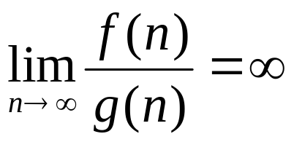
ω-notation (little ω)
This notation is used to define a class of cost functions that are strictly asymptotically lower bounded by a given function, i.e., the lower bound is not asymptotically tight.
Formally,
ω(g(n)) = { f(n) : for any positive constant c, there exists a
constant n₀ >0 such that 0 ≤ cg(n) < f(n) for all n ≥ n₀ }
  Example: 5n² = ω(n), but 5n² ≠ ω(n²), although 5n² = Ω(n²).
If f(n) = ω(g(n)), then g(n) becomes more and more insignificant or negligible compared to f(n) when n becomes larger and larger.
➔

Slide 8
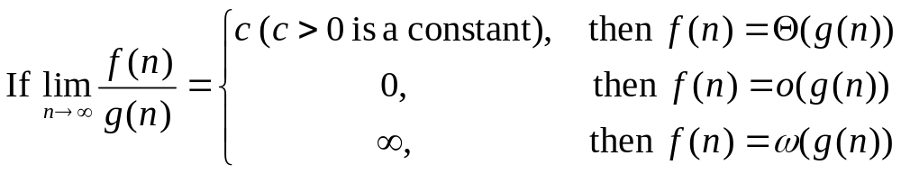
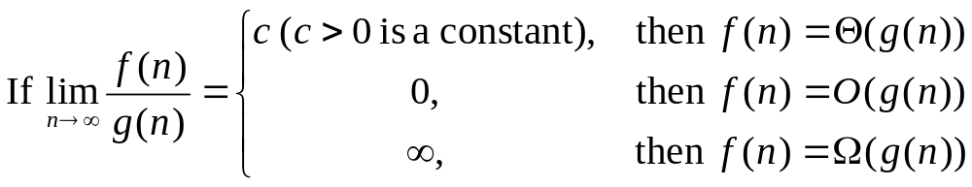
Use Limit for Asymptotic Notations
Use limit to define the asymptotic notations:
Since f(n) = o(g(n)) ➔ f(n) = O(g(n)) and
f(n) = ω(g(n)) ➔ f(n) = Ω(g(n)), we also have:

Slide 9
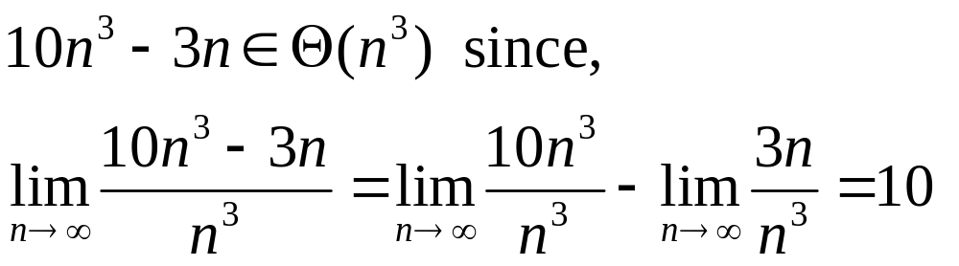
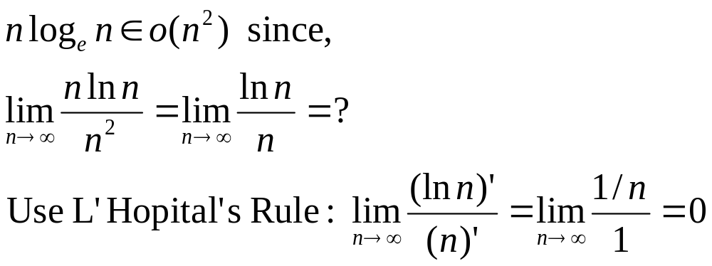
Examples Using Limit (1)

Slide 10
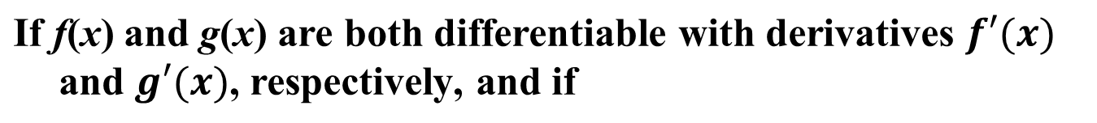
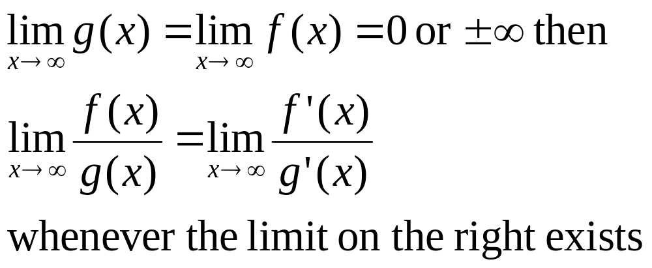
L’Hopital’s Rule
Notes:
L’Hopital pronounces as lopi’tal

Slide 11
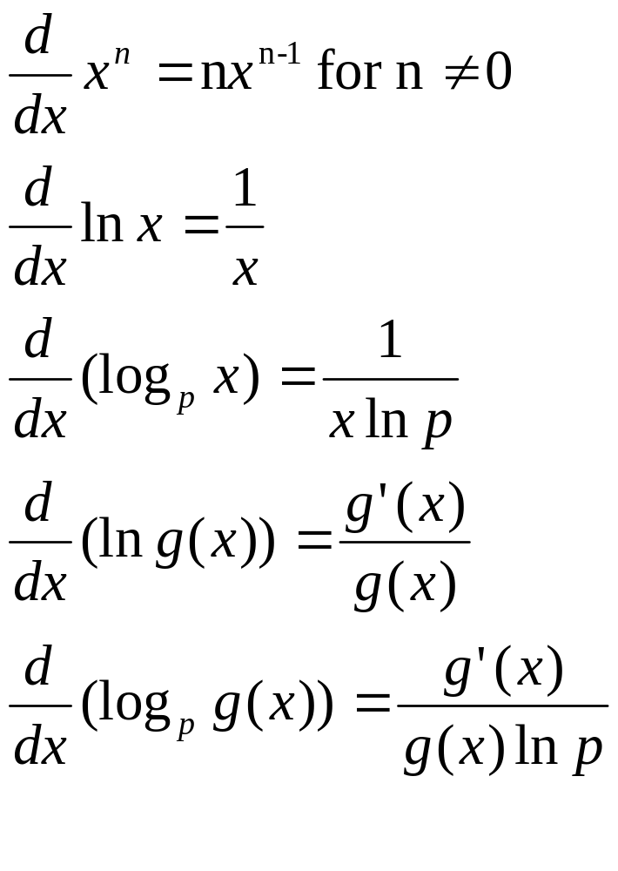
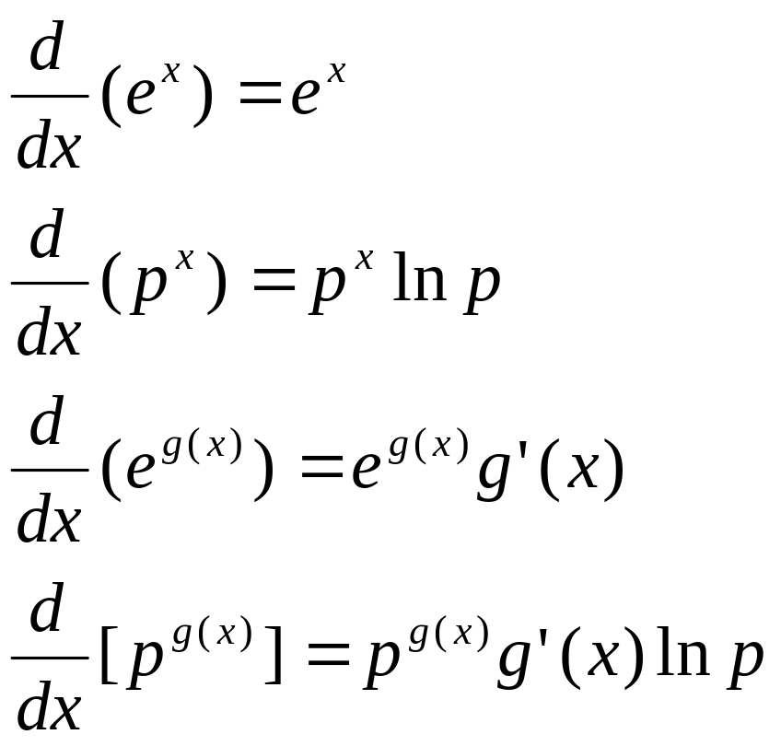
Review of Derivatives

Slide 12
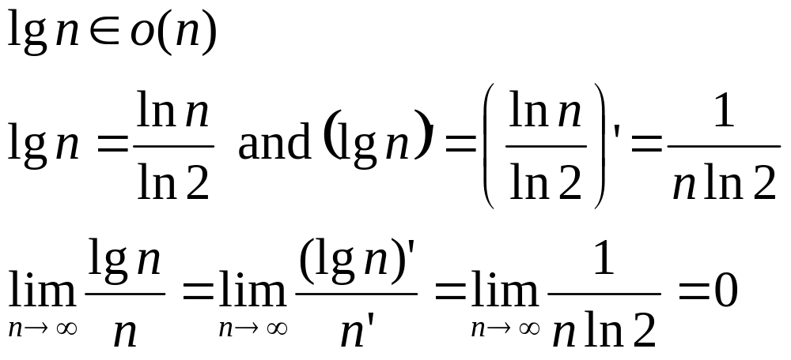
Examples Using Limit (2)
This example applies to log function of any base

Slide 13
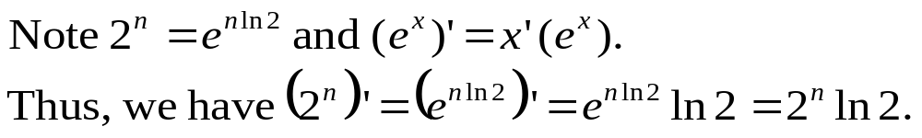
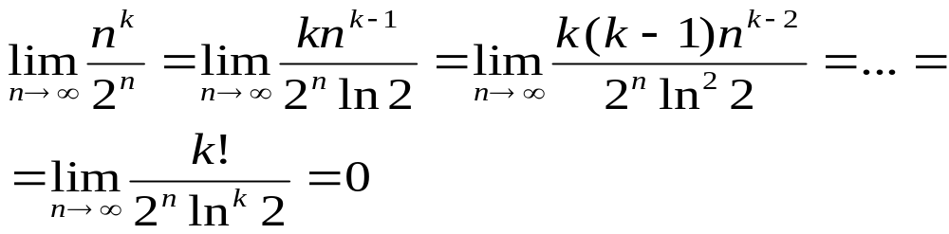
Examples Using Limit (3)
Show n^{k} ∈ o(2^{n}), where k is a positive integer.
By repeatedly applying L’Hopital’s Rule, we have
➔ n^{k} ∈ o(2^{n}) is true.
This example applies to exponential function of any base

Slide 14
Orders of Algorithms (1)
Common Complexity Categories in increasing order: if function f(x) is on the left of function g(x), then f(x) = o(g(x)).
Θ(lg n) Θ(n) Θ(n lg n) Θ(n²) Θ(n^{j}) Θ(n^{k}) Θ(a^{n}) Θ(b^{n}) Θ(n!)
where k > j > 2 and b > a >1.
General rules:
  Logarithmic functions grow slower than polynomial functions.
  Polynomial functions grow slower than exponential functions.
  Polynomial functions with a lower highest order term grow slower than polynomial functions with a higher highest order term.
  Exponential functions with a smaller base grow slower than exponential functions with a larger base, if the exponents are the same.

Slide 15
Orders of Algorithms (2)
We say a function f(n) is polynomially bounded if
f(n) = O(n^{k}) for some positive constant k.
We say a function f(n) is polylogarithmically bounded if
f(n) = O(lg^{k}n) for some positive constant k.
General rule:
  Polylogarithmic functions grow slower than polynomial functions.

Slide 16
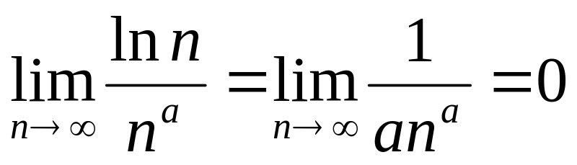
Comparing ln n with nª (a > 0)
Using limits we get:
So ln n = o(nª) for any a > 0
When the exponent a is very small, we need to look at very large values of n to see that nª > ln n
What about ln^{k} n compared to nª (a > 0)? See homework question

Slide 17
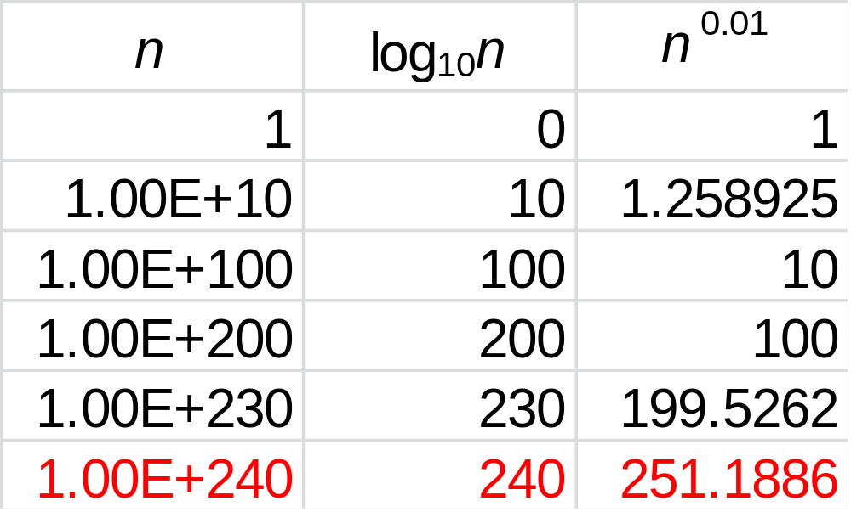
Values for log₁₀n and n^{0.01}

Slide 18
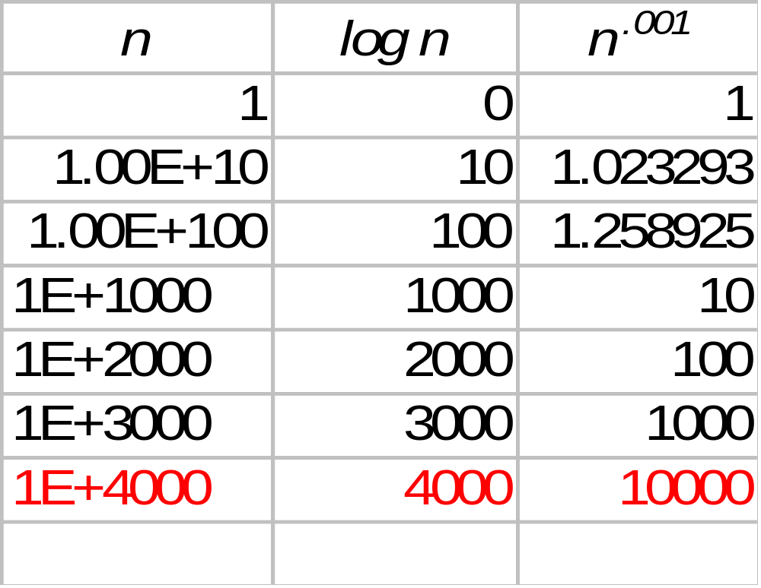
Values for log₁₀n and n^{0.001}

Slide 19
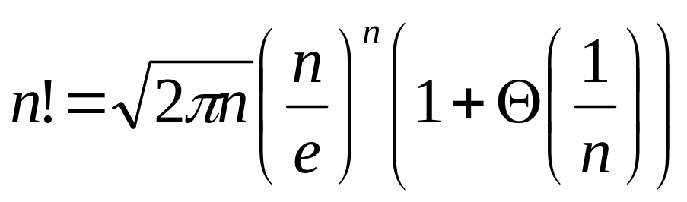
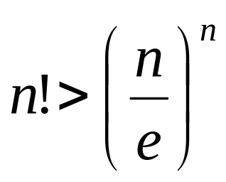
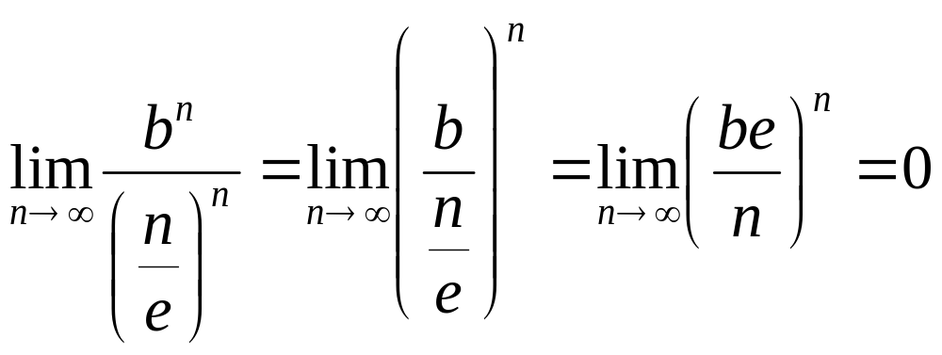
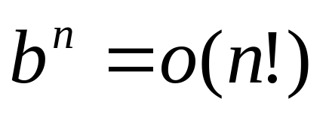
Comparing b^{n} (b > 1) with n!
Stirling’s Approximation:
➔
From
➔

Slide 20
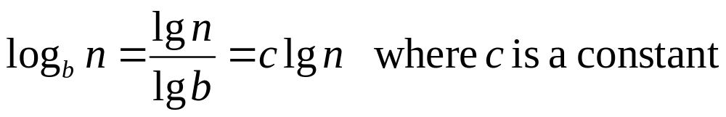
Lower-order Terms and Constants
Lower order terms of a function do not matter since lower-order terms are dominated by the higher order term.
Constants (multiplied by highest order term) do not matter, since they do not affect the asymptotic growth rate.
All logarithms with base b > 1 belong to Θ(lg n) since

Slide 21
Next Class
Continue on properties of asymptotic notations
Recursion and Merge Sort

