Slide 1
CS375
Design & Analysis of Algorithms
Spring 2016
Lecture 10
Lei Yu
Department of Computer Science
State University of New York at Binghamton
lyu@cs.binghamton.edu
www.cs.binghamton.edu/~lyu

Slide 2
Outline
Introduction to Divide and Conquer
Maximum-subarray problem
Algorithm design by Divide and Conquer
Time complexity analysis

Slide 3
Divide-and-Conquer Approach
  A general strategy for algorithm design
Divide the problem into a number of subproblems that are smaller instances of the same problem.
Conquer the subproblems by solving them recursively.
  Base case: If the subproblems are small enough, just solve them by brute force (exhaustive search) .
Combine the subproblem solutions to give a solution to the original problem.

Slide 4
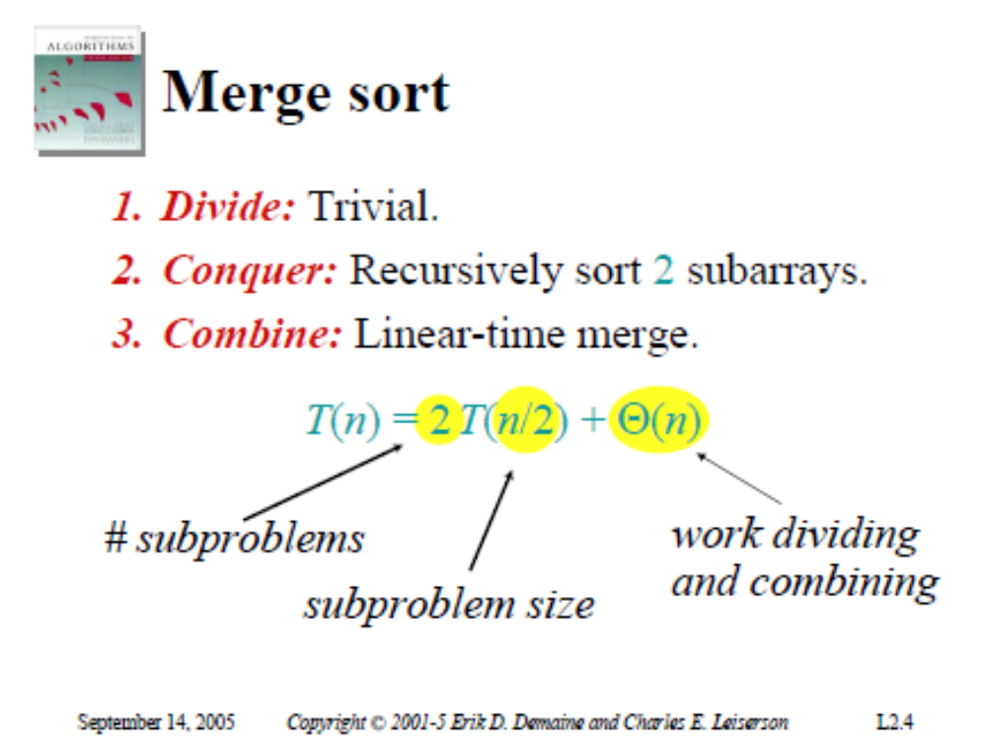

Slide 5
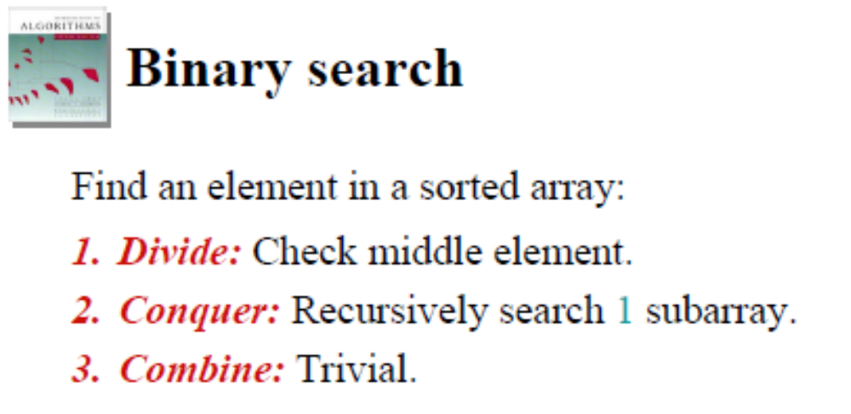
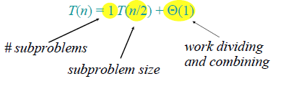
Notes:
Example: to find 9 in the array 3, 5, 7, 8, 9, 12, 15
What about an sorted array? Does divide and conquer work better than brute force?

Slide 6
Maximum-subarray Problem
Problem statement:
Input: An array A[1 .. n] of numbers.
  Assume that some of the numbers are negative, because this problem is trivial when all numbers are nonnegative.
Output: Indices i and j such that A[i .. j] has the greatest sum of any nonempty, contiguous subarray of A, along with the sum of the values in A[i .. j].
Why do we want to solve this problem? Is there a real-life example that makes the problem meaningful?

Slide 7
A Motivating Scenario
Consider the following scenario:
  You have the trading prices of a stock over a period of n consecutive days.
  When should you have bought the stock? When should you have sold the stock?
  Even though it’s in retrospect, you can yell at your stockbroker for not recommending these buy and sell dates ☺.
How to convert this problem to a maximum-subarray problem?
Define: A[i] = (closing price at day i ) – (closing price at day i – 1)
If the maximum subarray is A[i .. j], then should have bought just before day i and sold just at the end of day j.

Slide 8
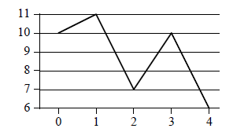
An Example
Here are the trading prices of a stock over n consecutive days:
For this simple array, the maximum subarray is A[3 .. 3].
Day | 0 | 1 | 2 | 3 | 4
Price | 10 | 11 | 7 | 10 | 6
Change |  | 1 | -4 | 3 | -4
Last row is A.

Slide 9
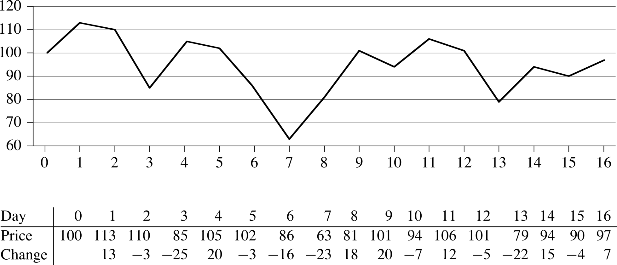
Another Example
Here are the trading prices of a stock over n consecutive days:
For this simple array, the maximum subarray is?
A[8 .. 11]
Last row is A.

Slide 10
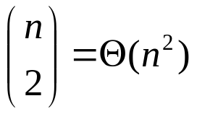
A Brute Force Solution
The general problem can be solved by brute force:
First, find all possible subarrays.
  How many are there?
Next, compute the sum for each subarray.
  How many additions do we need to do for each subarray?
    Depending on the size of the subarray: from 0 to n – 1.
    But at least Ω(1).
Finally, find the maximum among these sums: Θ(n²).
Therefore, the brute-force solution takes Ω(n²) time.
Can we do better?
Notes:
Each subarray is defined by two indices i and j among n numbers.

Slide 11
Divide-and-Conquer Solution
Subproblem: Find a maximum subarray of A[low .. high].
  In the original call, low = 1, high = n.
  Divide the subarray into two subarrays of as equal size as possible. Find the midpoint mid of the subarrays, and consider the subarrays A[low .. mid] and A[mid +1 .. high].
  Conquer by finding a maximum subarrays of A[low .. mid] and A[mid +1 .. high].
  Combine by finding a maximum subarray that crosses the midpoint, and using the best solution out of the three (the subarray crossing the midpoint and the two solutions found in the conquer step).
This strategy works because any subarray must either lie entirely on one side of the midpoint or cross the midpoint.

Slide 12
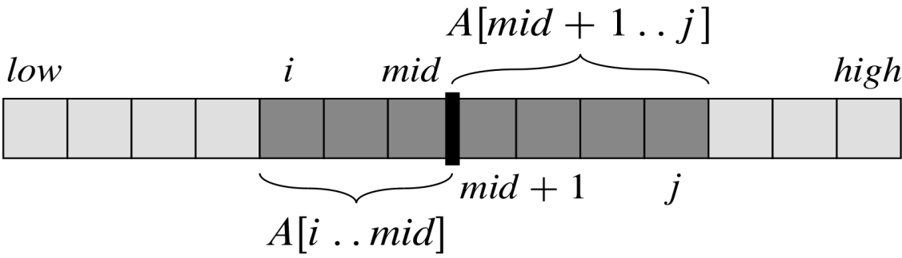
Finding the Maximum Subarray that Crosses the Midpoint
This is the key new problem in order to find a solution to the maximum subarray problem.
It is not a smaller instance of the original problem: has the added restriction that the subarray must cross the midpoint.
Can solve this problem in Θ(n) time.
  Any maximum subarray A[i .. j] crossing the midpoint A[mid] is made of two subarrays A[i .. mid] and A[mid+1 .. j], with low ≤ i ≤ mid < j ≤ high.
  Thus, just need to find maximum subarrays of the form A[i .. mid] and A[mid+1 .. j], and then combine them.

Slide 13
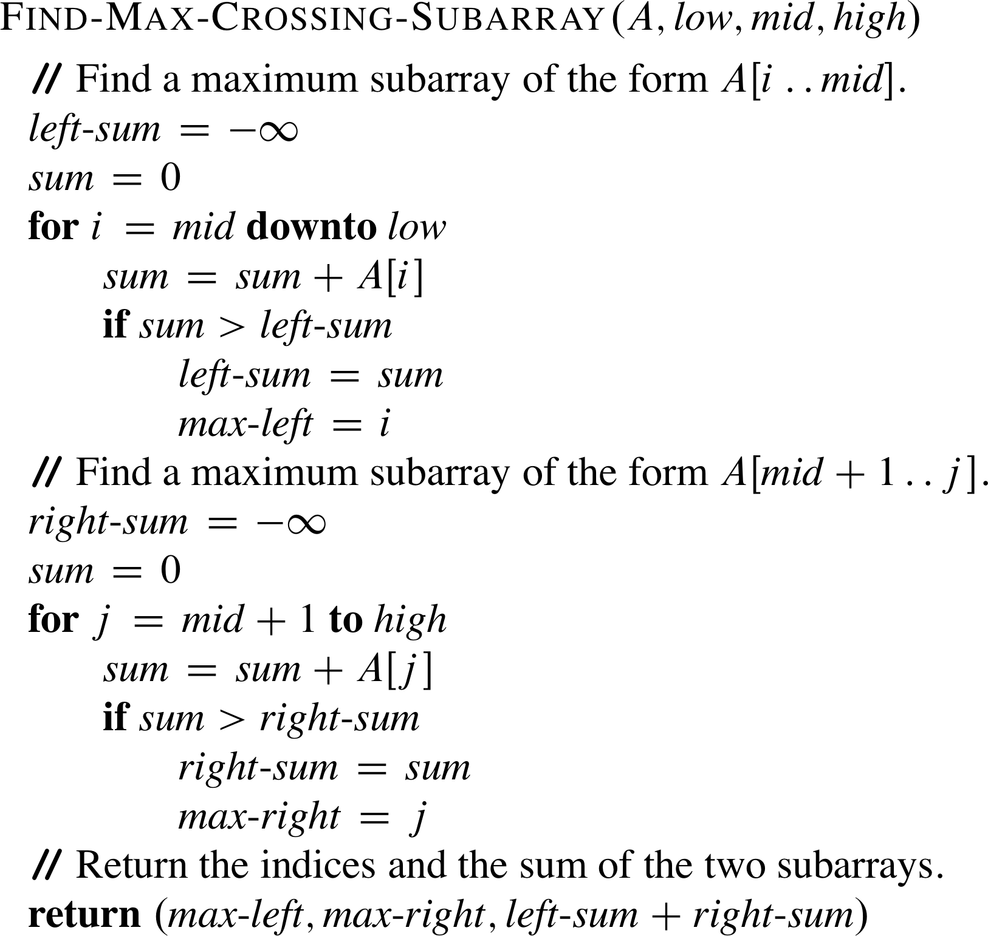
The Algorithm for Finding the Maximum Subarray that Crosses the Midpoint
Running time analysis: The two loops together consider each index in the range [low .. high] exactly once, and each iteration takes Θ(1) time ➔ the entire procedure takes Θ(n) time.

Slide 14
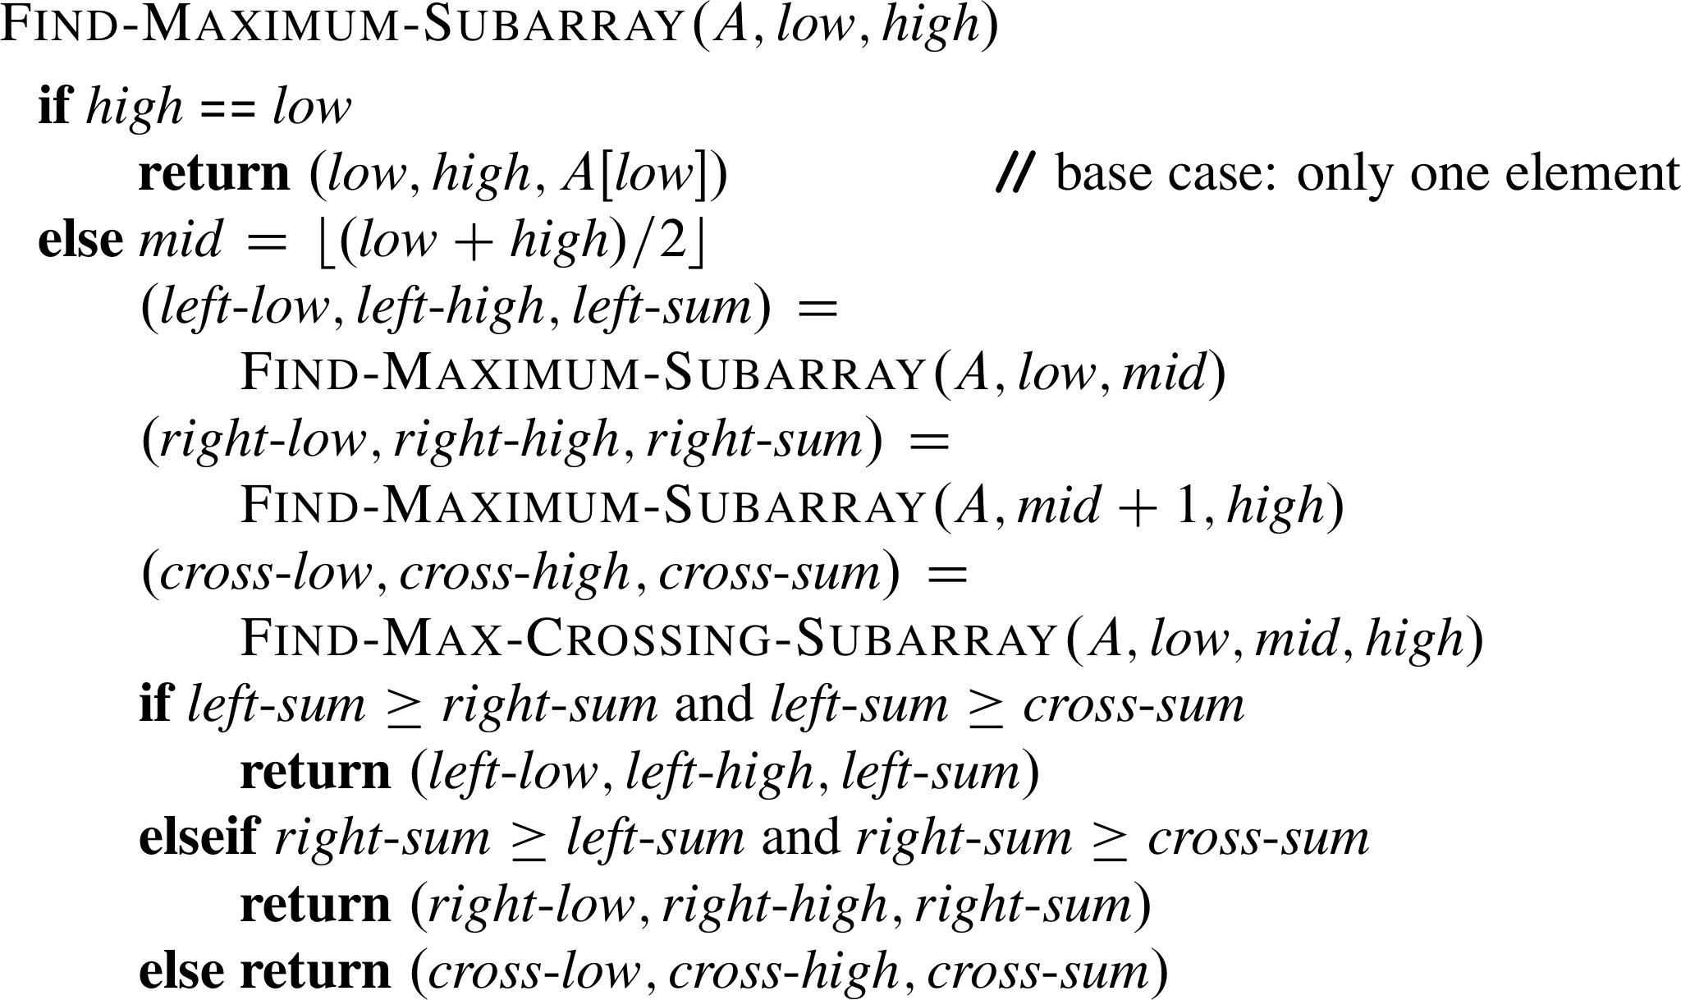
Divide-and-Conquer Algorithm for the Maximum-subarray Problem
Initial call: Find-Maximum-Subarray(A, 1, n)

Slide 15
Algorithm Analysis
Simplifying assumption: Original problem size is a power of 2, so that all subproblem sizes are integer.
Let T(n) denote the running time of Find-Maximum-Subarray on a subarray of n elements.
Base case: Occurs when high = low, so that n = 1. The procedure just returns ➔ T(n) = Θ(1).
Recursive case: Occurs when n > 1.
  Divide takes Θ(1) time.
  Conquer solves two subproblems, each on a subarray of n/2 elements. Takes T(n/2) time for each subproblem. ➔ need 2T(n/2) time.
  Combine consists of calling Find-Max-Crossing-Subarray, which takes Θ(n) time.

Slide 16
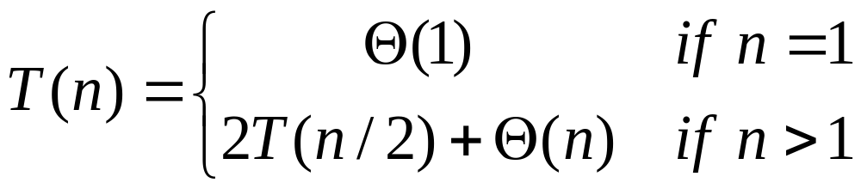
Algorithm Analysis (continued)
The recurrence equation for all cases becomes
  It is the same recurrence as that for merge-sort.
➔ the same running time as merge-sort: T(n) = Θ(n lg n).
Thus, divide-and-conquer algorithm is a Θ(n lg n)-time solution, better than the Ω(n²)-time brute-force solution.

Slide 17
Next Class
QuickSort

