Slide 1
CS375
Design & Analysis of Algorithms
Spring 2016
Lecture 12
Lei Yu
Department of Computer Science
State University of New York at Binghamton
lyu@cs.binghamton.edu
www.cs.binghamton.edu/~lyu

Slide 2
Outline
Additional discussion on Quicksort
  Proof of correctness
  Randomized Quicksort
Introduction to Dynamic Programming

Slide 3
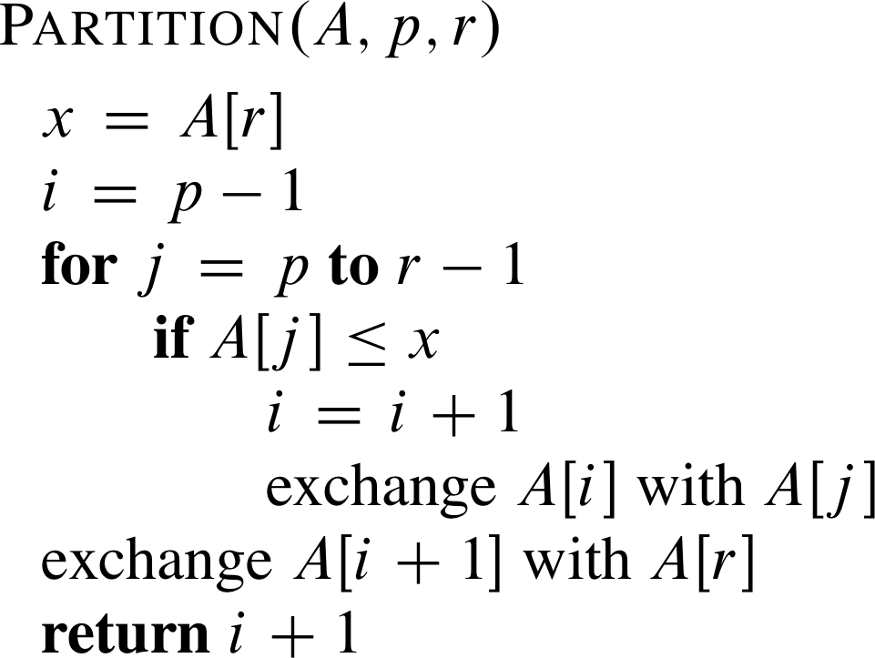
Partition Procedure: Algorithm
// A[p .. r] is an array
// index i is for tracking the potential left most element e > A[r].
// If e exists, it is located at A[i+1].
Running time for partitioning
an n-element subarray:
Θ(n).
// this is the pivot index
When “exchange A[i] with A[j]” happens, there are two cases:
  Case A: i = j. This keeps A[j] where it is. This happens when no element > A[r] is on the left of A[j].
  Case B: i < j. This happens when an element > A[r] is on the left of A[j]. The exchange moves A[i] to the right in the array.

Slide 4
Partition Procedure: Loop Invariant
Partition always selects the last element A[r] in the subarray A[p .. r] as the pivot – the element around which to partition.
As the procedure executes, the array is partitioned into four regions, some of which may be empty:
  Loop invariant consists of 3 regions:
    All entries in A[p .. i] are ≤ pivot.
    All entries in A[i + 1 .. j – 1] are > pivot.
    A[r] = pivot.
  The 4th region is A[j .. r – 1], whose entries have not yet been examined, and so we don’t know how they compare to the pivot.

Slide 5
Partition Procedure: Correctness
Initialization: Before the loop starts, all the conditions of the loop invariant are satisfied, because r is the pivot and the subarrays A[p .. i] and A[i + 1 .. j – 1] are empty.
Maintenance: While the loop is running, two cases for each j:
  If A[j] > pivot, A[j] is the new A[j –1] after j is incremented, making every element in A[i + 1 .. j – 1] are > pivot, condition 1 is satisfied. The other two regions of the loop invariant are not affected. See next slide.
  If A[j] ≤ pivot, then A[j] and A[i] (after i = i + 1 is performed first) are swapped, and j is incremented. This ensures the new A[i] ≤ pivot, and condition 1 is satisfied. Similaly, we also have the new A[j –1] (after j is incremented) is > pivot, and condition 2 is satisfied. ➔ The loop invariant holds. See next slide.
Termination: When the loop terminates, j = r, so all elements in A are partitioned into one of the three cases: A[p .. i] ≤ pivot, A[i + 1 .. r – 1] > pivot, and A[r] = pivot.

Slide 6
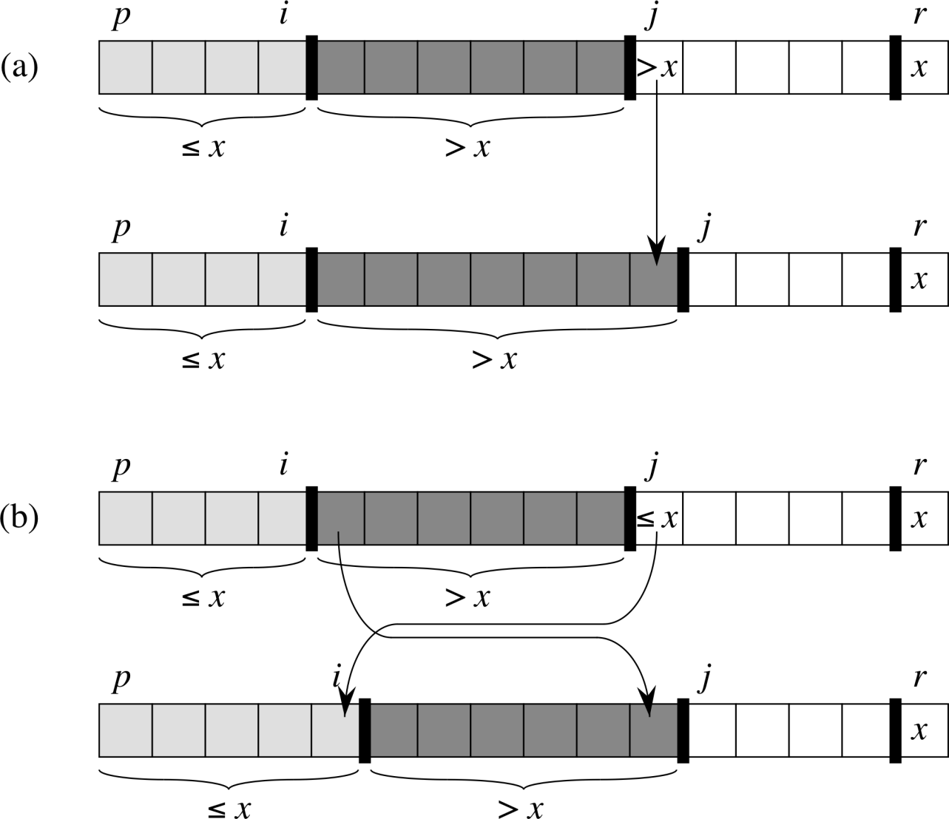
Partition Procedure: Correctness
Illustrating loop invariance maintenance:
when A[j] > A[r]
when A[j] ≤ A[r]

Slide 7
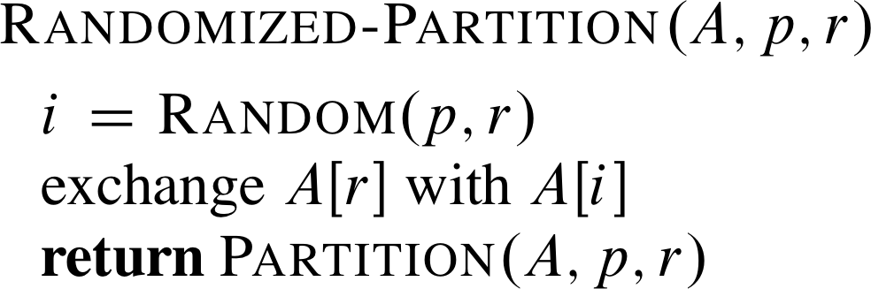
A Randomized Quicksort (1)
We have assumed that all input permutations are equally likely.
This is not always true.
To correct this, we can add randomization to quicksort.
Idea: Don’t always use A[r] as the pivot. Instead, randomly pick an element from the subarray that is being sorted.
Same running time as that for Partition: Θ(n)
  Just added a constant number of computations.

Slide 8
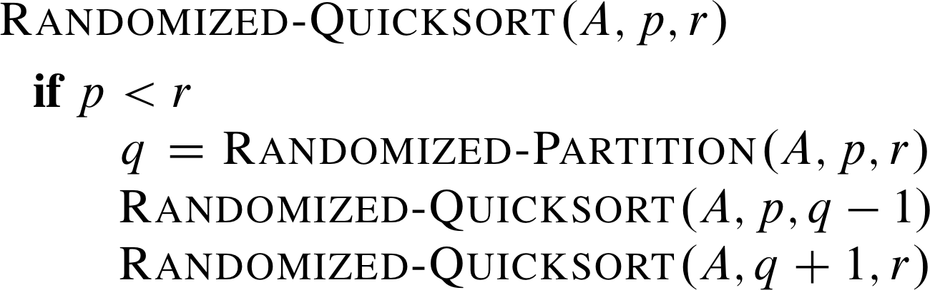
A Randomized Quicksort (2)
No change to the main procedure.
Performance analysis
  Worst case: O(n²)
  Expected running time: O(n lg n)

