Slide 1
CS375
Design & Analysis of Algorithms
Spring 2016
Lecture 15
Lei Yu
Department of Computer Science
State University of New York at Binghamton
lyu@cs.binghamton.edu
www.cs.binghamton.edu/~lyu

Slide 2
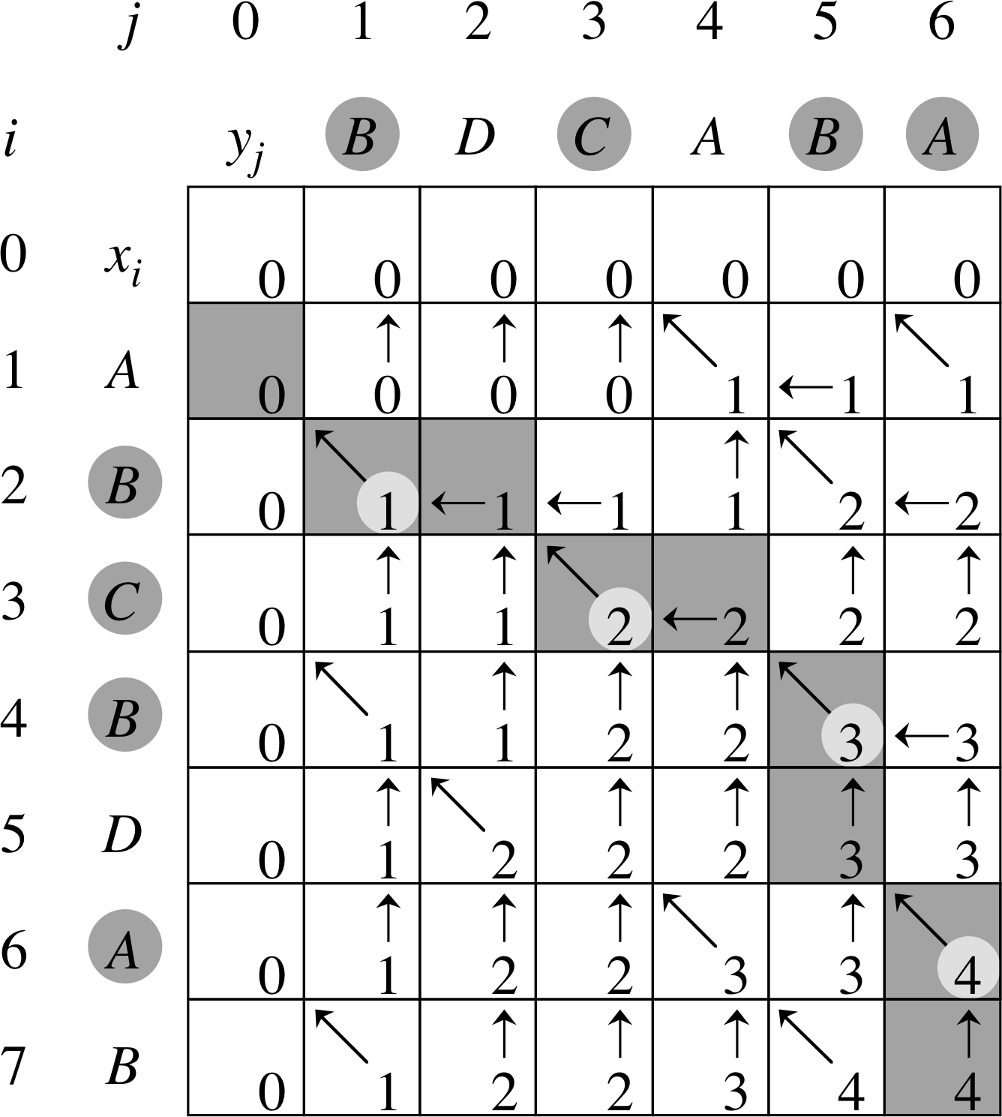
LCS: Example 2
X = A B C B D A B
Y = B D C A B A
This is a combined c table (contains numbers) and b table (contains arrows).
Computation process:
  First fill in 0’s in first row and first column.
  Now start the rest of the computation from c[1, 1] and b[1, 1] row by row, from left to right.

Slide 3
Step 4: Construct an LCS (1)
We use table b[1 .. m, 1 .. n] to construct an LCS of X and Y.
We start at entry b[m, n] and trace through the table by following the arrows.
  When a “ ” is encountered in entry b[i, j], it means that x_{i} = y_{j} is an element in the LCS.
  The elements of the LCS will be encountered in reverse order.

Slide 4
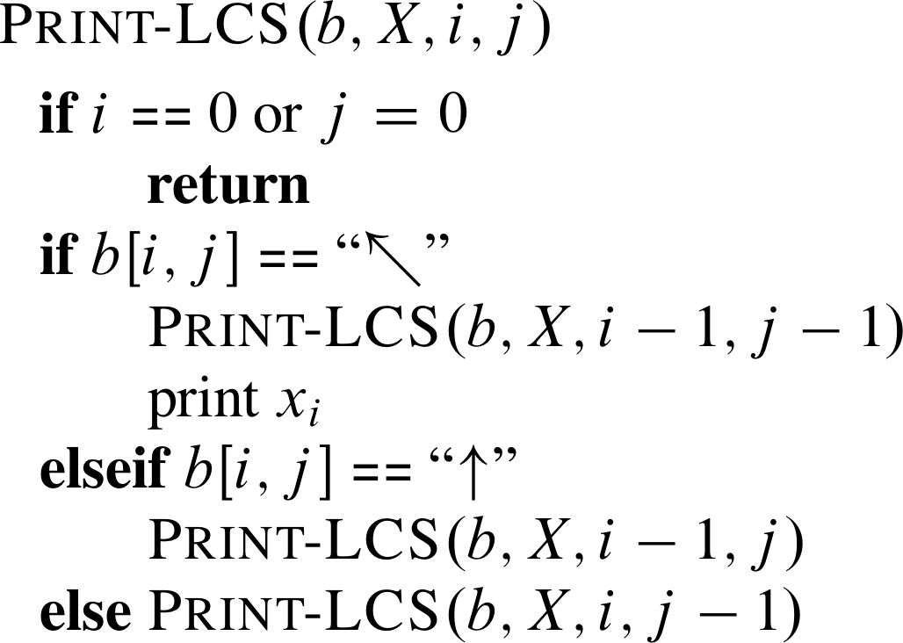
Step 4: Construct an LCS (2)
// X is the X sequence
Start by calling Print-LCS(b, X, m, n)
The running time of this procedure is O(m + n) as it decrements at least one of i and j in each recursive call.

Slide 5
LCS: Example 1 (12)
Focus on exploring the b table: (1) Start from b[m, n]; (2) Follow the arrow to move to the next entry; (3) Whenever encounter a “ ”, output x_{i} of the corresponding row.
j 0 1 2 3 4 5
i
y_{j}
B
D
C
A
B
0
x_{i}
0
0
0
0
0
0
Output in reverse order:
1
A
0
0
0
0
1
1
B
C
B
2
B
0
1
1
1
1
2
3
C
0
1
1
2
2
2
4
B
0
1
1
2
2
3

Slide 6
LCS: Example 2 (continued)
X = A B C B D A B
Y = B D C A B A
Focus on exploring the b table.
Exploration process:
  Start from b[m, n].
  Follow the arrow to move to the next entry.
  Whenever encounter a “ ”, output x_{i} of the corresponding row.
The output is in reverse order of the correct LCS.

Slide 7
Dynamic Programming
Dynamic programming is another general strategy for designing algorithms.
It is closely related to the basic idea of divide-and-conquer:
When trying to solve a large problem, first divide the problem into smaller problems of the same nature recursively and then build up the correct solutions to the smaller problems into those of larger ones, and eventually obtain the solution to the original problem.

Slide 8
Dynamic Programming vs.
Divide-and-Conquer
Dynamic programming is most suitable for solving problems that have overlapping subproblems.
  A dynamic programming algorithm solves each subproblem once while a divide-and-conquer solution may need to solve overlapping subproblems multiple times.
  An example of a problem with overlapping subproblems will be given shortly.
Divide-and-conquer is more suitable for problems that have non-overlapping subproblems.
  Recall Merge-sort and Quick-sort. The sorting problem does not need to sort the same subset multiple times.

Slide 9
When is Dynamic Programming Used?
It is used to solve certain optimization problems (either minimization or maximization problems).
It aims to find a solution with the optimal value, i.e., it is for finding an optimal solution, not all optimal solutions.
Such an optimization problem have two important properties:
  Optimal substructure: An optimal solution to the problem contains optimal solutions to its subproblems.
  Overlapping subproblems: A recursive algorithm to a problem needs to revisit the same (sub)problem repeatedly.
    Dynamic programming is good for problems that have a relatively small number (polynomial) of distinct subproblems while the total number of subproblem occurrences is large (exponential).

Slide 10
Principle of Optimality
Principle of optimality: If an optimal solution to a problem contains solutions to subproblems, then the solutions to subproblems must also be optimal.
An optimization problem that can be divided into subproblems and satisfies principle of optimality is said to have optimal substructure.
This principle applies to problems (not algorithms for solving the problems).
A large number of optimization problems satisfy this principle, but there are exceptions.
  See rod cutting and LCS examples, and others to be discussed later
  Give a real-life example for a problem that does not have optimal substructure.
Notes:
Task: sharpen knife and cut a bunch of stuffs. An optimal solution may use more time to sharpen the knife than another solution.

Slide 11
Longest Simple Path – A problem not Having Optimal Substructure
Problem: Find the longest simple path between city A and city B.
  Simple path: A path does do not visit the same place (vertex) more than once.
Example: Suppose the longest simple path (solid line) has city C as an intermediate city.
It does not consist of the longest simple path from A to C plus the longest simple path from C to B as it cannot pass the same city D more than once.
D
Longest C to B
Longest A to C
A
B
C
Longest A to B

Slide 12
Dynamic Programming: Main Idea
Solve an optimization problem by solving subproblems of increasing size and saving the optimal solution to each subproblem in a table (usually).
The table is then used for finding the optimal solution to larger problems in a bottom-up manner (i.e., solving smaller subproblems first).
Time is saved since each subproblem is solved only once.

Slide 13
Dynamic Programming: Methodology
A typical dynamic programming solution to an optimization problem consists of four steps:
Characterize the structure of an optimal solution.
  Identify the optimal substructure.
Recursively define the value of an optimal solution.
  Produce the recursive solution in terms of a recurrence equation.
Compute and save the value of an optimal solution in a bottom-up fashion.
  Compute the values for the table.
Construct an optimal solution from saved information.
  Use the table to construct the final solution.

Slide 14
Next Class
Additional examples of dynamic programming
  Fibonacci's Series
  Knapsack problem

