Slide 1
CS375
Design & Analysis of Algorithms
Spring 2016
Lecture 17
Lei Yu
Department of Computer Science
State University of New York at Binghamton
lyu@cs.binghamton.edu
www.cs.binghamton.edu/~lyu

Slide 2
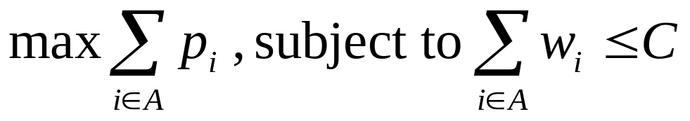
0/1 Knapsack Problem
Given
  a knapsack with integer weight capacity C > 0, and
  a set of n items with integer weights w_{i} > 0 and profits p_{i} > 0 for i = 1, …, n,
Find a subset of the items which does not exceed the weight capacity C of the knapsack and maximizes the profits
- to determine a subset A of { 1, 2, …, n } that satisfies the following:

Slide 3
Step 1: Structure of Optimal Solution
Assume S_{i} denote the subproblem in which only items labeled in {1, …, i } are considered, where i ≤ n, and the knapsack capacity available is c, where 0 ≤ c ≤ C.
  Let P[i, c] denote the maximum profit achieved for S_{i} when the capacity is c.
  Our goal is to compute the maximum profit for S_{n} when the capacity is C, i.e., we need to find out P[n, C] and the corresponding set of items included in the knapsack.

Slide 4
Optimal Substructure
Two cases for item_{n} when computing P[n, C]:
  1. w_{n} > C : In this case, an optimal solution for S_{n} with capacity C is the same as an optimal solution for a subproblem S_{n-1} with capacity C, and P[n, C] = P[n – 1, C].
  2. w_{n} ≤ C : In this case, an optimal solution for S_{n} with capacity C may or may not include item_{n}:
  if item_{n} is included, then the optimal solution for S_{n} with capacity C requires an optimal solution for a subproblem S_{n-1} with capacity C – w_{n} , and P[n, C] = P[n – 1, C – w_{n}] + p_{n} .
  if item_{n} is not included, then the optimal solution for S_{n} with capacity C is the same as an optimal solution for a subproblem S_{n-1} with capacity C, and P[n, C] = P[n – 1, C].
Overlapping subproblems: It is easy to see this, e.g., the subproblem S_{n-1} with capacity C is seen twice.

Slide 5
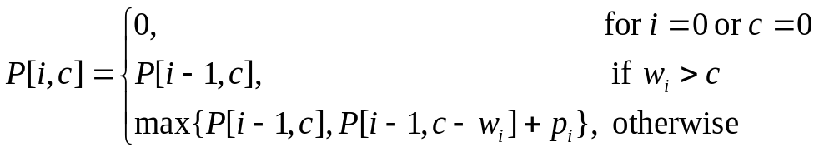
Step 2: Recursive Solution
Three cases when considering S_{i} with capacity c :
  1. There are no items (when i = 0) or the capacity c = 0: P[i, c] = 0.
  2. The weight of item_{i} exceeds the capacity c : item_{i} cannot be included in the knapsack: P[i, c] = P[i – 1, c].
  3. Otherwise, P[i, c] may be achieved by either not including item_{i} ( i.e., P[i, c] = P[i – 1, c]) or by including item_{i} (i.e., P[i, c] = P[i – 1, c – w_{i}] + p_{i} ).
Thus, the recurrence is:

Slide 6
Step 3: Computing P[n, C]
Table P has n + 1 row and C + 1 columns: P[0 .. n, 0 .. C].
Initialize: all entries in the first row and first column = 0
  P[0, c] = 0, 0 ≤ c ≤ C, and P[i, 0] = 0, 0 ≤ i ≤ n.
From the recurrence, we can analyze the computation order: row by row with increasing i
If w_{i} > c
If w_{i} ≤ c
P[i – 1, c]
P[i , c] = P[i –1, c ]
P[i –1, c –w_{i}] |  | P[i – 1, c]
P[i , c – w_{i}] |  | P[i , c] = max{P[i – 1, c], P[i – 1, c – w_{i}] + p_{i} }

Slide 7
Dynamic Programming Algorithm
Max-Profit-01Knapsack((w₁, p₁), …, (w_{n}, p_{n}), C )
for c = 0 to C
P[0, c] = 0
for i = 0 to n
P[i, 0] = 0
for c = 1 to C // items in columns 1 to C
if w_{i} ≤ c
if P[i – 1, c – w_{i}] + p_{i} > P[i – 1, c]
P[i, c] = P[i – 1, c – w_{i}] + p_{i}
else P[i, c] = P[i – 1, c]
else
P[i, c] = P[i – 1, c]

Slide 8
Example (1)
Input:
  n = 4
  (w₁, p₁) = (2, 3), (w₂, p₂) = (3, 4), (w₃, p₃) = (4, 5), (w₄, p₄) = (5, 6)
  C = 8
Initialization:
i
0
1
2
3
4
c 0 1 2 3 4 5 6 7 8
0 0 0 0 0 0 0 0 0
0
0
0
0

Slide 9
Example (2)
  Item 1 (i = 1): (w₁, p₁) = (2, 3)
i
0
1
2
3
4
c 0 1 2 3 4 5 6 7 8
0 0 0 0 0 0 0 0 0
0
0
0
0
0
3
3
3
3
3
3
3
If w₁ = 2 > c
If w₁ = 2 ≤ c
P[0, c]
P[1, c] = P[0, c ]
P[0, c – 2] | P[0, c – 1] | P[0, c]
P[1, c – 2] | P[1, c – 1] | P[1, c] = max{P[0, c], P[0, c – 2] + 3 }

Slide 10
Example (3)
  Item 2 (i = 2): (w₂, p₂) = (3, 4)
i
0
1
2
3
4
c 0 1 2 3 4 5 6 7 8
0 0 0 0 0 0 0 0 0
0
0
0
0
0
3
3
3
3
3
3
3
0 3 4 4 7 7 7 7
If w₂ = 3 > c
If w₂ = 3 ≤ c
P[1, c]
P[2, c] = P[1, c ]
P[1, c – 3] |  | P[1, c]
P[2, c – 3] |  | P[2, c] = max{P[1, c], P[1, c – 3] + 4 }

Slide 11
Example (4)
  Item 3 (i = 3): (w₃, p₃) = (4, 5)
i
0
1
2
3
4
c 0 1 2 3 4 5 6 7 8
0 0 0 0 0 0 0 0 0
0
0
0
0
0
3
3
3
3
3
3
3
0 3 4 4 7 7 7 7
0 3 4 5 7 8 9 9
If w₃ = 4 > c
If w₃ = 4 ≤ c
P[2, c]
P[3, c] = P[2, c ]
P[2, c – 4] |  | P[2, c]
P[3, c – 4] |  | P[3, c] = max{P[2, c], P[2, c – 4] + 5 }

Slide 12
Example (5)
  Item 4 (i = 4): (w₄, p₄) = (5, 6)
i
0
1
2
3
4
c 0 1 2 3 4 5 6 7 8
0 0 0 0 0 0 0 0 0
0
0
0
0
0
0
0
3
3
3
3
4
4
3
4
5
3
7
7
3
7
8
3
7
9
3
7
9
0 3 4 5 7 8 9 10
⬅P[4, 8]
If w₄ = 5 > c
If w₄ = 5 ≤ c
P[3, c]
P[4, c] = P[3, c ]
P[3, c – 5] |  | P[3, c]
P[4, c – 5] |  | P[4, c] = max{P[3, c], P[3, c – 5] + 6 }

Slide 13
Cost Analysis
The table P has (n + 1) ∗ (C + 1) entries.
The algorithm fills in the entries in the P table and each entry can be computed in constant number of simple operation.
➔ the running time is Θ(n*C ).
It appears to be linear BUT the capacity C is not a function of the number of items. What if C = n! ? Then this algorithm is worse than the brute force method.
This algorithm has good running time when C is relatively small in terms of n, for example, a polynomial function of n rather than an exponential function of n.

Slide 14
Step 4: Construct an Optimal Solution
Step 3 finds the maximum profit that can be achieved.
We need another procedure to identify a set of items that are included in the knapsack to achieve the maximum profit.
We now show such a procedure to construct an optimal solution from the table P.

Slide 15
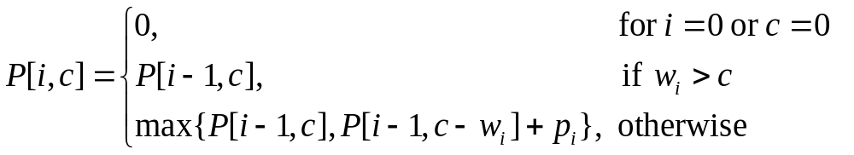
Step 4: The Basic Idea
We start from P[n, C] and work backward to determine when an item is added to the knapsack to achieve maximum profit.
From the recurrence, we can see that only when P[i, c] = P[i – 1, c – w_{i}] + p_{i} or when P[i, c] ≠ P[i – 1, c], another item (item_{i}) is added to the knapsack.

Slide 16
Step 4: Algorithm
Print-Op-Items(P) // P = P[0 .. n, 0 .. C]
IS = φ // IS will store an optimal item set, empty initially
i = n
c = C
while i > 0 and c > 0
if P[i, c] ≠ P[i – 1, c]
IS = IS ∪ { item_{i} }
i = i – 1
c = c – w_{i}
else
i = i – 1
return IS
Running time: O(n)
Notice that i is reduced by 1 in each iteration of the while loop.

Slide 17
Step 4: Example (1)
  Item 4 (i = 4): (w₄, p₄) = (5, 6)
i
0
1
2
3
4
c 0 1 2 3 4 5 6 7 8
0 0 0 0 0 0 0 0 0
0
0
0
0
0
0
0
3
3
3
3
4
4
3
4
5
3
7
7
3
7
8
3
7
9
3
7
9
0 3 4 5 7 8 9 10
⬅P[4, 8]
Since P[4, 8] = 10 ≠ P[3, 8] = 9, add item 4 to knapsack.
i = i – 1 = 3 and c = c – w₄ = 3.

Slide 18
Step 4: Example (2)
  Item 3 (i = 3): (w₃, p₃) = (4, 5)
i
0
1
2
3
4
c 0 1 2 3 4 5 6 7 8
0 0 0 0 0 0 0 0 0
0
0
0
0
0
0
0
3
3
3
3
4
4
3
4
5
3
7
7
3
7
8
3
7
9
3
7
9
0 3 4 5 7 8 9 10
Since P[3, 3] = 4 = P[2, 3], do not add item 3 to knapsack.
i = i – 1 = 2, c remains 3.

Slide 19
Step 4: Example (3)
  Item 2 (i = 2): (w₂, p₂) = (3, 4)
i
0
1
2
3
4
c 0 1 2 3 4 5 6 7 8
0 0 0 0 0 0 0 0 0
0
0
0
0
0
0
0
3
3
3
3
4
4
3
4
5
3
7
7
3
7
8
3
7
9
3
7
9
0 3 4 5 7 8 9 10
Since P[2, 3] = 4 ≠ P[1, 3] = 3, add item 2 to knapsack.
i = i – 1 = 1 and c = c – w₂ = 0. The procedure stops.
Final result: IS = {item 2, item 4}.

