Slide 1
CS375
Design & Analysis of Algorithms
Spring 2016
Lecture 19
Lei Yu
Department of Computer Science
State University of New York at Binghamton
lyu@cs.binghamton.edu
www.cs.binghamton.edu/~lyu

Slide 2
Activity-Selection Problem: A Motivating Example
Suppose you are in one of the Disney World theme parks (say Magic Kingdom). You bought a special fast-track pass to take ride with little waiting time.
  Suppose there are lots of rides, each starting and ending at different times.
  Suppose we either ignore the walking and waiting time between rides or include the time in the starting time.
Problem: How to get your money’s worth by getting as many rides as possible?
Welcome to the activity selection problem.

Slide 3
Activity-Selection Problem: Definition
Problem: Given a set of n activities S = {a₁ , …, a_{n} } with a_{i} spanning time interval [s_{i} , f_{i}), where s_{i} is the start time and f_{i} is the finish time, find the largest subset A of compatible activities.
  Activities are compatible if they do not overlap in time.
  With loss of generality, we assume: f₁ ≤ f₂ ≤ … ≤ f_{n}

Slide 4
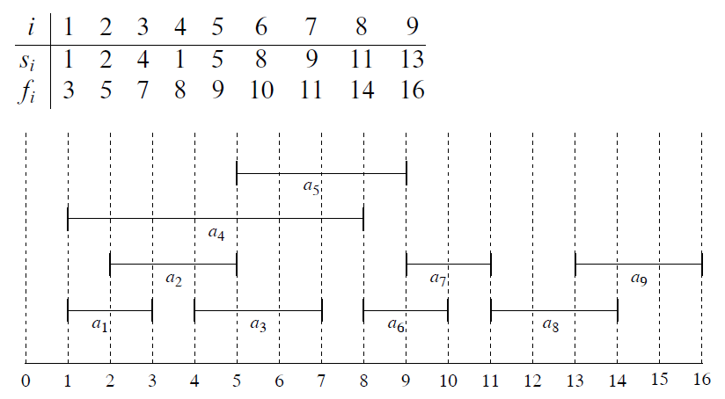
Activity-Selection Problem: Example
Consider a set of 9 activities:
Many solutions: {a₁ , a₃ , a₆ , a₈ }, {a₁ , a₃ , a₇ , a₉ }, {a₁ , a₃ , a₆ , a₉ }, {a₂ , a₅ , a₇ , a₉ }, {a₁ , a₅ , a₇ , a₈ }, ……

Slide 5
Activity-Selection: Greedy Choices
There are several intuitively reasonable greedy selection criteria to consider:
  Earliest start time first: Select the next compatible activity with the earliest start time.
  Minimum duration first: Select the next compatible activity with the smallest duration.
  Earliest finish time first: Select the next compatible activity with the earliest finish time.
Question: Which one is going to work?

Slide 6
Counter Example 1
Greedy selection criteria: earliest start time first
Activities
1
2
3
11 15
1 4
0 15
Time
0 1 2 3 4 5 6 7 8 9 10 11 12 13 14 15

Slide 7
Counter Example 2
Greedy selection criteria: smallest duration first
Activities
1
2
3
8 15
1 8
7 9
Time
0 1 2 3 4 5 6 7 8 9 10 11 12 13 14 15

Slide 8
Example 3
Greedy selection criteria: earliest finish time first
Activities
1
2
3
4
5
6
7
11 13
2 12
3 10
11 15
3 7
1 4
0 2
Time
0 1 2 3 4 5 6 7 8 9 10 11 12 13 14 15
Can you find a counter example?

Slide 9
Example 4
Greedy selection criteria: earliest finish time first
It works for this example too.
Need to prove the correctness of this greedy algorithm.

Slide 10
Activity-Selection: A Greedy Algorithm
We first show the algorithm (based on earliest finish time first criteria) more formally, then prove its correctness.
  we assume: f₁ ≤ f₂ ≤ … ≤ f_{n}
Greedy-Activity-Selector(s, f ) // s = (s₁, …, s_{n}) and f = (f₁, …, f_{n})
n = s.length // number of activities
A = {a₁} // A stores the solution, take a₁ first
j = 1 // a_{j} is the last activity added
for i = 2 to n //select next activity
if s_{i} ≥ f_{j} // a_{i} is compatible
A = A ∪ {a_{i}}
j = i // save the new last activity added
return A
Running time: Θ(n)
It is Θ(n log n) when including sorting cost.

Slide 11
Prove Optimality of Greedy Choice
Theorem: If activity a₁ has the earliest finish time among all activities in any nonempty subproblem S, then there is an optimal solution that selects a₁ first.
Proof:
Let A be an optimal solution for S. Let activity a₁ be the greedy choice (i.e., the first one selected). If a₁ ∈ A, the proof is done.
If a₁ ∉A, we show that A* = A – {a} + {a₁} is another optimal solution including a₁, where a is the activity with earliest finish time in A.
  Since all activities in A are disjoint and f(a₁) ≤ f(a), a₁ does not overlap with any other activities in A*, and all activities in A* are disjoint. We also know |A*| = |A|. Therefore, A* is an optimal solution.

