Slide 1
CS375
Design & Analysis of Algorithms
Spring 2016
Lecture 20
Lei Yu
Department of Computer Science
State University of New York at Binghamton
lyu@cs.binghamton.edu
www.cs.binghamton.edu/~lyu

Slide 2
Basic Graph Algorithms
Graph definitions
Graph implementations
  Adjacency lists
  Adjacency matrix
Graph traversals
  Breadth First Search
  Depth First Search

Slide 3
What is a Graph?
A graph is a set of nodes joined by a set of edges (lines or arrows).
1
3
1
2
3
2
4
5
6
4
5
6

Slide 4
A directed graph G is a pair (V, E), where V is a finite set of vertices (nodes) and E is a set of edges on V. Each edge in E is a binary relation on V : An edge e from node a to node b is denoted by the ordered pair e = (a, b).
Directed Graph
Self loop
1
2
3
7
Isolated node
V = { 1, 2, 3, 4, 5, 6, 7 }
|V | = 7
4
5
6
E = { (1,2), (2,2), (2,4), (4,5),
(4,1), (5,4),(6,3) }
| E | = 7

Slide 5
An undirected graph G = (V, E) , where V is a finite set of vertices and E is a set of edges on V. Each edge in E is an unordered pair of vertices in V.
Undirected Graph
Notations:
(a, b) refers to a directed edge from node a to node b
{a, b} denotes an undirected edge between node a to node b
(the textbook also use (a, b) for undirected edges).
V = { A, B, C, D, E, F }
|V | = 6
A
B
C
E = { {A, B}, {A,E}, {B,E}, {C,F} }
|E | = 4
D
E
F

Slide 6
What Can Graphs Model?
Cost of wiring electronic components together.
Shortest route between two cities.
Finding the shortest distance between all pairs of cities in a road atlas.
Flow of material (liquid flowing through pipes, current through electrical networks, information through communication networks, parts through an assembly line, …).
State of a machine.
Used in Operating systems to model resource handling (deadlock detection problem – wait-for graph).
Used in compilers for parsing and optimizing the code.
Social networks (facebook)
World Wide Web
……

Slide 7
In an undirected graph, the degree of a vertex is the number of edges incident on it.
Degree, Out-Degree, In-Degree of a Node
In a directed graph , the out-degree of a vertex is the number of edges leaving it and the in-degree is the number of edges entering it.
A
B
C
1
2
Self-loop
D
4
5
E
F
The degree of B is 2.
The in-degree of 2 is 2 and
the out-degree of 2 is 3.

Slide 8
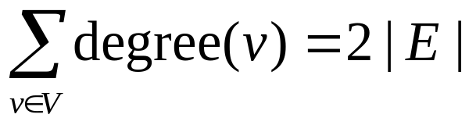
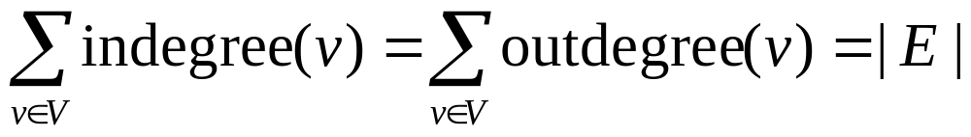
Simple Graphs
Simple graphs are graphs without multiple (directed in same direction or undirected) edges connecting a single pair of vertices, or self-loops.
  We will consider only simple graphs for this course.
Proposition: If G is an undirected graph then
Proposition: If G is a digraph then

Slide 9
A weighted graph is a graph for which each edge has an associated weight, usually given by a weight function w: E → R.
Weighted Graphs
1.2
2
1
2
3
1
2
3
.2
.5
1.5
5
3
.3
1
4
5
6
4
5
6
.5
The weight has different meanings in different applications, but usually reflecting how strongly or closely the corresponding nodes are related.
What are examples where the edges have weights?
Notes:
Discussion point for weights: probability from u to v in traffic flow, similarity between two nodes in document clustering, co-occurrences between to words in word clustering (topic analysis), etc.

Slide 10
Paths
A path is a sequence of vertices such that there is an edge from each vertex to its successor.
A path is simple if all vertices on it are distinct, i.e., it never passes through the same vertex more than once.
A path from a vertex to itself is called a cycle
Example: v₁ → v₂ → v₄ → v₁
If a graph contains a cycle, it is a cyclic
graph. Otherwise, it is an acyclic graph.
1
2
4
3

Slide 11
Connectivity
An undirected graph is connected if any two nodes are connected by a path.
A directed graph is strongly connected if there is a directed path from any node to any other node.
A graph is sparse if | E | ≈ | V |.
A graph is dense if | E | ≈ | V |².
1
2
A
B
C
4
5
D
E
F

Slide 12
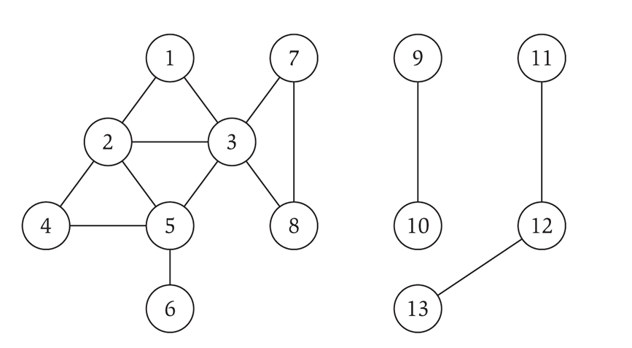
Connected Component
Connected component: A connected component of a graph is a maximal connected subgraph.
Example:
Connected component containing node 1 = { 1, 2, 3, 4, 5, 6, 7, 8 }.

Slide 13
A Complete graph is an undirected/directed graph in which every pair of vertices is adjacent.
Complete Graph
If (u, v) is an edge in a graph G, we say that vertex v is adjacent to vertex u.
A
A
B
B
E
D
D
4 nodes and (4*3)/2 edges
|V| nodes and |V|*(|V| – 1)/2 edges
3 nodes and 3*2 edges
|V| nodes and |V|*(|V| – 1) edges

Slide 14
A bipartite graph is an undirected graph G = (V,E) in which V can be partitioned into 2 sets V₁ and V₂ such that (u, v) ∈E implies either u ∈V₁ and v ∈V₂ or v ∈V₁ and u∈V_{2.}
Bipartite Graph
V₂
V₁
Notes:
Bipartite graphs in practice:
Homogeneous nodes: managers and non-manager employees
Heterogeneous nodes: authors and books

Slide 15
Trees
A free tree is an acyclic, connected, undirected graph.
A forest is an acyclic undirected graph.
A rooted tree is a tree with one node designated as the root.

Slide 16
Tree Definitions
Let G = (V, E ) be an undirected graph.
G is a (free) tree if one of the following is true:
1. G is acyclic and connected.
2. Any two vertices in G are connected by a unique simple path.
3. G is connected, but if any edge is removed from E, the resulting graph is disconnected.
4. G is connected, and | E | = | V | – 1.
5. G is acyclic, and | E | = | V | – 1.
6. G is acyclic, but if any edge is added to E, the resulting graph contains a cycle.

