Slide 1
We’re Playing Basketball
Project 4: Machine Learning Integration
Venkastesh Hegde
Julia Cheng
Donterrius Daniels
Avondre Henderson
Kawanda Gray
Harsh Patel

Slide 2
“Nothing is given. Everything is earned.”
- LeBron James

Slide 3
Let’s go over the basics…

Slide 4
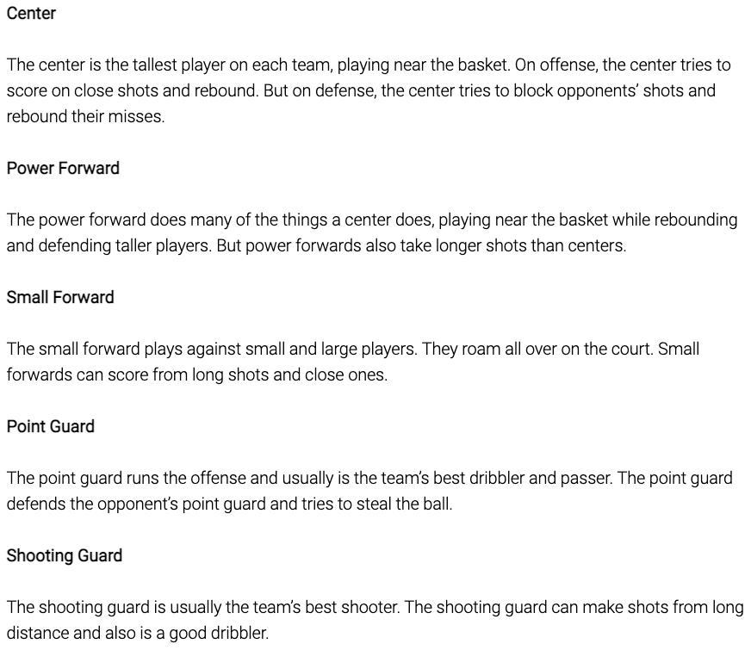
Basketball Position Definitions

Slide 5
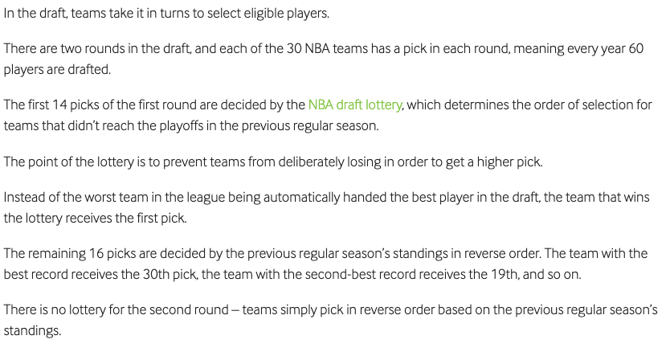
How the Draft Process Works?

Slide 6
Note: Height and Weight are displayed using the metric system for the purpose of our project.

Slide 7
Find the Data
Here are our original dataset links
https://www.kaggle.com/adityak2003/predicting-the-nba-draft-using-college-stats/data?select=CollegeBasketballPlayers2009-2021.csv
https://www.kaggle.com/adityak2003/predicting-the-nba-draft-using-college-stats/data?select=CollegeBasketballPlayers2022.csv

Slide 8

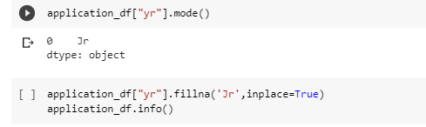
Data Clean Up
Part 1
During this step we work to drop some of the unnecessary columns that were found in the original data.
We replace some of the values with mean and mode values.

Slide 9
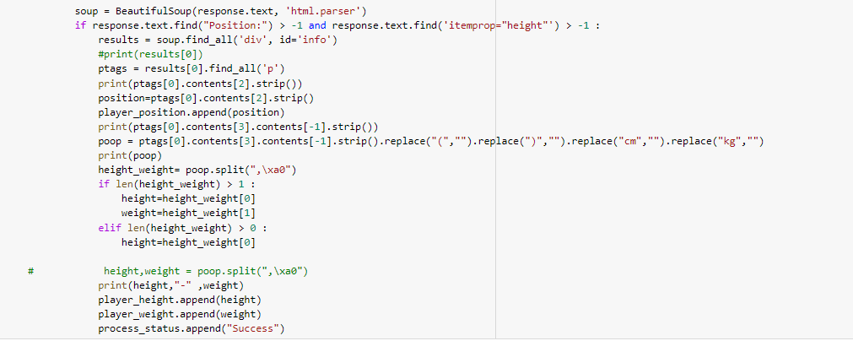
Web Scraping
We had to go and scrape for the height and weight as they were not included in the original dataset.
Ensured that the missing values for height and weight will still allow us to scrape whatever is available.

Slide 10
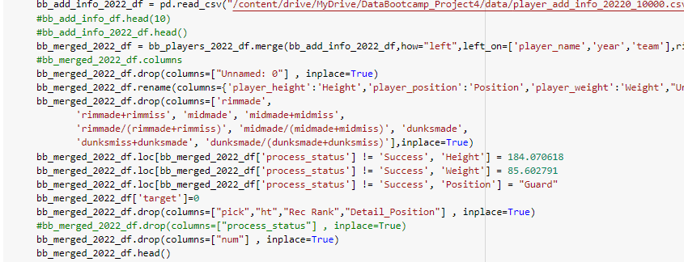
Data Merge
This is when we start to merge the original data with the scaped data.

Slide 11
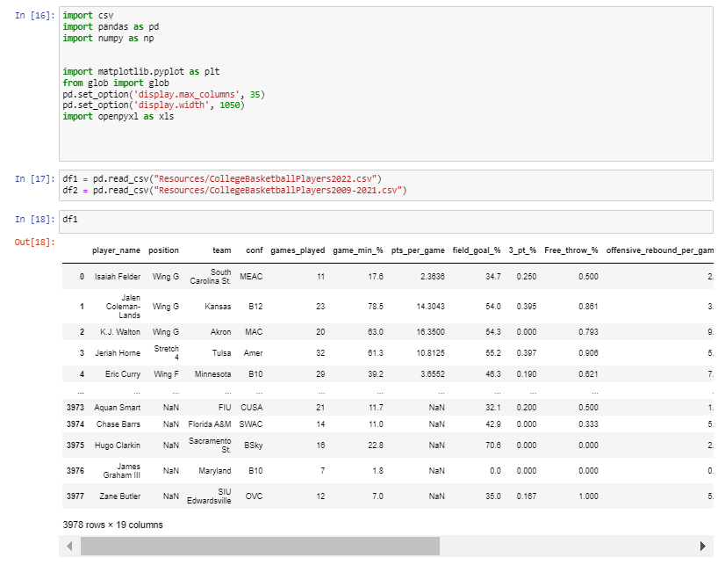
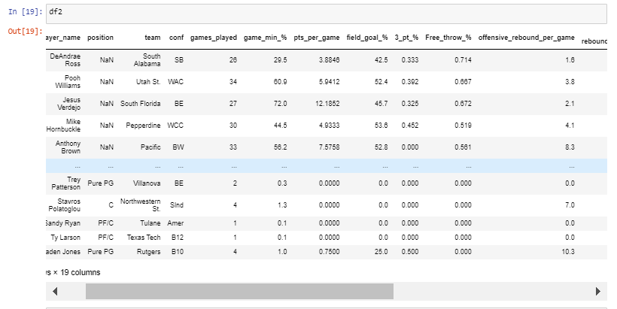
Data Merge

Slide 12
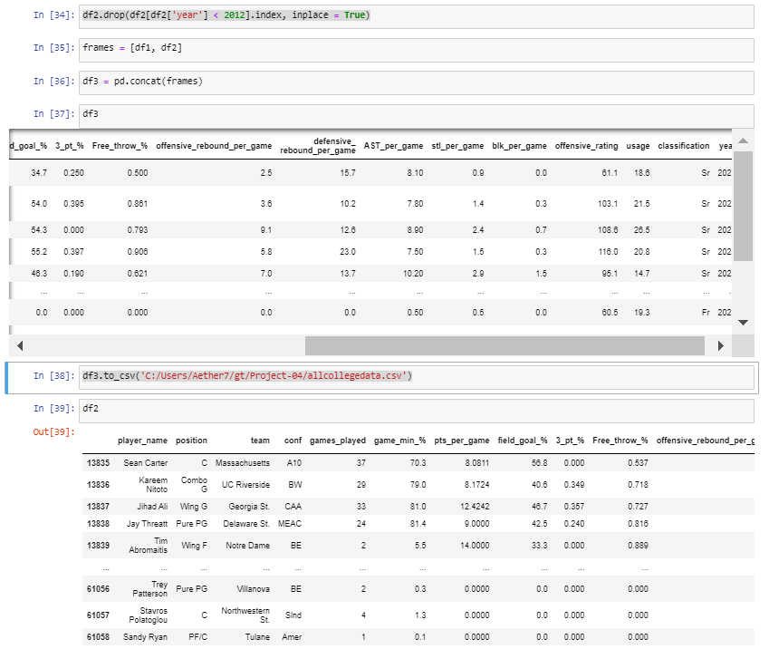
Data Merge
The data here was concatenated with these steps here.

Slide 13
Data Merge
Here is where the data has been concatenated together.
In this step we are saving the newly created data to a new file.

Slide 14
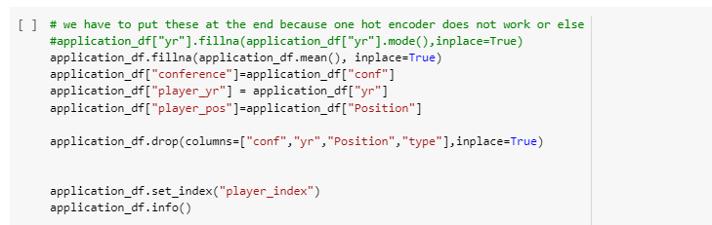
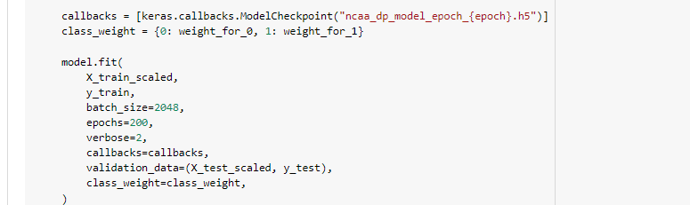
Test.Train.Split
Part 1
We had a problem with the categorical column names and had to put them at the end for the onehot encoder to work.
Used class weights based on the counts of the labels – 0 and 1 in this case.

Slide 15
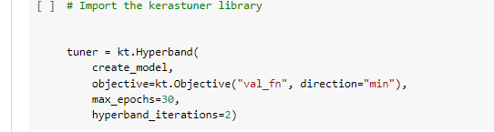

Train.Test.Split
Part 2
Use hyperband objectives parameters of val_fn to minimize the false negatives that we would get.
We don’t want to pick a candidate if they just genuinely weren’t that good.
Used the optimization of the optimizer parameter for unbalanced dataset.

Slide 16
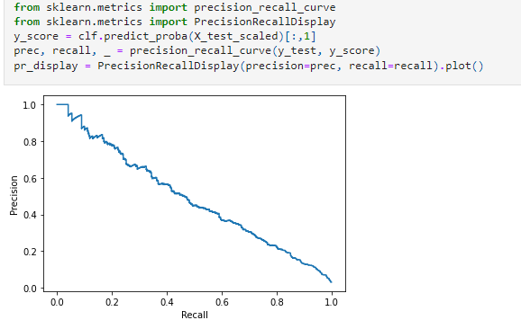
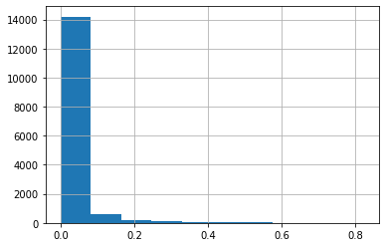
2022 Prediction
Distribution of Probability for Draft Picks for Test Set
Precision Recall

Slide 17
2022 Prediction
Accuracy of the Model

Slide 18
2022 Prediction
Andrew Jones, Texas Stanley Umude, Arkansas Paul Atkinson, Notre Dame Marreon Jackson, Arizona St. Christian Bishop, Texas Allen Flanigan, Auburn Drew Timme, Gonzaga Jaden Shackelford, Alabama Scotty Pippen Jr., Vanderbilt Julian Champagnie, St. John's Kalib Boone, Oklahoma St. Donta Scott, Maryland Xavier Cork, TCU
Iverson Molinar, Mississippi St. Johnny Juzang, UCLA DJ Horne, Arizona St. Marcus Williams, Texas A&M Justin Powell, Tennessee

Slide 19
Challenges In Cleaning
Understanding the various dataset columns and identifying which are important
Used the glossary at sports reference to understand the stats
Discussed within team
Defining a strategy to fill null values for various columns
Example Yr had Jr, Sr, etc. used mode (Jr)
For some of the other columns used mean
Removing columns that did not have data for some years

Slide 20
Challenges In Web Scraping
Player names that are duplicate
Some Players with missing Weight/Height or Position
Nature of tag for Position and the relationship to the height/weight tags
Large size of the dataset and the need to add a 300-millisecond gap
Multiple runs to recycle errored records.

Slide 21
Challenges when Preparing for Machine Learning
Varying number of categorical values
Categorical columns have to be at the end of the DF before one hot-encoding

Slide 22
Challenges Executing Machine Learning
Data is highly unbalanced
Had to use class_weights to ensure that the model is usable
Tried various Objectives using hyperband tuner

Slide 23
What we’d do if we had more time?

Slide 24
Final Thoughts and Conclusions

Slide 25
Questions?

