Slide 1
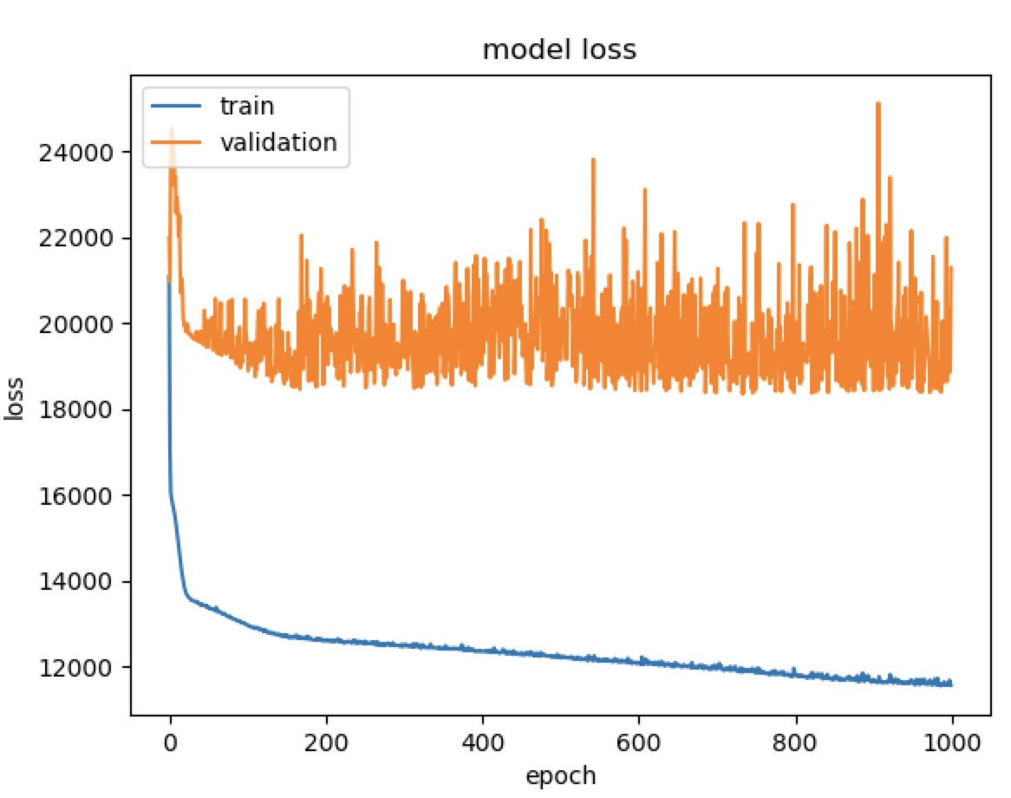
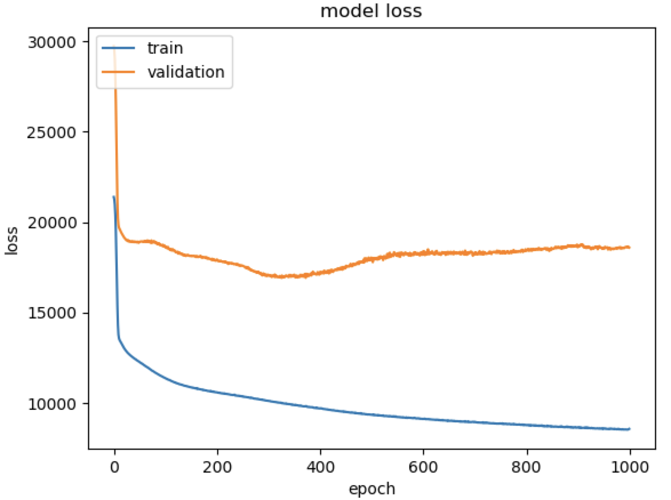
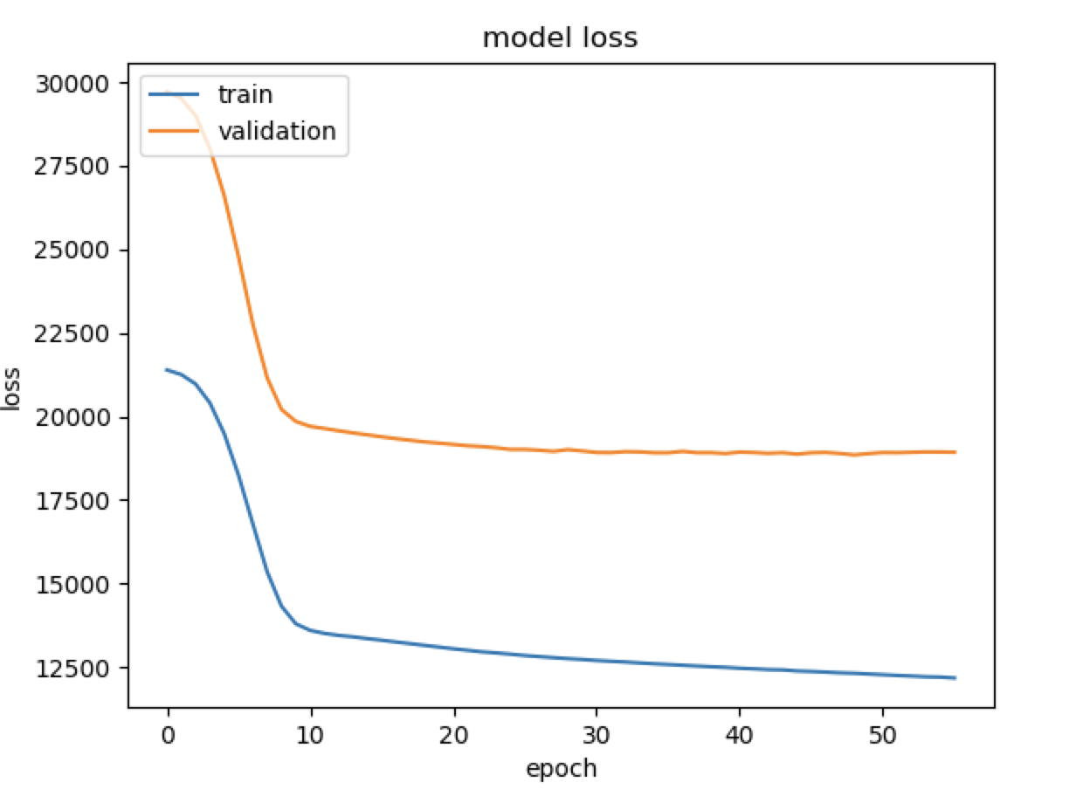

Without norm With normalization Norm + Early stopping
Using news titles to predict intraday DJIA movements
CS 224N
Arjun Arora, Avoy Datta, Victoria Ding
CS 224N | Winter 2019
Introduction
Methodology
Results
Experiments
Dataset
Features and Preliminary Statistics
Summary
.
[1]
[2]
[3]

