Slide 1
Investigating Image Reconstruction using HTM and KNN Classifiers
Information Technology
Software Engineering
ML 24/25-01 Investigate Image Reconstruction by using Classifiers
Anoushka Piplai[1566664] Email: anoushka.piplai@stud.fra-uas.de
Avradip Mazumdar[1566651] Email: avradip.mazumdar@stud.fra-uas.de
Raka Sarkar [1567153] Email: raka.sarkar@stud.fra-uas.de
Somava Ganguly[1566916] Email: somava.ganguly@stud.fra-uas.de

Slide 2
Content
Problem Statement
Introduction
Methodology
Experiment
Result
Future Scope

Slide 3

Problem Statement
ML 24/25-01 Investigate Image Reconstruction by using Classifiers
Design an experiment to explore HTM and KNN classifiers' ability to predict and reconstruct original inputs from SDRs and comparing both the classifiers in terms of accuracy and performance.

Slide 4
Introduction
Hierarchical Temporal Memory (HTM) is a machine learning model inspired by the structure and function of the human neocortex. It is designed to learn patterns, recognize sequences, and generate generalized representations from similar inputs. At the core of HTM is the Spatial Pooler (SP), which transforms raw input data into Sparse Distributed Representations (SDRs). These SDRs efficiently capture and store patterns in the input, with each bit representing a specific feature or characteristic. This process is further enhanced by classifiers like HTM and KNN, which learn and then predict and reconstruct images based on the SDRs generated by the Spatial Pooler, allowing the system to assess the accuracy and efficiency of these methods for pattern recognition and image reconstruction tasks.

Slide 5

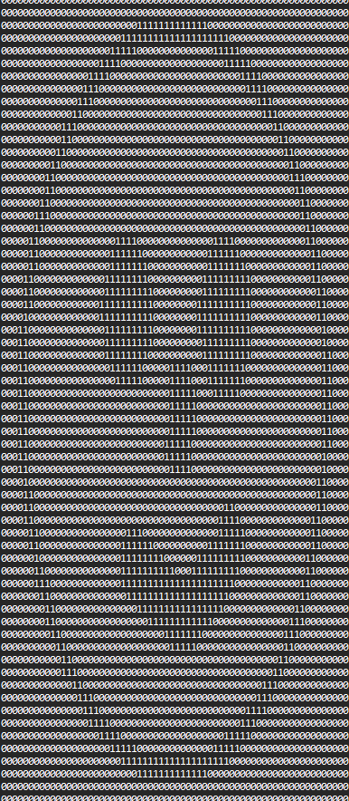

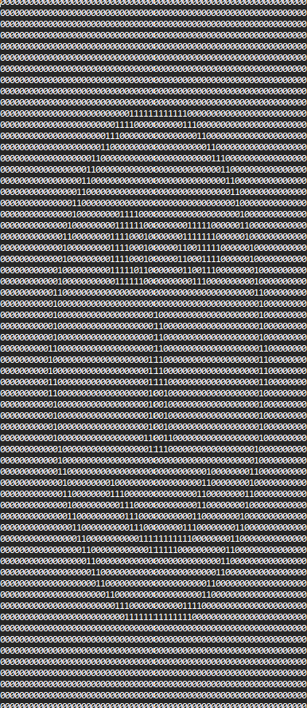
Methods
Image Binarizer
The Image Binarizer converts images into binary representations by thresholding RGB channels, resizing them to 64x64 pixels, and applying inversion for adaptability. It splits images into 80% training and 20% testing, saves binarized results, and maintains mappings to original images. The method returns structured data, enabling pattern recognition and classification tasks.

Slide 6
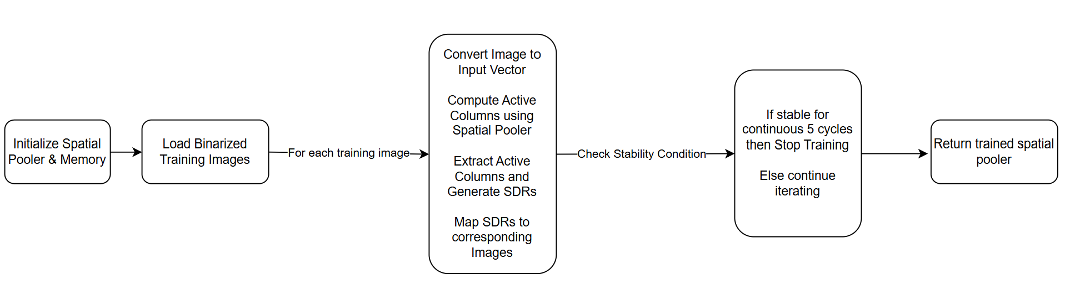
Methods
Spatial Pooler
The Spatial Pooler (SP) initializes memory and homeostatic plasticity, then processes binarized images into Sparse Distributed Representations (SDRs) through iterative learning. It computes active columns, maps SDRs to original images, and monitors stability. Finally, the trained SP is used for classifier training, prediction and image reconstruction.

Slide 7
Methods
Classifier Training
This phase trains both HTM and KNN classifiers using Sparse Distributed Representations (SDRs) from the training images. It iterates over the SDRs, passing each image’s SDRs to both classifiers for learning. The trained image names are logged, and the total training time is measured and displayed.
Classifier Prediction and Reconstruction
This phase predicts and reconstructs images using both HTM and KNN classifiers. It evaluates the performance of each classifier by comparing the Jaccard Index and Hamming Distance similarities of reconstructed images with original binarized images. The method tracks and logs performance, generates similarity plots and graphs, and compares the classifiers based on prediction accuracy. It also produces visualizations for the HTM and KNN similarity metrics, concluding with an overall performance summary.

Slide 8
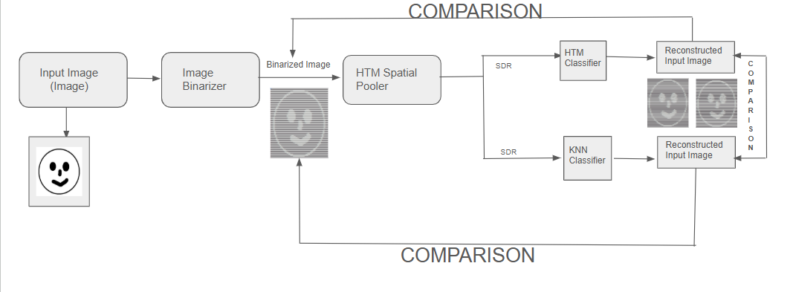
Experiment

Slide 9
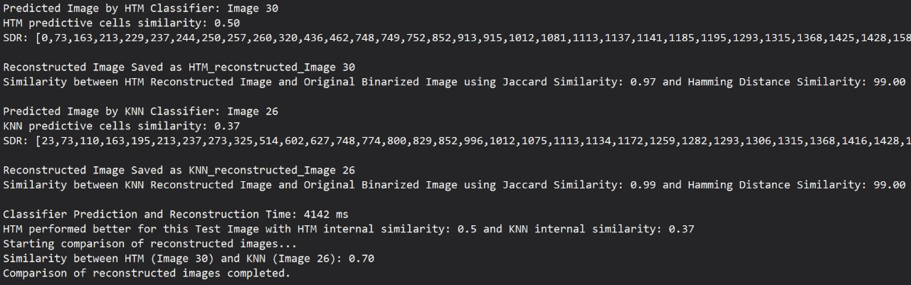
Results
Case 1 : HTM Classifiers performed better via predicting the Image with higher similarity. Also the classifier Prediction and Reconstruction time is being captured and the similarity between both the reconstructed images are presented.
Case 2 : This is the scenario where both the HTM and KNN Classifiers predicted the same image. So we can say that here both the classifiers performed equally.

Slide 10
Results
Overall , for all the predictions and reconstructions we calculated to check which classifier performed better. We can see here HTM Classifier outperformed KNN Classifier.

Slide 11
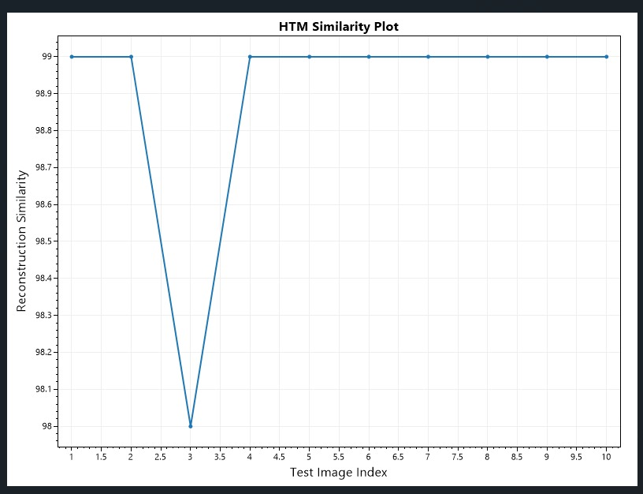
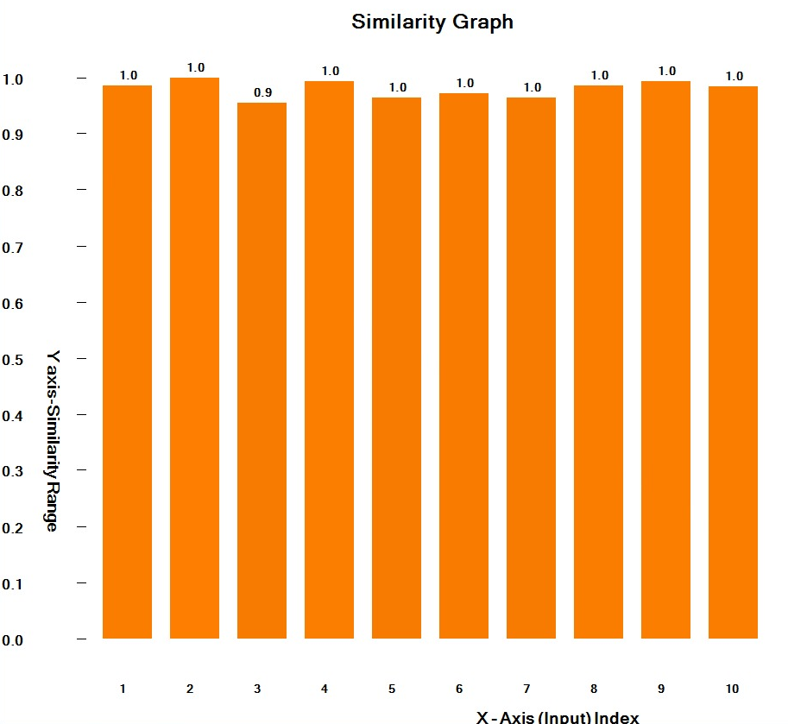
Results
Below figures represents the visualization of similarity between HTM Reconstructed V/s Original Binarized Images.
The Bar Graph is plotted with Jaccard Index Similarity and the Scott Plot is using Hamming Distance Similarity.

Slide 12
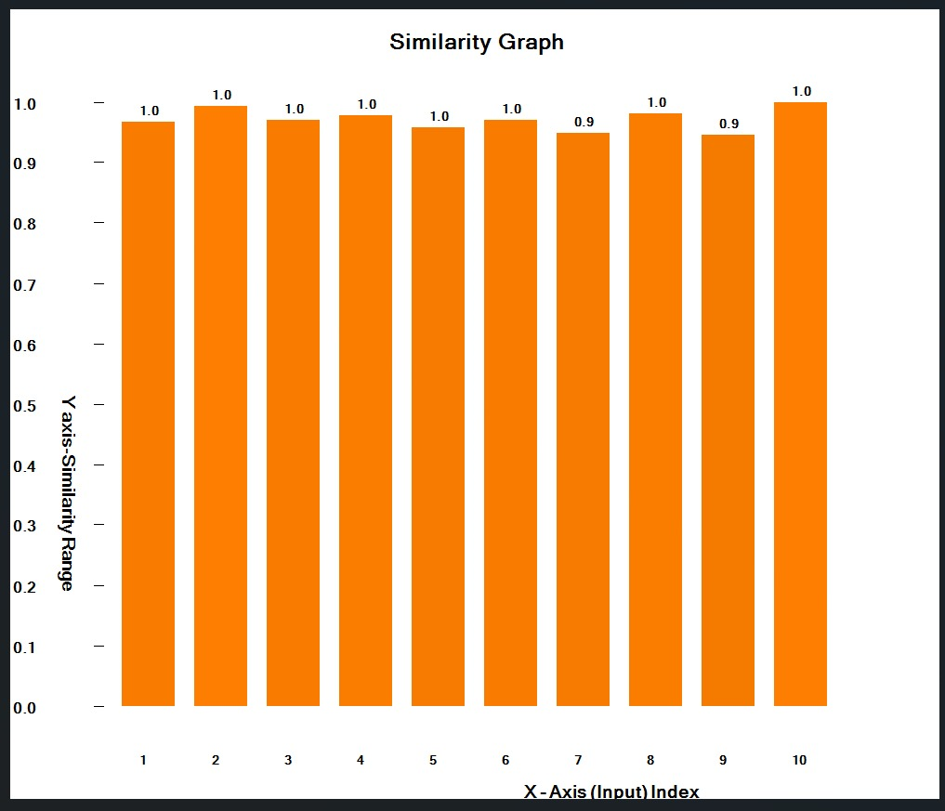
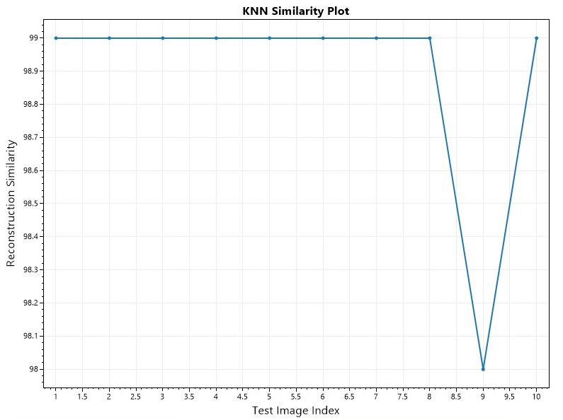
Results
Below figures represents the visualization of similarity between KNN Reconstructed V/s Original Binarized Images.
The Bar Graph is plotted with Jaccard Index Similarity and the Scott Plot is using Hamming Distance Similarity.

Slide 13

Future Scope
Larger image datasets can be processed, making it scalable for more complex tasks.
Accuracy of the reconstructed images can be improved.
The Spatial Pooler can be trained using images with varying dimensions, color gradients, and filters to enhance its robustness during training.
The user interface can be enhanced to offer a more intuitive and seamless experience when conducting experiments.
Advanced models can be integrated for better feature extraction and accuracy improvement.

Slide 14
Thank You!

