Slide 1
Social Media & Emotional Well-Being Presented by: Avram Darius
Last Updated: 25.05.2024

Slide 2
Objective
Identify which factors of daily social media usage affect the dominant emotion of a person.

Slide 3
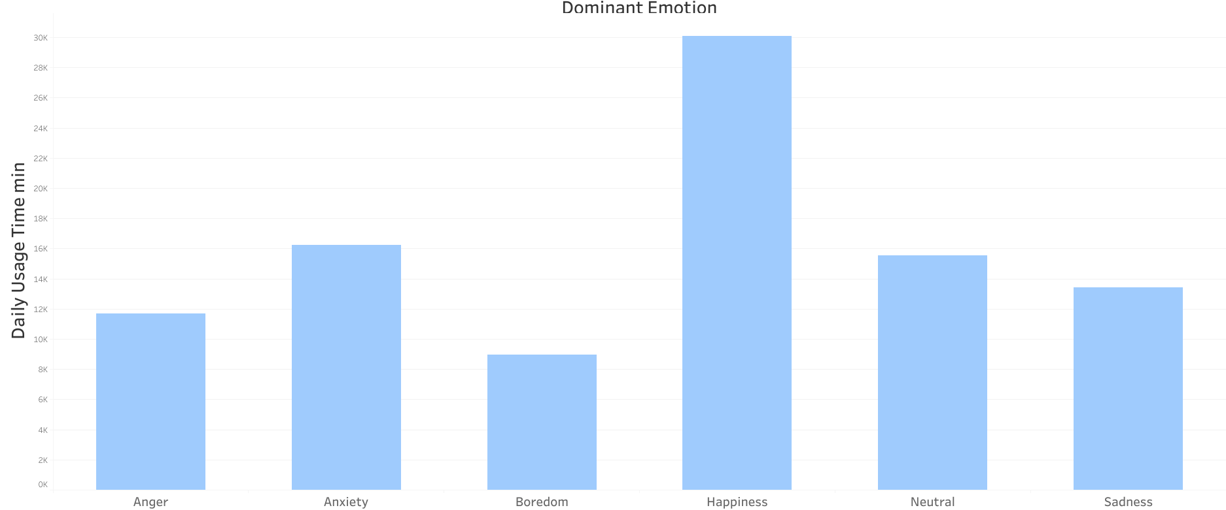
Daily Social Media Usage
Despite common misconception, according to this dataset, more daily usage time correlates with higher happiness, not the other way around.

Slide 4
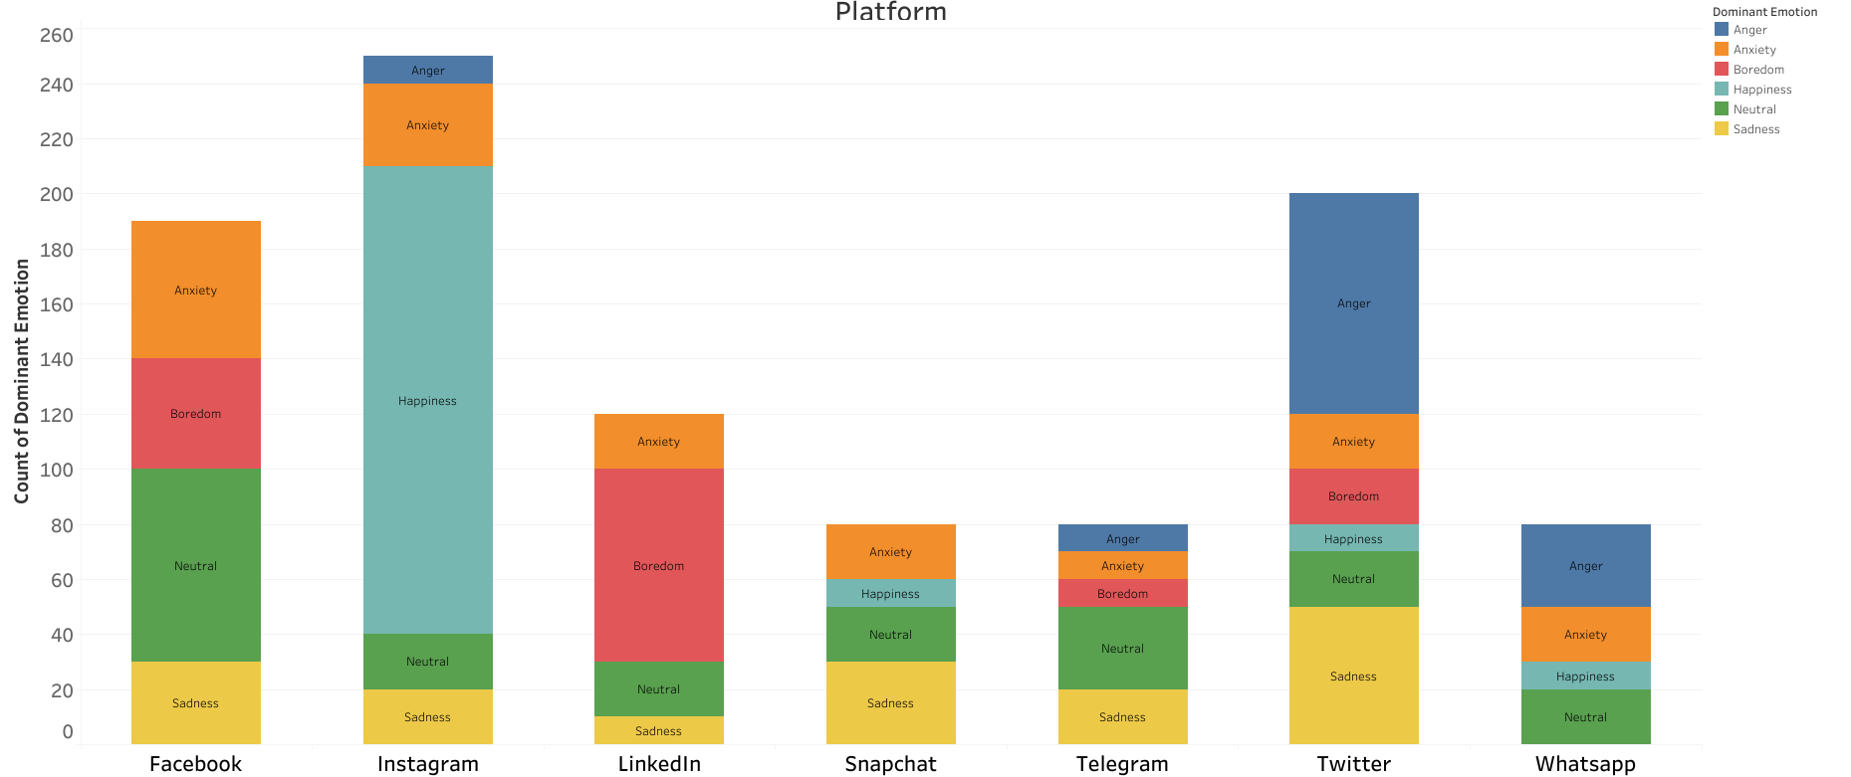
Emotion by platform
Looking further into the happiness, we can see that Instagram makes users the most happy, while on the polar opposite, Twitter makes most of its users angry and sad

Slide 5
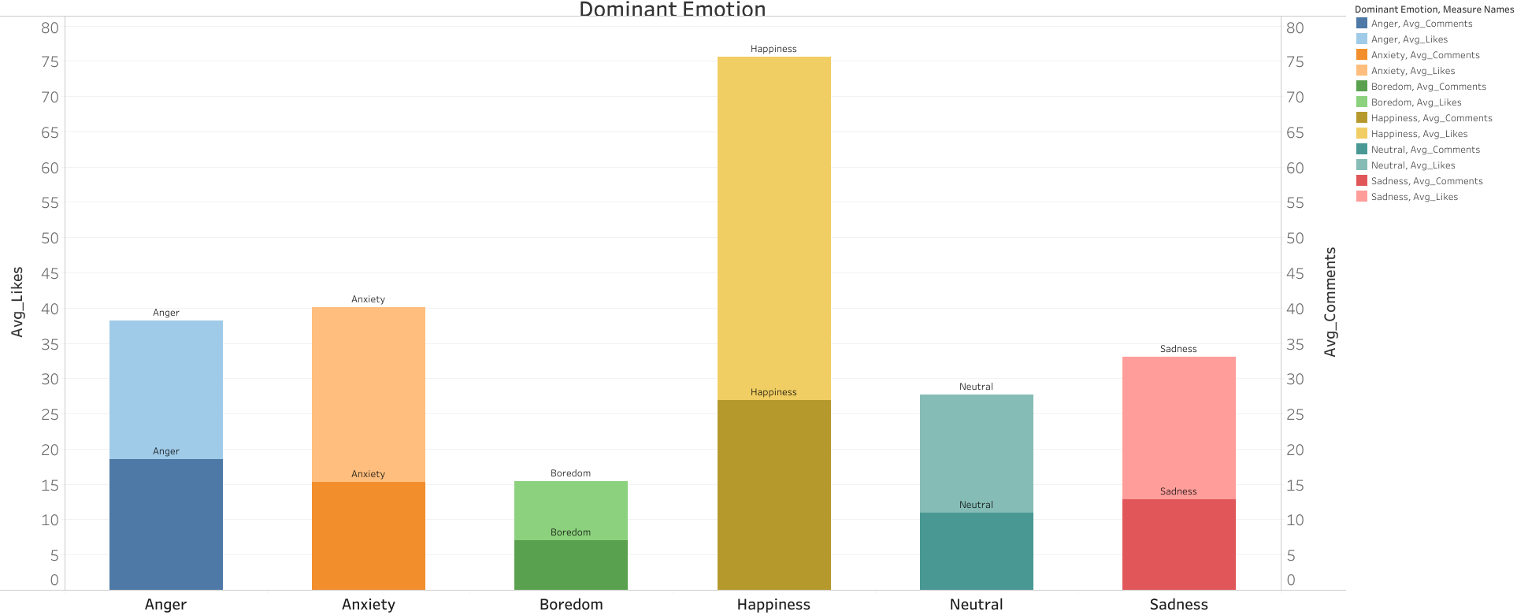
Effects of engagement
The way we engage with an app is extremely important. Here we can see that the more likes and comments we get, the more happy we feel!

Slide 6
Conclusion
As the data shows, simply restricting access to all apps, won’t increase users happiness.
The apps that the users use have a very high impact on their morale so, based on the first conclusion and this one, we can predict that restricting access to more toxic apps, such as Twitter or Facebook and promoting the usage of other apps, will increase overall well-being.
Engagement is also extremely important, a good way to increase positive emotions would be to push users towards interacting more with the community of those apps, if users get a lot of likes and comments, their happiness skyrockets.

Slide 7
Thanks!
Do you have any questions?
avram.dariusalexandru25@gmail.com
+0724086078
Website: startling-cat-922f3d.netlify.app
Documentation for project:https://docs.google.com/document/d/1Ma5D2NLAivtHWcUyP6HVy0fk_GAaZILu2tW-2rpAYQk/edit?usp=sharing

