Slide 1
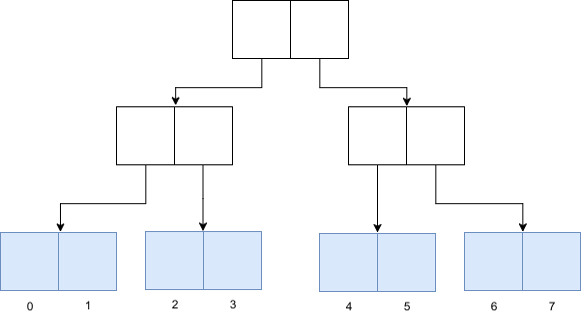

Marvellous Functional Datastructures:
The Vector

Slide 2
Hello!
Robert

Slide 3
Hello!
Robert
Scala & Clojure

Slide 4
Hello!
Robert
Scala & Clojure
Obsessed with FP

Slide 5
Vectors: An Introduction
What are Vectors?

Slide 6
Vectors: An Introduction
What are Vectors?
Hash Array Mapped Tries (HAMT)

Slide 7
Vectors: An Introduction
What are Vectors?
Hash Array Mapped Tries (HAMT)
  Tries?

Slide 8
Vectors: An Introduction
What are Vectors?
Hash Array Mapped Tries (HAMT)
  Tries?
  Trie, Radix Tree, Prefix Tree

Slide 9
Vectors: An Introduction
What are Vectors?
Hash Array Mapped Tries (HAMT)
  Tries?
  Trie, Radix Tree, Prefix Tree
  Structured based on their contents

Slide 10
Vectors: An Introduction
Tries:
  tee, try, add, aid, map, see, sit

Slide 11

Vectors: An Introduction
Tries:
  tee, try, add, aid, map, see, sit

Slide 12
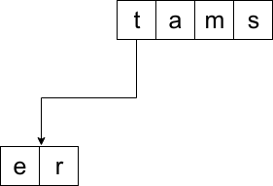
Vectors: An Introduction
Tries:
  tee, try, add, aid, map, see, sit

Slide 13
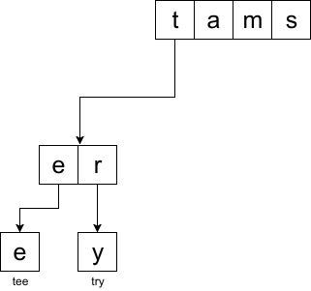
Vectors: An Introduction
Tries:
  tee, try, add, aid, map, see, sit

Slide 14
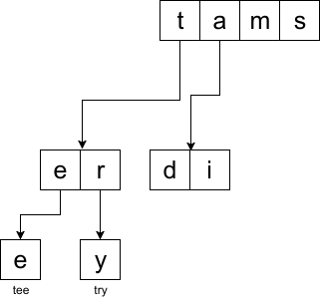
Vectors: An Introduction
Tries:
  tee, try, add, aid, map, see, sit

Slide 15
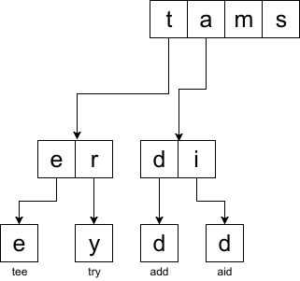
Vectors: An Introduction
Tries:
  tee, try, add, aid, map, see, sit

Slide 16
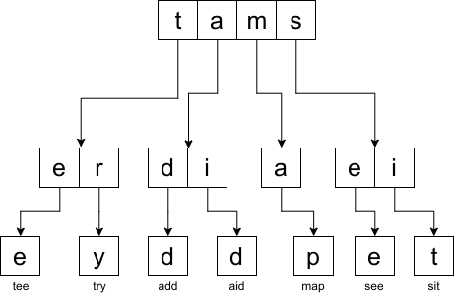
Vectors: An Introduction
Tries:
  tee, try, add, aid, map, see, sit

Slide 17
Vectors: An Introduction
Tries:
  Assume we want to lookup “add”

Slide 18
Vectors: An Introduction
Tries:
  Assume we want to lookup “add”
    Split: a - d - d

Slide 19
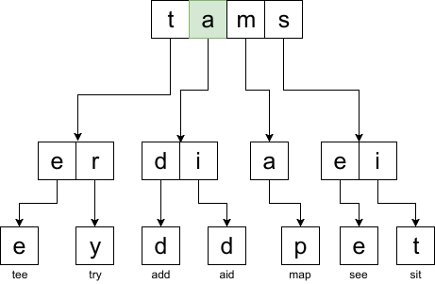
Vectors: An Introduction
Tries:
  Assume we want to lookup “add”
    Split: a - d - d

Slide 20
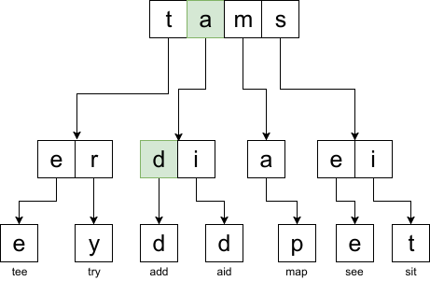
Vectors: An Introduction
Tries:
  Assume we want to lookup “add”
    Split: a - d - d

Slide 21
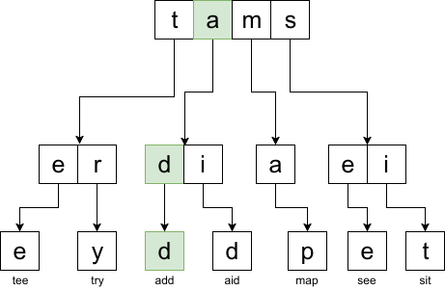
Vectors: An Introduction
Tries:
  Assume we want to lookup “add”
    Split: a - d - d

Slide 22
Vectors: An Introduction
Tries:
  Assume we want to lookup “nope”
    Split: n – o – p - e

Slide 23
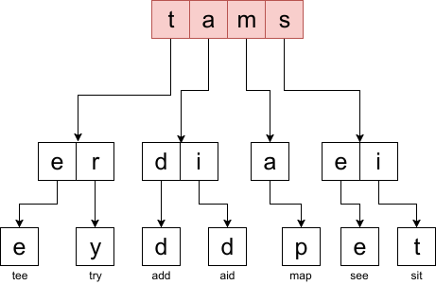
Vectors: An Introduction
Tries:
  Assume we want to lookup “nope”
    Split: n – o – p - e

Slide 24
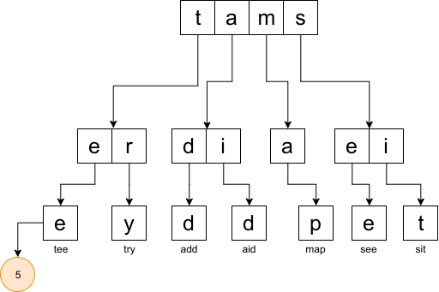
Vectors: An Introduction
Trie Maps:
  Associate value with leaf node

Slide 25
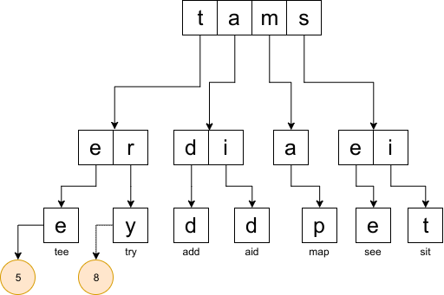
Vectors: An Introduction
Trie Maps:
  Associate value with leaf node

Slide 26
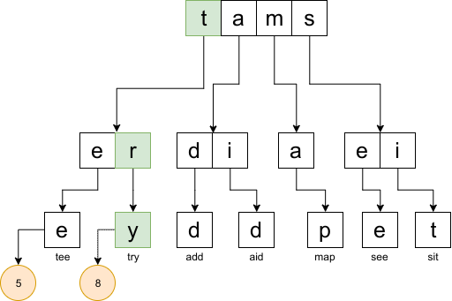
Vectors: An Introduction
Trie Maps:
  Associate value with leaf node
  Look-up: “try”

Slide 27
Vectors: An Introduction
Trie Maps:
  Associate value with leaf node
  Look-up: “try”
try → 8

Slide 28
Vectors: An Introduction
Hash Array Mapped Tries:
  Tries with hash ranges

Slide 29
Vectors: An Introduction
Hash Array Mapped Tries:
  Tries with hash ranges
  Hash-Maps!

Slide 30
Vectors: An Introduction
Hash Array Mapped Tries:
  Tries with hash ranges
  Hash-Maps!
Vectors:
  HAMTs with ranges of integers

Slide 31
Vectors: An Introduction
Indexing a trie:

Slide 32
Vectors: An Introduction
Indexing a trie:
  1. Fixed branching factors (power of 2):
            M = 2^b

Slide 33
Vectors: An Introduction
Indexing a trie:
  1. Fixed branching factors (power of 2):
            M = 2^b
  2. Indexes are binary => Trie is bit-mapped

Slide 34
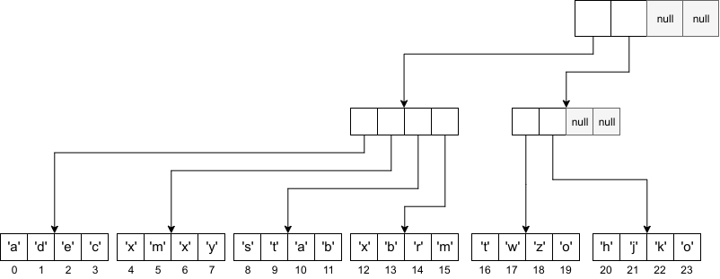
How to vector
Branching factor: 4
Height: 2

Slide 35
How to vector
Branching factor: 4
Height: 2
Look-up: 17

Slide 36
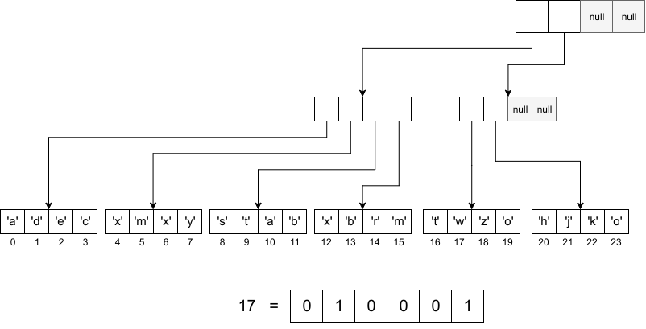
How to vector
Branching factor: 4
Height: 2
Look-up: 17

Slide 37
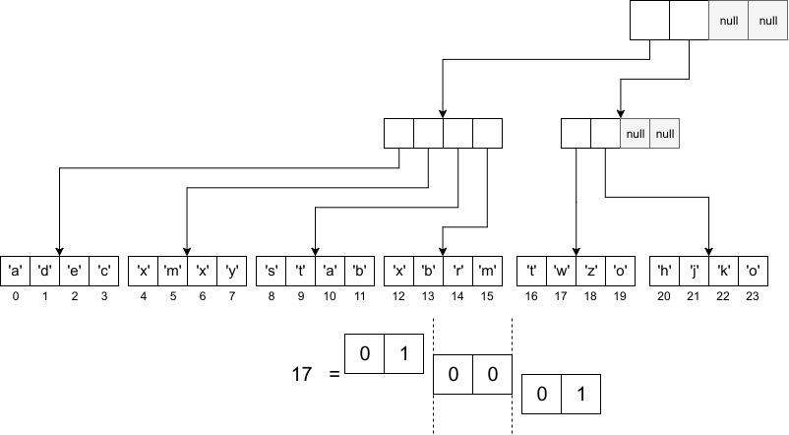
How to vector
Branching factor: 4
Height: 2
Look-up: 17

Slide 38
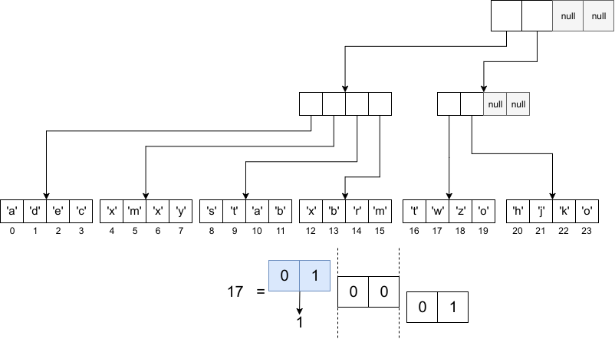
How to vector
Branching factor: 4
Height: 2
Look-up: 17

Slide 39
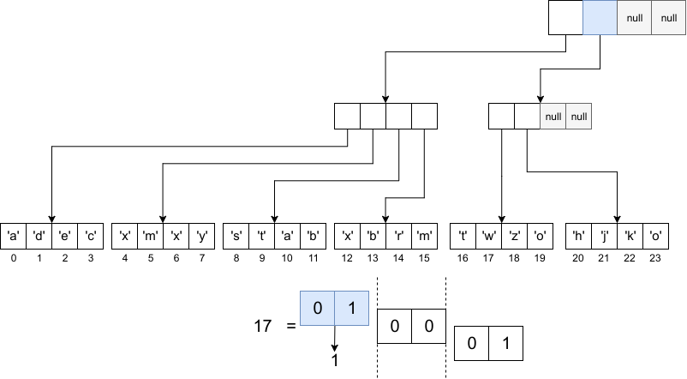
How to vector
Branching factor: 4
Height: 2
Look-up: 17

Slide 40
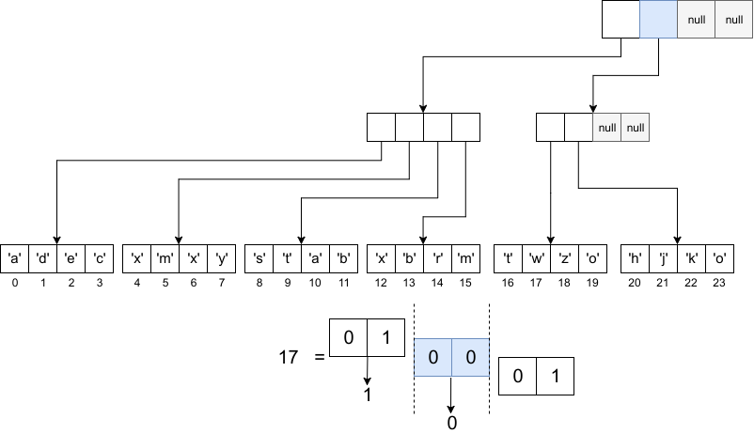
How to vector
Branching factor: 4
Height: 2
Look-up: 17

Slide 41
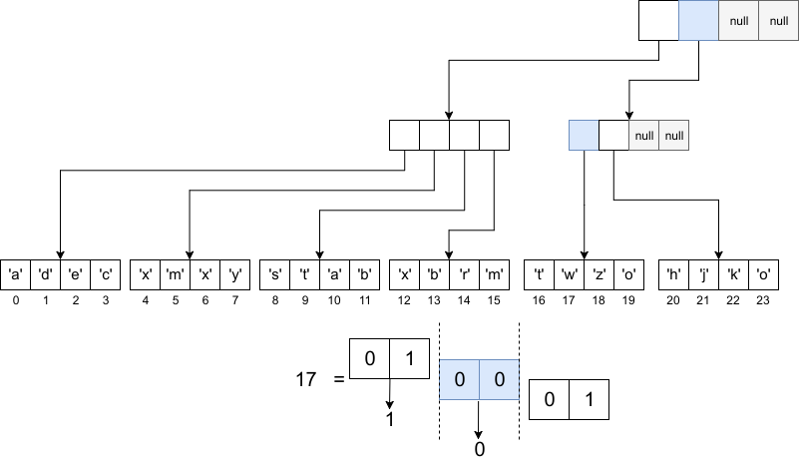
How to vector
Branching factor: 4
Height: 2
Look-up: 17

Slide 42
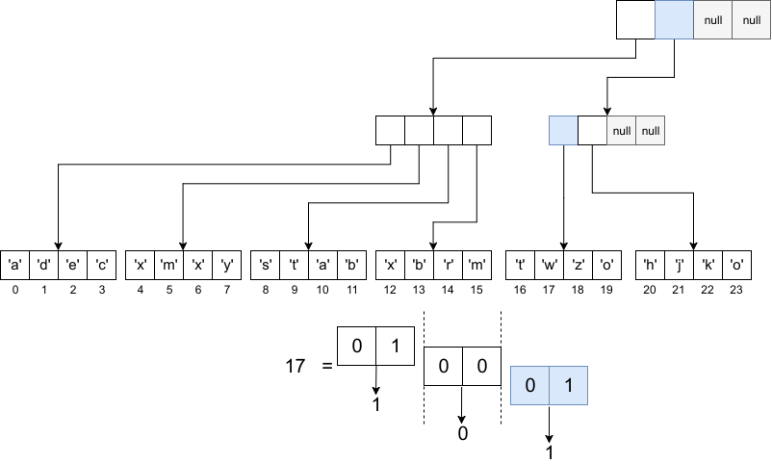
How to vector
Branching factor: 4
Height: 2
Look-up: 17

Slide 43
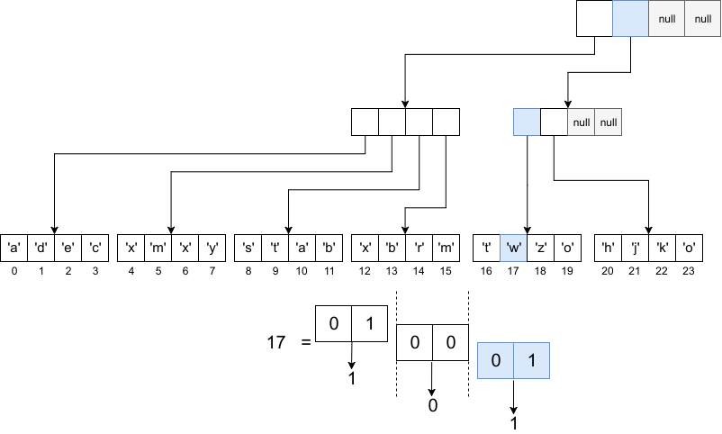
How to vector
Branching factor: 4
Height: 2
Look-up: 17

Slide 44
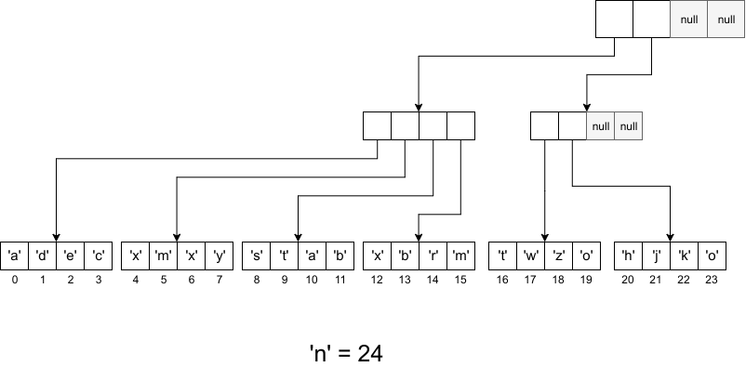
How to vector
Branching factor: 4
Height: 2
Append: ‘n’ → index 24

Slide 45
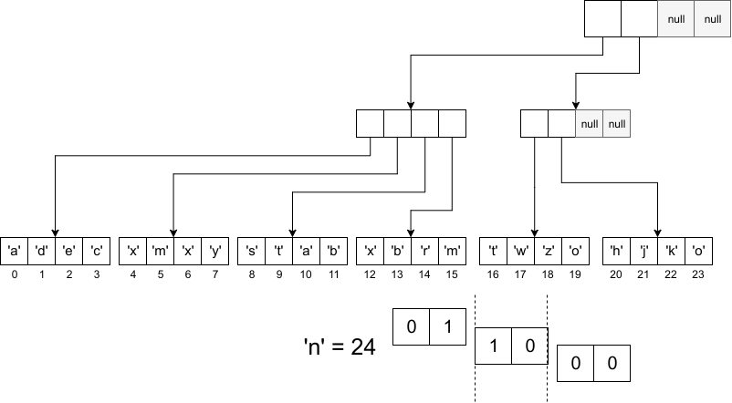
How to vector
Branching factor: 4
Height: 2
Append: ‘n’ → index 24

Slide 46
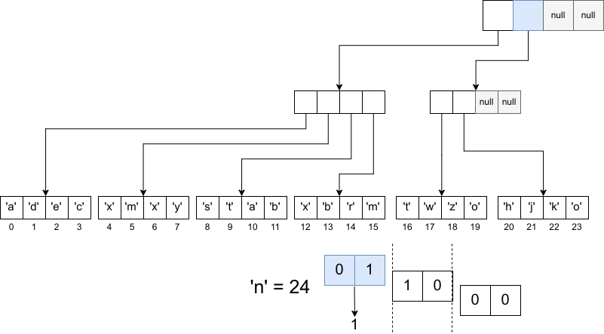
How to vector
Branching factor: 4
Height: 2
Append: ‘n’ → index 24

Slide 47
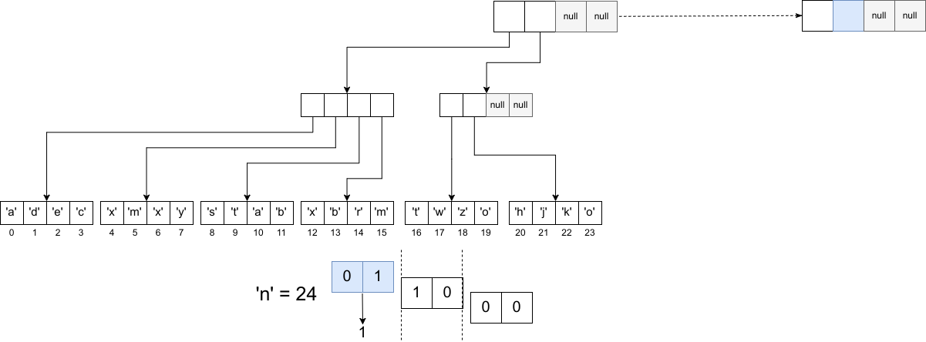
How to vector
Branching factor: 4
Height: 2
Append: ‘n’ → index 24

Slide 48
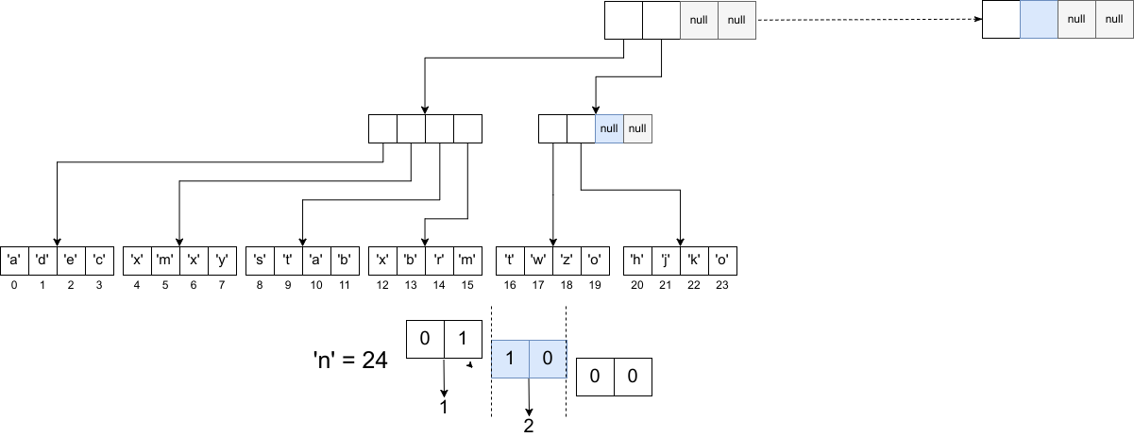
How to vector
Branching factor: 4
Height: 2
Append: ‘n’ → index 24

Slide 49
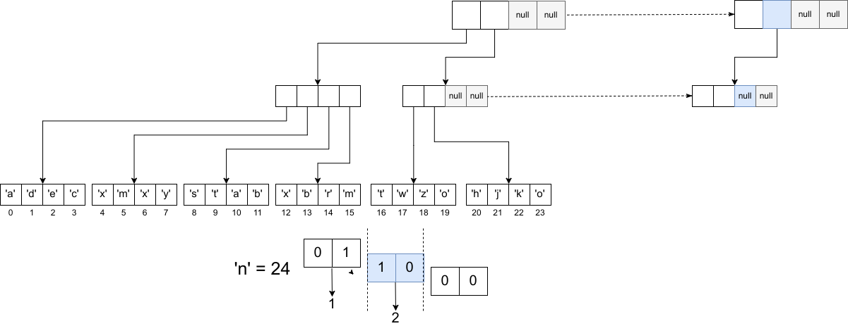
How to vector
Branching factor: 4
Height: 2
Append: ‘n’ → index 24

Slide 50
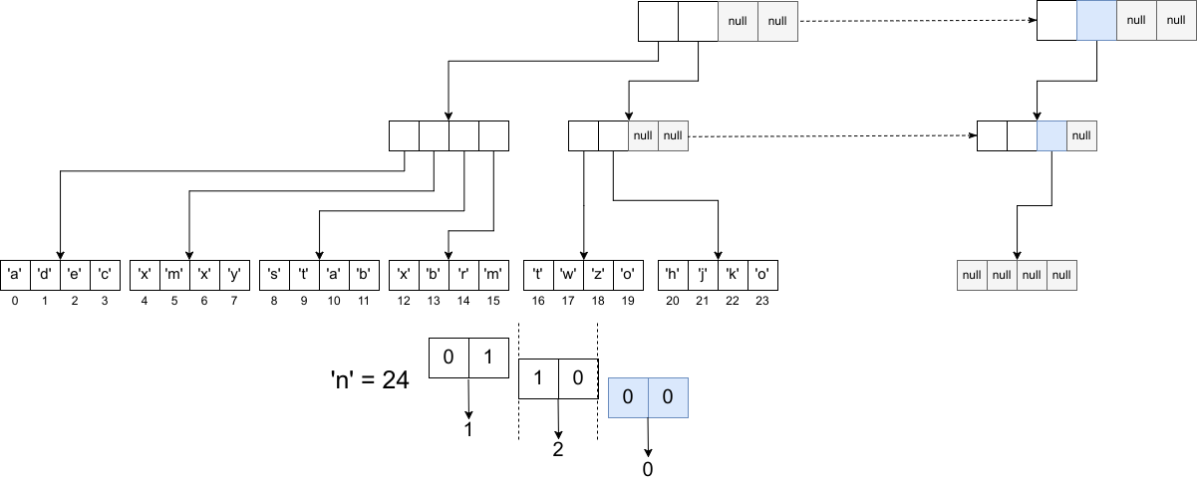
How to vector
Branching factor: 4
Height: 2
Append: ‘n’ → index 24

Slide 51
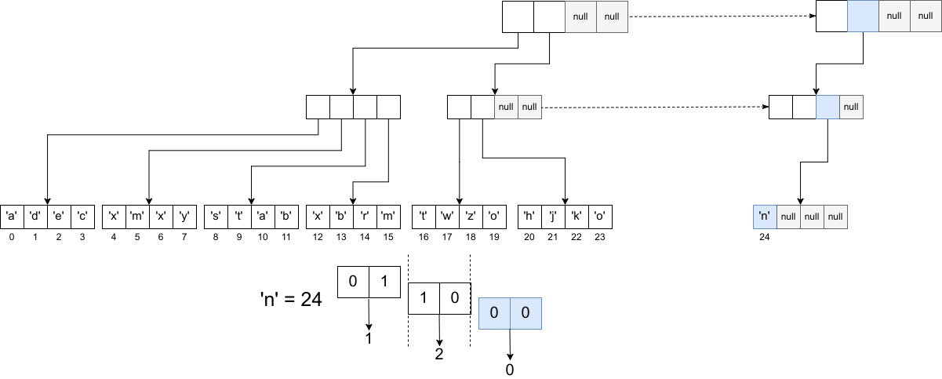
How to vector
Branching factor: 4
Height: 2
Append: ‘n’ → index 24

Slide 52
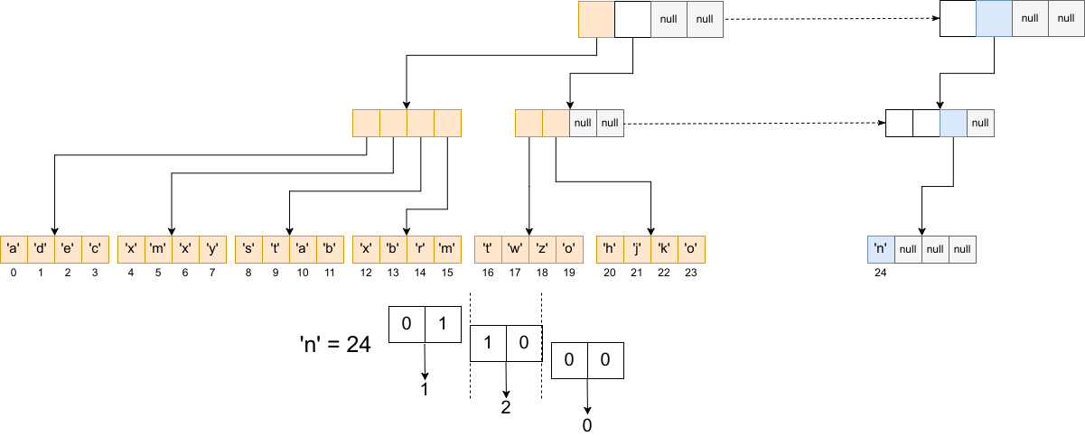
How to vector
Branching factor: 4
Height: 2
Append: ‘n’ → index 24

Slide 53
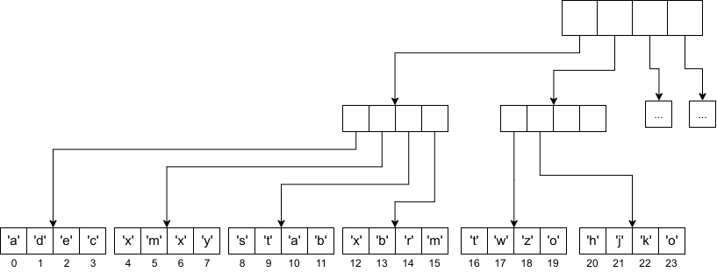
How to vector
Branching factor: 4
Height: 2
Append when full

Slide 54
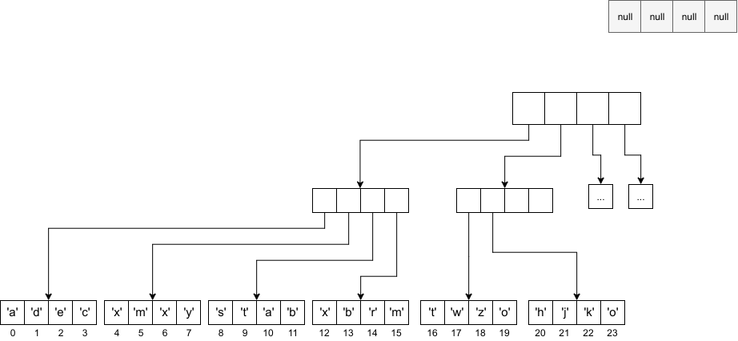
How to vector
Branching factor: 4
Height: 3
Append when full

Slide 55

How to vector
Branching factor: 4
Height: 3
Append when full

Slide 56
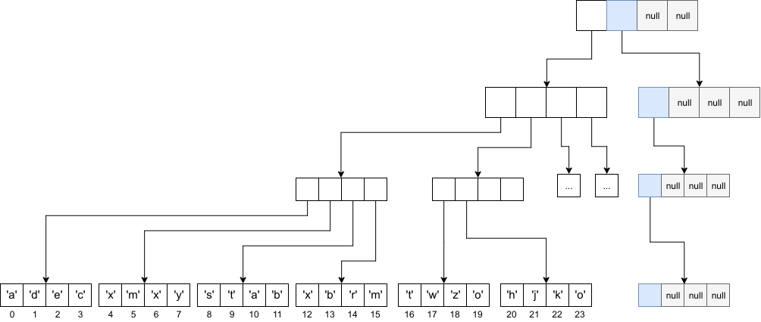
How to vector
Branching factor: 4
Height: 3
Append when full

Slide 57
How to vector
(properly this time)
You don’t implement binary nonesense

Slide 58
How to vector
(properly this time)
You don’t implement binary nonesense
Calculate with bitwise operations

Slide 59
How to vector
(properly this time)
You don’t implement binary nonesense
Calculate with bitwise operations
Index with formula:
  f (i, h) = (i >> shift) & (M – 1)
  shift = h * b (M = 2^b)
  M = branching factor

Slide 60

How to vector
(properly this time)

Slide 61

How to vector
(properly this time)

Slide 62
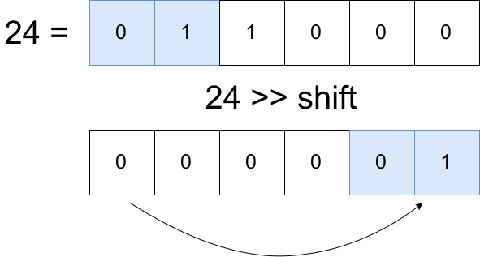
How to vector
(properly this time)

Slide 63
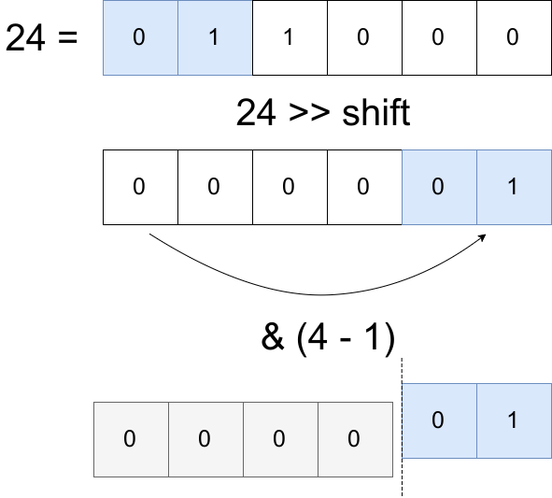
How to vector
(properly this time)

Slide 64
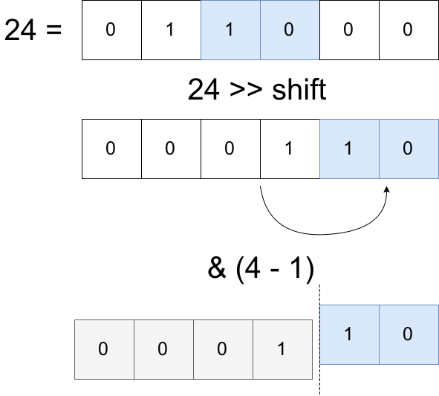
How to vector
(properly this time)

Slide 65
Vectors: Optimisations
Why log32?

Slide 66
Vectors: Optimisations
Why log32?
  Branching factor influences:

Slide 67
Vectors: Optimisations
Why log32?
  Branching factor influences:
    Look-up, iteration
    Appension, update

Slide 68
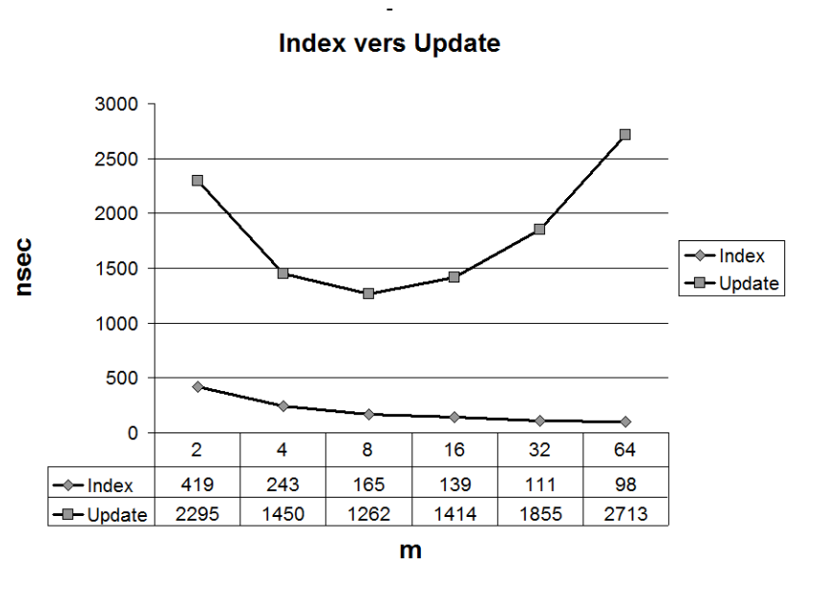
Vectors: Optimisations
Why log32?
  Branching factor influences:
    Look-up, iteration
    Appension, update
[1]

Slide 69
Vectors: Optimisations
Scala Vector:
  (on average) O(1) update
  (on average) O(1) look-up
[1]

Slide 70
Vectors: Optimisations
Scala Vector:
  (on average) O(1) update
  (on average) O(1) look-up
Clojure Vector:
  O(1) appension
  O(1) last
  O(1) pop
[1]

Slide 71
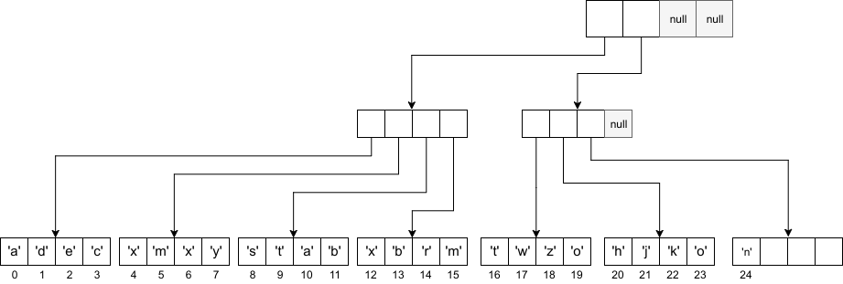
Clojure Vector
Tail

Slide 72
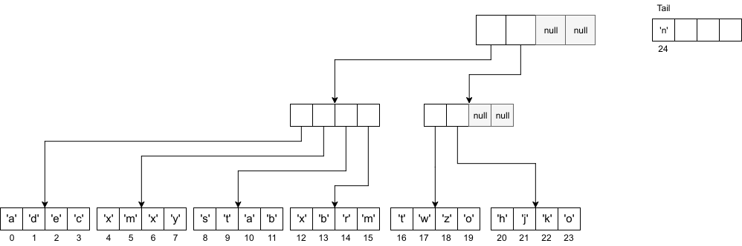
Clojure Vector
Tail

Slide 73
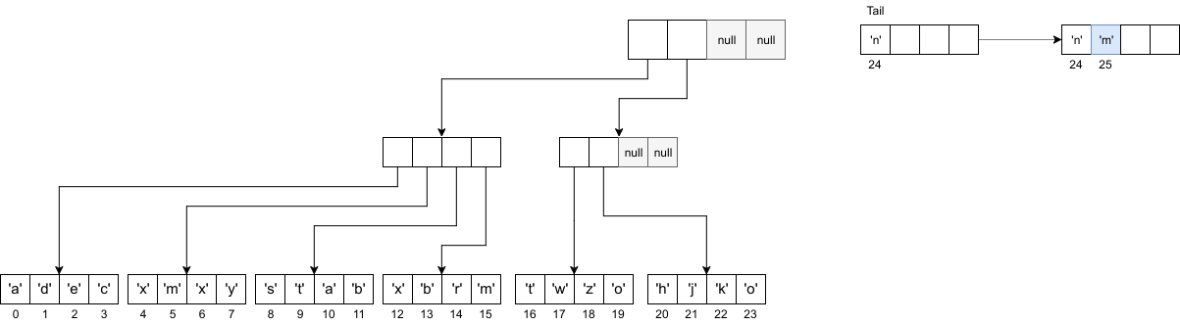
Clojure Vector
Tail

Slide 74
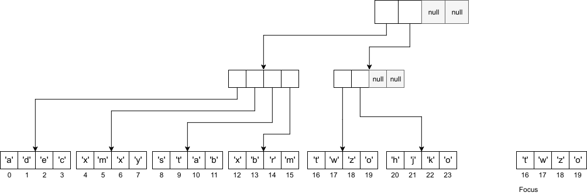
Scala Vector
Focus

Slide 75
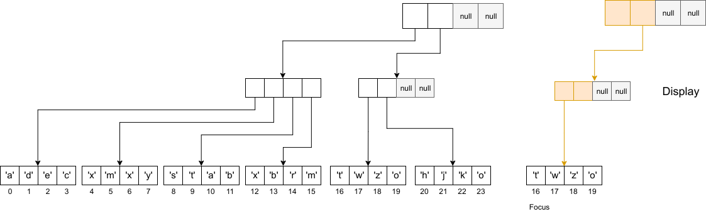
Scala Vector
Focus with Display

Slide 76
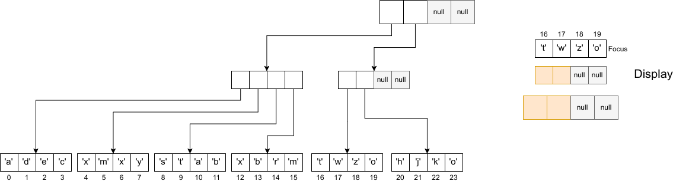
Scala Vector
Focus with Display

Slide 77
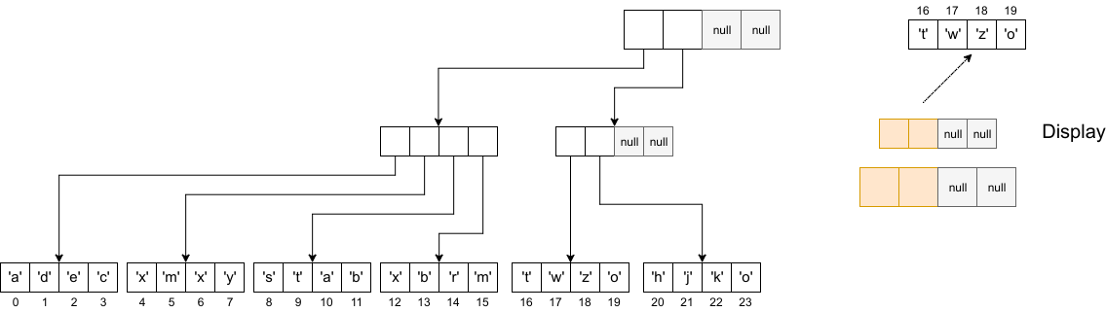
Scala Vector
Focus with Display

Slide 78
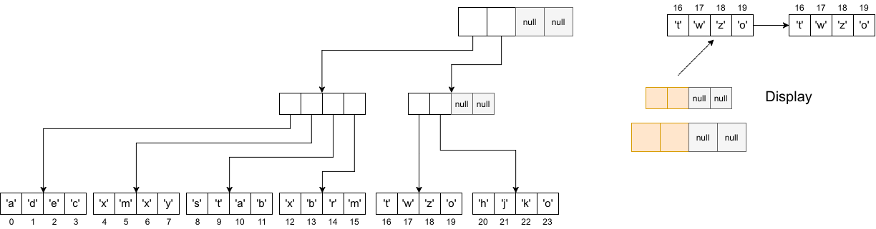
Scala Vector
Focus with Display

Slide 79
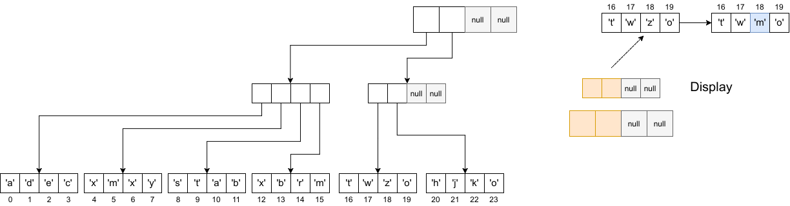
Scala Vector
Focus with Display

Slide 80
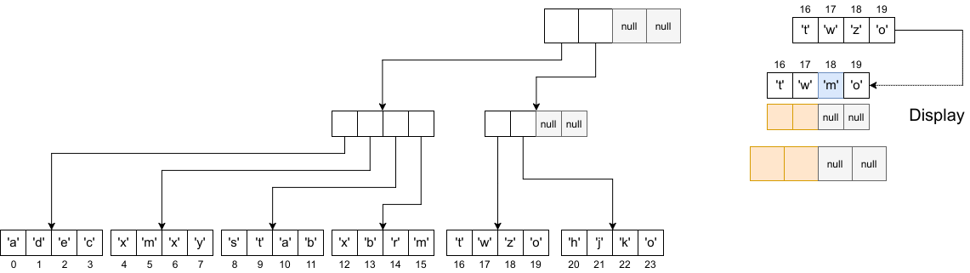
Scala Vector
Focus with Display

Slide 81
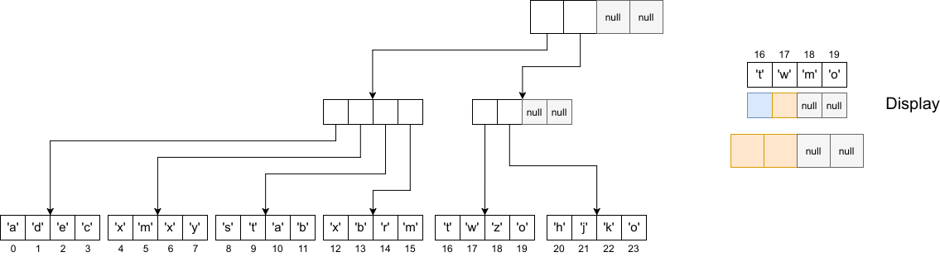
Scala Vector
Focus with Display

Slide 82
Vectors: An Implementation

Slide 83
Thank you!
Presentation: https://github.com/AvramRobert
[1] https://infoscience.epfl.ch/record/169879/files/RMTrees.pdf

