Slide 1

CHAPTER 0X01

Slide 2
Who am I?
Student of BIT
Penetration Tester / Ethical Hacker @ Stickman Consulting
Occasional Bugbounty hunter
Bugcrowd Ambassador
Learner

Slide 3
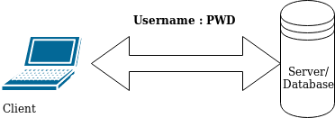
Authentication && Authorization
- Authentication means to prove the Application who you say, you are.
- Use of correct Username:Pwd goes through a check to authenticate you.
- Authorization means to let you use the application as per your own level of authority
- You can’t sell the unit rented by you while owner can and even kick you out of the house while u can only tell others who’re living under u to leave.

Slide 4
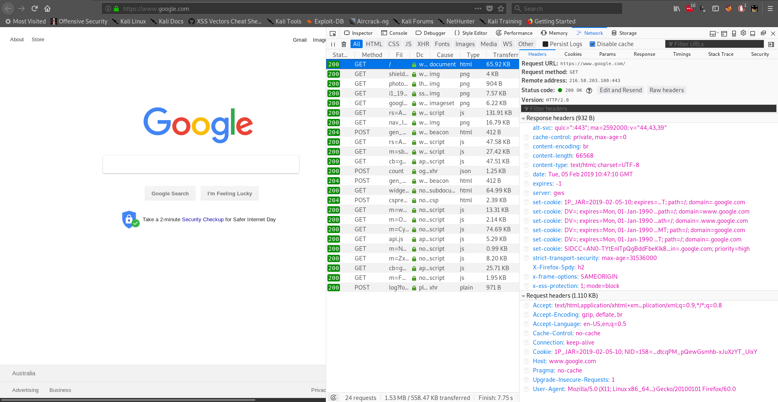
Headers

Slide 5
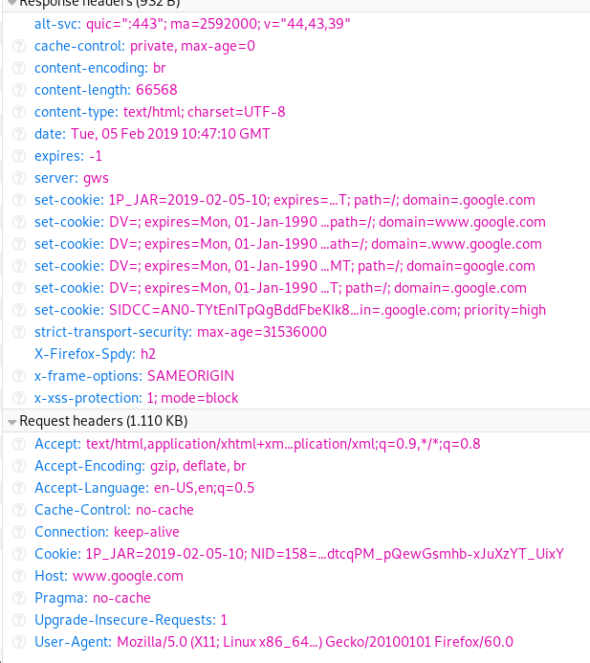
Headers
Set-cookie* – Authentication & Authorization Values
Server – Server information
Host – URL
User-Agent- Device Being used
Accept (Content-type): text/html,…….
= Type of data to be accepted by the server

Slide 6
Different Methods used to request data
GET – When we need to retrieve some data on our end from server. (For eg: Requesting Facebook login interface)
POST – When we need to send some data to the server before getting the specific data (For eg: login)
PUT – When need to upload/create/modify already existing data on the server. (Dangerous****)

Slide 7
Sessions
A chunk of data saved in the client side given by server in order to use the application throughout the authenticated time.
- Use of facebook as “YOU” until you log out.
- Sessions are managed/ identified by different cookie values

Slide 8
Demo

Slide 9
Recap
- How internet works
- How we send/receive data from internet
- Authentication && Authorization
- Headers
- Request Methods
- Session
- How to use Browser’s Developer Tools

Slide 10
Questions?

Slide 11
Thank You!!!

