Slide 1

Chapter 0X00

Slide 2
Who am I?
Student of BIT
Penetration Tester / Ethical Hacker @ Stickman Consulting
Occasional Bugbounty hunter
Bugcrowd Ambassador
Learner

Slide 3
History on this meetup
Loads of opportunity in infosec
Need of skilled professionals
Huge infosec community but less Nepalese participation
More and More enthusiastic Nepalese

Slide 4
What & How we learn!
Theories on how things work
Theories on what exactly is hacking
Theories on different attacks/vulnerabilities
Practically implementing those in vulnerable labs
Use of BurpSuite and other different tools
Self-Research & Learn

Slide 5
A good infosec personnel
HTML, JS, CSS – Client Side Attacks
PHP , MYSQL – Server Side Attacks
PYTHON,BASH,RUBY – For scripting and automating
C,C++,Java - Lots of softwares are build in it.

Slide 6
Don’t be Afraid if you don’t know/ never heard of any of them :D
Story Time!
- Dutch CA (that issues ssl certs) → 2011 bankrupt
- AWS Env takeover coz of sysadmin simple pwd and shutdown of company

Slide 7
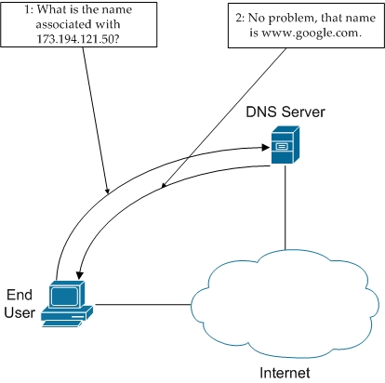
Surfing over Internet
1) What happens when you open google.com

Slide 8
How actually you access internet data?
Client PC (device)
Modem (Router)
IP, Ports, Packets
ISP DNS SERVER
Destination Server

Slide 9
Private vs Public IPs
Private IPs:
- Can’t be accessed
directly from internet.
- Prefix:
172.16.xx.xx – 172.31.xx.xx
192.168.xx.xx
10.xx.xx.xx
- Printer using your WIFI.
Public IPs:
- Can be directly accessed
in the internet
- Websites & Servers

Slide 10
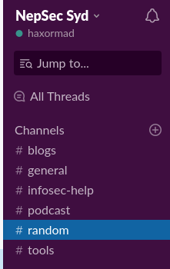
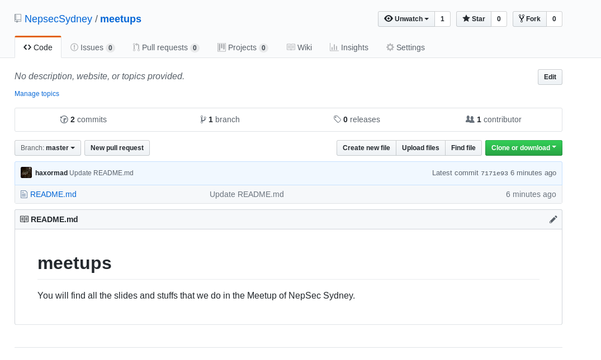
How we gonna go in a professional way?
Slack
We will use Slack
For messages
Instead of Facebook.
Github
We will upload all
Meetup contents
In our github.

Slide 11
For Next meet?
1) You guys need to learn HTML,CSS and Javascript’s Basics.
We will talk about
1) “Headers” data of Webapplication
2) Authentication & Authorization
3) Cookies
4) Sessions
5) Use of Browser’s Developer Tool

Slide 12
Any Questions?

