Slide 1
Sentiment Analysis of COVID-19 Tweets – Visualization Dashboard
Team Name: Ghidorah
Team Members:
Team Lead | Suyash Gupte
Team Member | Archana Prasad
Team Member | Mahesh Sawant

Slide 2
Extract Tweets
Using Twitter API & Tweepy.
tweets = api.search(q="place:%s AND covid OR lockdown" % place_id,lang='en',count = 100,result_type='recent',max_id=int(id_current)-1)
Find District using custom build district finder.
district = place_to_district(tweet.text)
Find problem using the problem classification model
problem = classify(tweet.text)
Find sentiment using VADER sentiment analysis(Positive, Neutral or Negative)
Store data in Google sheets
gd.set_with_dataframe(tweets_ws,realtime_tweets)

Slide 3
VADER Sentiment Analysis
VADER (Valence Aware Dictionary and sEntiment Reasoner) is a lexicon and rule-based sentiment analysis tool that is specifically attuned to sentiments expressed in social media.
def sentiment_analyzer_scores(text):
score = analyser.polarity_scores(text)
lb = score['compound']
if lb >= 0.4:
return 'positive'
elif (lb > -0.05) and (lb < 0.05):
return 'neutral'
elif(lb <= -0.05) or ((lb >= 0.05) and (lb < 0.4)):
return 'negative'

Slide 4
District Finder
The text is cleaned of links,mentions,emojis and is tokenized
openstreetmap is used as a source to find district of given place along with BeautifulSoup4
def get_soup(entity):
url = "https://nominatim.openstreetmap.org/search.php?q="+ entity
request = requests.get(url)
soup = BeautifulSoup(request.text,'html.parser')
result = soup.find_all('div', attrs = {'class' : 'result'})
return result

Slide 5
Problem Classification Model
Problems are divided into 5 categories:-
Food Shortage
Transportation
Economic
Daily Services
Others
LinearSVC from sklearn is used to classify tweets
The model is trained on manually selected tweets which face a particular problem

Slide 6
Map Sentiments to each District
Number of positive, negative and neutral sentiments along with count of each type of problem faced is counted and stored in Google sheets.
count_positive=len(total[total['sentiment']=='positive']) count_neutral=len(total[total['sentiment']=='neutral']) count_negative=len(total[total['sentiment']=='negative'])
count_pfs = len(total[total['problem']=="['Food Shortage']"])
count_pt = len(total[total['problem']=="['Transpotation']"])
count_pds = len(total[total['problem']=="['Daily Services']"])
count_pe = len(total[total['problem']=="['Economic']"])
count_po = len(total[total['problem']=="['Others']"])
This data is stored for each day as well as hourly basis for real time analysis

Slide 7
Extract Patient Count
The district wise patient count is scraped from the internet using BeautifulSoup4
url = "https://www.grainmart.in/news/covid-19-coronavirus-india-state-and-district-wise-tally/"
request = requests.get(url)
soup = BeautifulSoup(request.text,'html.parser')
result = soup.find_all('div', attrs = {'class' : 'skgm-td'})
This data is stored for each day as well as hourly basis for real time analysis

Slide 8
Delete Old data
Old data is deleted because we visualize data of only 8 days for easier understanding.
for date in dates:
if(len(df['date'].unique().tolist()) > 8 ):
df = df[df.date!=date]
else:
break

Slide 9
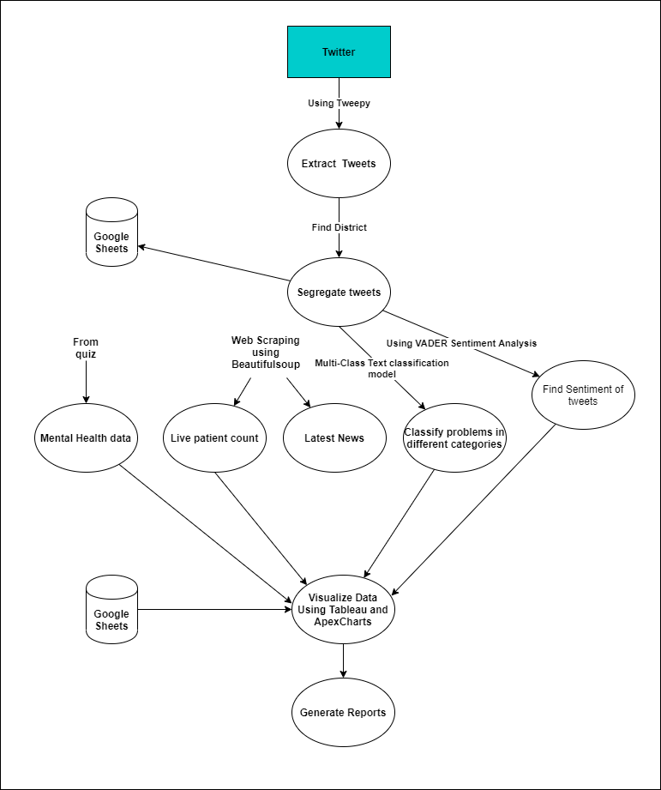

Slide 10
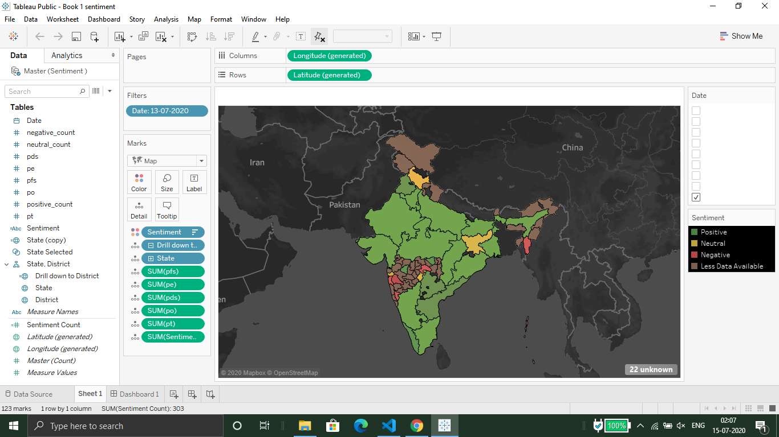
Tableau Maps
Google sheet’s data is visualized on maps using Tableau Public

Slide 11
Frontend
Pandas Dataframe is passed as a context variable in the template using Django
This data is visualized on maps and charts using Apexcharts.
With the state and district drop down data can be drilled down to each district.
We have sentiment analysis, patient count and mental health maps
Real time sentiment and patient count charts along with date wise data have been visualized.
Quick info tab displays government services available in lockdown, latest news, patient data of each district & user tweets.

Slide 12
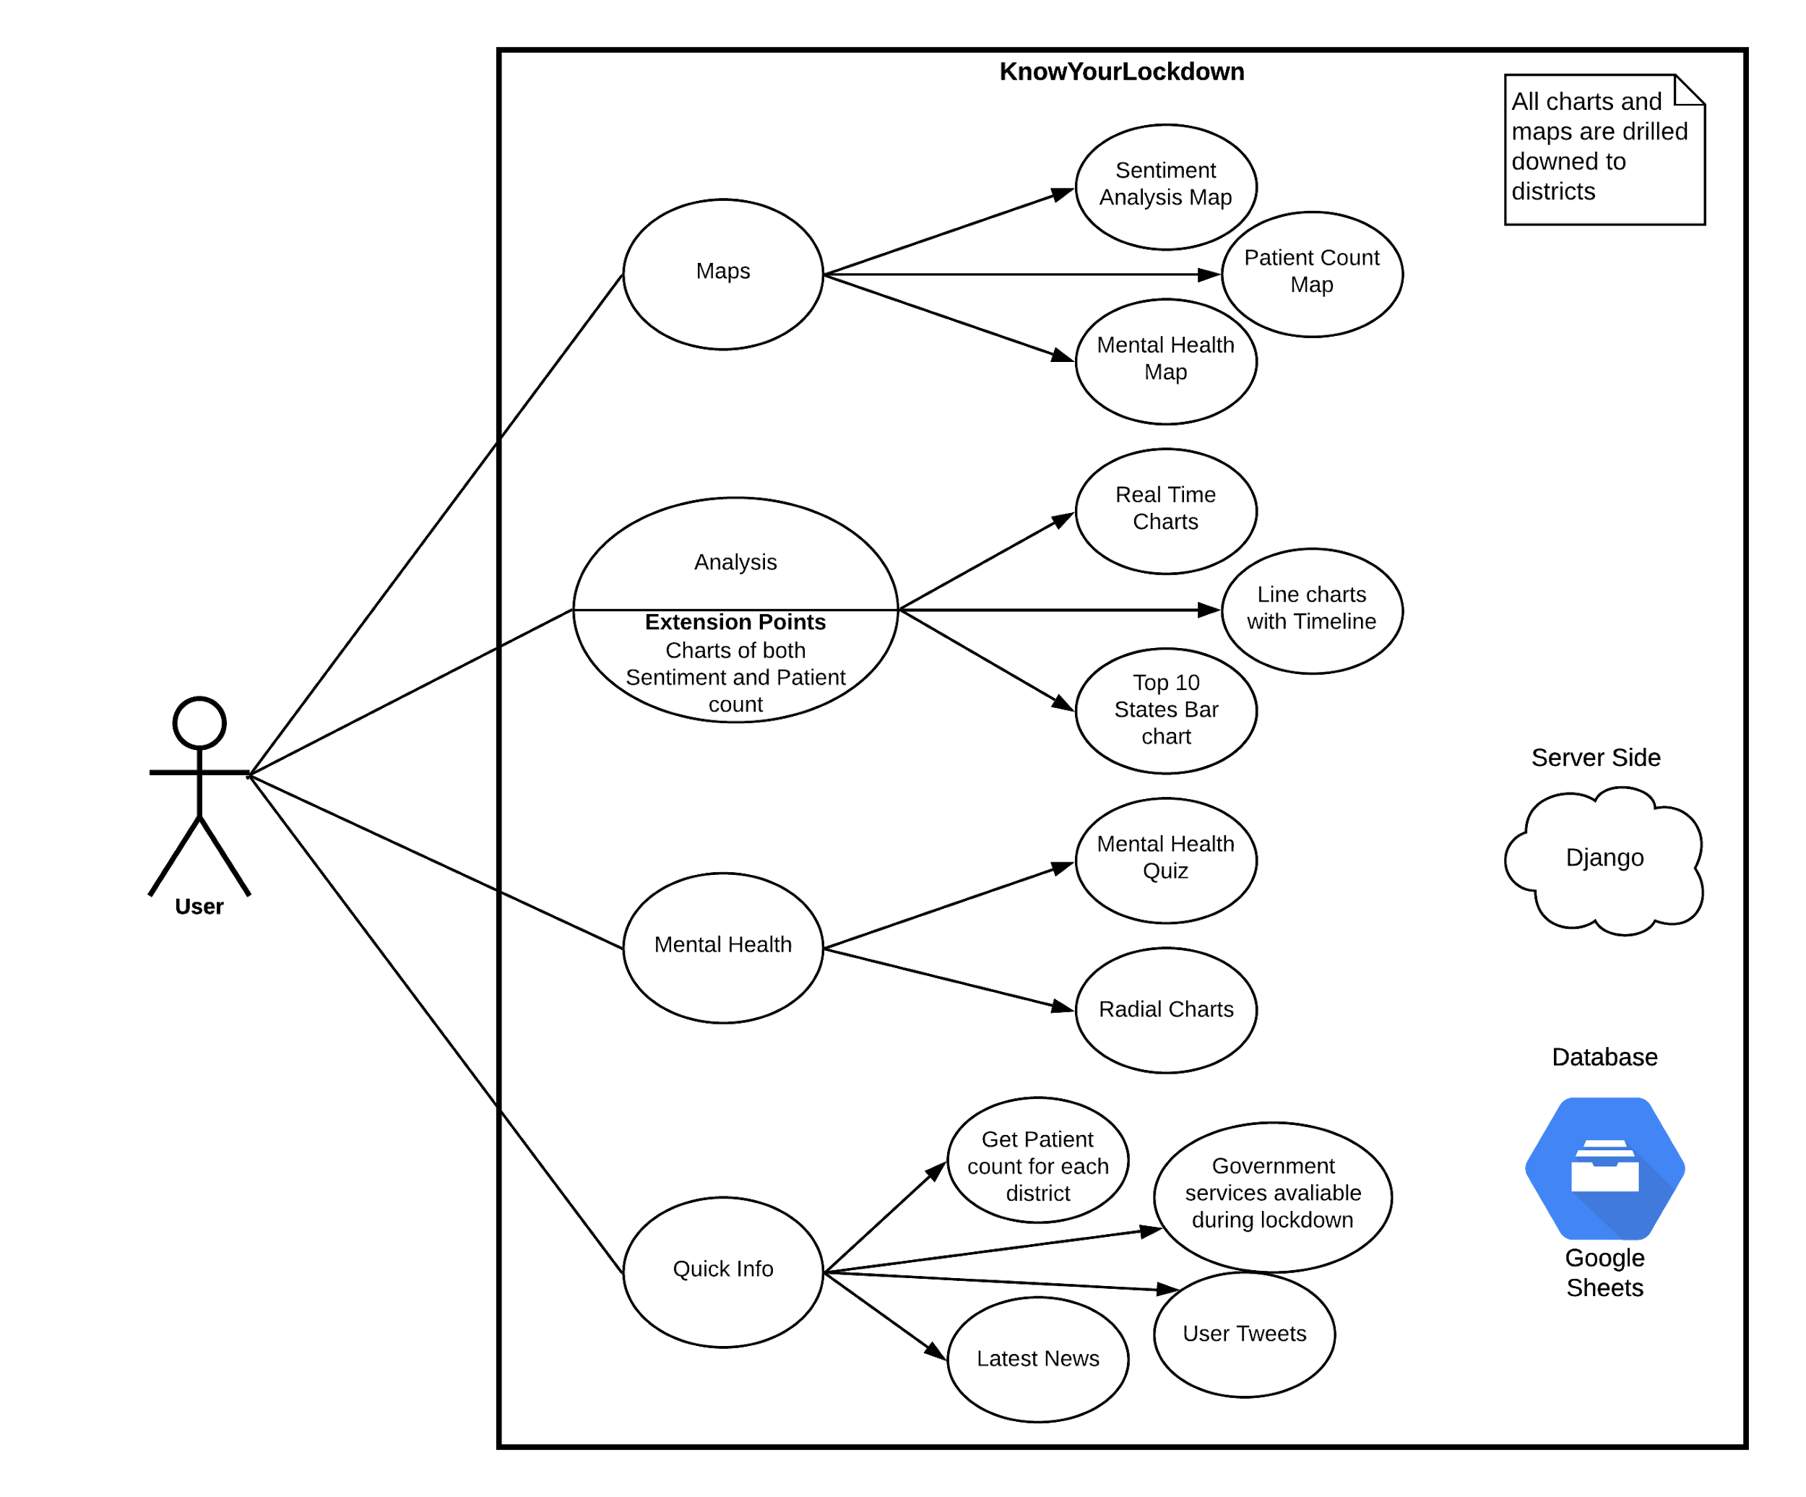

Slide 13
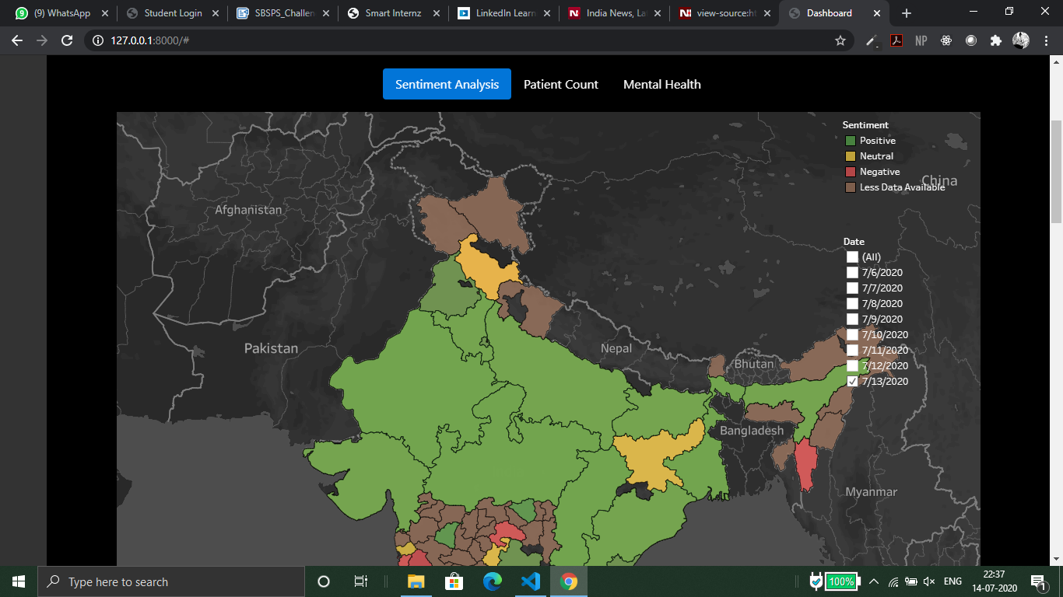

Slide 14
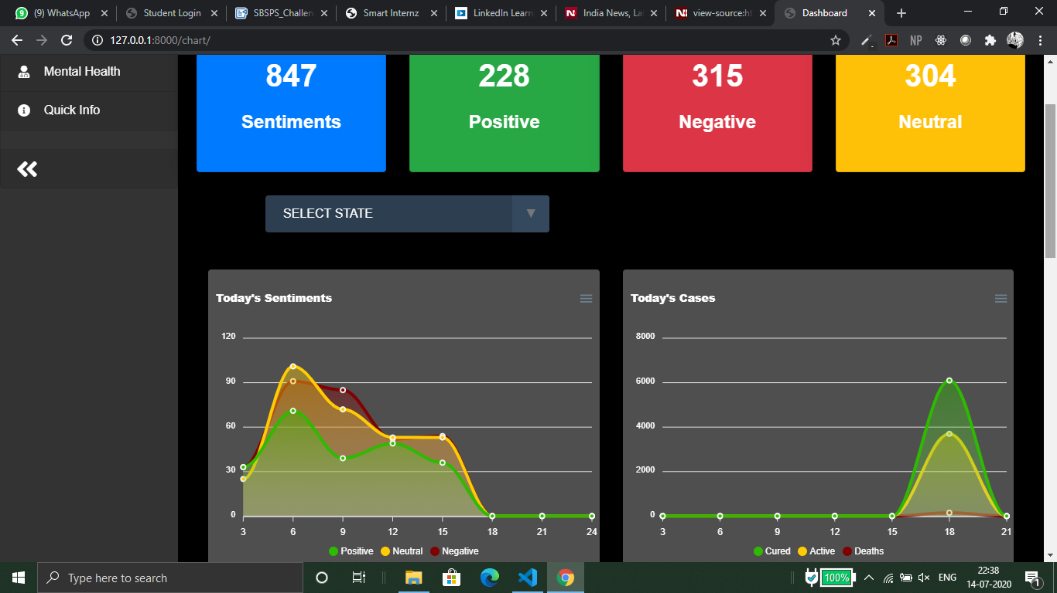

Slide 15
Mental Health Data
Latest News
We conducted a survey and asking people if the lockdown had any negative effect on them.
The data gathered is visualized on maps and radial charts
News is extracted using BeautifulSoup4.
url = "https://www.ndtv.com/india"
request = requests.get(url)
soup = BeautifulSoup(request.text,'html.parser')
result = soup.find_all('div', attrs = {'class' : 'new_storylising_contentwrap'})

Slide 16
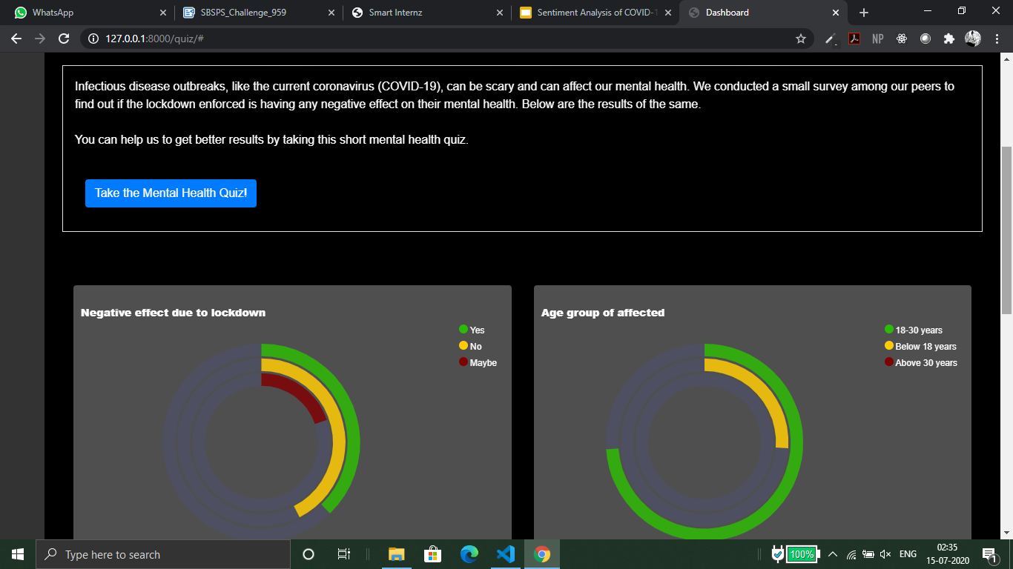

Slide 17
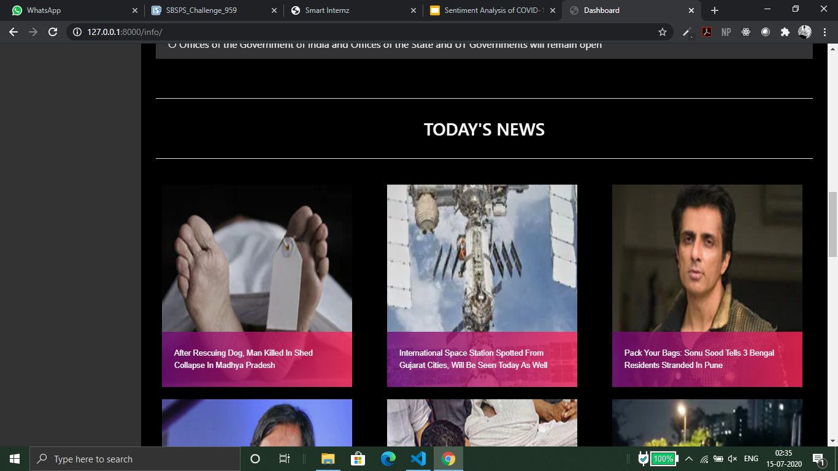

Slide 18
Dependencies
Internet connection is required.
Tweets are not available for all districts.
Twitter API has a delay of 5hr 30mins to extract latest tweets.
Patient count data depends on external source to update data.

Slide 19
THANK YOU

