Slide 1
PROJECT «TANKS»
Authors:
Fedotkin Nikita Alekseevich
Statsenko Ilya Romanovich
Ermakov Alexander Vyacheslavovich

Slide 2
TABLE OF CONTENTS
1
2
3
4
INTRODUCTION
ARCHITECTURE OF PROJECT
WORKING WITH PROCESSOR
CONCLUSION

Slide 3
INTRODUCTION
1

Slide 4
INTRODUCTION
GAME RULE
KEYBOARD CONTROLS
One enemy tank and one player tank one
Hit means destroying the tank
A tank can have only one active bullet
To win, the player needs to destroy the enemy tank
Right – W / Ц
Left – A /
Down – S /
Right – D /
Shot – SPACE
The “reset” button returns the game to initial state

Slide 5
ARCHITECTURE OF PROJECT
2

Slide 6
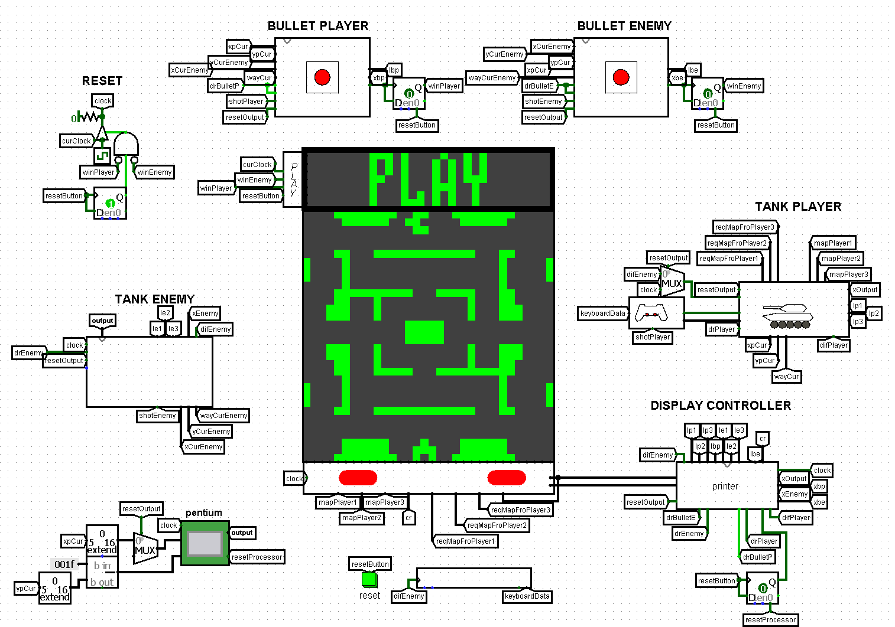
MAIN SCHEME
Connects all the circuits: screens, tanks, shells, controls
Implemented a reset by pressing the Reset button, locking the clock cycles before starting
Stops the game after winning

Slide 7
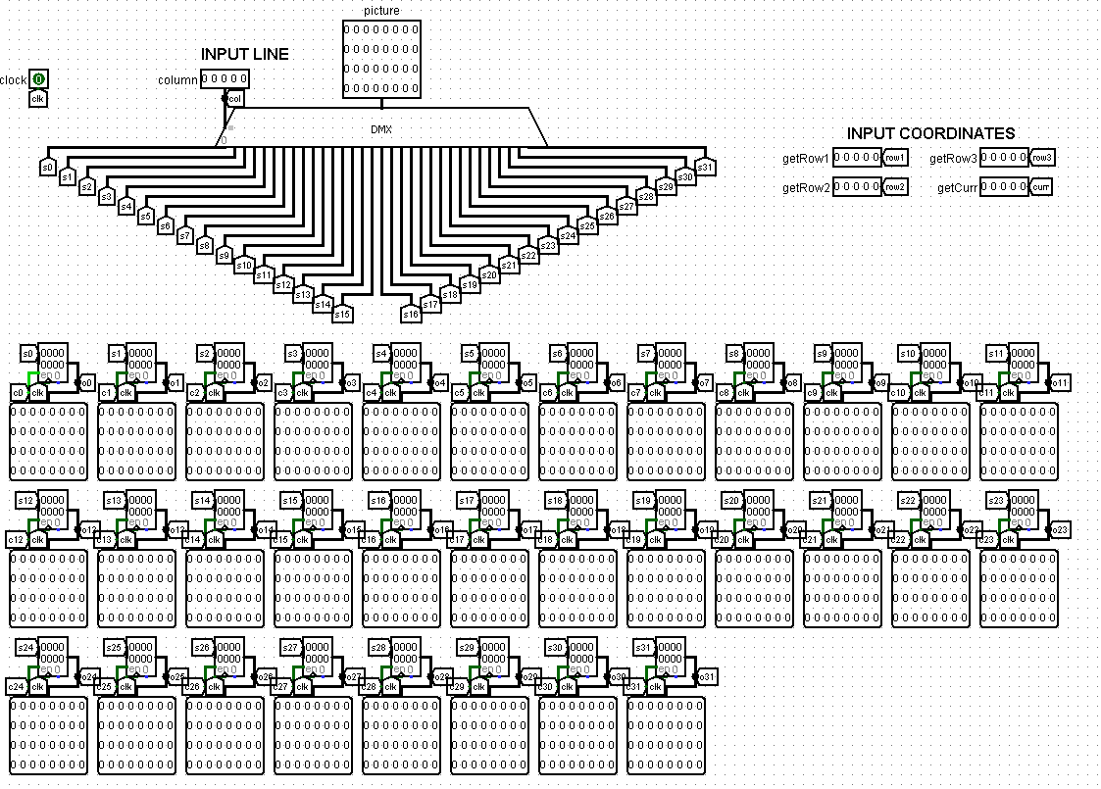
SCREEN CONTROL SCHEME
The columns are stored in registers
Using a demultiplexer, the value is transferred to the required register
The column is loaded in one clock

Slide 8
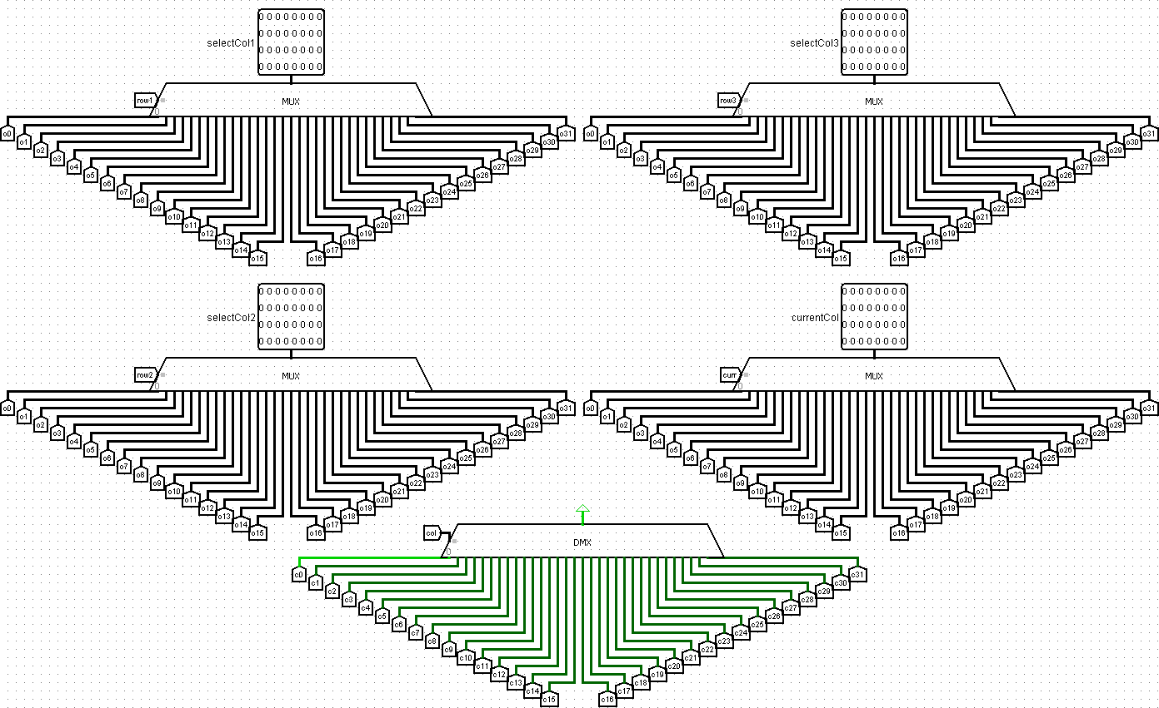
SCREEN RENDERING SCHEME
Multiplexers select the screen columns needed for other schemes
Demultiplexer selects a register to update

Slide 9
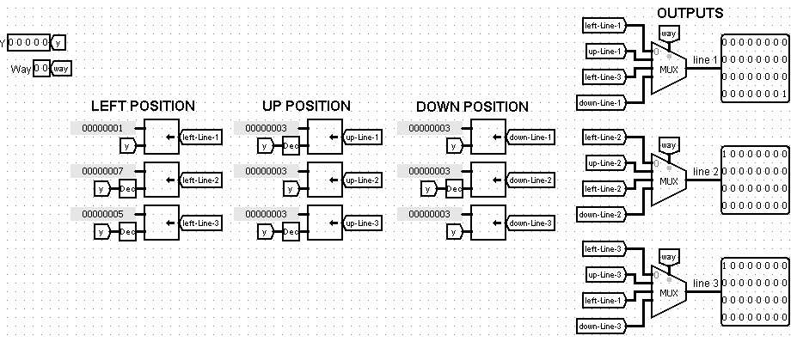
TANK RENDERING SCHEME
The scheme builds an image of tank
The image is created using bit shift

Slide 10
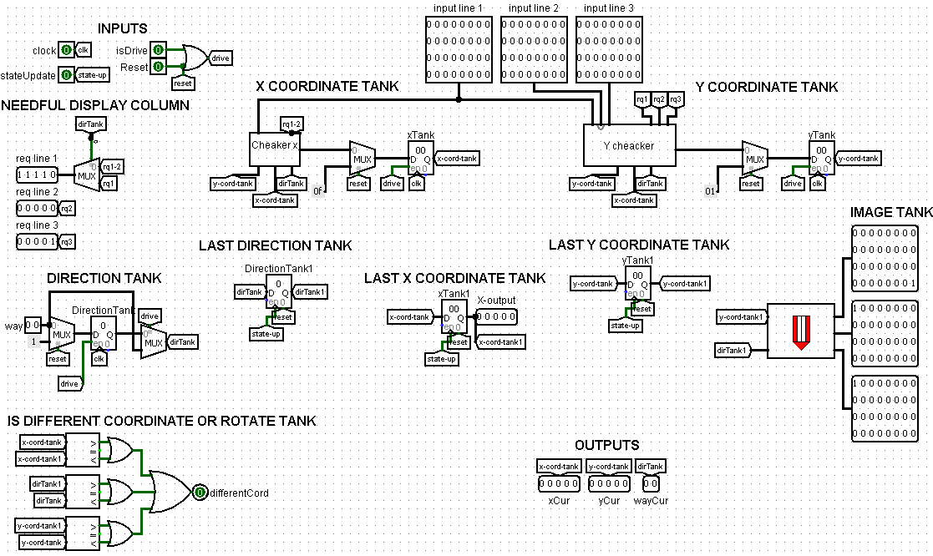
SCHEME OF PLAYER’S TANK
The circuit keeps information about the tank's position
uses additional schemes to check the way
implemented the ability to reset the status

Slide 11
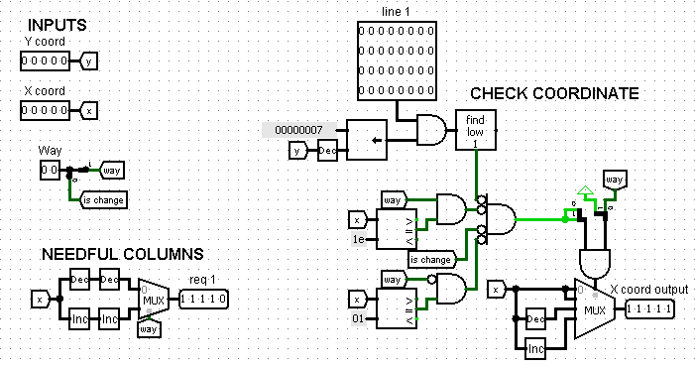
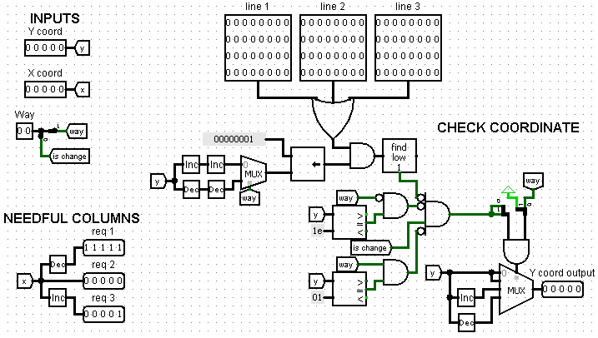
X AND Y COORDINATE CHECKING SCHEME
checking the X coordinate
checking the Y coordinate

Slide 12
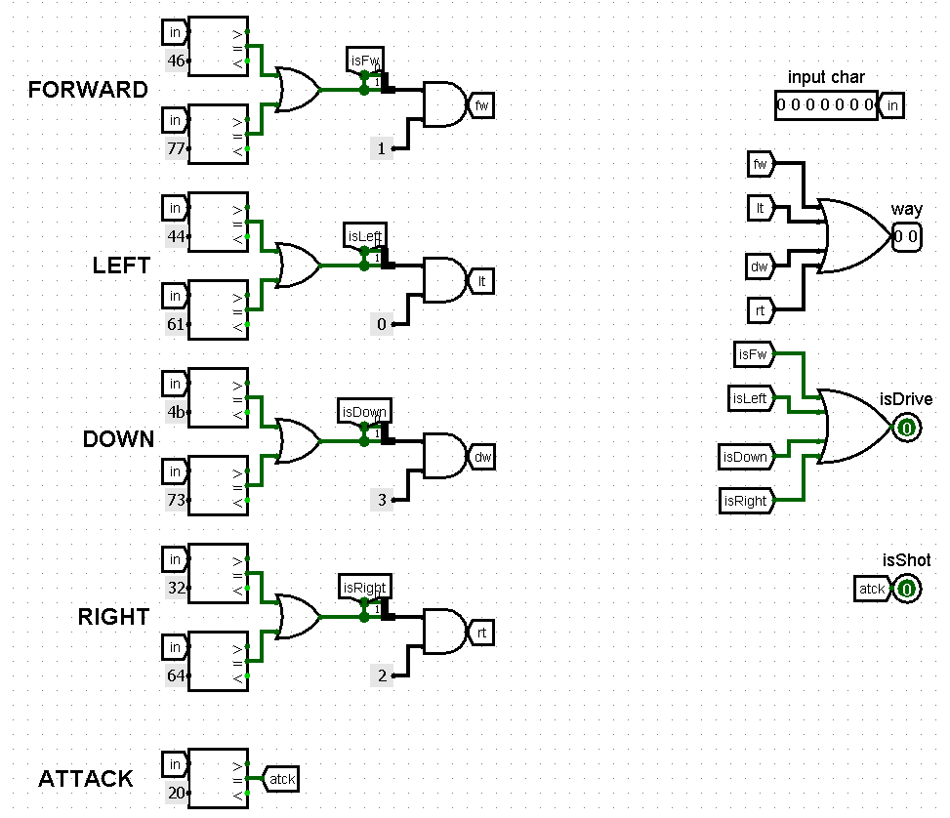
TANK CONTROL SCHEME
The scheme converts the ASCII character code into control signals.
The signals are passed to the player's tank scheme

Slide 13
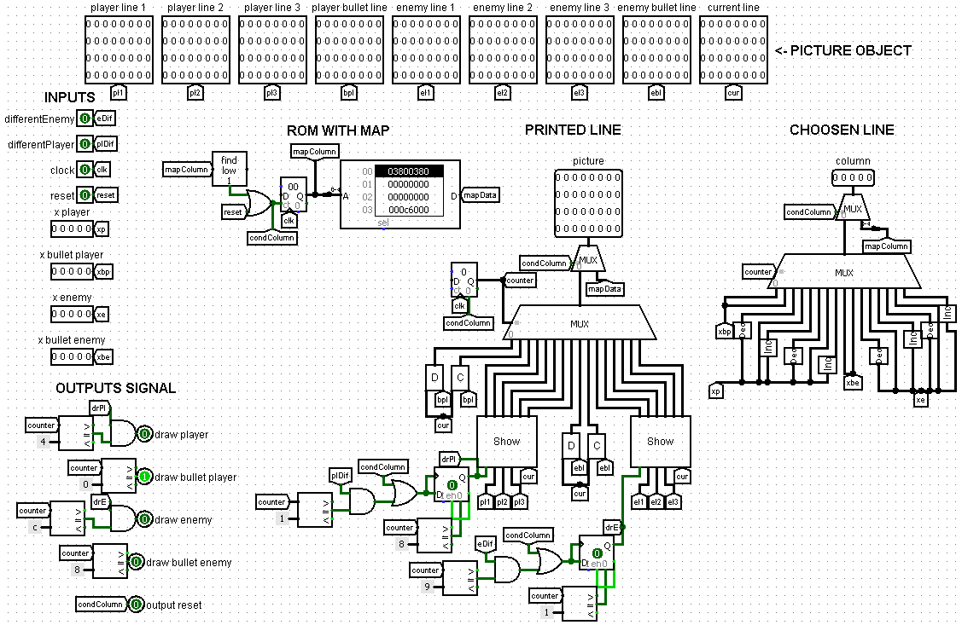
SCREEN RENDERING SCHEME
The scheme first erase the old image, then renders the new one

Slide 14
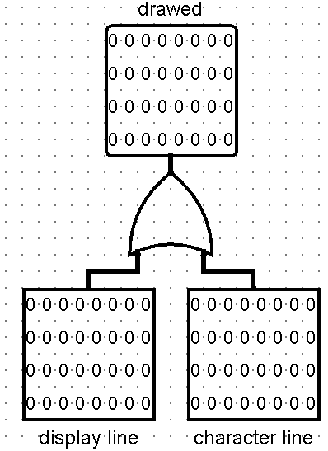
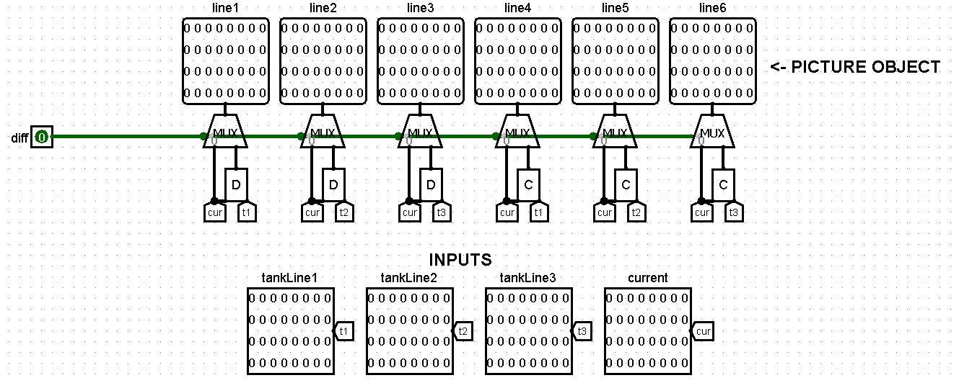
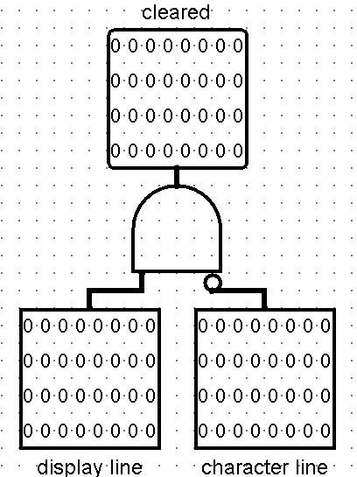
SCREEN RENDERING SCHEME
DRAW LINE
SHOW
CLEAR LINE

Slide 15
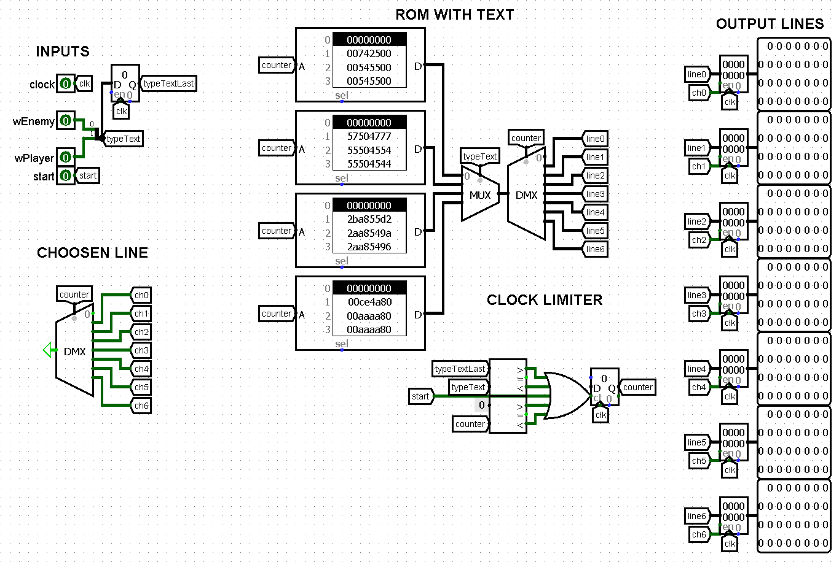
ADDITIONAL SCREEN CONTROL SCHEME
The scheme shows the current state of the game.
The text strings are stored in ROM.

Slide 16
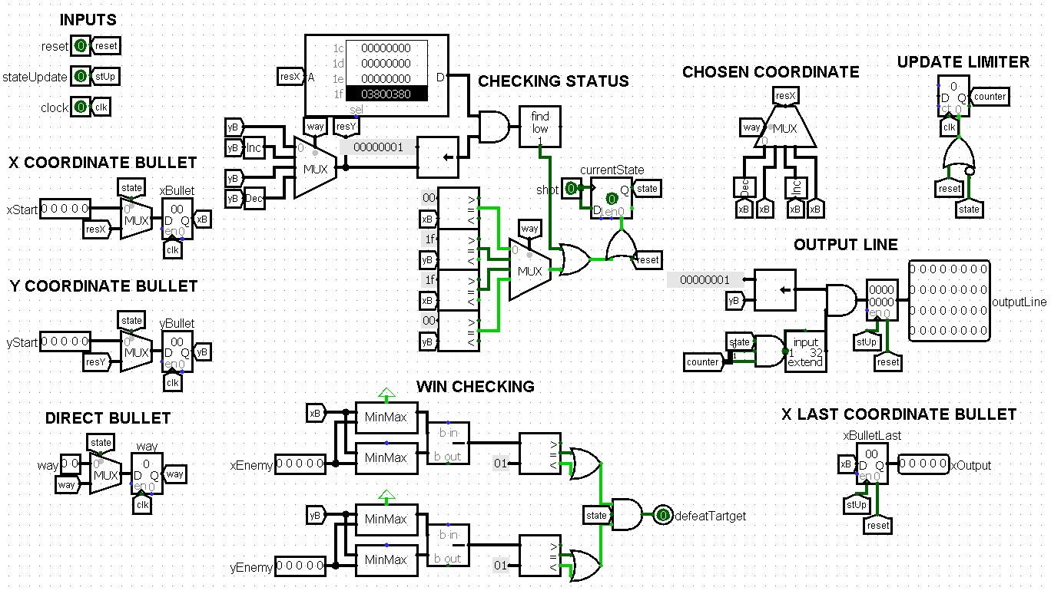
BULLET CONTROL SCHEME
The scheme stores information about the position of the bullet.
The bullet hitting the target is detected by comparing coordinates.
The bullet is active until it hits, goes beyond the map or the wall.

Slide 17
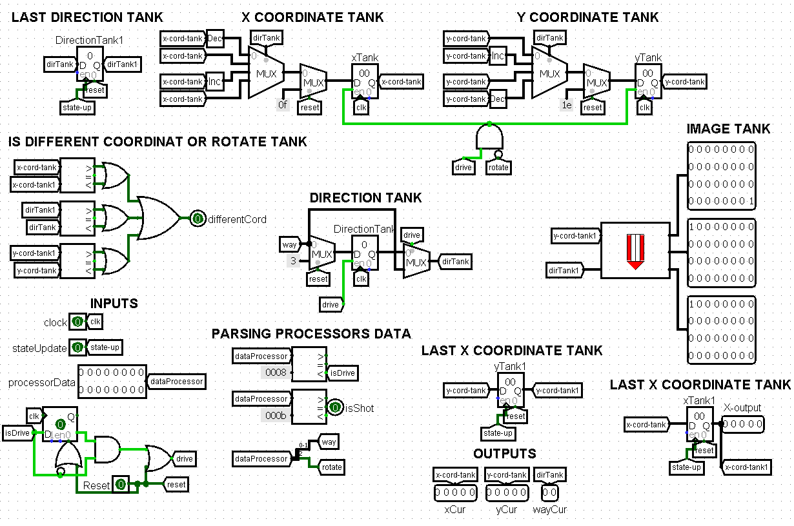
SCHEME OF ENEMY’S TANK
The circuit is controlled by commands from the CDM-16.
The circuit is based on the scheme of the player's tank.

Slide 18
WORKING WITH PROCESSOR
3

Slide 19
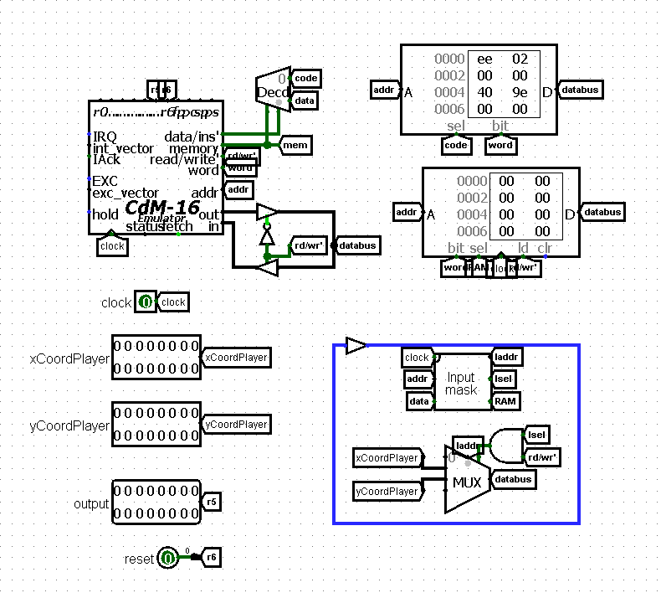
Processor scheme
Bot management on a CDM-16 Harvard processor with a precomputed Floyd–Warshell matrix
Shoot through prefix sums across rows and columns for instant obstacle check
The processor outputs motion, turn, shot, or inactivity codes through the CDM-16 register.

Slide 20
CONCLUSION
3

Slide 21
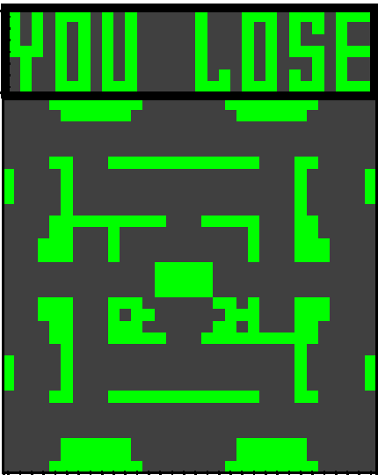
Conclusion
In the course of work on the project, a hardware model of a simplified version of the Battle City game was created on the basis of the CDM-16 processor and Logisim. The following has been implemented: rendering of the playing field taking into account frame synchronisation, control of the player's tanks and artificial intelligence, firing mechanics and collision handling. Despite the limited resources, the system demonstrates stable operation of all game mechanics without screen flickering and significant delays.

Slide 22
Thanks for your attention

