Slide 1
Entity Services
Data Centric
Product
SKU
Name
Description
Price
Cost
Quantity
ForSale
FreeShipping

Slide 2
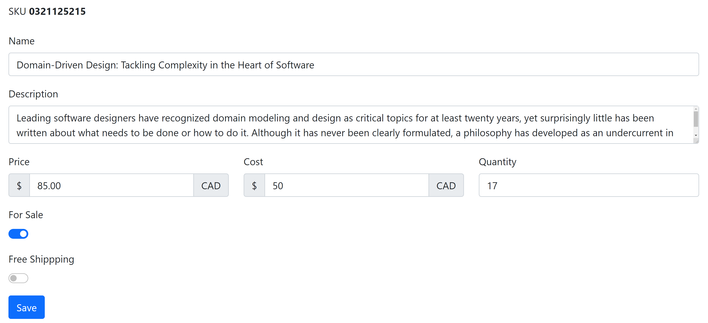

Slide 3
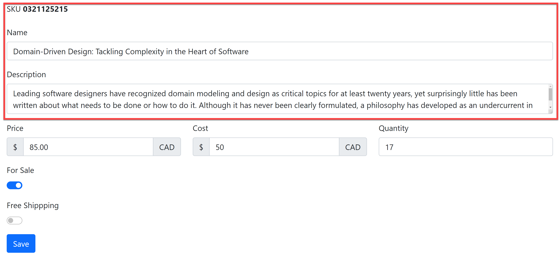

Slide 4
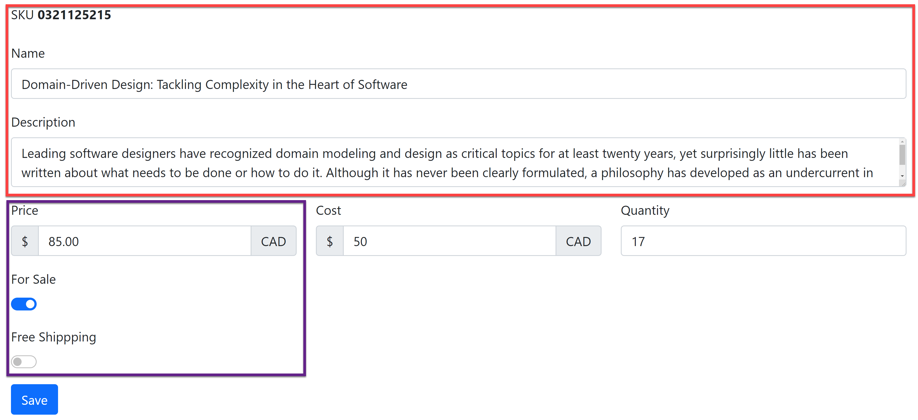

Slide 5
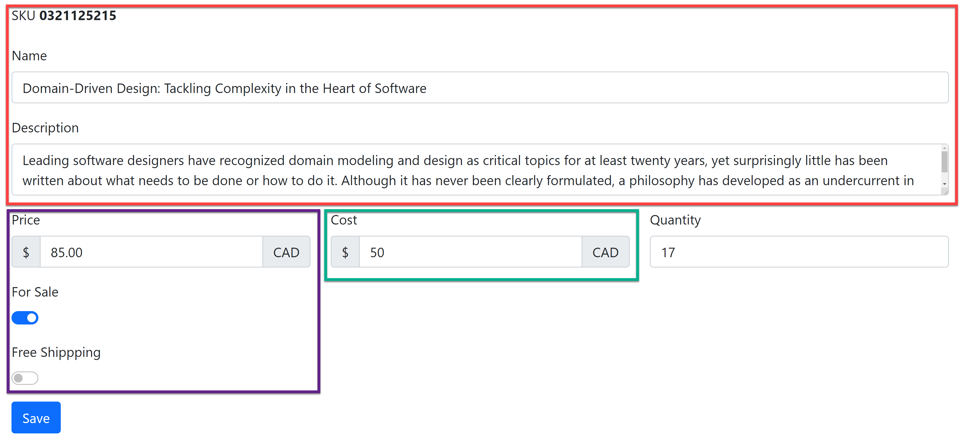

Slide 6
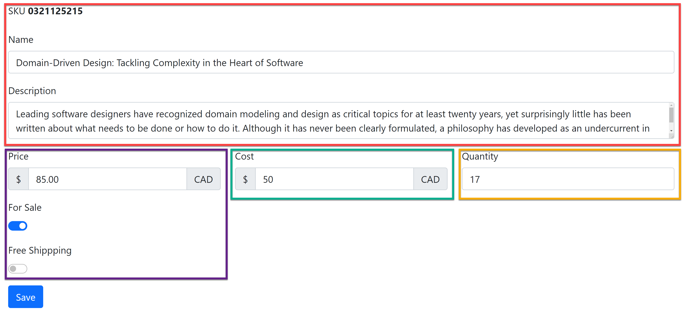

Slide 7
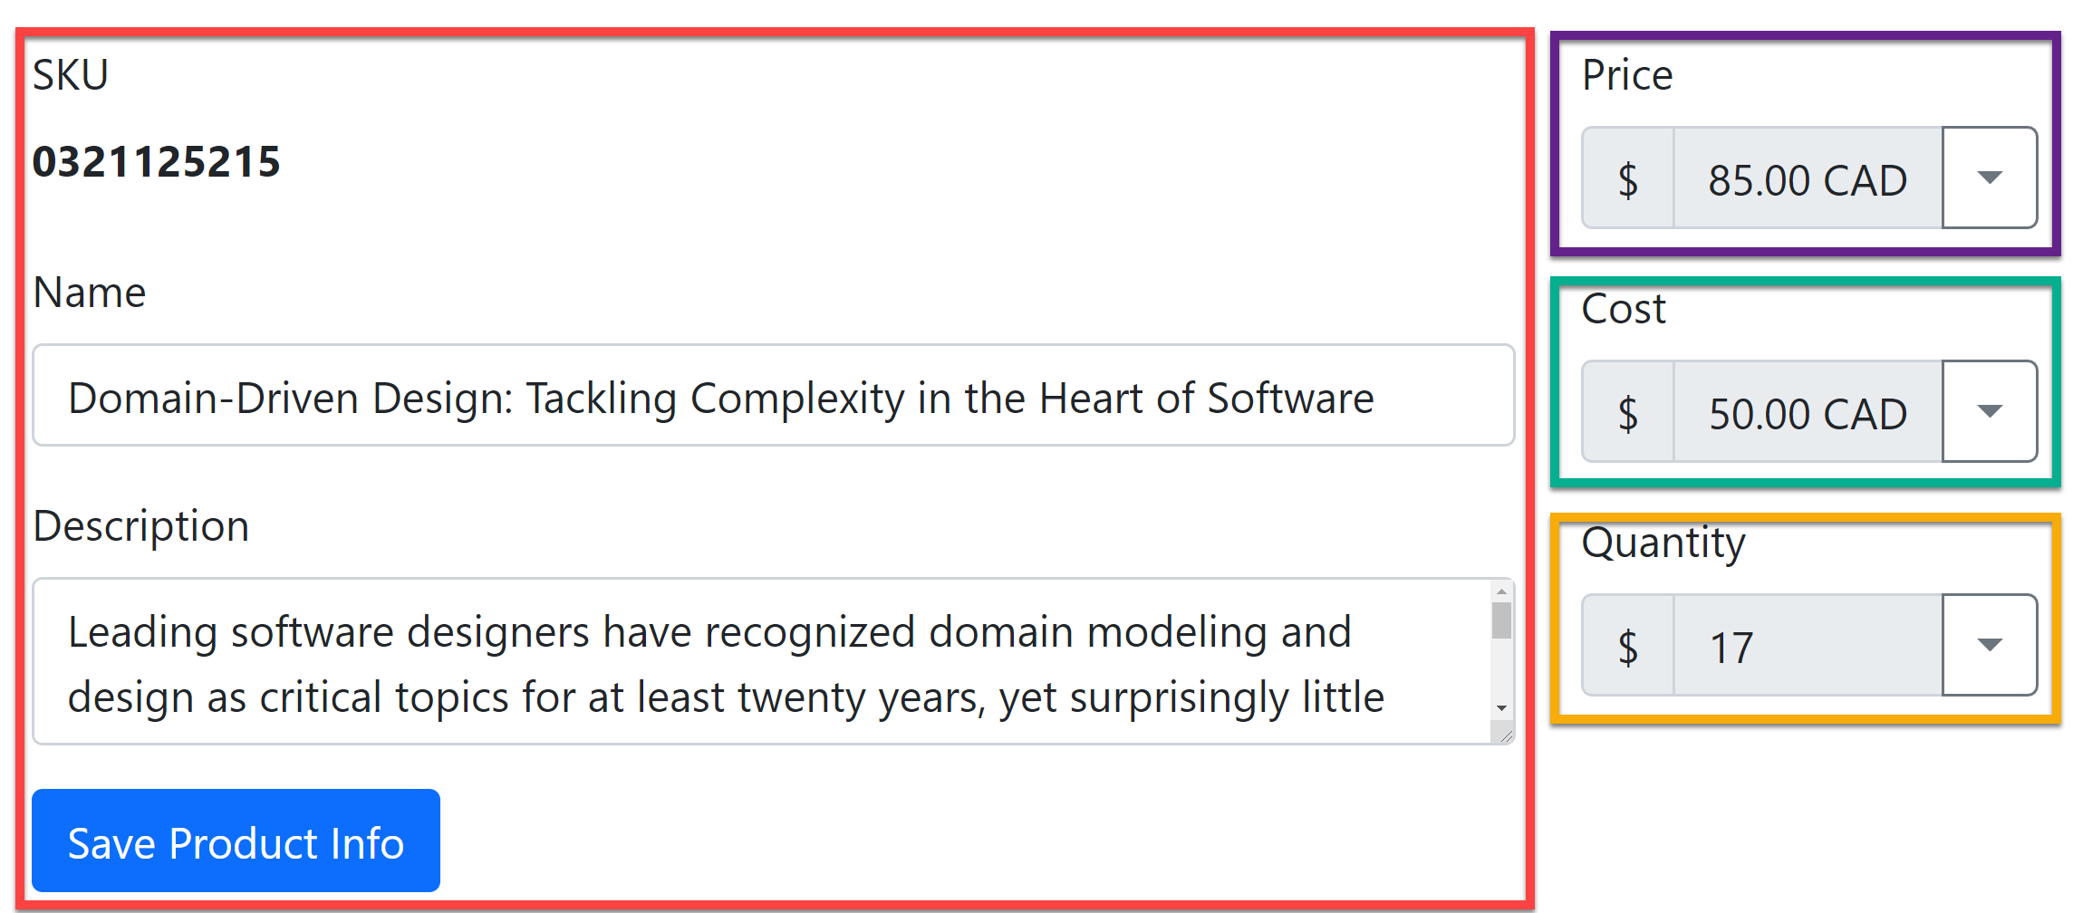
Sales
Purchasing
Warehouse
Catalog

Slide 8
Services
Capability Centric
Sales
SKU
Price
Purchasing
Catalog
SKU
Name
SKU
Cost
Warehouse
SKU
Quantity
Description
IncreasePrice()
ShipProduct()
ReceiveProduct()
UpdateProductInfo()
DecreasePrice()
Unavailable()
FreeShipping()
IncreaseCost()
DecreaseCost()
InventoryAdjustment()

