Slide 1
Salesflare Provider
Participants:
Avudai Selvi S

Slide 2
Salesflare
What is Salesflare
Salesflare is the smarter, modern-day CRM for small business. If you’re tired of manually entering customer data and spending time navigating a complex system, Salesflare will be the best suite. A simple yet powerful CRM for small businesses selling B2B.
Its very intuitive,automated and intelligent sales CRM. Its provides a very good insight dashboards inbuilt. Its provides integration with Zapier which enables complete automation.

Slide 3
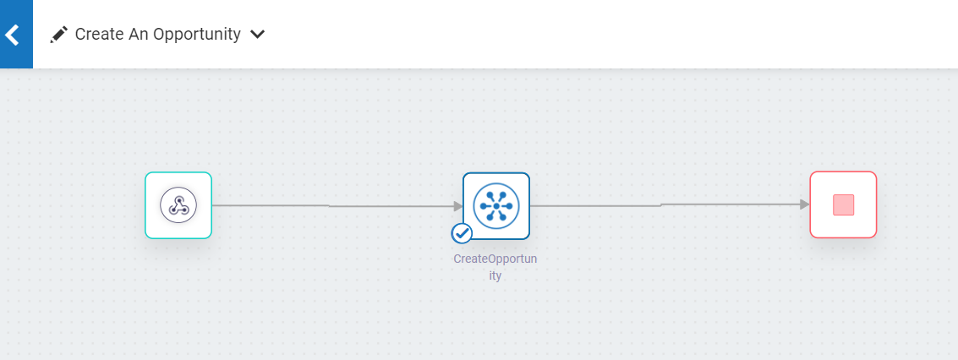
Screenshots for workflow

Slide 4
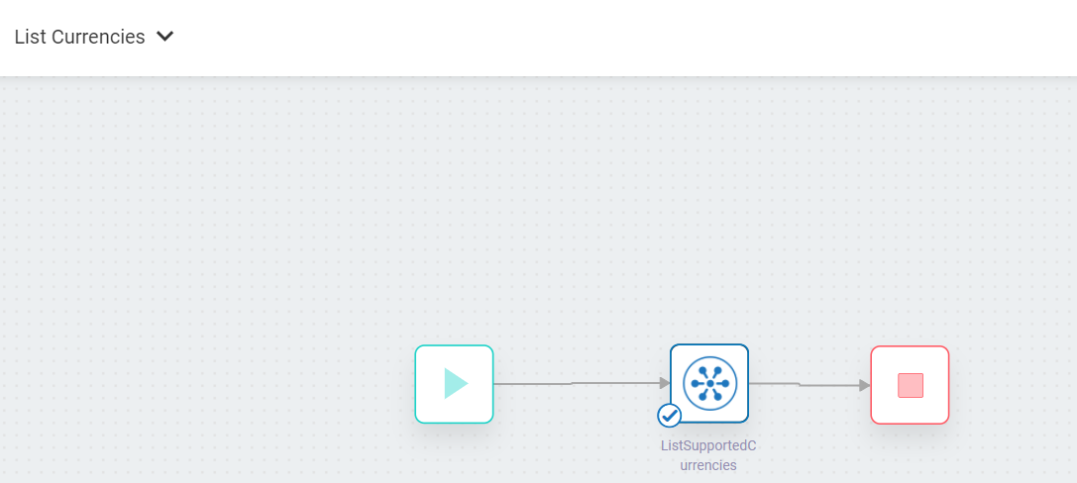
List Currencies

Slide 5
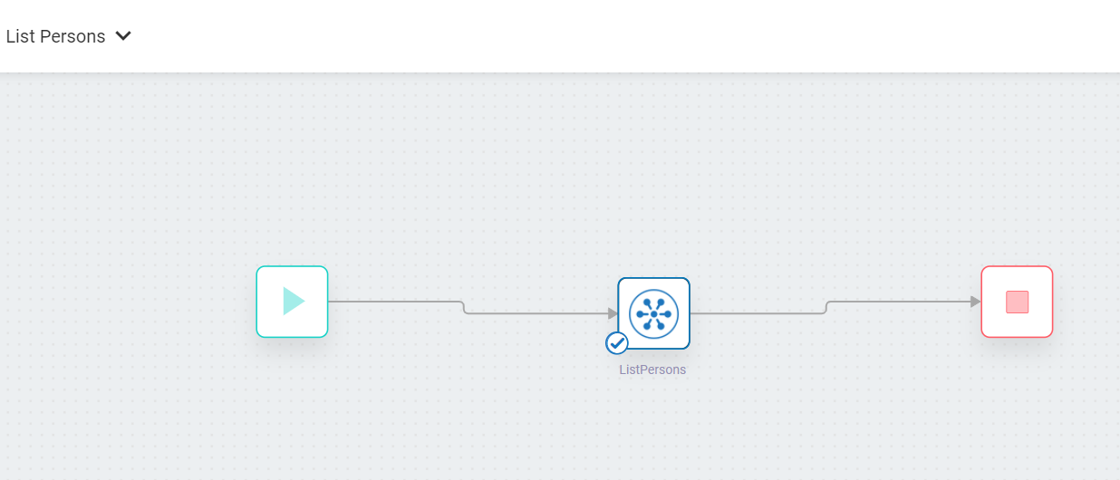
List Persons

Slide 6
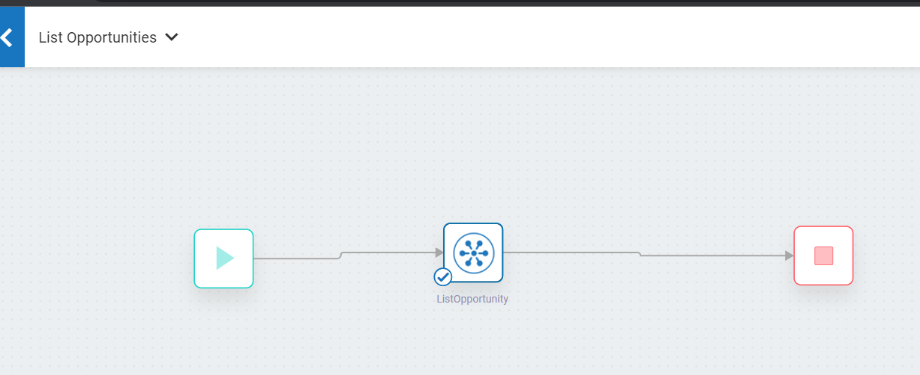
List Opportunities

Slide 7
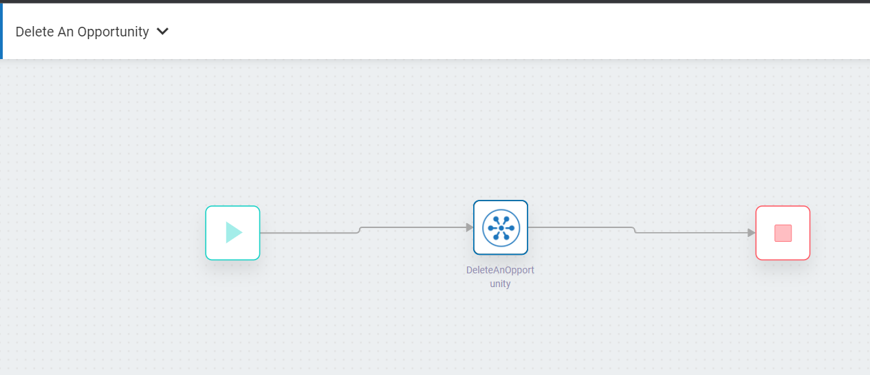
Delete Opportunity

Slide 8
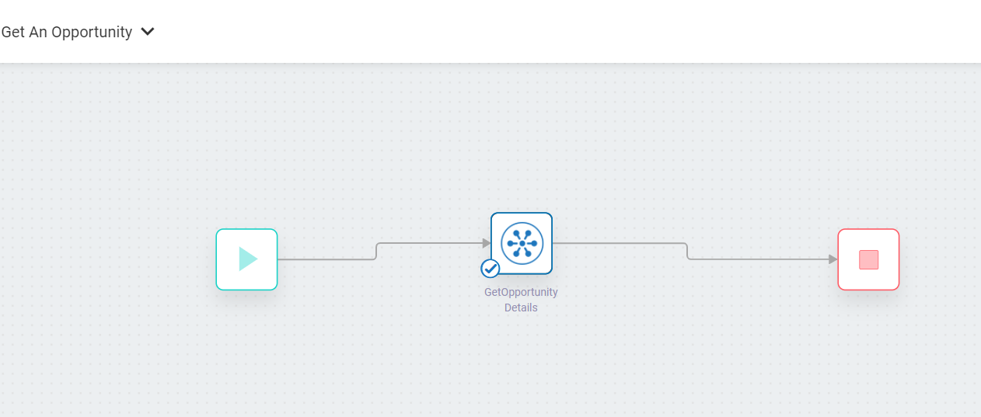
Get An Opportunity

Slide 9
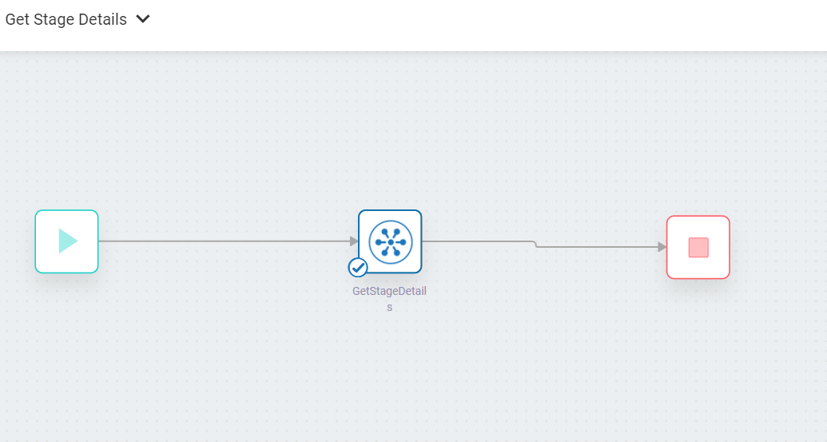
Get Stage Details

Slide 10
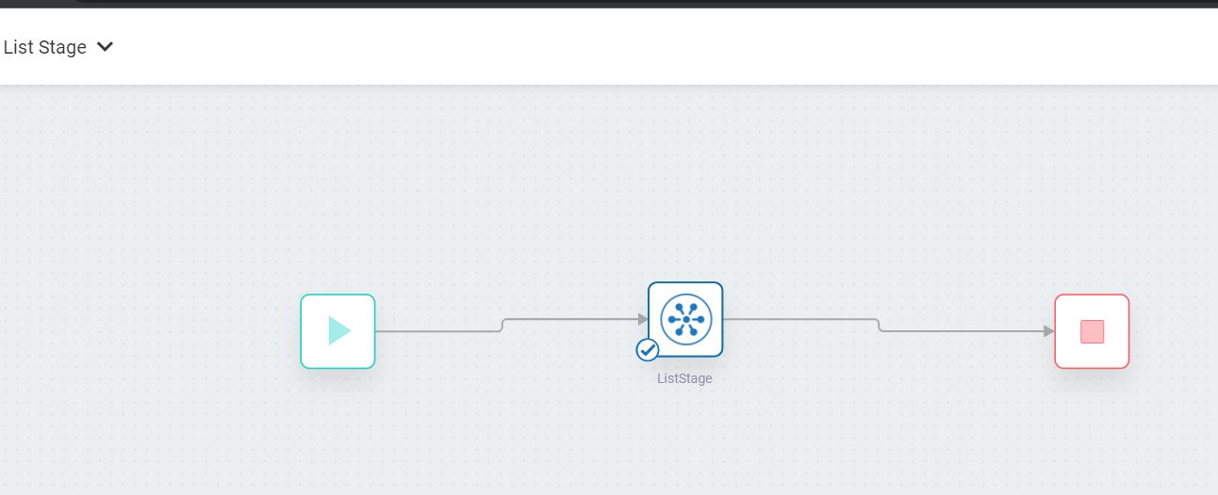
List Stage

