Slide 1

HOSPITAL EMERGENCY ROOM DASHBOARD
Built with Power BI and MySQL: patient flow, wait times, satisfaction and referrals
Data period: April 2023 – October 2024

Slide 2
Project Workflow
Dashboard first in Power BI, then validated with MySQL queries
Requirement Gathering
Data Walkthrough
Data Connection in Power BI
Data Cleaning & Modeling
1
2
3
4
DAX Measures
Dashboard Layout
Charts Development & Formatting
Import CSV into MySQL Workbench
5
6
7
8
SQL Queries for KPIs & Charts
Validate SQL vs Dashboard
Insights & Recommendations
9
10
11
HOSPITAL EMERGENCY ROOM DASHBOARD

Slide 3
Business Requirements: 4 KPIs
Each KPI is shown with a daily area sparkline to spot peaks, dips and trends
Number of Patients
Average Wait Time
Total patients visiting the ER each day. Identifies peak days and seasonal patterns.
Average wait before seeing a medical professional. Flags days needing operational changes.
Patient Satisfaction Score
Patients Referred
Daily average satisfaction. Reveals dips linked to peak times or operational issues.
Patients referred to departments from the ER. Shows where extra resources are needed.
HOSPITAL EMERGENCY ROOM DASHBOARD

Slide 4
Dashboard Pages
A Home page plus four report pages
1
2
3
4
Monthly View
Consolidated View
Patient Details
Key Takeaways
Month-by-month KPIs and trends to find patterns and areas for improvement.
The same metrics aggregated over a selectable date range for broader trend analysis.
Patient-level grid for granular analysis and troubleshooting.
Descriptive analysis of every metric, with patterns and recommendations.
HOSPITAL EMERGENCY ROOM DASHBOARD

Slide 5
Charts in the Monthly and Consolidated Views
Same charts in both; the Consolidated view uses a custom date range
Admission Status
Age Distribution
Department Referrals
Timeliness
Admitted vs. non-admitted
10-year age groups
Trends across departments
% of patients seen within 30 min
Gender Analysis
Racial Demographics
Time Analysis
Patients by gender
Patients by race
Volume by day and hour
HOSPITAL EMERGENCY ROOM DASHBOARD

Slide 6
Patient Details Page
A grid of nine fields for patient-level analysis
Patient ID
Patient Full Name
Gender
Age
Admission Date
Patient Race
Wait Time
Department Referral
Admission Status
HOSPITAL EMERGENCY ROOM DASHBOARD

Slide 7
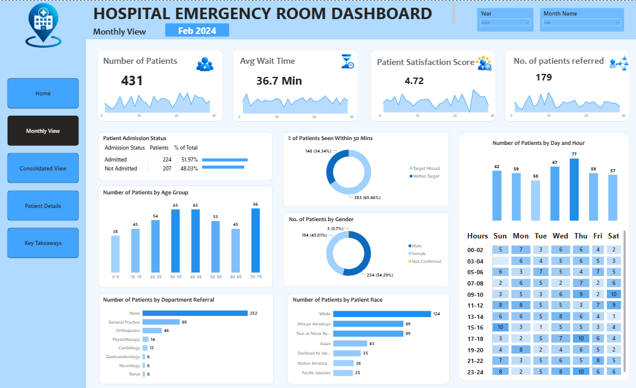
Dashboard: Monthly View
KPIs and charts for a selected month, with daily sparklines
HOSPITAL EMERGENCY ROOM DASHBOARD

Slide 8
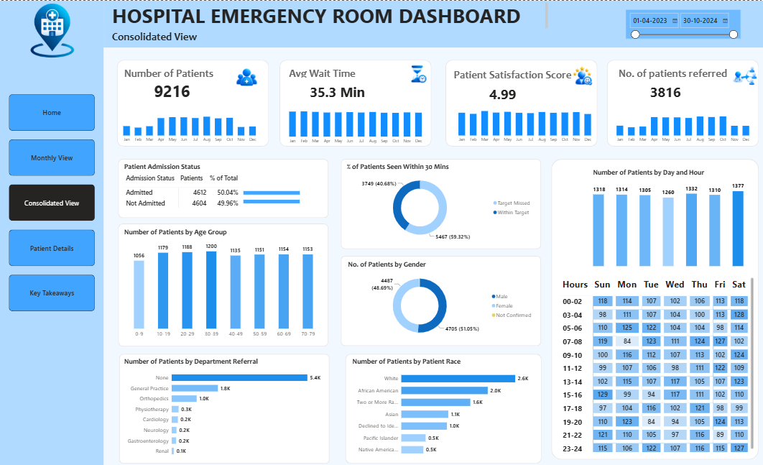
Dashboard: Consolidated View
The same metrics for the full period, 1 Apr 2023 to 30 Oct 2024
HOSPITAL EMERGENCY ROOM DASHBOARD

Slide 9
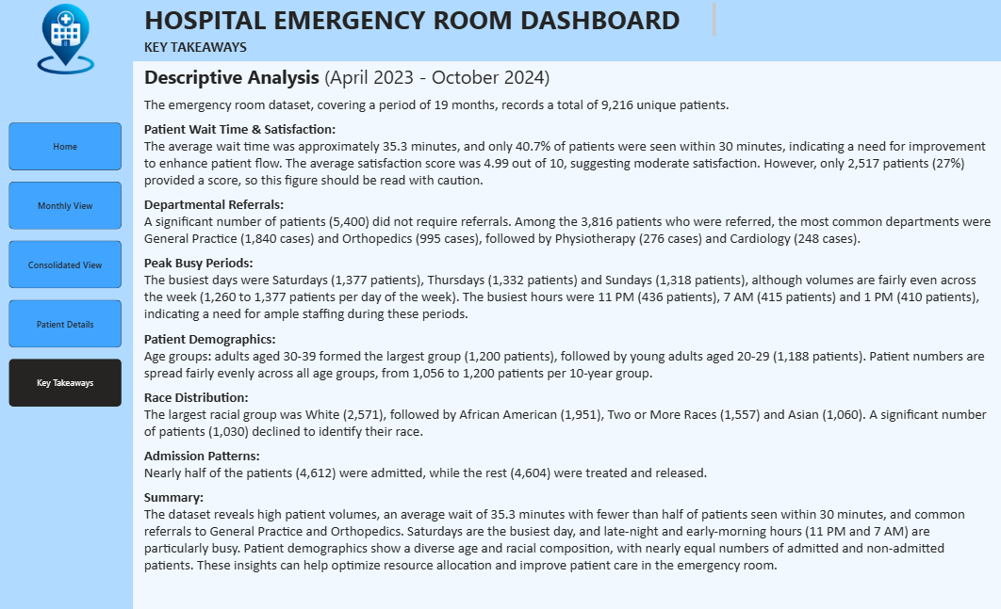
Dashboard: Key Takeaways
Written descriptive analysis of every metric and chart
HOSPITAL EMERGENCY ROOM DASHBOARD

Slide 10
Key Insights: The Numbers
April 2023 – October 2024 (19 months)
9,216
35.3 min
4.99 / 10
unique patients
average wait time
average satisfaction (2,517 responses)
4,612
40.68%
3,816
admitted (50%)
seen within 30 minutes (3,749 of 9,216)
referred to a department (5,400 had no referral)
Source: Consolidated View (1 Apr 2023 – 30 Oct 2024), confirmed by MySQL queries. Seen within 30 minutes = wait time of 30 minutes or less.
HOSPITAL EMERGENCY ROOM DASHBOARD

Slide 11
Referrals and Demographics
HOSPITAL EMERGENCY ROOM DASHBOARD

Slide 12
Peak Periods and Patient Age
Weekday volumes are close: 1,260 to 1,377 patients. Hourly volumes are on the next slide.
HOSPITAL EMERGENCY ROOM DASHBOARD

Slide 13
Patients by Hour of Day
11 PM, 7 AM and 1 PM are the busiest hours, but every hour sees 349 to 436 patients
HOSPITAL EMERGENCY ROOM DASHBOARD

Slide 14
Validation in MySQL
After the Power BI dashboard was built, the same CSV was imported into MySQL Workbench
1. Import the CSV
2. Quality checks
The 9,216-row CSV was loaded into a MySQL table and its columns and data types were cleaned.
9,216 unique patient IDs with no duplicates. Dates run 1 Apr 2023 to 30 Oct 2024. 6,699 satisfaction scores are missing.
3. Recreate with SQL
4. Compare and correct
Queries for the KPIs, monthly and daily trends, admission status, age groups, referrals, gender, race, day and hour, and wait intervals.
SQL results matched the dashboard KPIs. They also exposed wrong busiest days and hours in the first Key Takeaways text, which were fixed.
HOSPITAL EMERGENCY ROOM DASHBOARD

Slide 15
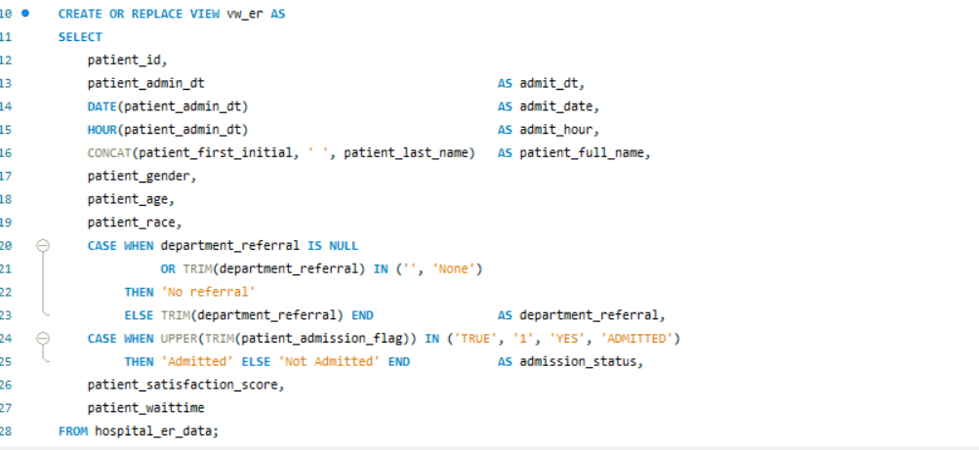
MySQL Query: Clean View (vw_er)
Cleans the data: referral NULLs, admission status, admit date and hour
Query
HOSPITAL EMERGENCY ROOM DASHBOARD

Slide 16
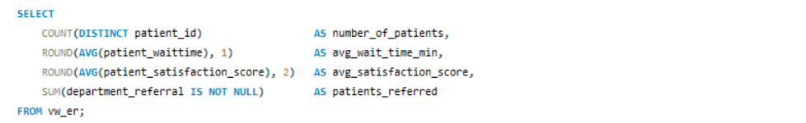

MySQL Query: Headline KPIs
Result: 9,216 patients, 35.3 min average wait, 4.99 satisfaction, 3,816 referred
Query
Output
HOSPITAL EMERGENCY ROOM DASHBOARD

Slide 17
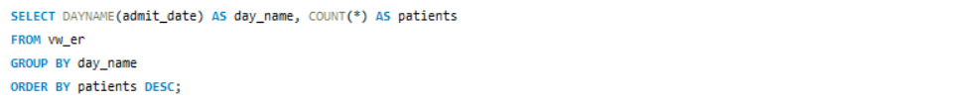
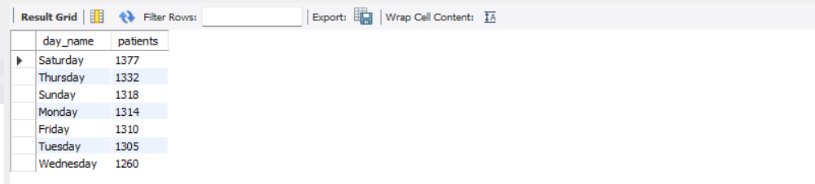
MySQL Query: Patients by Day of Week
Result: Saturday is busiest with 1,377 patients, then Thursday 1,332 and Sunday 1,318
Query
Output
HOSPITAL EMERGENCY ROOM DASHBOARD

Slide 18
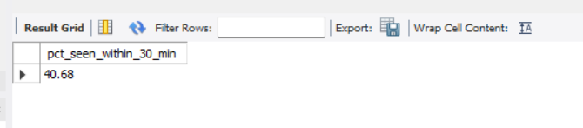
MySQL Query: % Seen Within 30 Minutes
Result: 40.7% of patients had a wait time of 30 minutes or less
Query
Output
HOSPITAL EMERGENCY ROOM DASHBOARD

Slide 19
SQL Results vs Power BI Dashboard
Every checked metric matched
Metric | Power BI | MySQL
Number of patients | 9,216 | 9,216
Average wait time | 35.3 min | 35.3 min
Average satisfaction | 4.99 | 4.99
Patients referred | 3,816 | 3,816
Admitted / not admitted | 4,612 / 4,604 | 4,612 / 4,604
Seen within 30 minutes | 40.68% | 40.68%
Busiest day | Saturday (1,377) | Saturday (1,377)
HOSPITAL EMERGENCY ROOM DASHBOARD

Slide 20
Recommendations
Actions the data supports
Staff for peak times
Saturdays are busiest, and 11 PM, 7 AM and 1 PM are the busiest hours. Differences are modest.
Reduce the 35-minute wait
Only 40.68% are seen within 30 minutes. Review triage and patient flow.
Collect more satisfaction scores
73% of patients (6,699) have no score, so the 4.99 average rests on 2,517 responses.
Resource top referral departments
General Practice and Orthopedics take most referrals and need capacity.
Improve race data capture
1,030 patients declined to identify their race; review how it is collected.
HOSPITAL EMERGENCY ROOM DASHBOARD

Slide 21
Tools and Skills
Power BI
DAX
Dashboard and report development
Measures for KPIs, wait-time status and referrals
MySQL
Data Modeling
Data import, quality checks and SQL validation of every KPI
Fact table plus a date table
HOSPITAL EMERGENCY ROOM DASHBOARD

Slide 22
Thank you

