Slide 1
Coffee-Machine-Interface-With-Voice Assistant
Submitted in the partial fulfillment for the award of the degree of
BACHELOR OF ENGINEERING
IN
ARTIFICIAL INTELLIGENCE AND MACHINE LEARNING
Submitted by:
AVUSALI MANOJ KUMAR
21BCS11858
Under the Supervision of:
PRIYANKA KOUSHIK MAM
Department of AIT-CSE
DISCOVER . LEARN . EMPOWER

Slide 2
Outline
Introduction to Project
Problem Formulation
Objectives of the work
Methodology used
Results and Outputs
Conclusion
Future Scope

Slide 3
Introduction to Project
Traditional coffee machines are limited by manual operations and lack customization. As smart appliances are reshaping daily life, a smart coffee machine brings enhanced convenience and personalized coffee experiences
The Smart Coffee Machine offers:
Personalized brewing experiences
Real-time insights into coffee consumption
Voice and remote-controlled functionalities
Integration with smart home ecosystems
Brew Smart. Live Smarter!!

Slide 4
Existing Systems Vs Proposed System
Existing Coffee Systems:
Limited customization
Manual and tedious operation
No tracking of user preferences
High energy consumption
Proposed Coffee System
Demand for automation and personalization of profiles
Integration into smart homes
Voice assistant and Guided preferences

Slide 5
Objectives of the Work
To design a smart coffee machine with customizable brewing profiles.
To enable automated and scheduled brewing.
To allow remote control and real-time monitoring through mobile and voice interfaces.
To provide a user-friendly interface that accommodates diverse users, including elderly and impaired users.

Slide 6
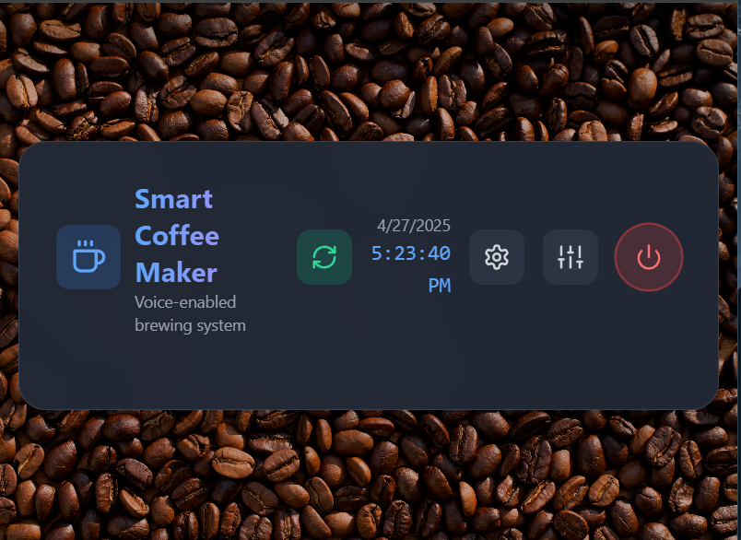
Methodology used
System Workflow:
Input from user profiles
Schedule management
Brewing process automation
Monitoring and feedback collection
Modules:
User Interface (Mobile App, Machine Screen)
Voice Assistant Integration
Machine Operations and Maintenance Module

Slide 7
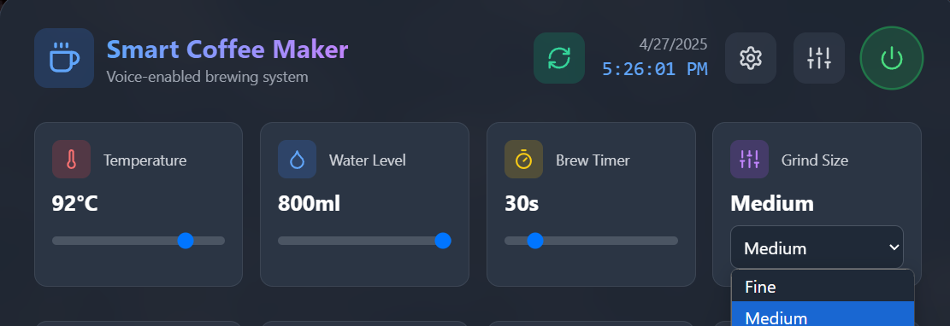

Results and Outputs
User Profiles:
Saved preferences grind size, strength,
whipped cream, cup size.
Real-Time Control:
Remote brewing
Status monitoring
Error alerts
Accessibility Features:
High contrast display
Voice-controlled commands
Large, easy-to-use buttons

Slide 8

Conclusion
The Smart Coffee Machine redefines convenience in brewing, offering automation, customization, and smarter energy use. The project successfully delivered a user-centric machine with real-time features and high accessibility. Challenges included ensuring universal accessibility and optimizing cloud integration.

Slide 9
Future Scope
Deeper AI Integration: Mood-based coffee recommendations.
Advanced Predictive Maintenance: Predict and fix issues before failures.
Greater IoT Ecosystem Integration: Connect with fitness trackers and calendars.
Expanded Beverage Options: Include tea, hot chocolate, and specialty drin

