Slide 1
FUNDAMENTAL IOT MECHANISM AND KEY TECHNOLOGIES, EVOLVING IOT STANDARDS, THIRD GENERATION PARTNERSHIP PROJECT SERVICE REQUIREMENTS FOR MACHINE
Module-2

Slide 2
Books Referred
Daniel Minoli, ”Building the Internet of Things with IPv6 and MIPv6:The Evolving World of M2M Communications”, Wiley, 2013.

Slide 3
FUNDAMENTAL IOT MECHANISM AND KEY TECHNOLOGIES

Slide 4
Some fundamental issues and technologies that have to be considered in the context of Internet of things (IoT) design and deployment.

Slide 5
Identification of IoT Object and Services
Identification codes can be classified as
(i) object IDs (OIDs)
(ii) communication IDs.
Examples
radio frequency identification (RFID)/electronic product code (EPC), content ID,1
telephone number, and uniform resource identifier (URI)/uniform resource locator (URL);
media access control (MAC) address, network layer/IP address, and session/protocol ID.

Slide 6
Identification of IoT Object and Services
All objects to have a permanent unique identifier, an OID.
All end-point network locations and/or intermediary-point network locations to have a durable, unique network address (NAdr) using IPv6
When objects that have enough intelligence to run a communications protocol stack (so that they can communicate), are placed on a network, these objects can be tagged with a NAdr.

Slide 7
Identification of IoT Object and Services
Every object then has a tuple (OID, NAdr) that is always unique, although the second entry (NAdr) of the tuple may change with time, location, or situation.
In a stationary, non-variable, or mostly static environment, assigns the OID to be identical to the NAdr where the object is expected to attach to the network; that is, the object tuple (NAdr, NAdr).
In case the object moved, the OID could then be refreshed to the address of the new location; that is, the object tuple (NAdr’, NAdr’).
In general trend toward object mobility, giving rise to a dynamic environment; hence, to retain maximal flexibility, it is best to separate, in principle, the OID from the NAdr

Slide 8
Identification of IoT Object and Services
Identification scheme is that it affords global uniqueness.
It is useful to have mechanisms for hierarchical grouping to deal with large populations.
The feature of IPv6 address provides such hierarchical grouping. For a number of applications, there is a need to map/bind IP addresses (communications IDs) with other relevant OIDs.
Modern layered communication architectures also require addressing and processing capabilities at several layers,
For example, at the Data Link Layer, at the Network Layer, at the Transport (Protocol ID), and at the session/application layer.
Some argue that different identification schemes are required for different applications.
For example, the information related to things such as books, medicine, and clothes may not require global identification because revocation lists are required

Slide 9
Identification of IoT Object and Services
An EPC (electronic product code) is a number assigned to an RFID tag representative of an actual EPC.
Each number is encoded with a header, identifying the particular EPC version used for coding the entire EPC number.
An EPC manager number is defined, allowing individual companies or organizations to be uniquely identified; an object class number is present, identifying objects used within this organization, such as product types EPC uses a numerical system for product identification, but its capabilities are much greater.
An EPC is actually a number that can be associated with specific product information, such as date of manufacture and origin and destination of shipment. This provides significant advantages for businesses and consumers.
The EPC is stored on an RFID tag, which transmits data when prompted by a signal emitted by a special reader.
Note that EPC and RFID are not interchangeable

Slide 10
Identification of IoT Object and Services
OID may be replaced by object naming
Domain name system (DNS) is a mechanism for Internet-based naming
In the IoT context, the advantages of identifying information by name, not by node address.
DNS is used to map the “human-friendly” host names of computers to their corresponding “machinefriendly” IP addresses. E.g. www.google.com
Object name service (ONS) will also be important in the IoT to map the “thing-friendly” names of object which may belong to heterogeneous name spaces (e.g., EPC, uCode, and any other self-defined code) on different networks (e.g., TCP/IP network) into their corresponding “machine-friendly” addresses or other related information of another TCP/IP network.
This naming system can used for set of systems as object name should disclose its identity.

Slide 11
Identification of IoT Object and Services
For some applications, especially where there is a need for simple end-user visibility of a small set of objects (i.e., where the objects are few and discretely identifiable a home’s thermostat, a home’s refrigerator, a home’s lighting system, a pet of the owner), the object may be identified through Web Services (WSs).
WSs provide standard infrastructure for data exchange between two different distributed applications.
Lightweight WS protocols for the representational state transfer (REST) interface may be useful in this context.
REST is a software architecture for distributed systems to implement WSs. REST is good compared to simple object access protocol (SOAP) and web services description language (WSDL) due to its relative simplicity.

Slide 12
Identification of IoT Object and Services
IoT objects and IoT applications (e.g., grid control, home control, traffic control, and medical monitoring), security and privacy in communications and services become absolutely critical.
Strong authentication, encryption while transmitting, and also encryptions for data at rest is ideal; however, the computational requirements for encryption can be significant.
At the central/authenticating site, rapid authentication support is desirable; otherwise objects would not be able to authenticate in large-population environments.

Slide 13
Identification of IoT Object and Services
Tracking the object using GPS is costly
But worst when tracking more than one object.
There is a need to maintain ubiquitous and seamless communication while tracking the location of objects.

Slide 14
Identification of IoT Object and Services
Capabilities for scalability are important in order to be able to support an IoT environment where there is a large population that is highly distributed.
Locator/identifier separation.
Basic idea behind the separation is that the Internet architecture combines two functions, routing locators (where one is attached to the network) and identifiers (where one is located), in one number space: the IP address.
Proponents of the separation architecture postulate that splitting these functions apart will yield several advantages, including improved scalability for the routing system.
The separation aims to decouple locators and identifiers, thus allowing for efficient aggregation of the routing locator space and providing persistent identifiers in the identifier space.
The protocol called locator/ID separation protocol (LISP)

Slide 15
Identification of IoT Object and Services
LISP aims for an incrementally deployable protocol.
The LISP WG (Working Group) frame that include
(i) an architecture description, (ii) deployment models,
(iii) a description of the impacts of LISP, (iv) LISP security threats and solutions,
(v) allocation of end-point identifier (EID) space, (vi) alternate mapping system designs
(vii) data models for management of LISP.

Slide 16
Structural Aspects of the IoT
Structural Issue related to
Environment Characteristics
Traffic Characteristics
Scalability
Interoperability
Security and Privacy
Open Architecture

Slide 17
Structural Aspects of the IoT Environment Characteristics
Most (but certainly not all) IoT/machine-to-machine (M2M) nodes have design constraints:
Low power (with the requirement that they will run potentially for years on batteries)
Low cost (total device cost in single-digit dollars or triple digit rupee)
Significantly more devices than in a LAN environment
Severely limited code and RAM space (e.g., generally desirable to fit the required code—MAC, IP, and anything else needed to execute the embedded application—in, for example, 32K of flash memory, using 8-bit microprocessors)
Unobtrusive but very different user interface for configuration (e.g., using gestures or interactions involving the physical world)
Requirement for simple wireless communication technology. In particular, the IEEE 802.15.4 standard is very promising for the lower (physical and link) layers

Slide 18
Structural Aspects of the IoT Traffic Characteristics
The characteristics of IoT/M2M communication is different from other types of networks or applications.
For example, cellular mobile networks are designed for human communication and communication is connection centric; it entails interactive communication like
between humans (voice, video), or data communication involving humans (web browsing, file downloads, and so on).
It follows that cellular mobile networks are optimized for traffic characteristics of human-based communication and applications.
But in IoT, M2M the expectation is that there are many devices, there will be long idle intervals, transmission entails small messages, there may be relaxed delay requirements, and device energy efficiency is paramount.

Slide 19
Structural Aspects of the IoT Traffic Characteristics

Slide 20
Structural Aspects of the IoT Scalability
The application and its a desire over time for the service decides the Scalability.
When contemplating expansion, one wants to be able to build on previously deployed technology (systems, protocols), without having to scrap the system and start from scratch.
The efficiency of a larger system should be better than the efficiency of a smaller system.
This is what is meant by scalability.
The goal is to make sure that capabilities such as addressing, communication, and service discovery, among others, are delivered efficiently in both small and large scale.

Slide 21
Structural Aspects of the IoT Interoperability
Applications, technology suppliers, and stakeholders, it is desirable to develop and/or re-use a core set of common standards.
To the degree possible, existing standards may prove advantageous to a rapid and cost-effective deployment of the technology.

Slide 22
Structural Aspects of the IoT Security and Privacy
IoT relates to electric power distribution, goods distribution, transport and traffic management, e-health, and other key applications, as noted earlier
It is critical to maintain system-wide confidentiality, identity integrity, and trustworthiness.

Slide 23
Structural Aspects of the IoT Open Architecture
The goal is to support a wide range of applications using a common infrastructure, preferably based on a service-oriented architecture (SOA) over an open service platform, and utilizing overly networks (these being logical networks defined on top of a physical infrastructure)

Slide 24
Key IoT Technologies
List of Technologies are:
Device Intelligence
Communication Capabilities
Mobility Support
Device Power
Sensor Technology
RFID Technology
Satellite Technology

Slide 25
Key IoT Technologies Device Intelligence
Device Intelligence
In order for the IoT to become a reality,
Objects should be able to intelligently sense and interact with the environment
Possibly store some passive or acquired data
Communicate with the world around them
Object-to-gateway device communication or even direct object-to-object communication is desirable

Slide 26
Key IoT Technologies Device Intelligence
These intelligent capabilities are necessary to support ubiquitous networking to provide seamlessly interconnection between humans and objects
Some have called this mode of communication Any Services, Any Time, Any Where, Any Devices, and Any Networks (also known as “5-Any”)

Slide 27
Key IoT Technologies Communication Capabilities
It is highly desirable for objects to support ubiquitous end-to-end communications
To achieve ubiquitous connectivity for human-to-object & object-to-object communications, networking capabilities will need to be implemented in the objects (“things”)
IP is considered to be key capability for IoT objects
Self-configuring capabilities, especially how an IoT device can establish its connectivity automatically without human intervention, are also of interest
IPv6 auto-configuration & multihoming features are useful, particularly scope-based IPv6 addressing features
Notes:
Ubiquitous computing (or "ubicomp") is a concept in software engineering and computer science where computing is made to appear anytime and everywhere.
Multihoming is the practice of connecting a host or a computer network to more than one network. This can be done in order to increase reliability or performance.

Slide 28
Key IoT Technologies Mobility Support
Another consideration related to tracking and mobility support of mobile object
Mobility-enabled architectures & protocols are required
Some objects move independently, while others will move as one of group
Therefore, according to the moving feature, different tracking methods are required.
It is important to provide ubiquitous and seamless communication among objects while tracking the location of objects.
Mobile IPv6 (MIPv6) offers several capabilities that can address this requirement.

Slide 29
Key IoT Technologies Device Power
Related to the powering of the “thing”
Especially for mobile devices or devices that do not have intrinsic power
M2M/IoT applications are always constrained by following factors:
Devices have ultra-low-power capabilities
Devices must be of low cost
Devices must have small physical size & light in weight

Slide 30
Key IoT Technologies Device Power
The following factors that must be considered in selecting the most suitable battery for a particular application :
Operating voltage level
Load current and profile
Duty cycle—continuous or intermittent
Service life
Physical requirement
Size
Shape
Weight
Environmental conditions
Temperature
Pressure
Humidity
Vibration
Shock
Safety and reliability
Shelf life
Maintenance and replacement
Environmental impact and recycling capability
Cost

Slide 31
Key IoT Technologies Sensor Technology
A sensor network is an infrastructure comprising sensing (measuring), computing, communication, data collection, monitoring, surveillance, and medical telemetry.
Sensor network technology, specifically, with embedded networked sensing, ships, aircrafts, and buildings can “self-detect” structural faults (e.g., fatigue-induced cracks).
Earthquake-oriented sensors in buildings can locate potential survivors and can help assess structural damage; tsunami-alerting sensors can certainly prove useful for nations with extensive coastlines.
Sensors also find extensive applicability in battlefield for reconnaissance and surveillance
Notes:
seashore, a line that forms the boundary between the land and the ocean or a lake.
Reconnaissance: military observation of a region to locate an enemy or ascertain strategic features.

Slide 32
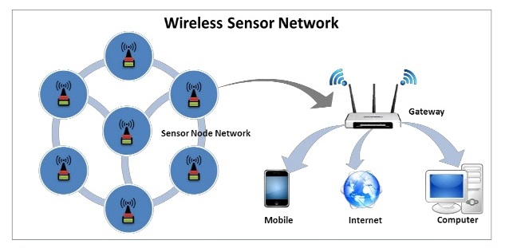
Key IoT Technologies Sensor Technology
Notes:
Gateway is a hardware device that acts as a "gate" between two networks. It may be a router, firewall, server, or other device that enables traffic to flow in and out of the network.

Slide 33
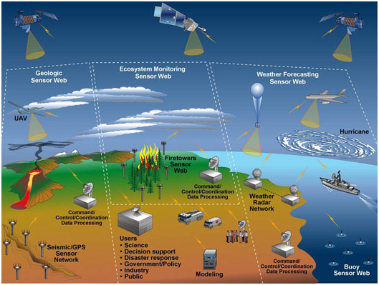
Key IoT Technologies Sensor Technology

Slide 34
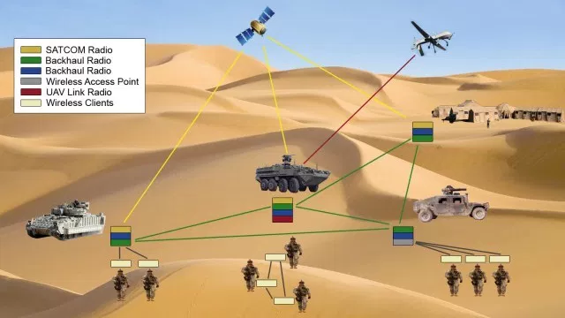
Key IoT Technologies Sensor Technology

Slide 35
Key IoT Technologies Sensor Technology
There are four basic components in a sensor network:
(i) an assembly of distributed or localized sensors
(ii) an interconnecting network (usually, but not always, wireless based)
(iii) a central point of information clustering
(iv) a set of computing resources at the central point (or beyond) to handle data correlation, event-trending, querying, and data mining.
Because the interconnecting network is generally wireless, these systems are known as wireless sensor networks (WSNs).
WSN have the potentially large quantity of data collected, algorithmic methods for data management play an important role in sensor networks.
In-network processing is desirable in sensor networks; furthermore, node power (and/or battery life) is a key design consideration.

Slide 36
Key IoT Technologies Sensor Technology
Sensors can be described as “smart” inexpensive devices equipped with multiple on-board sensing elements:
they are low cost, low power, untethered multifunctional nodes that are logically homed to a central sink node.
Sensor utilize the Internet or some other network for long-haul delivery of information to a point (or points) of final data aggregation and analysis.
Sensors are typically internetworked via a series of multihop short-distance low power wireless links called “sensor field”.
Sensors are typically deployed in a high density manner and in large quantities:
a WSN consists of densely distributed nodes that support sensing,
signal processing, embedded computing, and connectivity;
sensors are logically linked by self-organizing means (sensors that are deployed in short-hop point-to-point master-slave pair arrangements are also of interest).

Slide 37
Key IoT Technologies Sensor Technology
New wireless design methodologies are needed across a set of disciplines, information transport, network and operational management, confidentiality, integrity, availability, and in-network/local processing, low battery status, other wireless sensor malfunction and lightweight protocol stack.
Physical size can range from nanoscopic-scale devices to mesoscopic-scale devices at one end; from microscopic-scale devices to macroscopic-scale devices at the other end.
Nanoscopic (nanoscale) in the order of 1–100 nm in diameter;
Mesoscopic scale refers to objects between 100 and 10,000 nm in diameter
The microscopic scale ranges from 10 to 1000 microns
The macroscopic scale is at the millimeter-to-meter range.
Biological sensors, small passive microsensors (such as “smart dust”), and “lab-on-a-chip” assemblies
The miniaturized ones that are directly embedded in some physical infrastructure, as “microsensors.”

Slide 38
Key IoT Technologies Sensor Technology
Sensors may be passive and/or be self-powered; further along in the power consumption chain, some sensors may require relatively low power from a battery or high power.
Low power consumption for transmission over low bandwidth channels and low power-consumption logic to pre-process and/or compress data.
Power efficiency in WSNs is generally accomplished in three ways:
(i) Low duty cycle operation
(ii) Local/in-network processing to reduce data volume (and, hence, transmission time)
(iii) Multihop networking (this reduces the requirement for long-range transmission since signal path loss is an inverse power with range/distance) each node in the sensor network can act as a repeater, thereby reducing the link range coverage required, and, in turn, the transmission power

Slide 39
Key IoT Technologies RFID Technology
RFIDs are electronic devices associated with objects (“things”) that transmit their identity (usually a serial number) via radio links.
RFID tags are devices that typically have a read-only chip that stores a unique number but has no processing capability.
RFID and barcode facilitate the global supply chain and impact all subsystems within that overall process, including material requirement planning (MRP), just in time (JIT), electronic data interchange (EDI), and electronic commerce (EC).

Slide 40
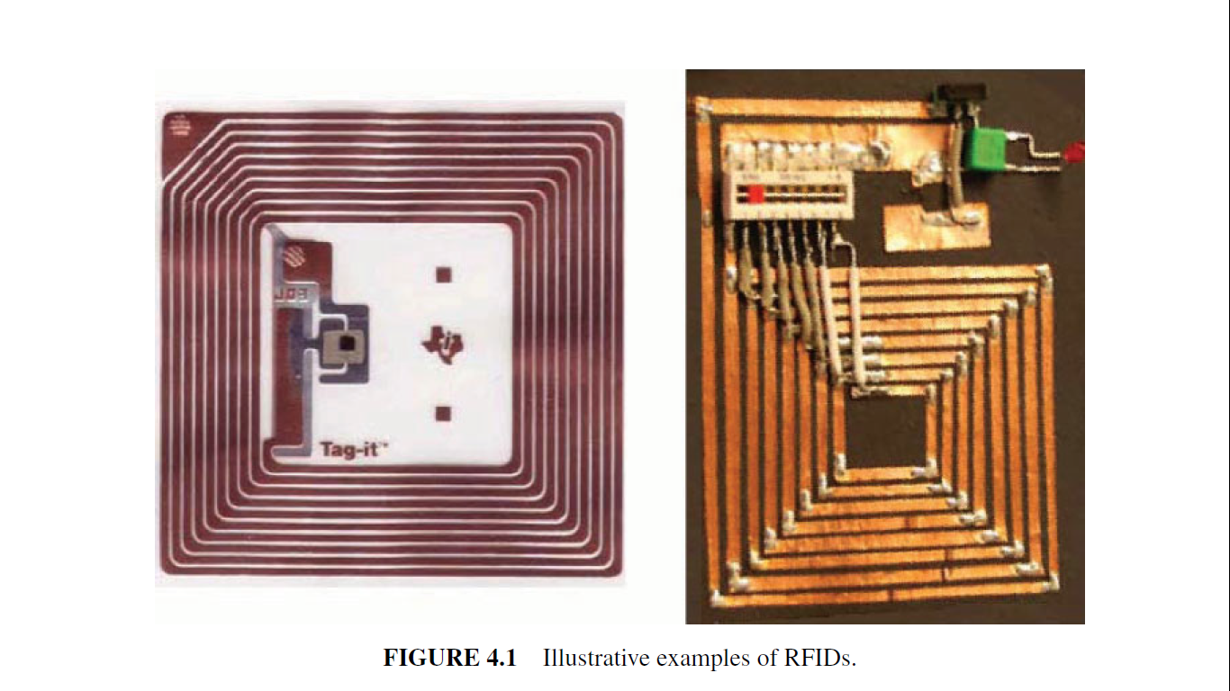
Key IoT Technologies RFID Technology
Notes:
A RFID system is made up of two parts: a tag or label and a reader. ... The RFID component on the tags have two parts: a microchip that stores and processes information, and an antenna to receive and transmit a signal. The tag contains the specific serial number for one specific object.

Slide 41
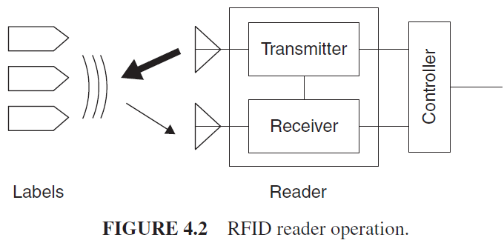
Key IoT Technologies RFID Technology
Notes:
A RFID system is made up of two parts: a tag or label and a reader. ... The RFID component on the tags have two parts: a microchip that stores and processes information, and an antenna to receive and transmit a signal. The tag contains the specific serial number for one specific object.

Slide 42
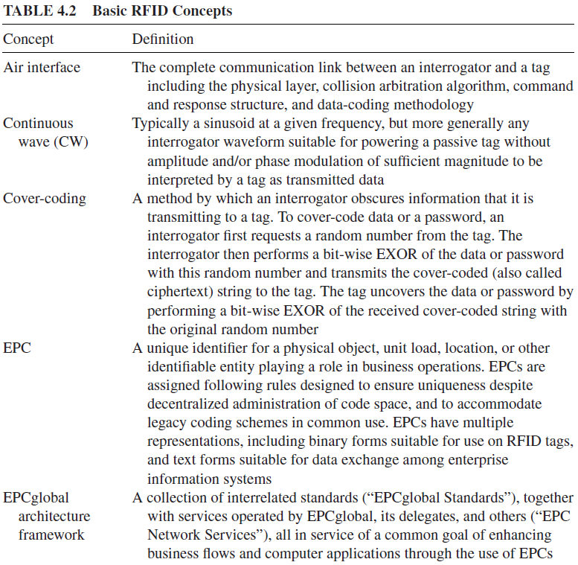
Key IoT Technologies RFID Technology- Basic Concept

Slide 43
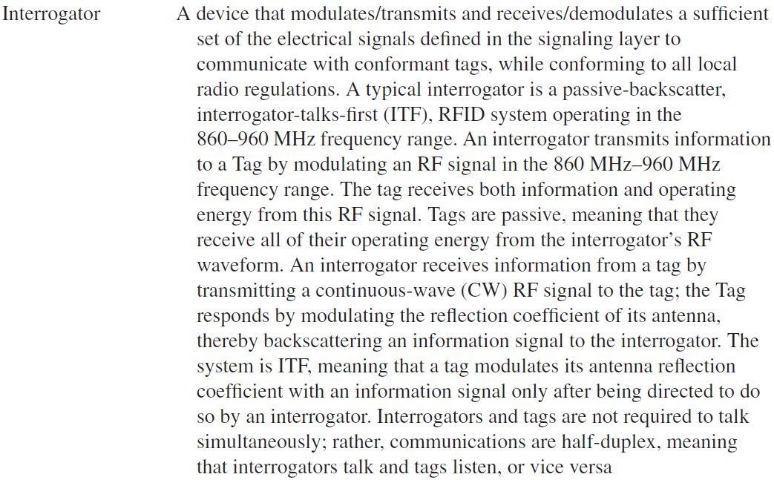
Key IoT Technologies RFID Technology - Basic Concept

Slide 44
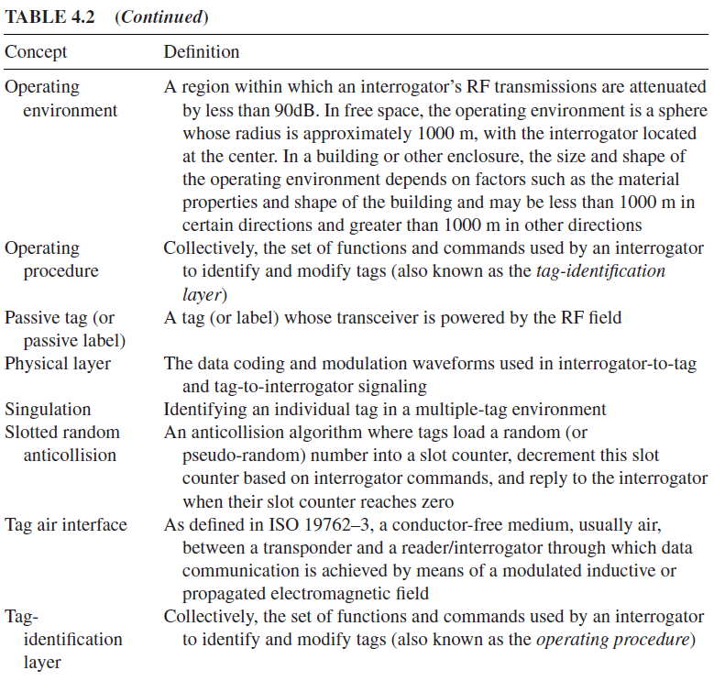
Key IoT Technologies RFID Technology - Basic Concept

Slide 45
Key IoT Technologies RFID Technology
Contactless smart cards (SCs) are more sophisticated than RFID tags
RFID tags are typically less expensive than SCs.
When an RFID tag or contactless SC passes within a defined range, a reader generates electromagnetic waves; the tag’s integrated antenna receives the signal and activates the chip in the tag/SC, and a wireless communications channel is set up between the reader and the tag enabling the transfer of pertinent data.

Slide 46
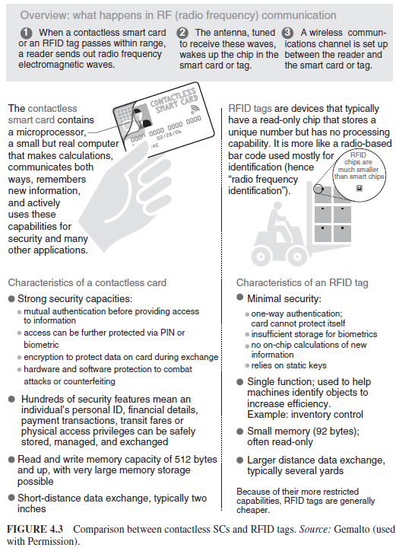
Key IoT Technologies RFID Technology

Slide 47
Key IoT Technologies RFID Technology
There are a number of standards for RFIDs. Some of the key ones include the following:
The ISO 14443
operating frequency of 13.56 MHz that embed a CPU; power consumption is about 10mW; data throughput is about 100 Kbps and the maximum working distance (from the reader) is around 10 cm.
The ISO 15693
operating at 13.56 MHz frequency, but it enables working distances as high as 1 m, with a data throughput of a few Kbps.
The ISO 18000
with frequency such as 135 KHz, 13.56 MHz, 2.45 GHz, 5.8 GHz, 860–960 MHz, and 433 MHz.
The ISO 18000–6 standard uses the 860–960MHz range and is the basis for the Class-1 Generation-2 UHF RFID, introduced by the EPCglobal Consortium.

Slide 48
Key IoT Technologies RFID Technology
Typically, EPC codes used for active RFIDs or IP addresses are transmitted in clear form
Provide strong privacy for the IoT.
The host identity protocol (HIP) with this protocol, active RFIDs do not expose their identity in clear text, but protect the identity value (e.g., an EPC) using cryptographic procedures.

Slide 49
Key IoT Technologies RFID Technology
An RFID system is logically comprising several layers, as follows:
the tag layer,
the air interface (also called media interface) layer,
the reader layer;
Tag (device) layer:
Architecture and EPCglobal Gen2 tag finite state machine
Media interface layer:
Frequency bands, antennas, read range, modulation, encoding, data rates
Reader layer:
Architecture, antenna configurations, Gen2 sessions, Gen2

Slide 50
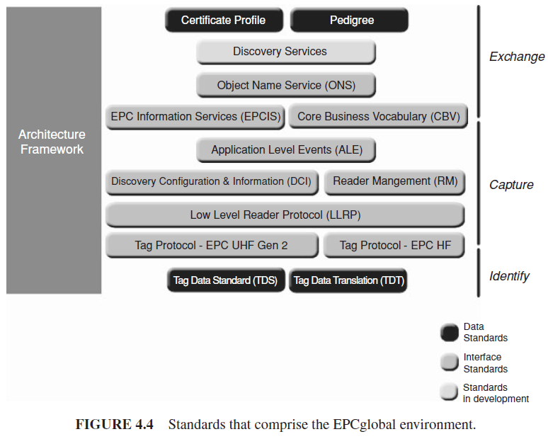
Key IoT Technologies RFID Technology- standards in the EPCglobal environment

Slide 51
Key IoT Technologies RFID Technology- standards in the EPCglobal environment
An interface is the UHF Class-1 Gen-2 tag air interface, which specifies a radio-frequency communications protocol by which an RFID tag and an RFID reader device may interact.
A component is an RFID tag that is the product of a specific tag manufacturer.
An EPC Network Service is the ONS, which provides a logically centralized registry through which an EPC may be associated with information services.

Slide 52
Key IoT Technologies Satellite Technology
Ability to support mobility in all geographical environments (including Antarctica)
Global reach
Offers interesting commercial possibilities

Slide 53
EVOLVING IOT STANDARDS

Slide 54
Covers supporting standards that come into play in the deployment of IoT and machine-to-machine (M2M) services.

Slide 55
Overview and Approaches
When there is insufficient standardization, capability mismatches between different devices easily arise.
While IoT systems can utilize existing Internet protocols, power, processing, and capabilities constrained IoT environment can benefit from additional protocols that help optimize the communications and lower the computational requirements.
Some challenges and modifications because of the larger capability variations than in the current Internet, and because of the fact that there is no human in most applications (M2M), although humans may be in human-to-machine (H2M) situations.

Slide 56
Overview and Approaches
Standards are particularly critical when there is a requirement to physically or logically connect entities across an interface.
Some areas requiring standardization which include:
Developing IP/routing/transport/web protocols subsets that scale down to IOT devices; specifically, lightweight routing protocols for the IoT;
Describing architectures that employ gateways and middleware;
Developing mobility management; Internetworking of IoT things
Lightweight implementations of cryptographic stacks; and building a suitable security infrastructure: end-to-end security capabilities for the IoT things
Developing standards for applications, specifically, data formats;
Discouraging on domain-specific solutions.

Slide 57
Overview and Approaches
Several global organizations are currently working on global M2M standards, layer-specific protocols, optimized architectures, and policy, includes following:
The Internet Engineering Task Force (IETF) IPv6 routing protocol for low power and lossy networks (RPL)/routing over low power and lossy networks (ROLL);
IETF constrained application protocol (CoAP);
IETF constrained RESTful environments (CoRE);
IETF IPv6 over low power WPAN (6LoWPAN);
3GPP MTC
ETSI M2M.
Recall thatM2Minvolves communication without (or only limited) human intervention where the human is not the input agent but possibly (but not always) the output agent.
For example, ETSI TS/TR 102 addresses M2M architecture and services (e.g., smart metering, e-health, auto, and city).

Slide 58
Overview and Approaches
A number of specific considerations need to be taken when designing protocols and architectures for interconnecting smart objects to the Internet which includes scalability, power efficiency, interworking between different technologies and network domains, usability and manageability, and security and privacy.
Other activities includes:
IEEE 802: addresses LANs, WLANs, and PANs (personal area networks), particularly the IEEE802.15.4 wireless standards such as IEC62591, 6LoWPAN, and ZigBee, ZigBee IP (ZIP), ZigBee SE 2.0—IEEE 802 now includes over 100 standards. Specifically, the ZigBee Alliance’s ZIP standard is a first definition of an open standards-based IPv6 stack for smart objects, the goal being to bring IPv6 network protocols over 802.15.4 wireless mesh networks to reality.
IEEE P2030/SCC21: addresses smart grid (SG) interoperability.
Emerging IEEE P1901.2 standard for Orthogonal Frequency Division Multiplexing (OFDM)-based communication over power lines and offers guaranteed interoperability. This standard is key to fostering SG deployments.
ETSI TS/TR 102: addresses M2M architecture, services, smart metering, e-health, auto, and city.
3GPP SA1-SA3: addresses services, architecture, and security.
JTC1 SC 6 and China NITSC: address sensor networks.
TIA: TR-50: addresses smart device communications.
CENELE: addresses device addressability.

Slide 59
Overview and Approaches
Three major strands of standardization include the following:
(i) ETSI: for end-to-end framework for M2M;
(ii) 3GPP: to enable operators to support services;
(iii) IEEE: to optimize the radio access/physical layer.

Slide 60
IETF IPV6 Routing Protocol for RPL Roll
IETF- Internet Engineering Task Force
RPL- Routing Protocol for LLNs
LLNs- Low power and Lossy Networks
ROLL- Routing Over Low power and Lossy networks

Slide 61
IETF IPV6 Routing Protocol for RPL Roll
Low power and lossy networks (LLNs)
A class of networks in which both the routers and their interconnect are constrained.
LLN routers typically operate with constraints on processing power, memory, and energy (battery power)
their interconnects are characterized by high loss rates, low data rates, and instability. LLNs comprise a few dozen routers up to thousands of routers.
Supported traffic flows include
point-to-point (between devices inside the LLN),
point-to-multipoint (from a central control point to a subset of devices inside the LLN)
multipoint-to-point (from devices inside the LLN toward a central control point).
The IPv6 Routing Protocol for LLNs (RPL) is proposed by the IETF to support multipoint-to-point traffic from devices inside the LLN toward a central control point, as well as point to-multipoint traffic from the central control point to the devices inside the LLN.

Slide 62
IETF IPV6 Routing Protocol for RPL Roll
LLNs consist largely of constrained nodes
with limited processing power, memory, and sometimes energy when they are battery operated or energy scavenging.
These routers are interconnected by lossy unstable links, resulting in relatively high packet loss rates and typically supporting only low data rates.
Another characteristic of such networks is that the traffic patterns are not simply point-to-point, but in many cases point-to-multipoint or multipoint-to-point. Furthermore, such networks may potentially comprise up to thousands of nodes.
To address these issues, the IETF ROLL Working Group has defined application-specific routing requirements for an LLN routing protocol; it has also specified the RPL.

Slide 63
IETF IPV6 Routing Protocol for RPL Roll
Existing routing protocols include
OSPF/IS-IS (open shortest path first/ intermediate system to intermediate system),
OLSRv2 (optimized link state routing protocol version 2),
TBRPF (topology-based reverse path forwarding),
RIP (routing information protocol),
AODV (ad hoc on-demand distance vector),
DYMO (dynamic MANET on-demand),
DSR (dynamic source routing).
Some of the metrics for IoT applications include the following:
Routing state memory space—limited memory resources of low power nodes;
Loss response—what happens in response to link failures;
Control cost—constraints on control traffic;
Link and node cost—link and node properties are considered when choosing routes.
The existing protocols all fail one or more of these goals for IoT applications.

Slide 64
IETF IPV6 Routing Protocol for RPL Roll
In order to be use of LLN application domains, RPL separates packet processing and forwarding from the routing optimization objective.
Examples of such objectives include minimizing energy, minimizing latency, or satisfying constraints.
Consistent with the layered architecture of IP, RPL does not rely on any particular features of a specific link layer technology.
RPL is able to operate over a variety of different link layers.

Slide 65
IETF IPV6 Routing Protocol for RPL Roll
RPL operations, require bidirectional links.
LLN scenarios, communication links may exhibit asymmetric properties.
the reachability of a router needs to be verified before the router can be used as a parent.
RPL expects an external mechanism to be triggered during the parent selection phase in order to verify link properties and neighbour reachability.
Neighbour unreachability detection (NUD) is a mechanism,
but alternates are possible, including bidirectional forwarding detection and hints from lower layers via layer 2 triggers.
In general, a detection mechanism that is reactive to traffic is favored in order to minimize the cost of monitoring links that are not being used.

Slide 66
IETF IPV6 Routing Protocol for RPL Roll
RPL also expects an external mechanism to access and transport some control information, referred to as the “RPL Packet Information,” in data packets.
The RPL packet information enables the association of a data packet with an RPL instance and the validation of RPL routing states.
Example : IPv6 Hop-by-Hop RPL
The mechanism is required for all packets except when strict source routing is used which, by nature, prevents endless loops and alleviates the need for the RPL packet information.

Slide 67
IETF IPV6 Routing Protocol for RPL Roll
RPL provides a mechanism to disseminate information over the dynamically formed network topology to operate autonomously.
In some applications, RPL assembles topologies of routers that own independent prefixes.
A prefix that is owned by a router is advertised as “on-link.”
RPL have the capability to bind a subnet together with a common prefix and to route within that subnet.
RPL in particular, disseminate IPv6 neighbour discovery (ND) information prefix information option (PIO) and the route information option (RIO).

Slide 68
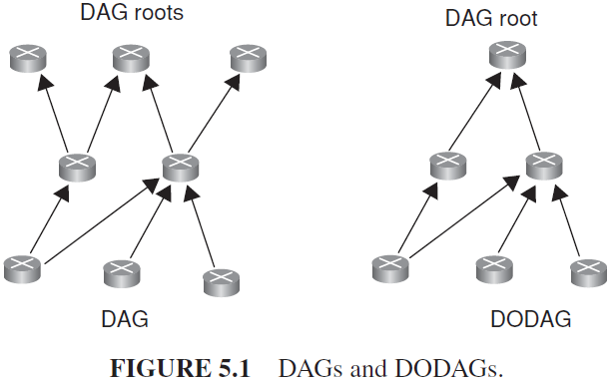
IETF IPV6 Routing Protocol for RPL Roll
Some basic definitions in RPL are as follows :
Directed acyclic graph (DAG) is a directed graph with no cycles.
Destination-oriented DAG (DODAG) is a DAG rooted at a single destination.
RPL defines optimization objective when forming paths toward roots based on one or more metrics.
Metrics may include both link properties (reliability, latency) and node properties (e.g., powered on not).

Slide 69
IETF IPV6 Routing Protocol for RPL Roll
RPL defines a new ICMPv6 (Internet control message protocol version 6) message with three possible types:
DAG information object (DIO)—carries information that allows a node to discover an RPL instance, learn its configuration parameters, and select DODAG parents;
DAG information solicitation (DIS)—solicit a DODAG information object from an RPL node;
Destination advertisement object (DAO)—used to propagate destination information upward along the DODAG.

Slide 70
IETF IPV6 Routing Protocol for RPL Roll
A node rank defines a node’s relative position within a DODAG with respect to the DODAG root.
DODAG construction proceeds as follows:
Nodes periodically send link-local multicast DIO messages;
Stability or detection of routing inconsistencies influence the rate of DIO messages;
Nodes listen for DIOs and use their information to join a new DODAG, or to maintain an existing DODAG;
Nodes may use a DIS message to solicit a DIO;
Based on information in the DIOs, the node chooses parents that minimize path cost to the DODAG root.
RPL is optimized for many-to-one and one-to-many traffic patterns

Slide 71
Constrained Application Protocol (CoAP)
Background
Messaging Model
Request/Response Model
Intermediaries and Caching

Slide 72
Constrained Application Protocol (CoAP) Background
CoAP is a simple application layer protocol targeted to simple electronic devices (e.g., IoT/M2M things) to allow them to communicate interactively over the Internet.
CoAP is designed for low power sensors (wireless sensor network [WSN] nodes and actuators.
CoAP can be seen as a specialized web transfer protocol for use with constrained networks and nodes for M2M applications.
CoAP operates with HTTP (hypertext transfer protocol) for basic support with the web

Slide 73
Constrained Application Protocol (CoAP) Background
CoAP protocol are as follows:
(i) minimal complexity for the mapping with HTTP;
(ii) low header overhead and low parsing complexity;
(iii) support for the discovery of resources;
(iv) simple resource subscription process;
(v) simple caching based on max-age.

Slide 74
Constrained Application Protocol (CoAP) Background
CoAP makes use of two message types, requests and responses, using a simple binary base header format.
Any bytes after the headers in the packet are considered the message body if any.
The length of the message body is implied by the datagram length.

Slide 75
Constrained Application Protocol (CoAP) Background
The constrained nodes for which CoAP is targeted often have 8-bit microcontrollers with small amounts of ROM and RAM, while networks such as 6LoWPAN (IPv6 OVER LOWPOWER WPAN)
CoAP provides a method/response interaction model between application end-points, supports built-in resource discovery, and includes key web concepts such as URIs (uniform resource identifiers) and content-types.
CoAP easily translates to HTTP for integration with the web.

Slide 76
Constrained Application Protocol (CoAP) Background
The use of Web Services (WS) on the Internet has become ubiquitous in most applications; it depends on the fundamental representational state transfer (REST) architecture of the web.

Slide 77
Constrained Application Protocol (CoAP) Background
CoAP has the following main features:
Constrained web protocol fulfilling M2M requirements;
UDP (User datagram protocol) binding with optional reliability supporting unicast and multicast requests;
Asynchronous message exchanges;
Low header overhead and parsing complexity;
URI and content-type support;
Simple proxy and caching capabilities;
A stateless HTTP mapping, allowing proxies to be built providing access to CoAP resources via HTTP in a uniform way or for HTTP simple interfaces to be realized alternatively over CoAP
Security binding to datagram transport layer security (DTLS).

Slide 78
Constrained Application Protocol (CoAP) Background
M2M interactions typically result in a CoAP implementation acting in both client and server roles (called an end-point).
A CoAP request is equivalent to that of HTTP and is sent by a client to request an action (using a method code) on a resource (identified by a URI) on a server.
The server then sends a response with a response code; this response may include a resource representation.
Unlike HTTP, CoAP deals with these interchanges asynchronously over a datagram-oriented transport such as UDP. This is done logically using a layer of messages that supports optional reliability (with exponential back-off).
CoAP defines four types of messages:
confirmable (CON), non-confirmable (NON), acknowledgement, reset;
Method codes and response codes included in some of these messages make them carry requests or responses.
The basic exchanges of the four types of messages are transparent to the request/response interactions.

Slide 79
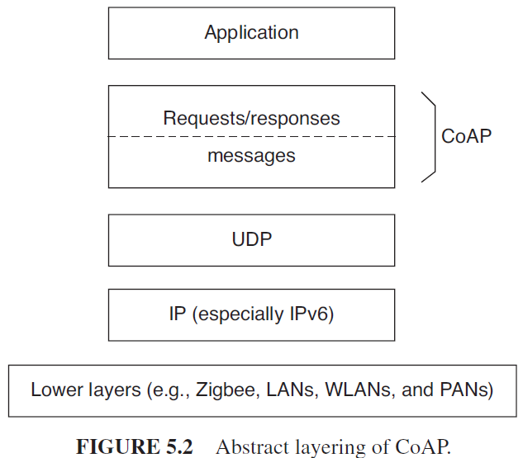
Constrained Application Protocol (CoAP) Background
CoAP logically as
using a two-layer approach,
a CoAP messaging layer used to deal with UDP (User Datagram Protocol)
the asynchronous nature of the interactions,
the request/response interactions using method and response codes

Slide 80
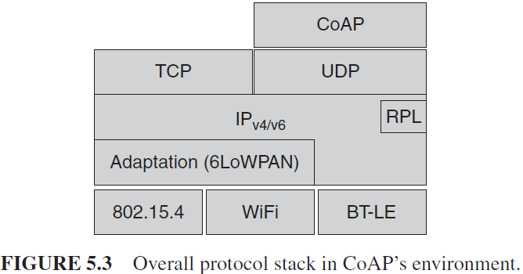
Constrained Application Protocol (CoAP) Background
CoAP is, however, a single protocol, with messaging and request/response just features of the CoAP header.
Figure depicts the overall protocol stack that is being considered in the CoAP context.

Slide 81
Constrained Application Protocol (CoAP) Messaging Model
The CoAP messaging model is based on the exchange of messages over UDP between end-points.
It uses a short fixed-length binary header (4 bytes) that may be followed by compact binary options and a payload.
This message format is shared by requests and responses.
Each CoAP message contains a message ID used to detect duplicates and for optional reliability.

Slide 82
Constrained Application Protocol (CoAP) Messaging Model
Reliability is provided by marking a message as CON.
A CON message is retransmitted using a default timeout and exponential back-off between retransmissions, until the recipient sends an acknowledgement message (ACK) with the same message ID from the corresponding end-point.
When a recipient is not able to process a CON message, it replies with a reset message (RST) instead of an ACK.
A message that does not require reliable delivery, for example, each single measurement out of a stream of sensor data, can be sent as a NONmessage.
These are not acknowledged, but still have a message ID for duplicate detection.
When a recipient is not able to process a NON message, it may reply with an RST.
Since CoAP is based on UDP, it also supports the use of multicast IP destination addresses, enabling multicast CoAP requests.

Slide 83
Constrained Application Protocol (CoAP) Request/Response Model
CoAP messages, which include either a method code or response code, respectively.
Optional (or default) request and response information, such as the URI (uniform resource identifier) and payload content-type, are carried as CoAP options.
A token option is used to match responses to requests independent of the underlying messages.

Slide 84
Constrained Application Protocol (CoAP) Request/Response Model
A request is carried in a CON (confirmable) or NON (non-confirmable) message, and if immediately available, the response to a request carried in a CON message is carried in the resulting ACK message. This is called a piggy-backed response.
If the server is not able to respond immediately to a request carried in a CON message, it simply responds with an empty ACK message so that the client can stop retransmitting the request.
When the response is ready, the server sends it in a new CON message (which then in turn needs to be acknowledged by the client). This is called a separate response.
Likewise, if a request is sent in a NON message, then the response is usually sent using a new NON message, although the server may send a CON message.
CoAP makes use of GET, PUT, POST, and DELETE methods in a similar manner to HTTP.

Slide 85
Constrained Application Protocol (CoAP) Intermediaries and Caching
The protocol supports the caching of responses in order to efficiently fulfill requests.
Simple caching is enabled using freshness and validity information carried with CoAP responses.
A cache could be located in an end-point or an intermediary.

Slide 86
Constrained Application Protocol (CoAP) Intermediaries and Caching
Proxying is useful in constrained networks for several reasons, including
(i) network traffic limiting,
(ii) to improve performance,
(iii) to access resources of sleeping devices,
(iv) for security reasons.
The proxying of requests on behalf of another CoAP end-point is supported in the protocol.
The URI of the resource to request is included in the request, while the destination IP address is set to the proxy.

Slide 87
REPRESENTATIONAL STATE TRANSFER (REST)
As noted, CoAP uses REST techniques. Its like distributed computing.
REST aims at supporting scalability of component interactions, generality of interfaces, and independent deployment of components.
It defines a set of architectural principles by which one can design WS that focus on a system’s resources, including how resource states are addressed and transferred over HTTP.
REST is an architectural style of large-scale networked software that takes advantage of the technologies and protocols of the World Wide Web; it describes how distributed data objects, or resources, can be defined and addressed, stressing the easy exchange of information and scalability.

Slide 88
REPRESENTATIONAL STATE TRANSFER (REST)
A REST-based WS follows four basic design principles:
Use HTTP methods explicitly.
Be stateless.
Expose directory structure-like URIs.
Transfer XML, JavaScript Object Notation (JSON), or both.

Slide 89
ETSI M2M
ETSI recently created a dedicated Technical Committee, to develop standard M2M communications.
The group seeks to provide an end-to-end view of M2M standardization and is expected to co-operate closely with ETSI’s ongoing activities on next-generation networks (NGNs), radio communications, fiber optics and powerline, as well as collaboration with 3GPP standards group on mobile communication technologies.
M2M model developed by this group, as defined in various evolving standards, including
the ETSI M2M Release 1 standards described in ETSI TS 102 689 (requirements),
ETSI TS 102 690 (functional architecture),
ETSI TS 102 921 (interface descriptions).

Slide 90
ETSI M2M
Key elements in the M2M environment include the following :
M2M device: A device capable of replying to request for data contained within those device or capable of transmitting data contained within those devices autonomously;
M2M area network (device domain): A network that provides connectivity between M2M devices and M2M gateways, for example, a PAN;
M2M gateway: A gateway (say a router or higher layer network element) that uses M2M capabilities to ensure M2M devices interworking and interconnection to the communication network;
M2M communication networks (network domain): A wider-range network that supports communications between the M2M gateway(s) and M2M application; examples include xDSL, LTE, WiMAX, and WLAN; and
M2M applications: Systems that contain the middleware layer where data goes through various application services and is used by the specific business processing engines.

Slide 91
Third Generation Partnership Project Service Requirements for Machine Type Communications (MTC)
Approach
Architectural Reference Model for MTC

Slide 92
Third Generation Partnership Project Service Requirements for Machine Type Communications (MTC) Approach
Current mobile networks are optimized for human-to-human (H2H) traffic and not for M2M/MTC interactions; hence, optimizations for MTC are advantageous.
For example, one needs lower costs to reflect lower MTC ARPUs (average revenue per user); also, there is a need to support triggering.
Hence, 3GPP has started work on M2Mspecification in 2010 for interoperable solutions, particularly in the 3G/4G/LTE context.

Slide 93
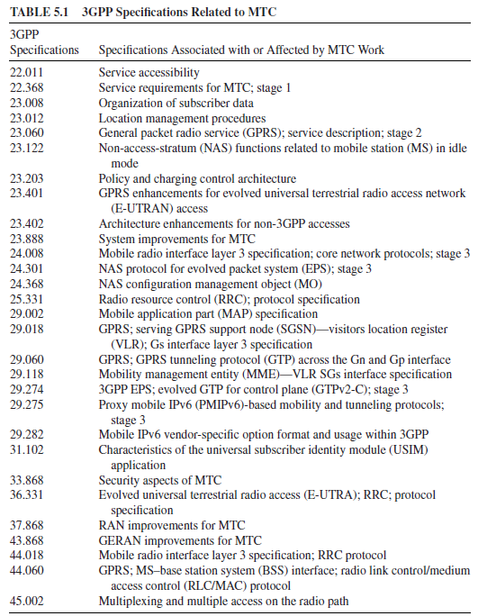
Third Generation Partnership Project Service Requirements for Machine Type Communications (MTC) Approach

Slide 94
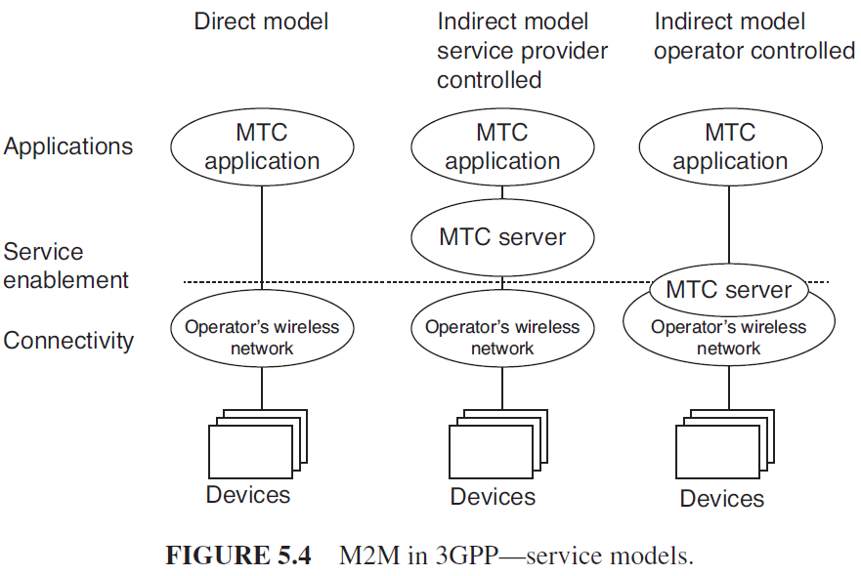
Third Generation Partnership Project Service Requirements for Machine Type Communications (MTC) Approach

Slide 95
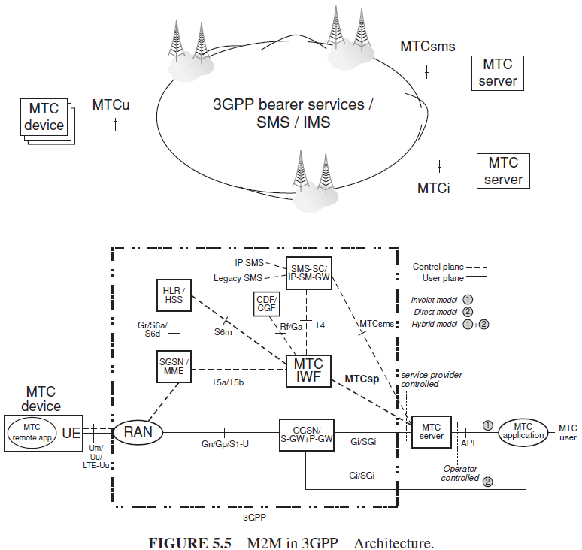
Third Generation Partnership Project Service Requirements for Machine Type Communications (MTC) Approach
In architecture, the interfaces are as follows:
MTCu: provides MTC devices access to the 3GPP network for the transport of user traffic;
MTCi: the reference point for MTC server to connect the 3GPP network via 3GPP bearer service;
MTCsms: the reference point for MTC server to connect the 3GPP network via 3GPP SMS.

Slide 96
Third Generation Partnership Project Service Requirements for Machine Type Communications (MTC) Approach
The key document 3rd Generation Partnership Project Service Requirements for Machine Type Communications—focused on
overload and congestion control,
extended access barring (EAB),
low priority access,
APN (access point name)-based congestion control,
downlink throttling.

Slide 97
Third Generation Partnership Project Service Requirements for Machine Type Communications (MTC) Approach
For MTC communication, the following communication scenarios are identified:
(i) MTC devices communicating with one or more MTC server;
(ii) MTC devices communicating with each other.

Slide 98
Third Generation Partnership Project Service Requirements for Machine Type Communications (MTC) Approach
For MTC devices communicating with one or more MTC servers, the following use cases exist:
(a) MTC server controlled by the network operator; namely the MTC server is located in the operator domain. Here
The network operator offers API (e.g., Open Systems Architecture [OSA]) on its MTC server(s)
MTC user accesses MTC server(s) of the network operator via API
(b) MTC server not controlled by the network operator; namely MTC server is located outside the operator domain. Here
The network operator offers the network connectivity to the MTC server(s) located outside of the network operator domain

Slide 99
Third Generation Partnership Project Service Requirements for Machine Type Communications (MTC) Approach
MTC applications do not all have the same characteristics.
This implies that not every system optimization is suitable for every MTC application.
Therefore, MTC features are to provide structure for the different system optimization possibilities that can be invoked.

Slide 100
Third Generation Partnership Project Service Requirements for Machine Type Communications (MTC) Approach
The following MTC features have been defined:
Low mobility
Time controlled
Time tolerant
Packet switched (PS) only (here the MTC feature PS only is intended for use with MTC devices that only require packet switched services)
Small data transmissions
Mobile originated only
Infrequent mobile terminated
MTC monitoring
Priority alarm
Secure connection
Location-specific trigger
Network provided destination for uplink data
Infrequent transmission

Slide 101
Third Generation Partnership Project Service Requirements for Machine Type Communications (MTC) Architectural Reference Model for MTC
3rd Generation Partnership Project Service Requirements for Machine Type Communications focuses on numbers and addressing, on improvements of device triggering, and on interfaces between MTC server and mobile network.
Referring to Figure in next slide,

Slide 102
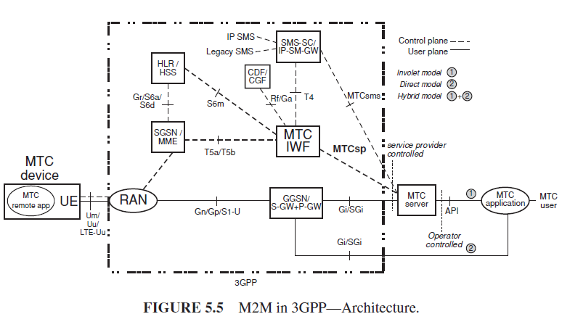
Third Generation Partnership Project Service Requirements for Machine Type Communications (MTC) Architectural Reference Model for MTC
MTC-IWF is a new interworking function between (external) MTC server and operator core network handling security, authorization, authentication, and charging.
MTCsp is a new control interface for interactions with MTC server

Slide 103
Third Generation Partnership Project Service Requirements for Machine Type Communications (MTC) Architectural Reference Model for MTC
The end-to-end application, between the user equipment (UE) used for MTC and the MTC application, uses services provided by the 3GPP system, and optionally services provided by an MTC server.
The 3GPP system provides transport and communication services (including 3GPP bearer services, IMS, and SMS) including various optimizations that can facilitate MTC.
UE used for MTC connecting to the 3GPP network (UTRAN, E-UTRAN, GERAN, I-WLAN, and so on) via the Um/Uu/LTE-Uu interface.

Slide 104
Third Generation Partnership Project Service Requirements for Machine Type Communications (MTC) Architectural Reference Model for MTC
The architecture encompasses a number of models as follows:
Direct model —direct communication provided by the 3GPP operator: The MTC application connects directly to the operator network without the use of any MTC server;
Indirect model —MTC service provider controlled communication: The MTC server is an entity outside of the operator domain. The MTCsp and MTCsms are external interfaces (i.e., to a third-party M2M service provider);
Indirect model—3GPP operator controlled communication: The MTC server is an entity inside the operator domain. The MTCsp and MTCsms are internal to the public land mobile network (PLMN);
Hybrid model: The direct and indirect models are used simultaneously in the hybrid model, for example, connecting the user plane using the direct model and doing control plane signalling using the indirect model.

Slide 105
Third Generation Partnership Project Service Requirements for Machine Type Communications (MTC) Architectural Reference Model for MTC
In several countries, regulators have indicated that there are not enough (mobile) numbers available for M2M applications.
3GPP postulates that solutions will have to support 100× more M2M devices than devices for H2H communications.
Proposed solutions include:
(i) mid-term solution: special M2M number ranges with longer telephone numbers (e.g., 14 digits);
(ii) long-term solution: no longer provide telephone numbers for M2M applications.

Slide 106
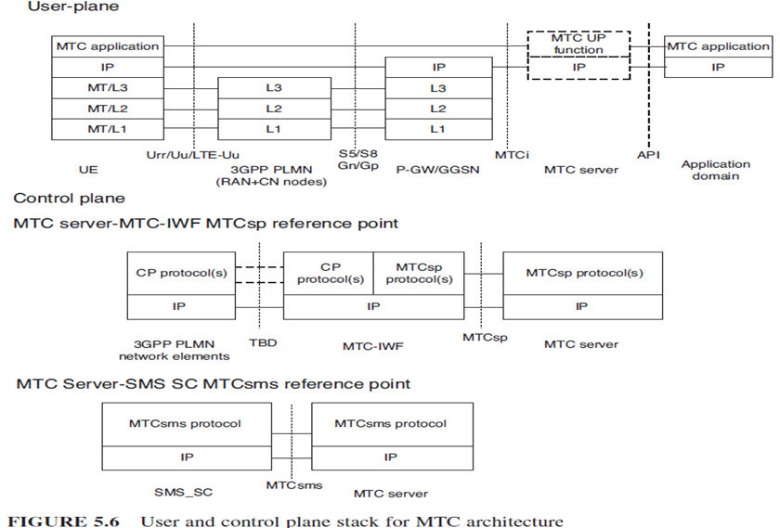
Third Generation Partnership Project Service Requirements for Machine Type Communications (MTC) Architectural Reference Model for MTC

Slide 107
CENELEC
European Committee for Electrotechnical Standardization (CENELEC)
has adopted the transport profile of Siemens’ distribution line carrier communication protocol (CX1) as a standardization proposal.
The standard aims at supporting open and fault tolerant communication via powerline in intelligent power supply grids.
As the basis for the transmission protocol, which uses the low voltage network as a communication channel for data of grid sensors and smart meters, the transport profile has been designed to ensure interoperability in accordance with EU Mandate M/441.

Slide 108
CENELEC
CENELEC TC 13 was planning to forward the CX1 transport profile to TC 57 of the International Electrotechnical Commission (IEC).
CX1 is already used to connect meters and other intelligent terminal devices in Siemens’ SG metering systems, such as in the load switching devices that will replace household ripple control receivers.
The systems collect energy consumption data and network information, which are then relayed to a control center for further processing.
The communication protocol can handle any change in the physical communication parameters of a low voltage power supply grid, such as signal attenuation, noise, network disruption and signal coupling, as well as operational changes in network configuration.
The protocol can also be integrated into existing IEC protocol-based network automation and energy management infrastructures.

Slide 109
IETF IPv6 Over Lowpower WPAN
6LoWPAN is an IPv6 adaption layer for low power wireless PAN (LoWPAN).
Network with the help of an adaptation layer which sits between the MAC layer and the IP network layer.
As it should be clear at this juncture, a link in a LoWPAN is characterized as lossy, low power, low bit-rate, short range, with many nodes saving energy with long sleep periods.

Slide 110
IETF IPv6 Over Lowpower WPAN
A LoWPAN is potentially composed of a large number of overlapping radio ranges. Although a given radio range has broadcast capabilities, the aggregation of these is a complex non-broadcast multiaccess (NBMA) structure with generally no LoWPAN-wide multicast capabilities.
Link-local scope is in reality defined by reachability and radio strength.
A LoWPAN to be made up of links with undetermined connectivity properties, along with the corresponding address model assumptions defined therein.

Slide 111
Zigbee IP(ZIP)
ZigBee is a wireless PAN IEEE 802.15.4 standard
ZigBee Alliance’s ZIP standard, which is a first definition of an open standards-based IPv6 stack for smart objects.
The goal is to extend the use of IP networking into resource-constrained devices over a wide range of low power link technologies.
ZIP is a protocol stack based on IETF- and IEEE-defined standards such as 6LoWPAN and IEEE 802.15.4 to be used for the Smart Energy 2.0 (SE 2.0) profile.

Slide 112
Zigbee IP(ZIP)
ZIP enables low power 802.15.4 nodes to participate natively with other IPv6-enabled WiFi, Homeplug, and Ethernet nodes without the complexity and cost of application layer gateways.
To accomplish this, the ZIP stack incorporates a number of standardized IETF protocols including 6LoWPAN for IP header compression and ND (Neighbour Discovery), and RPL for mesh routing.
ZIP further employs other IETF standards to support network joining procedures, service discovery, and TLS/SSL-based security mechanisms.

Slide 113
IPSO (IP IN SMART OBJECTS)
The IPSO Alliance is an advocate for IP-networked devices for use in energy, consumer, healthcare, and industrial applications.
The objective of the Alliance is not to define technologies or standards, but to document the use of IP-based technologies defined at the standard organizations such as IETF with focus on support by the Alliance of various use cases.

Slide 114
IPSO (IP IN SMART OBJECTS)
Goals include:
Promote IP as the premier solution for access and communication for smart objects.
Promote the use of IP in smart objects by developing and publishing white papers and case studies and providing updates on standards progress from associations like IETF, among others, and through other supporting marketing activities.
Understand the industries and markets where smart objects can have an effective role in growth when connected using the Internet protocol.
Organize interoperability tests that will allow members and interested parties to show that products and services using IP for smart objects can work together and meet industry standards for communication.
Support IETF and other standards development organizations in the development of standards for IP for smart objects.

