Slide 1

An LLM-based Serialization Framework for Representation Learning in Recommender Systems
Dahee Kim
Master’s Student, Department of Big Data Analytics, Kyung Hee University
Supervising Professor: Sung-Byung Yang

Slide 2
Table of Contents
Introduction
Framework
Experiments
Prompt Design
Performance
Conclusion and Future Work

Slide 3
1. Introduction
With the advancement of ICT and digital platforms, users are exposed to an increasing number of choices, leading to frequent information overload situations (Arnold et al., 2023).
In this environment, recommender systems have emerged as a core technology for improving user experience and supporting decision-making by effectively connecting appropriate products to ausers (Kashlot et l., 2026).
Recommender systems predict items that users are likely to prefer based on user preferences and behavioral histories and provide them in a personalized manner (Alamdari et al., 2020).
Recommender systems are generally categorized into personalized ranking and rating prediction model(Zhao et al., 2022).
In particular, rating prediction aims to quantitatively estimate user preference scores for specific items based on historical rating information (Khan et al., 2021).
Since representation learning directly affects rating prediction, this study focuses on advancements in rating prediction through improvements in representation learning in recommender systems.
ICEC 2026 27th International Conference on Electronic Commerce

Slide 4
1. Introduction
To achieve personalized recommendation, various recommendation techniques have been proposed such as collaborative filtering (CF), content-based filtering (CBF) and hybrid filtering.
﻿Hybrid approaches combine user-item interaction information with item attributes, helping alleviate data sparsity and cold-start problems (Alyari & Jafari Navimipour, 2018).
﻿Recent recommendation studies have mainly focused on advancing model architectures and refining embedding representations.
These approaches are effective for learning user-item relationships (Hasan et al., 2025).
Despite the advantage stated above, they still have limitations in integrating heterogeneous data into a unified and consistent semantic representation.
ICEC 2026 27th International Conference on Electronic Commerce

Slide 5
1. Introduction
In recent online environments, diverse types of data (user-generated reviews, item descriptions and attributes) are continuously generated.
These data are generally managed as tabular data consisting of rows and columns to systematically store and efficiently process various attributes (Jiang et al., 2026).
Existing recommendation studies mainly embed each feature in columns independently and use them as inputs to recommendation models (Li et al., 2023).
Although feature-wise representations are simple and computationally efficient, they may fail to sufficiently capture complex contextual dependencies among heterogeneous data.
Simply combining heterogeneous features makes it difficult to preserve semantic consistency and representation stability, which may negatively affect personalization and prediction accuracy (Cai et al., 2024).
Furthermore, datasets collected from real-world industrial environments frequently contain missing values, which represent not only simple data omission but also incompleteness in information representation (Zhou et al., 2024).
ICEC 2026 27th International Conference on Electronic Commerce

Slide 6
1. Introduction
Prior studies typically remove or replace missing values using statistical approaches, such as average imputation (Popovich 2025).
﻿Existing approaches mainly focus on learning from the given input data, making it difficult to fundamentally resolve data incompleteness (Wani 2024).
Therefore, there is an increasing need for approaches that can semantically understand and represent heterogeneous data.
Table 1. Comparison of Datasets Before and After Missing Value Processing
Title | Average_rating | Rating_number | Features | Description | Price | Store | Details | Parent_asin
Dash 8-300... | 5.0 | 1 | [Features Dash... | [The Dash 8-300 Professional... | None | Aerosoft | {'Pricing': 'The strikethrough ... | B000FH0MHO
Phantasmagoria... | 4.1 | 18 | [Windows 95] | [] | None | Sierra | {'Best Sellers Rank': {'Video Games... | B00069EVOG
NBA 2K17... | 4.3 | 223 | [The #1 rated... | [Following the record-breaking... | 58.0 | 2K | {'Release date': 'September 16, 2016... | B00Z9TLVK0
Nintendo Selects... | 4.9 | 22 | [Authentic Nintendo... | [] | 37.42 | Amazon Renewed | {'Best Sellers Rank': ... | B07SZJZV88
Title | Average_rating | Rating_number | Features | Description | Price | Store | Details | Parent_asin
NBA 2K17... | 4.3 | 223 | [The #1 rated... | [Following the record-breaking... | 58.0 | 2K | {'Release date': 'September 16, 2016... | B00Z9TLVK0
ICEC 2026 27th International Conference on Electronic Commerce

Slide 7
1. Introduction
In this context, Large Language Models(LLMs), which can contextually understand and represent diverse data types, have emerged as an effective solution (Lin et al., 2025).
﻿Transformer-based self-attention mechanisms enable LLMs to model relationships among input components by considering the entire input context.
LLMs also internalize conceptual knowledge through large-scale pretraining (Minaee et al., 2024).
Unlike independent feature-wise processing approaches, these characteristics enable heterogeneous attributes to be interpreted within a unified semantic context (Yadav et al., 2024).
In particular, LLM-based serialization approaches have recently attracted attention as a method for representing attribute values as semantic units rather than simple numerical or categorical values (Sui et al., 2024).
Serialization refers to the process of converting structured tabular data into semantic units.
﻿Serialized representations can contextually connect relationships among different attributes and provide richer representations of user-item interactions (Azime et al., 2025).
ICEC 2026 27th International Conference on Electronic Commerce

Slide 8
1. Introduction
﻿﻿Despite LLMs capabilities in turning heterogeneous data into semantic units, existing recommendation studies are utilizing them only in limited ways.
Most studies focus on simple review summarization, feature extraction and prompting of interaction histories and item attributes (Wei et al., 2024; Wu et al., 2024).
The problem of semantically reconstructing heterogeneous data into a unified representation space has still not been explored sufficiently.
﻿Therefore, this study proposes: LCSR (LLM-based Content Serialization for Recommendation).
LCSR is a representation learning framework that reconstructs heterogeneous and incomplete data into semantically consistent representations for more accurate user preference modeling.
This study is based on the assumption that semantic reconstruction of input data significantly influences embedding quality and recommendation performance.
ICEC 2026 27th International Conference on Electronic Commerce

Slide 9
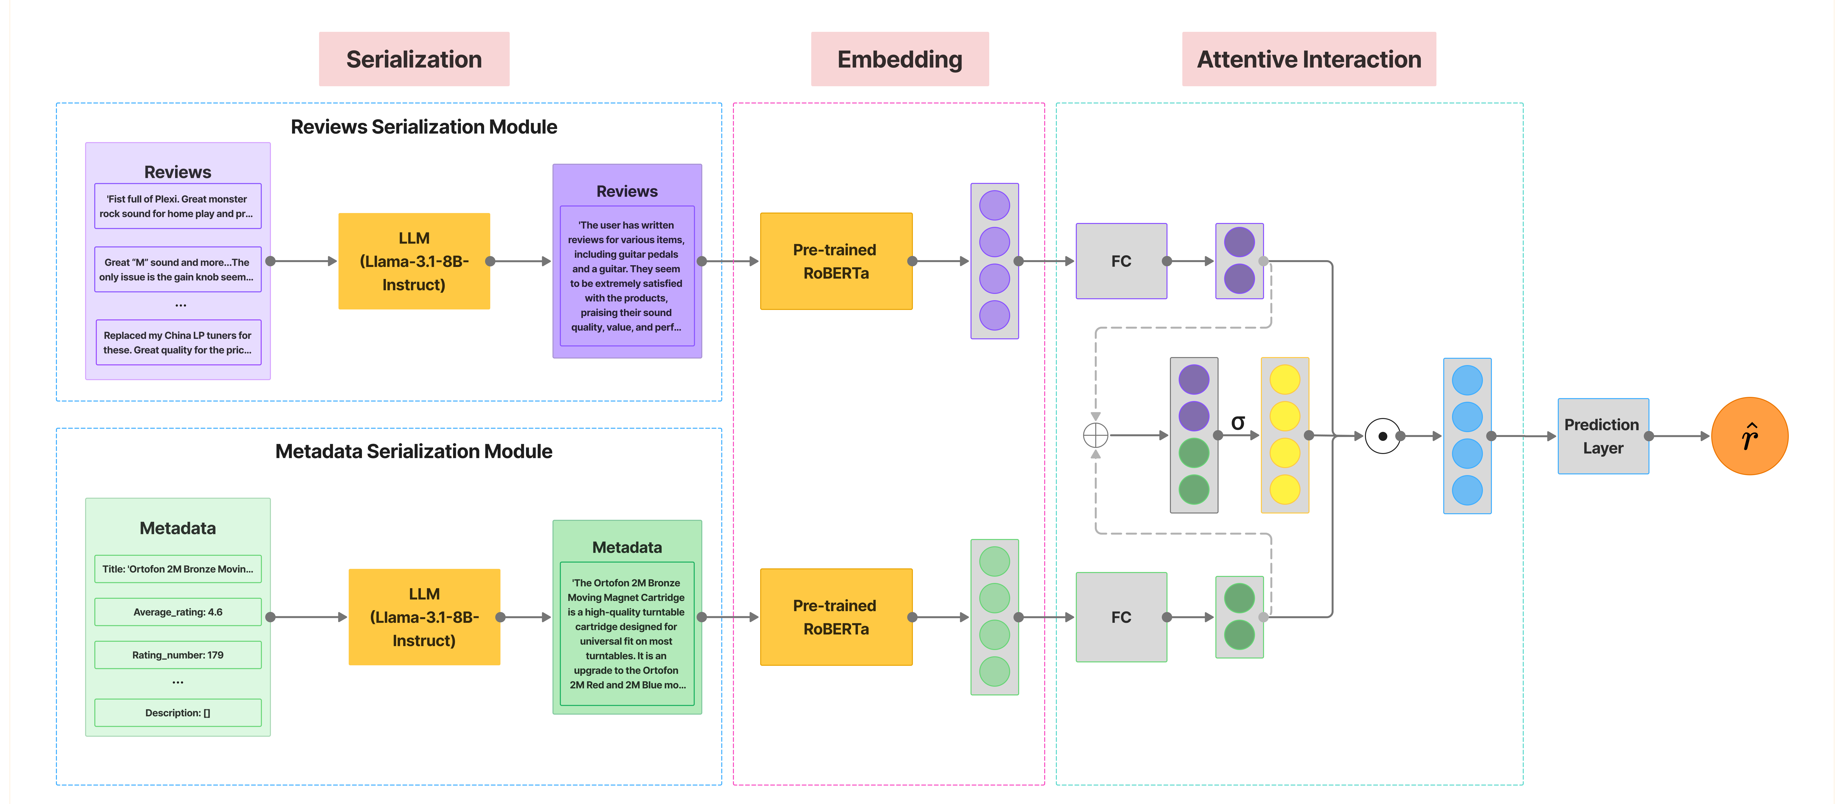
2. Framework
Figure 2. Proposed LCSR Framework
ICEC 2026 27th International Conference on Electronic Commerce

Slide 10
3. Experiments
Datasets (Details in Appendix A, B)
Amazon Review datasets released by UCSD (https://amazon-reviews-2023.github.io/)
Widely used benchmark datasets in recommender system research.
Video Games, Musical Instruments (Chiang et al., 2023; Wang et al., 2025)
Data Preprocessing
Reviews written by unverified purchasers were removed to improve data reliability.
Minimal textual preprocessing was applied, including HTML/URL removal and whitespace normalization.
For LLM input construction, five reviews per user were randomly aggregated into a review document.
Table 2. Final Dataset Statistics
Category | Number of Reviews | Number of Users | Number of Items | Missing Valued data
Musical Instruments | 449,244 | 51,582 | 21,112 | 120,832
Video Games | 577,070 | 71,697 | 19,186 | 131,229
ICEC 2026 27th International Conference on Electronic Commerce
Notes:
결측값이 있는 데이터가 몇 개인지 통계에 보여주기 (or 결측값 제외한 총 데이터 개수)

Slide 11
3. Experiments
Evaluation Metrics
MAE (Mean Absolute Error)
RMSE (Root Mean Squared Error)
Baseline Model Selection
Table 3. Description of Baseline Models
Category | Models | Description | Author
Rating-based | NeuMF | Models user-item interactions using neural network architectures | He et al., (2017)
Review-based | DeepCoNN | Learns semantic user-item interactions through parallel CNN-based review encoding | Zheng et al., (2017)
 | NARRE | Assigns higher attention weights to informative reviews using review-level attention | Chen et al., (2018)
 | AENAR | Identifies informative aspects using CNNs and aspect-level attention mechanisms | Zhang et al., (2022)
 | MFNR | Captures feature dependencies and relative importance within reviews using CNNs and self-attention | Lim et al., (2025)
 | LCSR | Utilizes LLMs to serialize metadata and reviews for preference extraction | Ours
ICEC 2026 27th International Conference on Electronic Commerce

Slide 12
3. Experiments
Validation of Recommendation Performance
Compare the rating prediction performance between representative recommendation models and the proposed framework.
Verify the impact of the proposed LCSR framework on recommendation performance.
Validation of Serialization Effectiveness
Compare the proposed serialization approach with traditional review preprocessing and aggregation approaches.
Analyze the effect of serialized data on recommendation performance.
Comparison of Serialization Strategies
Compare the proposed serialization prompt with existing serialization approaches such as: Attribute-value listing, Plain text conversion
Analyze differences in serialization quality and performance according to serialization strategies.
Ablation Study
Compare model performance using: Non-serialized raw data, Review-only serialized data, Metadata-only serialized data
Investigate the influence of serialization strategies under the same recommendation architecture.
ICEC 2026 27th International Conference on Electronic Commerce

Slide 13
4. Prompt Design
Previous LLM-based serialization studies demonstrated that reconstructing tabular data into textual formats is effective for improving semantic understanding.
Table 4. Prior Studies on LLM-based Data Reconstruction
References | Research Topics | Prompt Strategies | Results
Hegselmann et al. (2023) | Tabular Data Classification | Serialize Tabular Row into Natural Language | Natural language serialization prompts are more effective for tabular data classification.
Azime et al. (2025)
Sui et al. (2024) | Understanding Table | A two-stage prompting approach that generates intermediate structured knowledge for the target task | Incorporating intermediate structured knowledge improves downstream task performance.
Bajaj & Borhan (2024) | Text Summarization | Zero-shot vs Roleplay style | The structure of prompts has a greater impact than individual prompt words in extracting rich semantic information.
Tang et al. (2024) | Review Summarization | Task definition, format specification, and role/instruction-based prompting | More structured prompts enable clearer aspect extraction and sentiment classification.
Mufti et al. (2025) | Ranking Reviews | Extracting user preferences through ABSA and incorporating them into prompts | Preference-aware prompts can improve the quality of personalized summarization.
ICEC 2026 27th International Conference on Electronic Commerce

Slide 14
4. Prompt Design
Prompt Component Design
Based on prior studies, we defined three core prompt components.
Table 5. Definition of Prompt Components
Component | Description and Example
Instruction | Specifies the core task using actionable verbs and detailed requirements.
 | Ex) “Summarize this article in 200 words or more.”
Constraint | Restricts response format, length, and prohibited patterns to reduce hallucination and redundancy.
 | Ex) “1. do not say any words or characters before repeating the request.”
Context | Provides task-related background knowledge and input characteristics to improve semantic understanding.
 | Ex) “Below are user reviews, each separated by newline escape.”
ICEC 2026 27th International Conference on Electronic Commerce
Notes:
수정하기

Slide 15
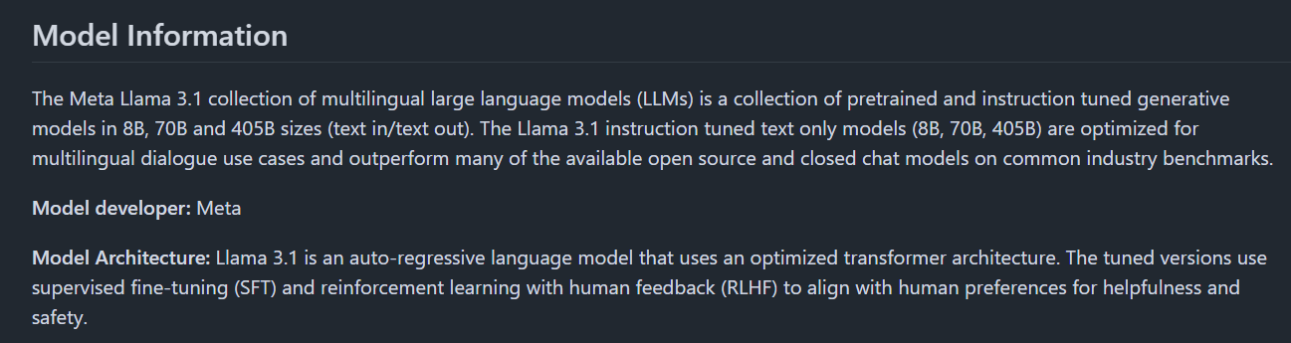
4. Prompt Design
Llama3.1-8B-Instruct was used for LLM-based serialization.
The proposed LCSR framework is not dependent on a specific LLM and can be generalized to various LLM architectures.
Llama was selected because it is one of the representative LLMs widely used in recommender system research.
Figure 3. Introduction to Llama-3.1-8B-Instruct
Table 6. LLM Hyperparameter Settings
Parameter | Description | Values
Do sample | Determines whether probabilistic sampling is applied(True, False). When disabled (False), the model generates more stable and reproducible outputs. | False
Max new tokens | Sets the maximum number of output tokens generated by the model. | 512
ICEC 2026 27th International Conference on Electronic Commerce

Slide 16
4. Prompt Design
Item Metadata Serialization Prompt (Details in Appendix C)
User Review Serialization Prompt (Details in Appendix D)
Prompt | The following is the metadata for the "{item_title}", provided in the format {{metadata: value}}. Reconstruct the following information to write an objective and descriptive paragraph.
Input | metadata: {title, average_rating, rating_number, …, categories}
Prompt | The following are the reviews written by a user for different items. Write a summary of the following reviews in a paragraph.
Input | reviews: {review text 1, review text 2, review text 3, …, review text N}
ICEC 2026 27th International Conference on Electronic Commerce

Slide 17
4. Prompt Design
Serialization Output Examples
Metadata Serialized Output | 'The Ortofon 2M Bronze Moving Magnet Cartridge is a high-quality turntable cartridge designed for universal fit on most turntables. It is an upgrade to the Ortofon 2M Red and 2M Blue models, offering even more resolution and details in an even-handed way. The cartridge features a Nude Fine Line diamond and can be upgraded with an Ortofon Stylus 2M Black. With an average rating of 4.6 out of 5 stars based on 179 customer reviews, the Ortofon 2M Bronze Moving Magnet Cartridge is a highly regarded product in the music industry. It is priced at $499.00 and is suitable for a wide range of musical genres and applications. The cartridge is designed to provide clear and accurate sound reproduction, making it an excellent choice for audiophiles and music enthusiasts. Its universal fit design ensures compatibility with most turntables, making it a versatile option for those looking to upgrade their turntable setup. Overall, the Ortofon 2M Bronze Moving Magnet Cartridge is a high-quality product that offers excellent sound reproduction and versatility, making it a great choice for anyone looking to upgrade their turntable setup.’
Review Serialized Output | 'The user has written reviews for various items, including guitar pedals and a guitar. They seem to be extremely satisfied with the products, praising their sound quality, value, and performance. The user mentions that a guitar pedal provides a great "monster rock sound" and a "great \'M\' sound", while another pedal is described as having an "awesome" sound with the only drawback being a sensitive gain knob. The user also replaced their old tuners with new ones, which greatly improved the tuning stability of their guitar. Additionally, they purchased a guitar and were impressed by the significant improvement in quality, particularly with intonation and adjustability. Overall, the user highly recommends these products for their great value and performance.'
ICEC 2026 27th International Conference on Electronic Commerce

Slide 18
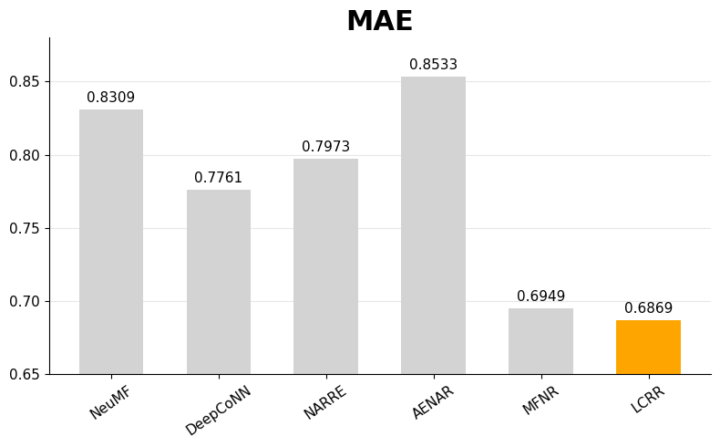
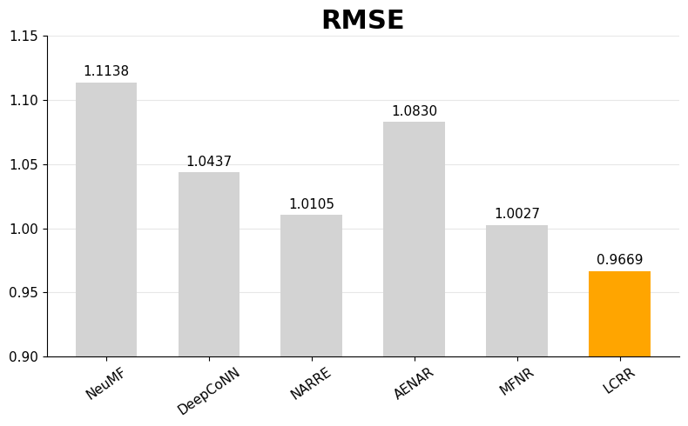
5. Performance
Video Games Dataset
LCSR outperformed all baseline models in both MAE and RMSE.
Semantic reconstruction through LLM-based serialization showed promising effectiveness.
LCSR
LCSR
ICEC 2026 27th International Conference on Electronic Commerce

Slide 19
6. Conclusion and Future Work
Conclusion
This study proposed LCSR, an LLM-based framework for semantic reconstruction of heterogeneous recommendation data.
The proposed framework utilized LLM-based serialization to generate semantically consistent representations.
Preliminary results showed promising recommendation performance on real-world datasets.
Limitations
The current experiments are limited to a small number of datasets and domains.
In addition, LLM-based serialization still requires relatively high computational cost.
Future Work
Future work will validate the proposed framework across additional datasets and recommendation domains to improve generalizability.
We also plan to investigate more efficient serialization strategies to reduce the computational cost of LLM-based reconstruction.
ICEC 2026 27th International Conference on Electronic Commerce

Slide 20
Thank you

Slide 21
Appendix
A: Item Metadata Description
Table 7. Item Metadata Example
Title | Average_rating | Rating_number | Features | Description | Price | Store | Categories | Details | Parent_asin
Dash 8-300 Professional Add-On | 5.0 | 1 | [Features Dash 8-300 and 8-Q300 ('Q' rollout l... | [The Dash 8-300 Professional Add-On lets you p... | None | Aerosoft | [Video Games, PC, Games] | {'Pricing': 'The strikethrough price is the Li... | B000FH0MHO
Phantasmagoria: A Puzzle of Flesh | 4.1 | 18 | [Windows 95] | [] | None | Sierra | [Video Games, PC, Games] | {'Best Sellers Rank': {'Video Games': 137612, ... | B00069EVOG
NBA 2K17 - Early Tip Off Edition - PlayStation 4 | 4.3 | 223 | [The #1 rated NBA video game simulation series... | [Following the record-breaking launch of NBA 2... | 58.0 | 2K | [Video Games, PlayStation 4, Games] | {'Release date': 'September 16, 2016', 'Best S... | B00Z9TLVK0
Nintendo Selects: The Legend of Zelda Ocarina ... | 4.9 | 22 | [Authentic Nintendo Selects: The Legend of Zel... | [] | 37.42 | Amazon Renewed | [Video Games, Legacy Systems, Nintendo Systems... | {'Best Sellers Rank': {'Video Games': 51019, '... | B07SZJZV88
Thrustmaster Elite Fitness Pack for Nintendo Wii | 3.0 | 3 | [Includes (9) Total Accessories, Pedometer, Wi... | [The Thrustmaster Motion Plus Elite Fitness Pa... | None | THRUSTMASTER | [Video Games, Legacy Systems, Nintendo Systems.. | {'Release date': 'November 1, 2009', 'Pricing'... | B002WH4ZJG
Grand Prix 4 | 3.7 | 18 | [Operating System: Windows 98, ME, XP, Develop... | [Grand Prix 4 is the fourth installment in the... | None | None | [Video Games, PC, Games] | {'Pricing': 'The strikethrough price is the Li... | B00005Y3OJ
ICEC 2026 27th International Conference on Electronic Commerce

Slide 22
Appendix
A: Item Metadata Description
Table 8. Description of Metadata
Columns Name | Type | Description
Title | str | Name of the product
Average_rating | float | Rating of the product shown on the product page
Rating_number | int | Number of ratings in the product
Features | list | Bullet-point format features of the product
Description | list | Description of the product
Price | float | Price in US dollars
Store | str | Store name of the product
Categories | list | Hierarchical categories of the product
Details | dict | Product details, including materials, brand, sizes, etc
Parent_asin | str | Parent ID of the product
ICEC 2026 27th International Conference on Electronic Commerce

Slide 23
Appendix
B: Review Data Description
Table 9. Review Dataset Example
Rating | Title | Text | Images | Asin | Parent_asin | User_id | Timestamp | Helpful_vote | Verified_purchase
4.0 | It’s pretty sexual. Not my fav | I’m playing on ps5 and it’s interesting. It’s... | [] | B07DJWBYKP | B07DK1H3H5 | AGCI7FAH4GL5FI65HYLKWTMFZ2CQ | 1608186804795 | 0 | True
5.0 | Good. A bit slow | Nostalgic fun. A bit slow. I hope they don’t... | [] | B00ZS80PC2 | B07SRWRH5D | AGCI7FAH4GL5FI65HYLKWTMFZ2CQ | 1587051114941 | 1 | False
5.0 | ... an order for my kids & they have really en... | This was an order for my kids & they have real... | [] | B01FEHJYUU | B07MFMFW34 | AGXVBIUFLFGMVLATYXHJYL4A5Q7Q | 1490877431000 | 0 | True
3.0 | love all the amazing colors but the black is r... | love all the amazing colors but the black is r... | [] | B016Y2BVKA | B073SC6V1D | AHXSBZT52TCPZUBVCBRICTHWUCBA | 1518124539574 | 0 | True
5.0 | Will use again | Instant delivery! | [] | B004RMK57U | B004RMK57U | AHZIJGKEWRTAEOZ673G5B3SNXEGQ | 1602937709361 | 0 | True
5.0 | if its prime day and you're contemplating, jus... | you should probably get these. you'll journal ... | [{'small_image_url': 'https://images-na.ssl-im... | B07N85FY1G | B0BYVN9ZK2 | AFO6QN6ICKWUFQV3UEWK5EECIQTQ | 1602718512453 | 0 | False
ICEC 2026 27th International Conference on Electronic Commerce

Slide 24
Appendix
B: Review Data Description
Table 10. Description of Amazon Review Dataset
Columns Name | Type | Description
Rating | float | Rating of the product (1.0 ~ 5.0)
Title | str | Title of the user review
Text | str | Text body of the user review
Image | str | Images that users post after they have received the product (small / medium / large size)
Asin | str | ID of the product
Parent_asin | str | Parent ID of the product
User_id | str | ID of the reviewer
Timestamp | int | Time of the review (Unix Time)
Helpful_vote | int | Helpful votes of the review
Verified_purchase | bool | User purchase verification
ICEC 2026 27th International Conference on Electronic Commerce

Slide 25
Appendix
C: Example of Item Metadata Input
D: Example of Review Data Input
Input | Title: 'Ortofon 2M Bronze Moving Magnet Cartridge’ Average_rating: 4.6 Rating_number: 179 Features: [Universal fit for most turntables’, 'Upgrade to the Ortofon 2M Red and 2M Blue’, 'The Ortofon…] Description: [] Price: 499 Brand: Ortofon Categories: ['Musical Instruments', 'Electronic Music, DJ & Karaoke', 'DJ Equipment', 'Accessories’,…] Details: [DJ Turntable Cartridges': 275.0, 'Darbukas': None, 'Decorative Rubber Stamps & Ink Pads': None, …]
Input | 'Fist full of Plexi. Great monster rock sound for home play and practice. (Can even mic for the right gigs). Great “M” sound and more...The only issue is the gain knob seems to jump from ‘break up’ to full-blown distortion too fast (between 1-5). Otherwise, the overall sound is AWESOME. Best price value of all similar pedals out there. Replaced my China LP tuners for these. Great quality for the price. Now it actually stays in tune. Great guitar for the price. Highly recommended. Bought this for my Oscar Schmidt LP. What a difference in quality. Love it, cant beat the value. Now intonation is easy to adjust and holds.'
ICEC 2026 27th International Conference on Electronic Commerce

