Slide 1
Project Based Learning - III
Name –Sat-Nav Hazard Rerouting System
Problem Statement – Adaptive Path Planning and Collision Avoidance for Autonomous Vehicles on Unstructured Indian Roads

Slide 2
Vehicle Sat-Nav Hazard Detection & Rerouting System
PROPOSED SOLUTION -
1 DETECT
2 ASSESS
3 REROUTE + ALERT
Ingest weather, terrain/DEM, satellite and on-road perception data.
Analyse a 10–20 km route corridor using H3 tiles.
GBMs score landslide, flood and avalanche risk.
CNN handles glacier/GLOF imagery and obstacle/lane perception.
Fuse probability, severity, exposure and confidence; hysteresis filters noise.
OSRM/Valhalla treats fused risk as an edge-weight penalty.
Reroute only after threshold + hysteresis confirm a real transition.
Local LLM produces schema-constrained JSON alerts only.
Innovation: routing remains deterministic, the gated LLM only explains confirmed state changes. Connectivity loss triggers last-known risk + static terrain/obstacle fallback.

Slide 3
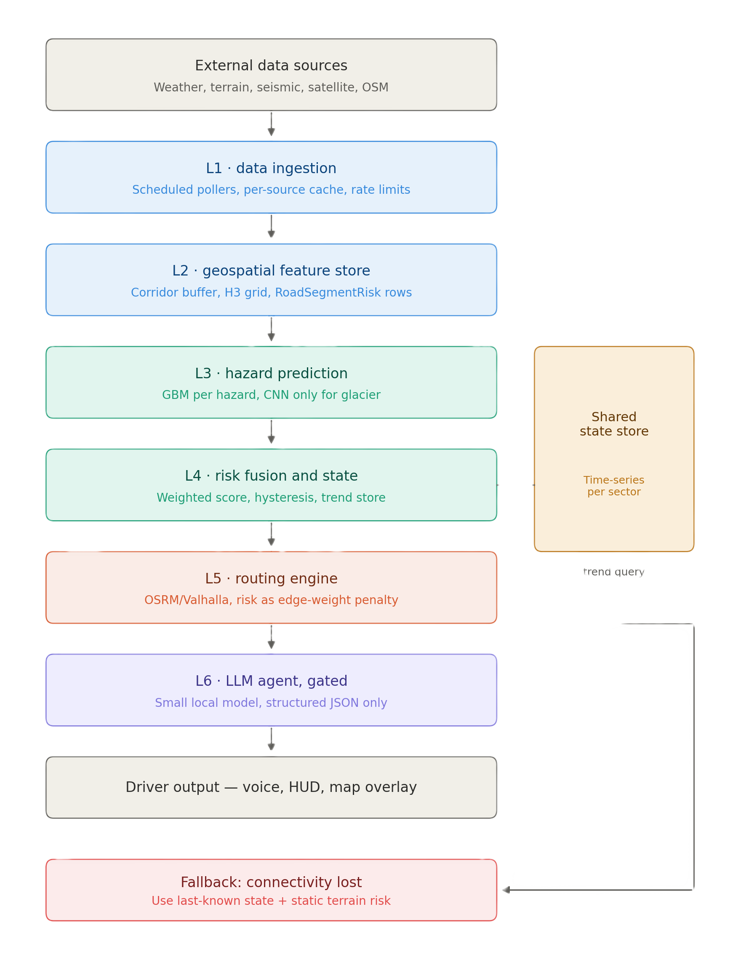
Vehicle Sat-Nav Hazard Detection & Rerouting System
TECHNOLOGY STACK
Android mobile / in-vehicle client
OSRM or Valhalla + OpenStreetMap
H3 + RoadSegmentRisk geospatial store
XGBoost/LightGBM GBMs; CNN for glacier/GLOF
Shared time-series risk state
Local 3–8B quantized LLM (e.g., Ollama), JSON-only
IMPLEMENTATION METHOD
1. Routing core + corridor/H3 tiling
2. Landslide GBM end-to-end pipeline
3. Risk fusion + hysteresis state
4. Risk-weighted alternate routing
5. Gated local LLM + structured JSON
6. Flood, avalanche, glacier CNN + offline fallback

Slide 4
Vehicle Sat-Nav Hazard Detection & Rerouting System
FEASIBLE
CHALLENGES
MITIGATION
OpenStreetMap + OSRM/Valhalla provide an accessible routing base.
GBMs support millisecond inference with smaller labelled datasets.
Scope is bounded to a 10–20 km corridor.
API rate limits and data availability.
Noisy readings may cause false reroutes.
Connectivity loss and slow satellite revisit.
Aggressive caching + scheduled polling.
Threshold + hysteresis before rerouting.
Last-known-state fallback; async glacier CNN.
Test every phase on a real route.
SCOPE CONTROL –
Full Level 4/5 autonomous control and heavier Physics-GNN / ConvLSTM+ResNet models are deferred from the SIH MVP.

Slide 5
Vehicle Sat-Nav Hazard Detection & Rerouting System
TARGET USERS
BENEFITS
Drivers / travellers: route maps, hazard overlays and reroute alerts via a low-distraction interface.
Local authority / disaster-management officials: aggregated hazard and road-condition review in future dashboard work.
Administrators: data-source, threshold and retraining configuration.
Reduces risk exposure by adapting routes around flagged segments.
Supports collision avoidance for dynamic obstacles and unmarked lane conditions.
Concise structured alerts instead of raw model output.
Warnings persist during connectivity loss via last-known + static risk.
Lightweight design limits compute and LLM use to meaningful transitions.
Prototype scope: decision support and alerts; no assumption of full vehicle actuation control.

Slide 6
Vehicle Sat-Nav Hazard Detection & Rerouting System
REFERENCE BASE
Smart India Hackathon 2026 problem statement documentation — SIH 26037.
IEEE Std 830-1998 — Recommended Practice for Software Requirements Specifications.
Team architecture design — six-layer architecture, UML class model, runtime flow and execution plan.
DESIGN EVIDENCE
  Six ordered layers from data ingestion to driver output.
  Shared time-series state supports rising/falling risk trends.
  Routing remains a graph-search responsibility; LLM is gated and JSON-only.
  Offline fallback prevents connectivity loss from becoming a false 'no warning' state.
Content source: supplied SRS + architecture documents. Layout: supplied SIH 2026 presentation template.

