Slide 1
Data and Signals

Slide 2
Data and Signals
Data are entities that convey meaning (computer file, music on CD, results from a blood gas analysis machine)
Signals are the electric or electromagnetic encoding of data (telephone conversation)
Computer networks and data/voice communication systems transmit signals

Slide 3
Analog vs. Digital Signals
Signals can be interpreted as either analog or digital
In reality, all signals are analog
Analog signals are continuous, non-discrete
Digital signals are non-continuous, discrete
Digital signals lend themselves more nicely to noise reduction techniques

Slide 4
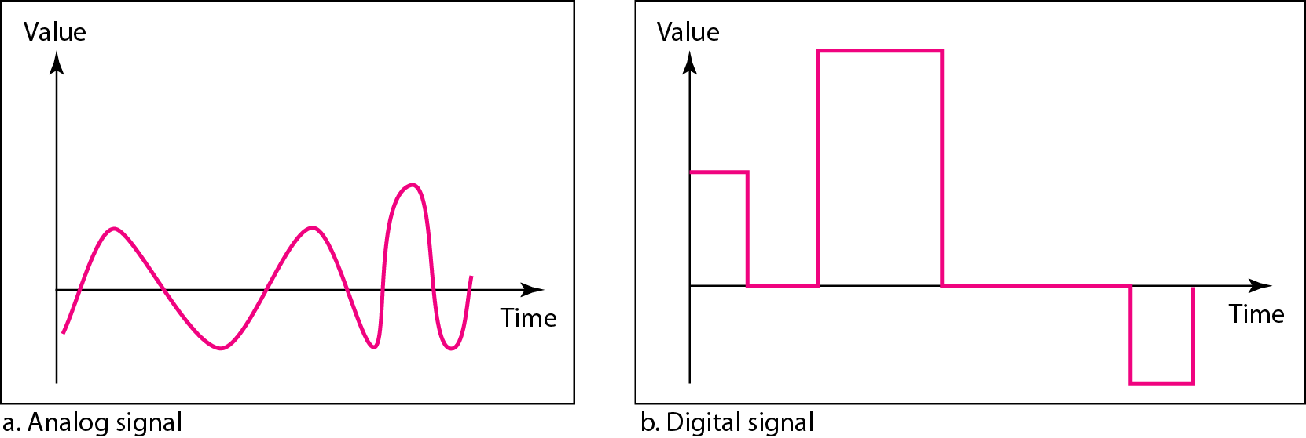
Figure 3.1 Comparison of analog and digital signals

Slide 5
Time domain concepts
Continuous signal
  Infinite number of points at any given time
Discrete signal
  Finite number of points at any given time; maintains a constant level then changes to another constant level
Periodic signal
  Pattern repeated over time
Aperiodic (non-periodic) signal
  Pattern not repeated over time

Slide 6
Time domain concepts
In data communications, we commonly use periodic analog signals and nonperiodic digital signals.
Periodic analog signals can be classified as simple or composite.
A simple periodic analog signal, a sine wave, cannot be decomposed into simpler signals.
A composite periodic analog signal is composed of multiple sine waves.

Slide 7
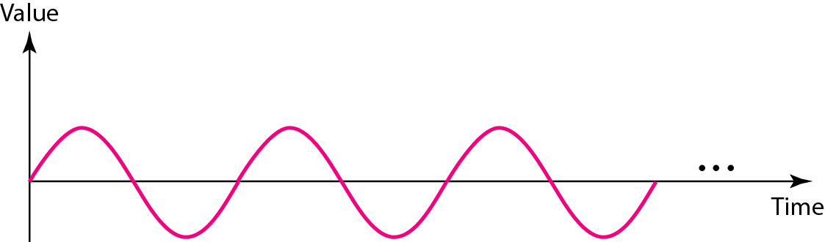
Figure 3.2 A sine wave

Slide 8
Periodic analog Signal Properties
All signals are composed of three properties:
  Amplitude
  Frequency
  Phase

Slide 9
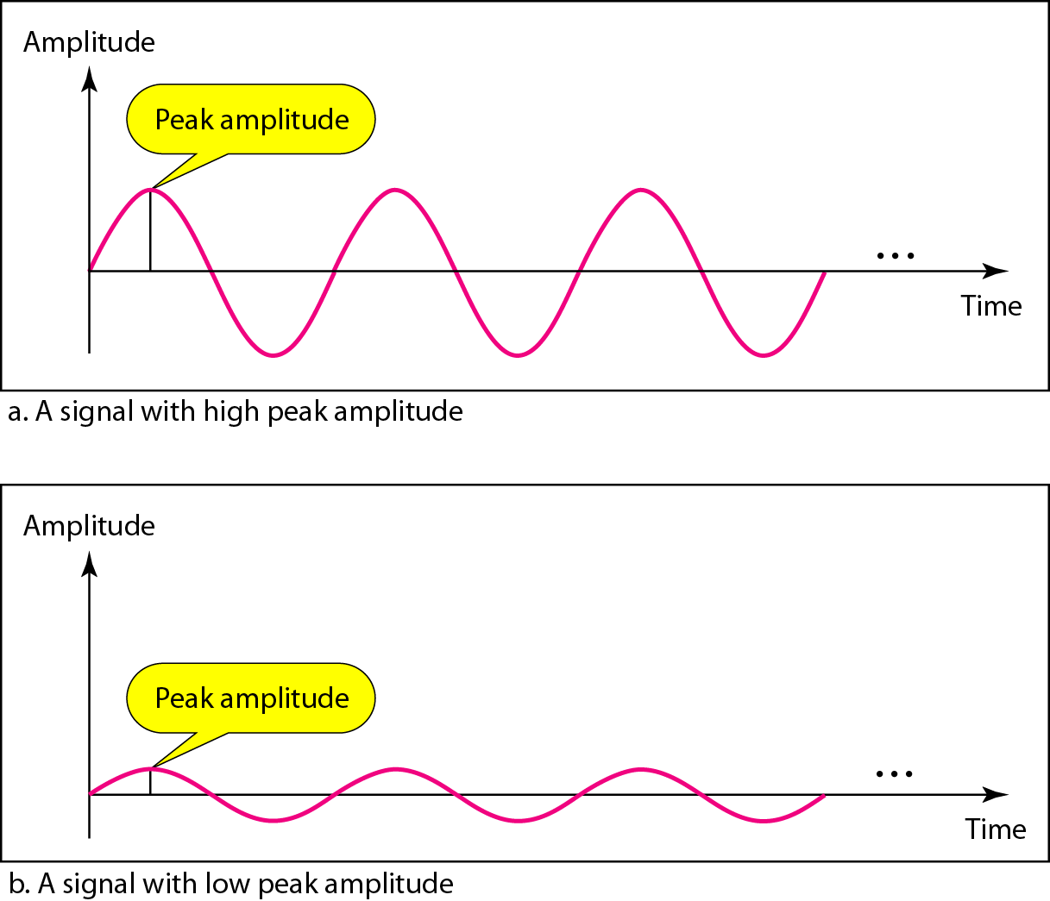
Figure 3.3 Two signals with the same phase and frequency,
but different amplitudes

Slide 10


Note
Frequency and period are the inverse of each other.

Slide 11
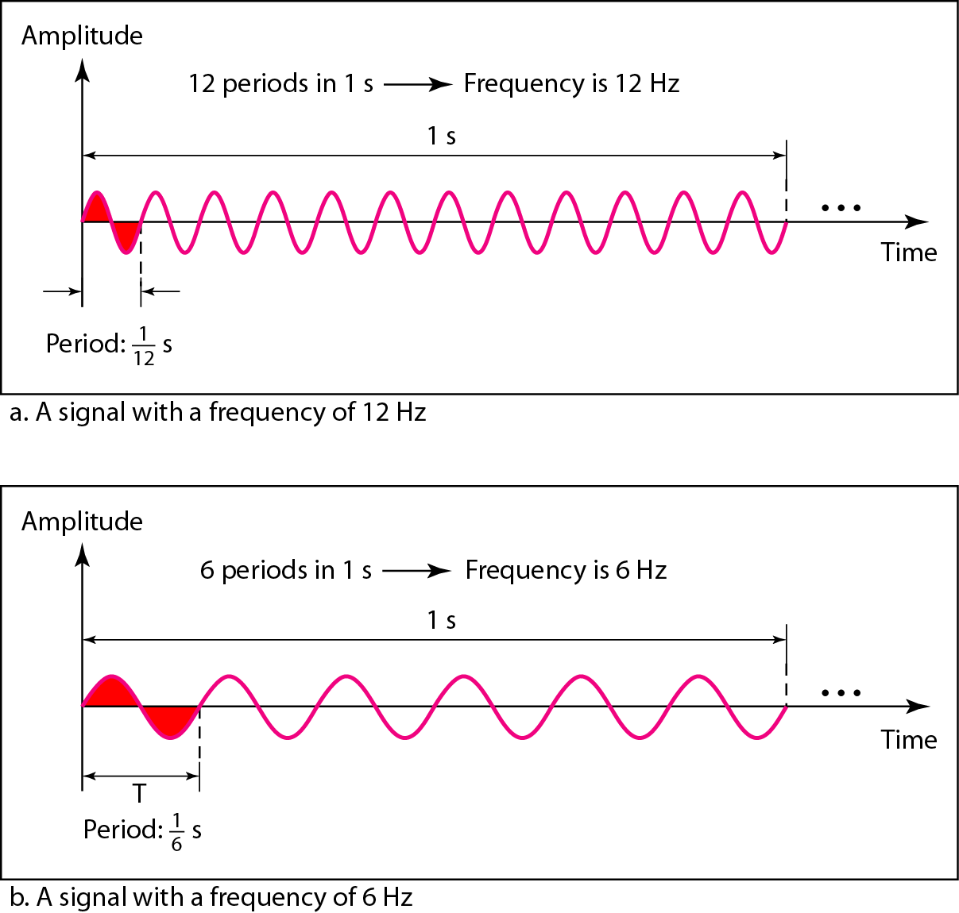
Figure 3.4 Two signals with the same amplitude and phase,
but different frequencies

Slide 12
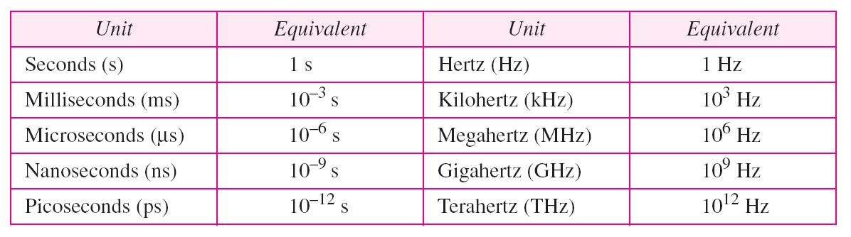
Table 3.1 Units of period and frequency

Slide 13
Example 3.3
The power we use at home has a frequency of 60 Hz. The period of this sine wave can be determined as follows:

Slide 14
Example 3.5
The period of a signal is 100 ms. What is its frequency in kilohertz?
Solution
First we change 100 ms to seconds, and then we calculate the frequency from the period (1 Hz = 10⁻³ kHz).

Slide 15
Note
Frequency is the rate of change with respect to time.
Change in a short span of time
means high frequency.
Change over a long span of
time means low frequency.

Slide 16
Note
If a signal does not change at all, its frequency is zero.
If a signal changes instantaneously, its frequency is infinite.

Slide 17
Note
Phase describes the position of the waveform relative to time 0.

Slide 18
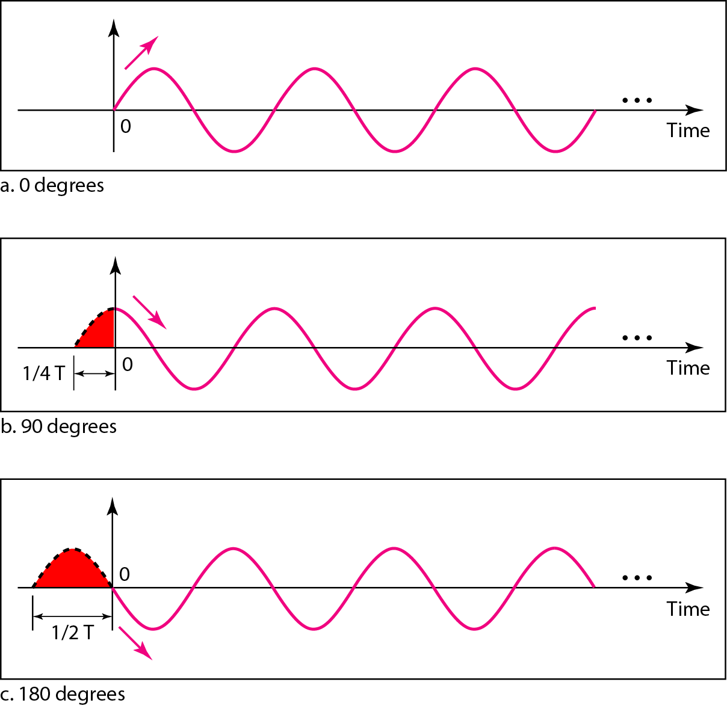
Figure 3.5 Three sine waves with the same amplitude and frequency,
but different phases

Slide 19
Example 3.6
A sine wave is offset 1/6 cycle with respect to time 0. What is its phase in degrees and radians?
Solution
We know that 1 complete cycle is 360°. Therefore, 1/6 cycle is

Slide 20
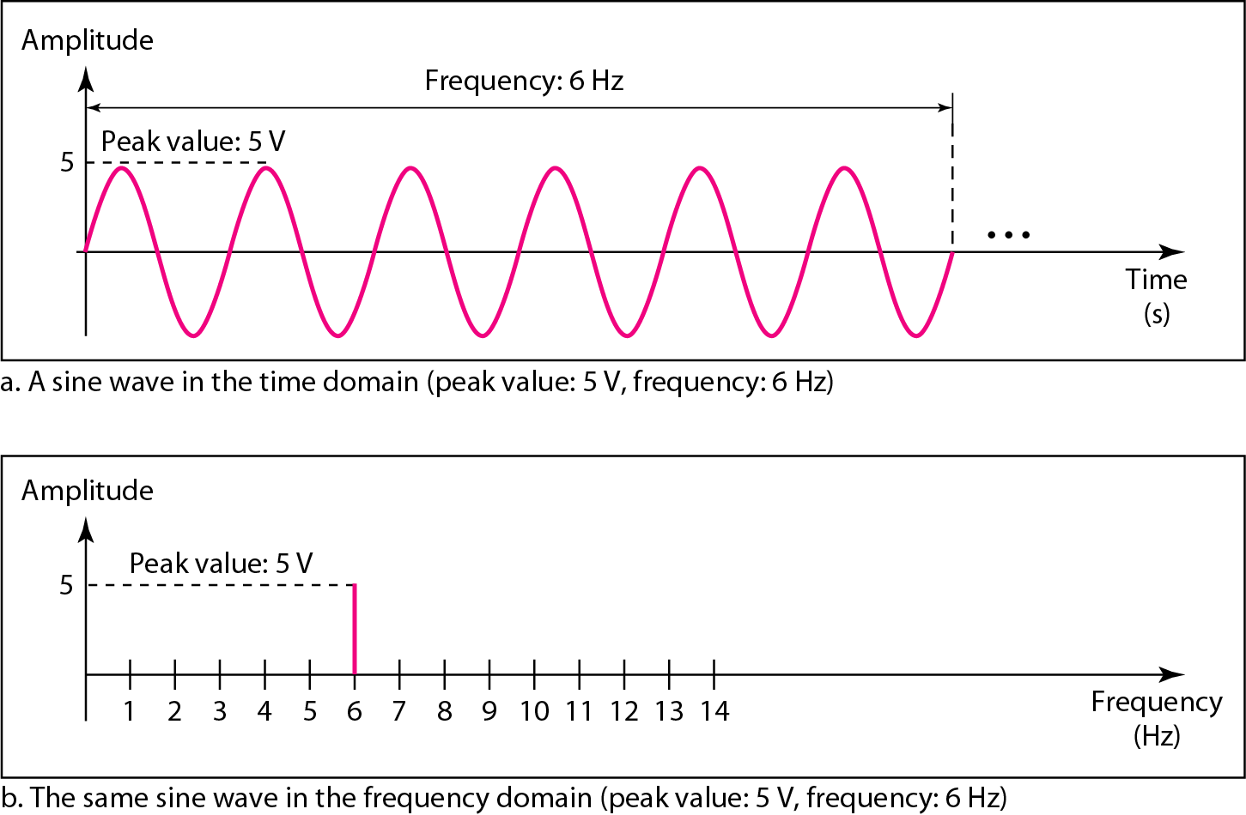
Figure 3.7 The time-domain and frequency-domain plots of a sine wave

Slide 21
Example 3.7
The frequency domain is more compact and useful when we are dealing with more than one sine wave. For example, Figure 3.8 shows three sine waves, each with different amplitude and frequency. All can be represented by three spikes in the frequency domain.

Slide 22
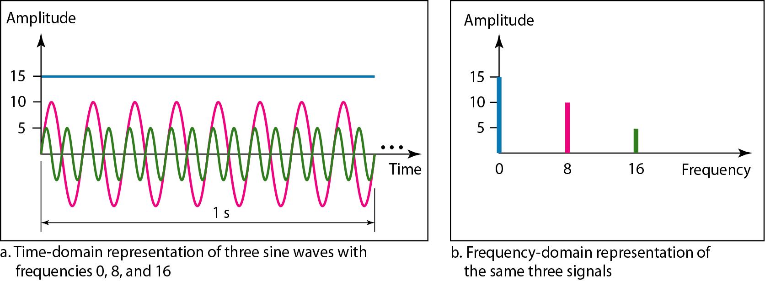
Figure 3.8 The time domain and frequency domain of three sine waves

Slide 23
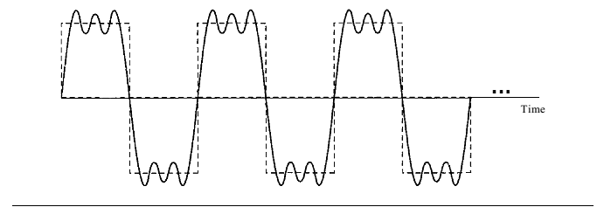
A Composite periodic signal

Slide 24
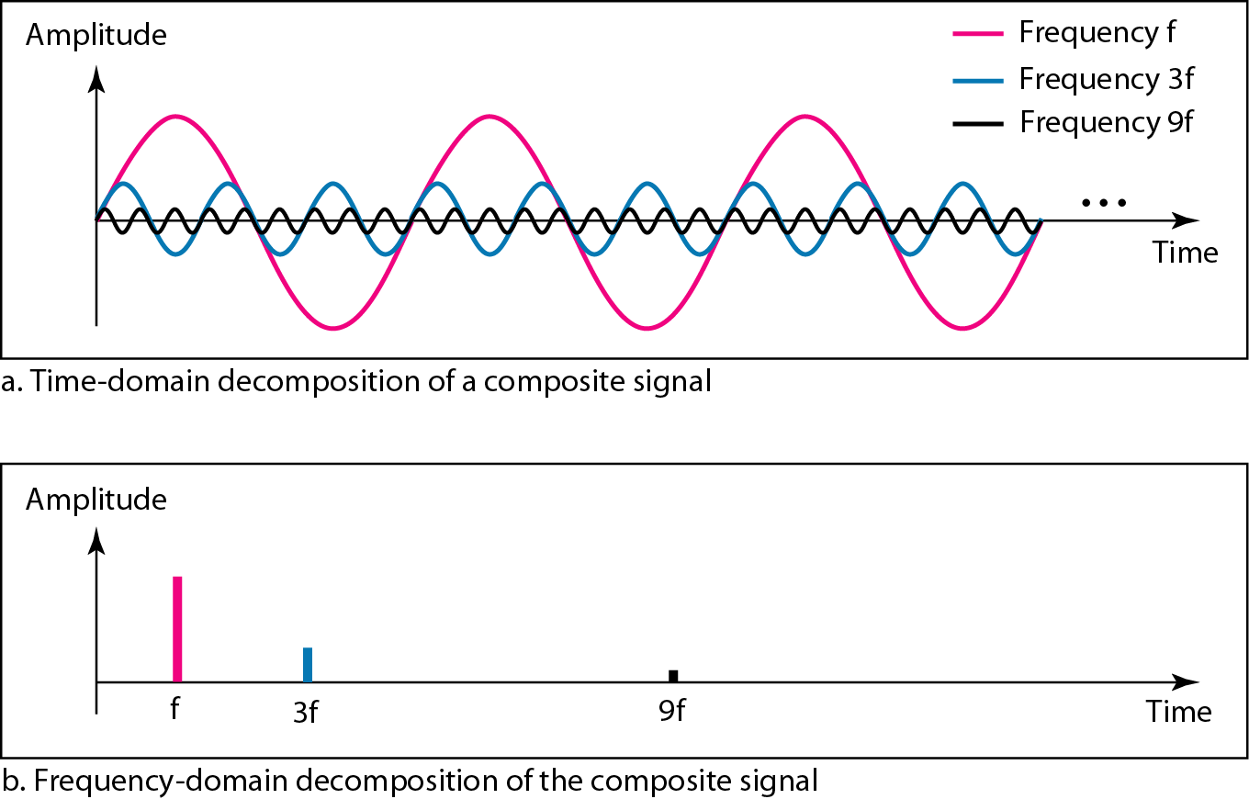
Figure 3.10 Decomposition of a composite periodic signal in the time and
frequency domains

Slide 25
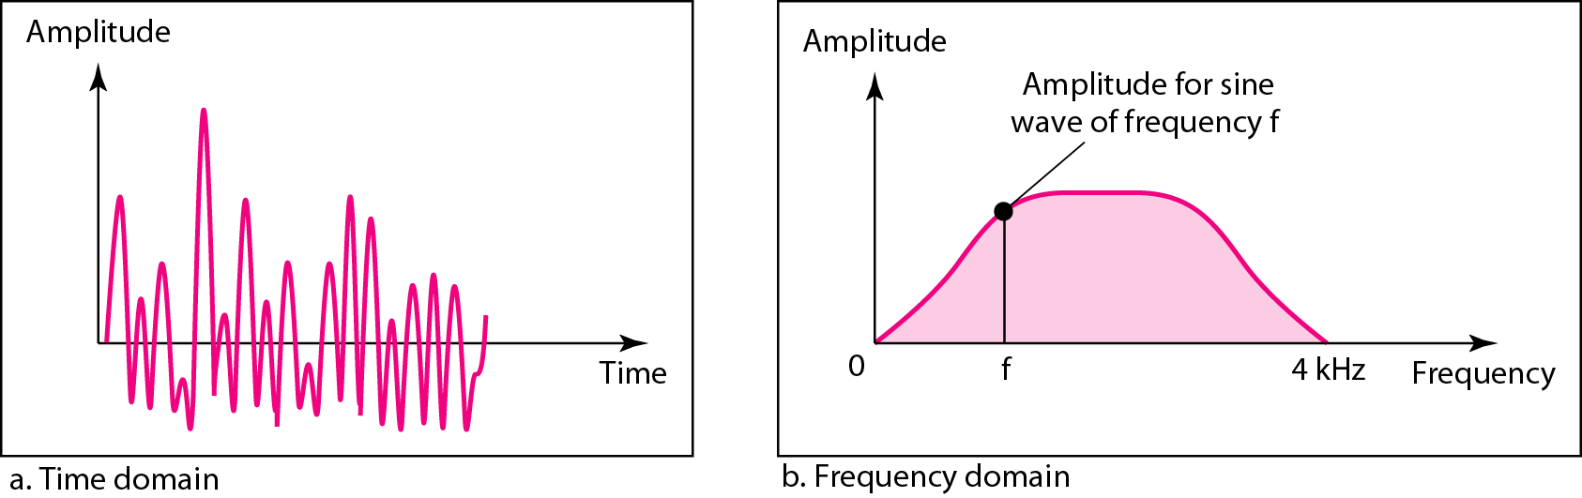
Figure 3.11 The time and frequency domains of a nonperiodic signal, such
someone speaking into a microphone

Slide 26
Note
The bandwidth of a composite signal is the difference between the
highest and the lowest frequencies contained in that signal.

Slide 27
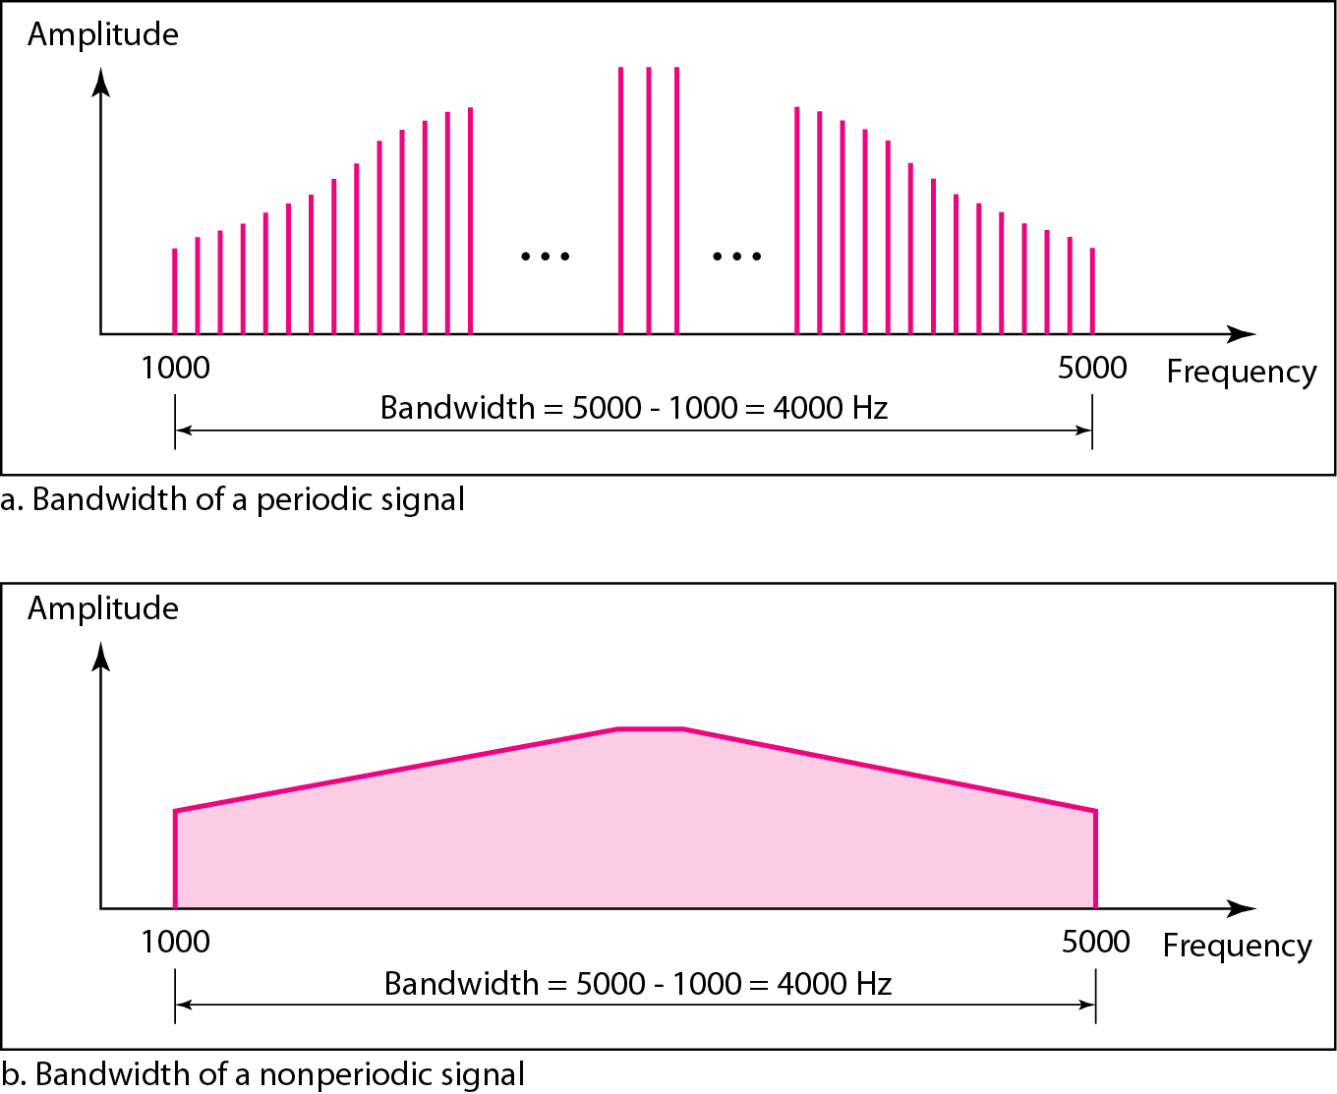
Figure 3.12 The bandwidth of periodic and nonperiodic composite signals
Note: each
frequency is
identifiable
Note:
frequencies
are all over
the place

Slide 28
Example 3.10
If a periodic signal is decomposed into five sine waves with frequencies of 100, 300, 500, 700, and 900 Hz, what is its bandwidth? Draw the spectrum (range of frequencies), assuming all components have a maximum amplitude of 10 V. Frequency domain plot

Slide 29
Example 3.10
Solution
Let f_{h} be the highest frequency, f_{l} the lowest frequency, and B the bandwidth. Then
The spectrum has only five spikes, at 100, 300, 500, 700, and 900 Hz (see Figure 3.13).

Slide 30
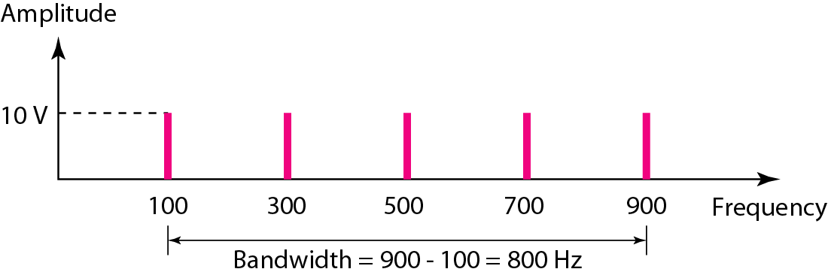
Figure 3.13 The bandwidth for Example 3.10

Slide 31
Example 3.12
A nonperiodic composite signal has a bandwidth of 200 kHz, with a middle frequency of 140 kHz and peak amplitude of 20 V. The two extreme frequencies have an amplitude of 0. Draw the frequency domain of the signal.

Slide 32
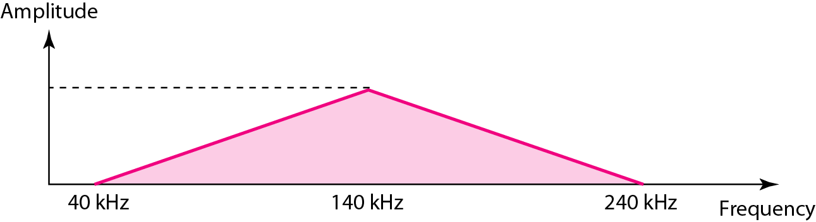
Figure 3.15 The bandwidth for Example 3.12
Solution
The lowest frequency must be at 40 kHz and the highest at 240 kHz. Figure 3.15 shows the frequency domain and the bandwidth.

