Slide 1
Digital Transmission

Slide 2
4-1 DIGITAL-TO-DIGITAL CONVERSION
In this section, we see how we can represent digital data by using digital signals. The conversion involves three techniques: line coding, block coding, and scrambling. Line coding is always needed; block coding and scrambling may or may not be needed
Topics discussed in this section:
Line Coding
Line Coding Schemes
Block Coding
Scrambling
4.<number>

Slide 3
Line Coding
Converting a string of 1’s and 0’s (digital data) into a sequence of signals that denote the 1’s and 0’s.
For example a high voltage level (+V) could represent a “1” and a low voltage level (0 or -V) could represent a “0”.
4.<number>

Slide 4

Figure 4.1 Line coding and decoding
4.<number>

Slide 5
Mapping Data element onto Signal element
A data symbol (or element) can consist of a number of data bits:
  1 , 0 or
  11, 10, 01, ……
A data symbol can be coded into a single signal element or multiple signal elements
  1 -> +V, 0 -> -V
  1 -> +V and -V, 0 -> -V and +V
The ratio ‘r’ is the number of data elements carried by a signal element.
4.<number>

Slide 6

Figure 4.2 Signal element versus data element
4.<number>

Slide 7
Relationship between data rate and signal rate
The data rate defines the number of bits sent per sec - bps. It is often referred to the bit rate.
The signal rate is the number of signal elements sent in a second and is measured in bauds. It is also referred to as the modulation rate.
Goal is to increase the data rate whilst reducing the baud rate.
4.<number>

Slide 8
Data rate and Baud rate
The baud or signal rate can be expressed as:
S = c x N x 1/r bauds
where N is data rate
c is the case factor (worst, best & avg.)
r is the ratio between data element & signal element
4.<number>

Slide 9

Example 4.1
A signal is carrying data in which one data element is encoded as one signal element ( r = 1). If the bit rate is 100 kbps, what is the average value of the baud rate if c is between 0 and 1?
Solution
We assume that the average value of c is 1/2 . The baud rate is then
4.<number>

Slide 10

Note
Although the actual bandwidth of a digital signal is infinite, the effective bandwidth is finite.
4.<number>

Slide 11
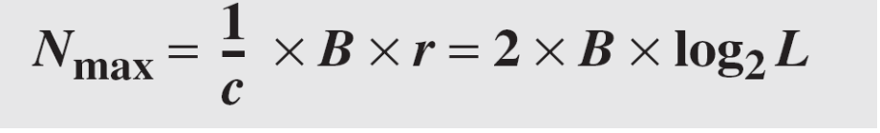
Example 4.2
The maximum data rate of a channel (see Chapter 3) is N_{max} = 2 × B × log₂ L (defined by the Nyquist formula). Does this agree with the previous formula for N_{max}?
Solution
A signal with L levels actually can carry log₂L bits per level. If each level corresponds to one signal element and we assume the average case (c = 1/2), then we have
4.<number>

Slide 12
Considerations for choosing a good signal element referred to as line encoding
Baseline wandering - a receiver will evaluate the average power of the received signal (called the baseline) and use that to determine the value of the incoming data elements. If the incoming signal does not vary over a long period of time, the baseline will drift and thus cause errors in detection of incoming data elements.
A good line encoding scheme will prevent long runs of fixed amplitude.
4.<number>

Slide 13
Line encoding C/Cs
DC components - when the voltage level remains constant for long periods of time, there is an increase in the low frequencies of the signal. Most channels are bandpass and may not support the low frequencies.
This will require the removal of the dc component of a transmitted signal.
4.<number>

Slide 14
Line encoding C/Cs
Self synchronization - the clocks at the sender and the receiver must have the same bit interval.
If the receiver clock is faster or slower it will misinterpret the incoming bit stream.
4.<number>

Slide 15

Figure 4.3 Effect of lack of synchronization
4.<number>

Slide 16
Example 4.3
In a digital transmission, the receiver clock is 0.1 percent faster than the sender clock. How many extra bits per second does the receiver receive if the data rate is
1 kbps? How many if the data rate is 1 Mbps?
Solution
At 1 kbps, the receiver receives 1001 bps instead of 1000 bps.
At 1 Mbps, the receiver receives 1,001,000 bps instead of 1,000,000 bps.
4.<number>

Slide 17
Line encoding C/Cs
Error detection - errors occur during transmission due to line impairments.
Some codes are constructed such that when an error occurs it can be detected. For example: a particular signal transition is not part of the code. When it occurs, the receiver will know that a symbol error has occurred.
4.<number>

Slide 18
Line encoding C/Cs
Noise and interference - there are line encoding techniques that make the transmitted signal “immune” to noise and interference.
This means that the signal cannot be corrupted, it is stronger than error detection.
4.<number>

Slide 19
Line encoding C/Cs
Complexity - the more robust and resilient the code, the more complex it is to implement and the price is often paid in baud rate or required bandwidth.
4.<number>

Slide 20

Figure 4.4 Line coding schemes
4.<number>

Slide 21
Unipolar
All signal levels are on one side of the time axis - either above or below
NRZ - Non Return to Zero scheme is an example of this code. The signal level does not return to zero during a symbol transmission.
Scheme is prone to baseline wandering and DC components. It has no synchronization or any error detection. It is simple but costly in power consumption.
4.<number>

Slide 22

Figure 4.5 Unipolar NRZ scheme
4.<number>

Slide 23
Polar - NRZ
The voltages are on both sides of the time axis.
Polar NRZ scheme can be implemented with two voltages.
There are two versions:
  NRZ - Level (NRZ-L) - positive voltage for one symbol and negative for the other
  NRZ - Inversion (NRZ-I) - the change or lack of change in polarity determines the value of a symbol. E.g. a “1” symbol inverts the polarity a “0” does not.
4.<number>

Slide 24

Figure 4.6 Polar NRZ-L and NRZ-I schemes
4.<number>

Slide 25
Note
In NRZ-L the level of the voltage determines the value of the bit.
In NRZ-I the inversion
or the lack of inversion
determines the value of the bit.
4.<number>

Slide 26
Note
NRZ-L and NRZ-I both have an average signal rate of N/2 Bd.
4.<number>

Slide 27
Note
NRZ-L and NRZ-I both have a DC component problem and baseline wandering, it is worse for NRZ-L. Both have no self synchronization &no error detection. Both are relatively simple to implement.
4.<number>

Slide 28
Example 4.4
A system is using NRZ-I to transfer 1-Mbps data. What are the average signal rate and minimum bandwidth?
Solution
The average signal rate is S= c x N x R = 1/2 x N x 1 = 500 kbaud. The minimum bandwidth for this average baud rate is B_{min} = S = 500 kHz.
Note c = 1/2 for the avg. case as worst case is 1 and best case is 0
4.<number>

Slide 29
Polar - RZ
The Return to Zero (RZ) scheme uses three voltage values. +, 0, -.
Each symbol has a transition in the middle. Either from high to zero or from low to zero.
This scheme has more signal transitions (two per symbol) and therefore requires a wider bandwidth.
No DC components or baseline wandering.
Self synchronization - transition indicates symbol value.
More complex as it uses three voltage level. It has no error detection capability.
4.<number>

Slide 30

Figure 4.7 Polar RZ scheme
4.<number>

Slide 31
Polar - Biphase: Manchester and Differential Manchester
Manchester coding consists of combining the NRZ-L and RZ schemes.
  Every symbol has a level transition in the middle: from high to low or low to high. Uses only two voltage levels.
Differential Manchester coding consists of combining the NRZ-I and RZ schemes.
  Every symbol has a level transition in the middle. But the level at the beginning of the symbol is determined by the symbol value. One symbol causes a level change the other does not.
4.<number>

Slide 32

Figure 4.8 Polar biphase: Manchester and differential Manchester schemes
4.<number>

Slide 33
Note
In Manchester and differential Manchester encoding, the transition
at the middle of the bit is used for synchronization.
4.<number>

Slide 34
Note
The minimum bandwidth of Manchester and differential Manchester is 2 times that of NRZ. The is no DC component and no baseline wandering. None of these codes has error detection.
4.<number>

Slide 35
Bipolar - AMI and Pseudoternary
Code uses 3 voltage levels: - +, 0, -, to represent the symbols (note not transitions to zero as in RZ).
Voltage level for one symbol is at “0” and the other alternates between + & -.
Bipolar Alternate Mark Inversion (AMI) - the “0” symbol is represented by zero voltage and the “1” symbol alternates between +V and -V.
Pseudoternary is the reverse of AMI.
4.<number>

Slide 36

Figure 4.9 Bipolar schemes: AMI and pseudoternary
4.<number>

Slide 37
Bipolar C/Cs
It is a better alternative to NRZ.
Has no DC component or baseline wandering.
Has no self synchronization because long runs of “0”s results in no signal transitions.
No error detection.
4.<number>

Slide 38
Summary of line coding schemes
1.unipolar-NRZ
1->+ve voltage
0->0 Voltage
2.Polar
NRZ-L
0->+ve voltage
1-> -ve voltage
NRZ-I
0-> no transition
1-> transition
RZ
+,-ve,0
signal goes to zero in the middle
Polar Biphase
Manchester encoding
1-> low to high transition at middle
0-> high to low transition
Differential Manchester
0-> transition at beginning of bit
1-> absence of transition
3. Bipolar Encoding
AMI
0-> no voltage
1->alternate + and –ve voltage
Pseudoternary
1->0 voltage
0->alternate + and –ve voltage

Slide 39
Represent signal encoding for the binary sequence 01001 using
1.NRZ-L
2.NRZ-I
3.AMI
4.Pseudoternary
5.Manchester
6.Differential Manchester

Slide 40
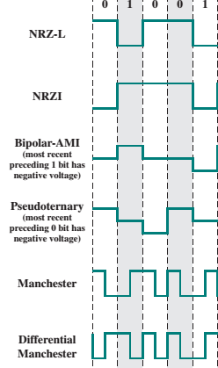
Solution

Slide 41
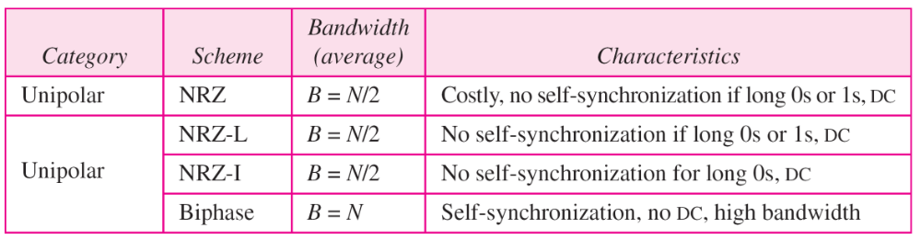

Table 4.1 Summary of line coding schemes
4.<number>

Slide 42
Block Coding
For a code to be capable of error detection, we need to add redundancy, i.e., extra bits to the data bits.
Synchronization also requires redundancy - transitions are important in the signal flow and must occur frequently.
Block coding is done in three steps: division, substitution and combination.
It is distinguished from multilevel coding by use of the slash - xB/yB.
The resulting bit stream prevents certain bit combinations that when used with line encoding would result in DC components or poor sync. quality.
4.<number>

Slide 43
Note
Block coding is normally referred to as mB/nB coding;
it replaces each m-bit group with an
n-bit group.
4.<number>

Slide 44

Figure 4.14 Block coding concept
4.<number>

Slide 45

Figure 4.15 Using block coding 4B/5B with NRZ-I line coding scheme
4.<number>

Slide 46
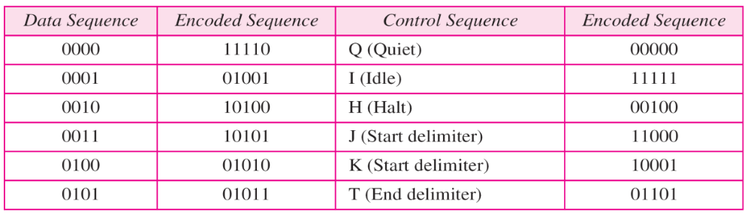

Table 4.2 4B/5B mapping codes
4.<number>

Slide 47

Figure 4.16 Substitution in 4B/5B block coding
4.<number>

Slide 48
Redundancy
A 4 bit data word can have 24 combinations.
A 5 bit word can have 25=32 combinations.
We therefore have 32 - 26 = 16 extra words.
Some of the extra words are used for control/signalling purposes.
4.<number>

Slide 49
Example 4.5
We need to send data at a 1-Mbps rate. What is the minimum required bandwidth, using a combination of 4B/5B and NRZ-I or Manchester coding?
Solution
First 4B/5B block coding increases the bit rate to 1.25 Mbps. The minimum bandwidth using NRZ-I is N/2 or 625 kHz. The Manchester scheme needs a minimum bandwidth of 1.25 MHz. The first choice needs a lower bandwidth, but has a DC component problem; the second choice needs a higher bandwidth, but does not have a DC component problem.
4.<number>

Slide 50

Figure 4.17 8B/10B block encoding
4.<number>

Slide 51
More bits - better error detection
The 8B10B block code adds more redundant bits and can thereby choose code words that would prevent a long run of a voltage level that would cause DC components.
4.<number>

Slide 52
Scrambling
The best code is one that does not increase the bandwidth for synchronization and has no DC components.
Scrambling is a technique used to create a sequence of bits that has the required c/c’s for transmission - self clocking, no low frequencies, no wide bandwidth.
It is implemented at the same time as encoding, the bit stream is created on the fly.
It replaces ‘unfriendly’ runs of bits with a violation code that is easy to recognize and removes the unfriendly c/c.
4.<number>

Slide 53

Figure 4.18 AMI used with scrambling
4.<number>

Slide 54
For example: B8ZS substitutes eight consecutive zeros with 000VB0VB.
The V stands for violation, it violates the line encoding rule
B stands for bipolar, it implements the bipolar line encoding rule
4.<number>

Slide 55

Figure 4.19 Two cases of B8ZS scrambling technique
4.<number>

Slide 56
HDB3 substitutes four consecutive zeros with 000V or B00V depending
on the number of nonzero pulses after the last substitution.
If # of non zero pulses is even the substitution is B00V to make total # of non zero pulse even.
If # of non zero pulses is odd the substitution is 000V to make total # of non zero pulses even.
4.<number>

Slide 57

Figure 4.20 Different situations in HDB3 scrambling technique
4.<number>

