Slide 1
Error Detection
and
Correction
10.

Slide 2

Note
The Hamming distance between two words is the number of differences between corresponding bits.
10.

Slide 3

Example 10.4
Let us find the Hamming distance between two pairs of words.
1. The Hamming distance d(000, 011) is 2 because
2. The Hamming distance d(10101, 11110) is 3 because
10.

Slide 4
Note
The minimum Hamming distance is the smallest Hamming distance between
all possible pairs in a set of words.
10.

Slide 5
Example 10.5
Find the minimum Hamming distance of the coding scheme in Table 10.1.
Solution
We first find all Hamming distances.
The d_{min} in this case is 2.
10.

Slide 6
Example 10.6
Find the minimum Hamming distance of the coding scheme in Table 10.2.
Solution
We first find all the Hamming distances.
The d_{min} in this case is 3.
10.

Slide 7
Note
To guarantee the detection of up to s errors in all cases, the minimum
Hamming distance in a block
code must be d_{min} = s + 1.
10.

Slide 8
Example 10.7
The minimum Hamming distance for our first code scheme (Table 10.1) is 2. This code guarantees detection of only a single error. For example, if the third codeword (101) is sent and one error occurs, the received codeword does not match any valid codeword. If two errors occur, however, the received codeword may match a valid codeword and the errors are not detected.
10.

Slide 9
Example 10.8
Our second block code scheme (Table 10.2) has d_{min} = 3. This code can detect up to two errors. Again, we see that when any of the valid codewords is sent, two errors create a codeword which is not in the table of valid codewords. The receiver cannot be fooled.
However, some combinations of three errors change a valid codeword to another valid codeword. The receiver accepts the received codeword and the errors are undetected.
10.

Slide 10

Figure 10.8 Geometric concept for finding d_{min} in error detection
10.

Slide 11

Figure 10.9 Geometric concept for finding d_{min} in error correction
10.

Slide 12
Note
To guarantee correction of up to t errors in all cases, the minimum Hamming distance in a block code
must be d_{min} = 2t + 1.
10.

Slide 13
Example 10.9
A code scheme has a Hamming distance d_{min} = 4. What is the error detection and correction capability of this scheme?
Solution
This code guarantees the detection of up to three errors
(s = 3), but it can correct up to one error. In other words,
if this code is used for error correction, part of its capability is wasted. Error correction codes need to have an odd minimum distance (3, 5, 7, . . . ).
10.

Slide 14
10-3 LINEAR BLOCK CODES
Almost all block codes used today belong to a subset called linear block codes. A linear block code is a code in which the exclusive OR (addition modulo-2) of two valid codewords creates another valid codeword.
Topics discussed in this section:
Minimum Distance for Linear Block Codes
Some Linear Block Codes
10.

Slide 15
Note
In a linear block code, the exclusive OR (XOR) of any two valid codewords creates another valid codeword.
10.

Slide 16
Example 10.10
Let us see if the two codes we defined in Table 10.1 and Table 10.2 belong to the class of linear block codes.
1. The scheme in Table 10.1 is a linear block code
because the result of XORing any codeword with any
other codeword is a valid codeword. For example, the
XORing of the second and third codewords creates the
fourth one.
2. The scheme in Table 10.2 is also a linear block code.
We can create all four codewords by XORing two
other codewords.
10.

Slide 17
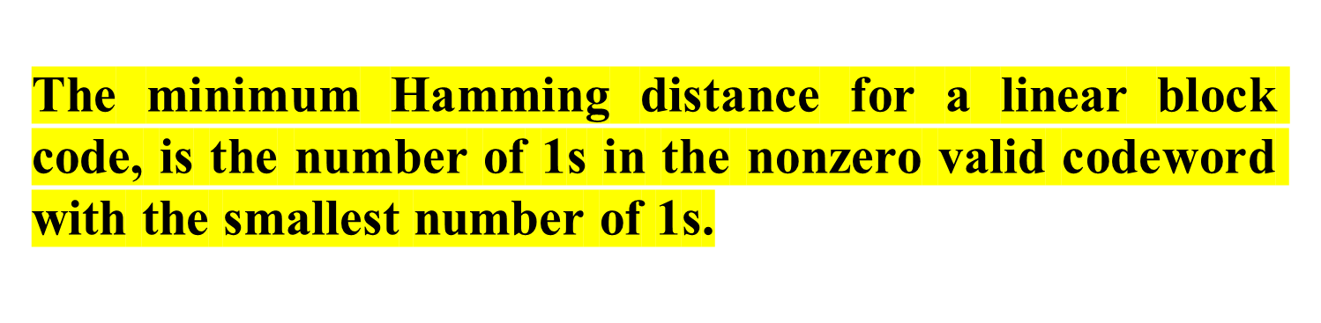
Example 10.11
In our first code (Table 10.1), the numbers of 1s in the nonzero codewords are 2, 2, and 2. So the minimum Hamming distance is d_{min} = 2. In our second code (Table 10.2), the numbers of 1s in the nonzero codewords are 3, 3, and 4. So in this code we have d_{min} = 3.
10.

Slide 18
Note
A simple parity-check code is a
single-bit error-detecting
code in which
n = k + 1 with d_{min} = 2.
Even parity (ensures that a codeword has an even number of 1’s) and odd parity (ensures that there are an odd number of 1’s in the codeword)
10.

Slide 19
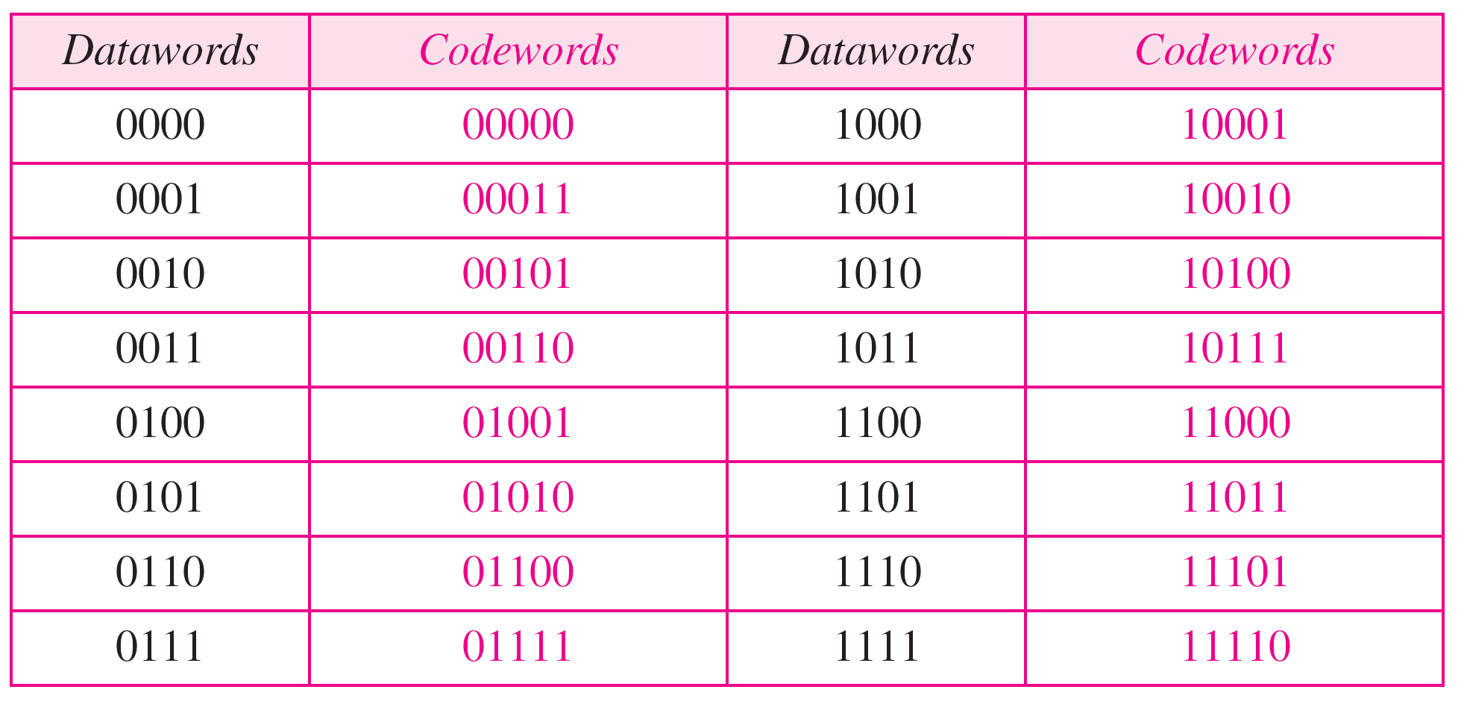
Table 10.3 Simple parity-check code C(5, 4)
10.

Slide 20

Figure 10.10 Encoder and decoder for simple parity-check code
10.

Slide 21
Example 10.12
Let us look at some transmission scenarios. Assume the sender sends the dataword 1011. The codeword created from this dataword is 10111, which is sent to the receiver. We examine five cases:
1. No error occurs; the received codeword is 10111. The
syndrome is 0. The dataword 1011 is created.
2. One single-bit error changes a₁ . The received
codeword is 10011. The syndrome is 1. No dataword
is created.
3. One single-bit error changes r₀ . The received codeword
is 10110. The syndrome is 1. No dataword is created.
10.

Slide 22
Example 10.12 (continued)
4. An error changes r₀ and a second error changes a₃ .
The received codeword is 00110. The syndrome is 0.
The dataword 0011 is created at the receiver. Note that
here the dataword is wrongly created due to the
syndrome value.
5. Three bits—a₃, a₂, and a₁—are changed by errors.
The received codeword is 01011. The syndrome is 1.
The dataword is not created. This shows that the simple
parity check, guaranteed to detect one single error, can
also find any odd number of errors.
10.

Slide 23
Note
A simple parity-check code can detect an odd number of errors.
10.

Slide 24
Note
All Hamming codes discussed in this book have d_{min} = 3 (2 bit error detection and single bit error correction).
A codeword consists of n bits of which k are data bits and r are check bits.
Let m = r, then we have: n = 2^{m} -1
and k = n-m
10.

Slide 25

Figure 10.11 Two-dimensional parity-check code
10.

Slide 26

Figure 10.11 Two-dimensional parity-check code
10.

Slide 27

Figure 10.11 Two-dimensional parity-check code
10.

Slide 28
Calculating the parity bits at the transmitter
:
Modulo 2 arithmetic:
r0 = a2 + a1 + a0
r1 = a3 + a2 + a1
r2 = a2 + a0 + a3
Calculating the syndrome at the receiver:
s0 = b2 + b1 + b0
s1 = b3 + b2 + b1
s2 = b1 + b0 + b3
10.

Slide 29

Table 10.5 Logical decision made by the correction logic analyzer
10.

Slide 30
Example 10.13
Let us trace the path of three datawords from the sender to the destination:
1. The dataword 0100 becomes the codeword 0100011.
The codeword 0100011 is received. The syndrome is
000, the final dataword is 0100.
2. The dataword 0111 becomes the codeword 0111001.
The received codeword is: 0011001. The syndrome is 011. After flipping b₂ (changing the 1 to 0), the final dataword is 0111.
3. The dataword 1101 becomes the codeword 1101000.
The syndrome is 101. After flipping b₀, we get 0000,
the wrong dataword. This shows that our code cannot
correct two errors.
10.

Slide 31
Example 10.14
We need a dataword of at least 7 bits. Calculate values of k and n that satisfy this requirement.
Solution
We need to make k = n − m greater than or equal to 7, or 2m − 1 − m ≥ 7.
1. If we set m = 3, the result is n = 2³ − 1=7 and k = 7 − 3,
or 4, which is < 7.
2. If we set m = 4, then n = 2⁴ − 1 = 15 and k = 15 − 4 =
11, which satisfies the condition k>7. So the code is
C(15, 11)
10.

Slide 32
Burst Errors
Burst errors are very common, in particular in wireless environments where a fade will affect a group of bits in transit. The length of the burst is dependent on the duration of the fade.
One way to counter burst errors, is to break up a transmission into shorter words and create a block (one word per row), then have a parity check per word.
The words are then sent column by column. When a burst error occurs, it will affect 1 bit in several words as the transmission is read back into the block format and each word is checked individually.

Slide 33

Figure 10.13 Burst error correction using Hamming code
10.

Slide 34
10-4 CYCLIC CODES
Cyclic codes are special linear block codes with one extra property. In a cyclic code, if a codeword is cyclically shifted (rotated), the result is another codeword.
Topics discussed in this section:
Cyclic Redundancy Check
Polynomials
Cyclic Code Analysis
Advantages of Cyclic Codes
10.

Slide 35
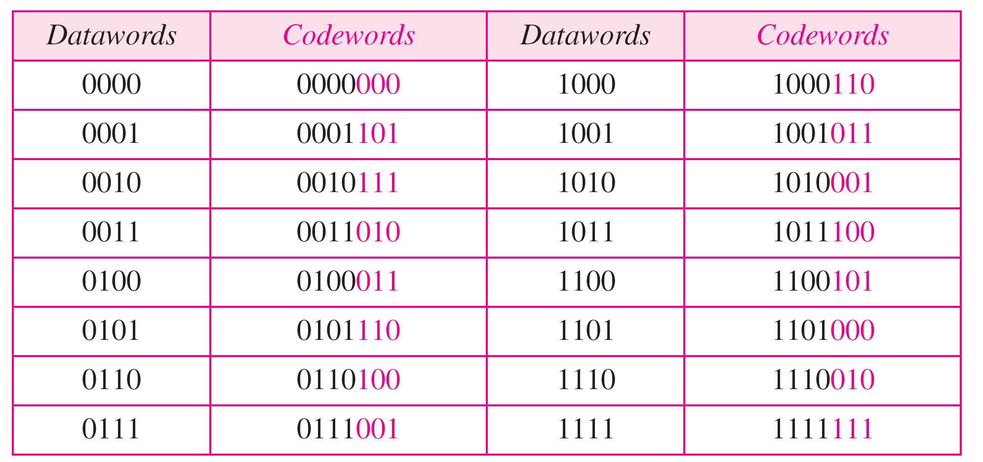
Table 10.4 CRC code C(7, 4) - n=7, k = 4
10.

Slide 36

Figure 10.12 The structure of the encoder and decoder for a CRC code
10.

Slide 37

Table 10.6 A CRC code with C(7, 4)
10.

Slide 38
Modulo 2 arithmetic Division
Modulo 2 arithmetic works like clock arithmetic.
In clock arithmetic, if we add 2 hours to 11:00, we get 1:00.
In modulo 2 arithmetic if we add 1 to 1, we get 0. The addition (substraction) rules
⁰ ⁺ ⁰ ⁼ ⁰ ⁰ ⁺ ¹ ⁼ ¹
¹ ⁺ ⁰ ⁼ ¹ ¹ ⁺ ¹ ⁼ ⁰

Slide 39
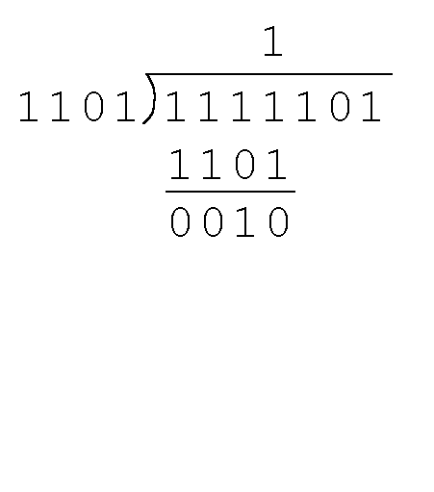
2.8 Error Detection and Correction
Find the quotient and remainder when 1111101 is divided by 1101 in modulo 2 arithmetic.
  As with traditional division, we note that the dividend is divisible once by the divisor.
  We place the divisor under the dividend and perform modulo 2 subtraction.

Slide 40
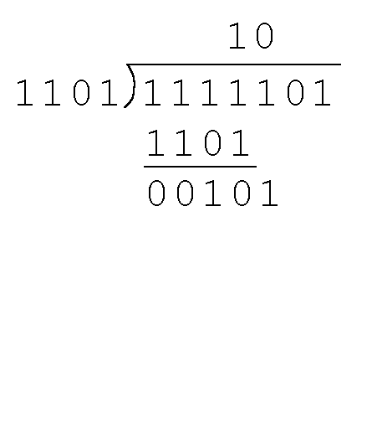
2.8 Error Detection and Correction
Find the quotient and remainder when 1111101 is divided by 1101 in modulo 2 arithmetic…
  Now we bring down the next bit of the dividend.
  We see that 00101 is not divisible by 1101. So we place a zero in the quotient.

Slide 41
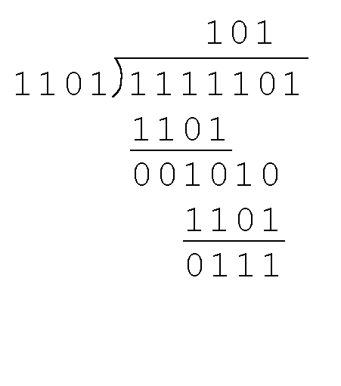
2.8 Error Detection and Correction
Find the quotient and remainder when 1111101 is divided by 1101 in modulo 2 arithmetic…
  1010 is divisible by 1101 in modulo 2.
  We perform the modulo 2 subtraction.

Slide 42
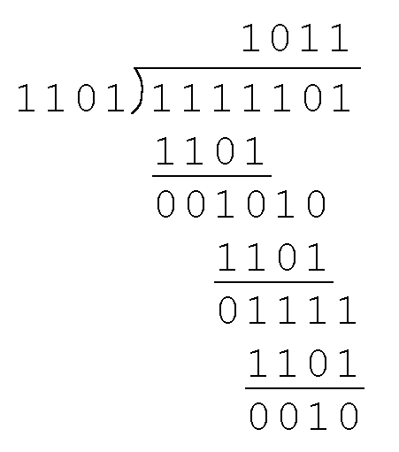
2.8 Error Detection and Correction
Find the quotient and remainder when 1111101 is divided by 1101 in modulo 2 arithmetic…
  We find the quotient is 1011, and the remainder is 0010.
This procedure is very useful to us in calculating CRC syndromes.
Note: The divisor in this example corresponds to a modulo 2 polynomial: X ³ + X ² + 1.

Slide 43
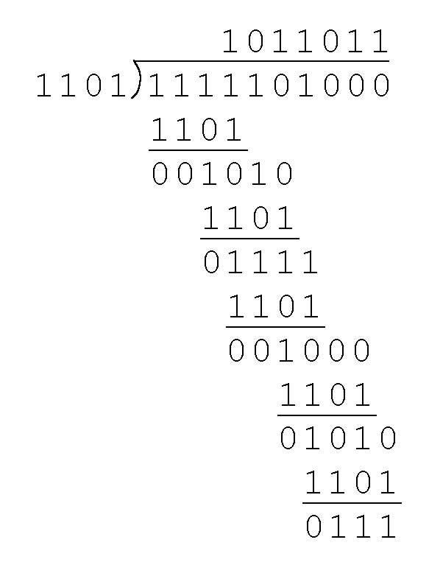
2.8 Error Detection and Correction
Suppose we want to transmit the information string: 1111101.
The receiver and sender decide to use the (arbitrary) polynomial pattern, 1101.
The information string is shifted left by one position less than the number of positions in the divisor.
The remainder is found through modulo 2 division (at right) and added to the information string: 1111101000 + 111 = 1111101111.

Slide 44
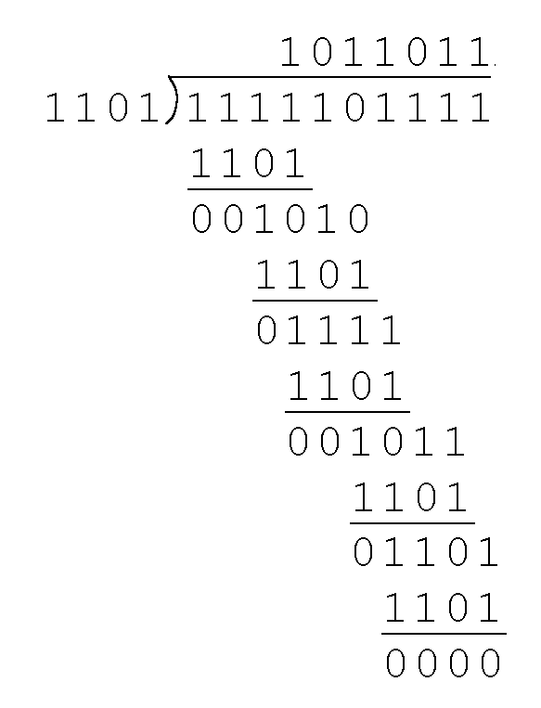
2.8 Error Detection and Correction
If no bits are lost or corrupted, dividing the received information string by the agreed upon pattern will give a remainder of zero.
We see this is so in the calculation at the right.
Real applications use longer polynomials to cover larger information strings.
  Some of the standard poly-nomials are listed in the text.

Slide 45
2.8 Error Detection and Correction
Data transmission errors are easy to fix once an error is detected.
  Just ask the sender to transmit the data again.
In computer memory and data storage, however, this cannot be done.
  Too often the only copy of something important is in memory or on disk.
Thus, to provide data integrity over the long term, error correcting codes are required.

Slide 46

Figure 10.14 CRC encoder and decoder
10.

Slide 47



Data: 1000 Divisor: 1011
What is the codeword?
10.<number>

Slide 48
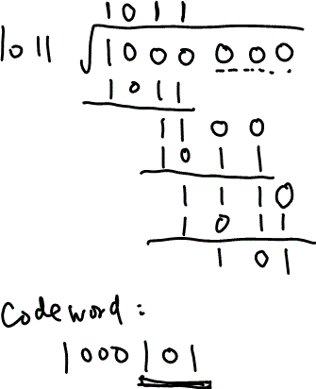
Data: 1000 Divisor: 1011
What is the codeword?
10.<number>

Slide 49
Data: 1010 Divisor: 10111
What is the codeword?
10.<number>

Slide 50
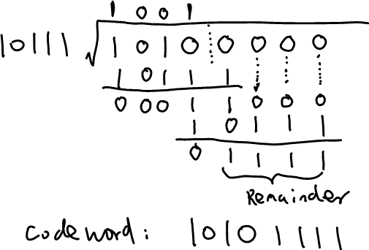
Data: 1010 Divisor: 10111
What is the codeword?
10.<number>

Slide 51

Figure 10.15 Division in CRC encoder
10.

Slide 52

Figure 10.16 Division in the CRC decoder for two cases
10.

Slide 53
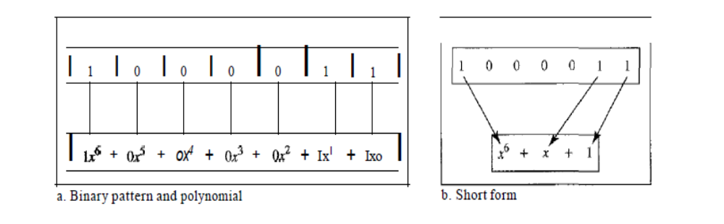
A polynomial to represent a binary word

