Slide 1
SLM FUNDAMENTALS & ARCHITECTURE
How Small Language Model (SLM) Works
What is a Small Language Model?
• A Small Language Model (SLM) is a compact, highly efficient AI neural network designed for natural language understanding and generation.
• Typically contains under 10 Billion parameters (e.g. 500M to 3.8B params).
• Trained using curated, high-quality domain-specific datasets and synthetic data.
• Basic Pipeline: Input Text → Tokenization → Embedding & Transformer Attention → Probability Logits → Output Token Generation.
• Learns statistical word, sentence, and semantic relationships without massive compute requirements.
Key Advantages of SLMs
✔ Ultra-Low Latency & High Speed:
Generates responses in milliseconds due to small parameter footprint.
✔ Low Memory & Hardware Requirements:
Can run locally on CPUs, edge devices, laptops, and mobile phones without high-end GPUs.
✔ Cost-Efficient:
Drastically reduces cloud API inference costs and carbon footprint.
✔ Enhanced Privacy & Data Security:
Processes sensitive technical data locally offline without sending information to cloud servers.
✔ Easy Domain Adaptability:
Quick to fine-tune on domain-specific datasets (e.g. Malayalam translation).

Slide 2
SLM MODEL TAXONOMY
SLM Architectures & Popular SLM Models
Core SLM Architectures:
1. Decoder-Only (Autoregressive - e.g. Phi-3, Llama 3.2) | 2. Encoder-Only (Contextual - e.g. MobileBERT) | 3. Encoder-Decoder (Seq2Seq - e.g. NLLB-200 600M, T5-Small)
Model Name | Year | Characteristics | Companies Using | Limitations | Products Created | Architecture
NLLB-200 Distilled (Used in Project) | 2022 | 600M params, Seq2Seq multilingual translation across 200+ languages including Malayalam. | Meta, Wikimedia Foundation, NLP Researchers | Focused solely on translation; lacks multi-turn conversational reasoning. | Facebook/Insta post translation, Wikipedia translation tool | Encoder-Decoder
Phi-3-mini | 2024 | 3.8B params, state-of-the-art synthetic data training, 128k context window. | Microsoft, Azure AI developers, Healthcare apps | Higher memory than 600M models; slight hallucination on complex math. | Microsoft Copilot local features, Azure AI Edge | Decoder-only
Llama-3.2 (1B/3B) | 2024 | 1B & 3B lightweight params, Qualcomm/MediaTek mobile optimization, text+vision. | Meta, Qualcomm, MediaTek, Edge AI developers | Lower world knowledge capacity than Llama 70B. | Meta AI mobile assistant, On-device edge features | Decoder-only
Gemma-2B | 2024 | 2B params, built from Gemini tech, open weights, safety aligned. | Google, Kaggle community, Android app devs | Limited long-context multi-step reasoning capabilities. | Google AI Edge, Android AICore features | Decoder-only

Slide 3
LARGE LANGUAGE MODEL OVERVIEW
How Large Language Model (LLM) Works
Understanding Large Language Models (LLMs)
1. Scale & Deep Architecture
LLMs (e.g. GPT-4, Gemini 1.5, Claude 3.5) consist of tens to hundreds of billions of parameters (70B - 1 Trillion+). Built on stacked Transformer blocks with Multi-Head Self-Attention layers.
2. Massive Web-Scale Pre-Training
Trained on trillions of tokens from web crawl datasets, books, code repositories, and scientific literature to learn deep world knowledge and grammar patterns.
3. Training Pipeline
Pre-Training (Next-Token Prediction) → Supervised Fine-Tuning (SFT for instruction following) → Reinforcement Learning from Human Feedback (RLHF / DPO for safety & alignment).
4. Inference & Generation Process
Input Prompt → Tokenization (BPE/WordPiece) → High-dimensional Vector Embedding → Stacked Attention Layers → Softmax Probability Logits → Autoregressive Next-Token Sampling → Output Response.
5. Commercial Examples & Products
ChatGPT (OpenAI), Gemini (Google), Claude (Anthropic), Llama 3.1 405B (Meta).

Slide 4
MODEL ARCHITECTURE COMPARISON
Comparative Analysis: SLM vs LLM
Feature / Parameter | Small Language Model (SLM) | Large Language Model (LLM)
Parameter Size | Under 10 Billion parameters (e.g. 600M, 1B, 3.8B) | Tens to Hundreds of Billions (70B - 1Trillion+)
Hardware Requirements | Runs on edge devices, CPU, laptop, or low-cost single GPU | Requires massive multi-GPU / TPU clusters (e.g. 8x H100s)
Inference Latency & Speed | Ultra-fast response time (milliseconds, real-time) | Higher latency, queue dependent on cloud infrastructure
Training & Operating Cost | Low cost ($1k - $50k training), minimal operational overhead | Extremely expensive ($1M - $100M+ per model run)
Data Privacy & Security | Complete local offline processing; zero data leakage risk | Data sent via Cloud API endpoints; risk of telemetry leakage
Domain Adaptability | Highly agile; easily fine-tuned on custom domain datasets | Generalist capability; complex & costly to fine-tune directly
Best Use Cases | On-device AI, Machine Translation (e.g. Malayalam), IoT, Privacy NLP | Complex multi-step reasoning, general QA, coding assistants

Slide 5
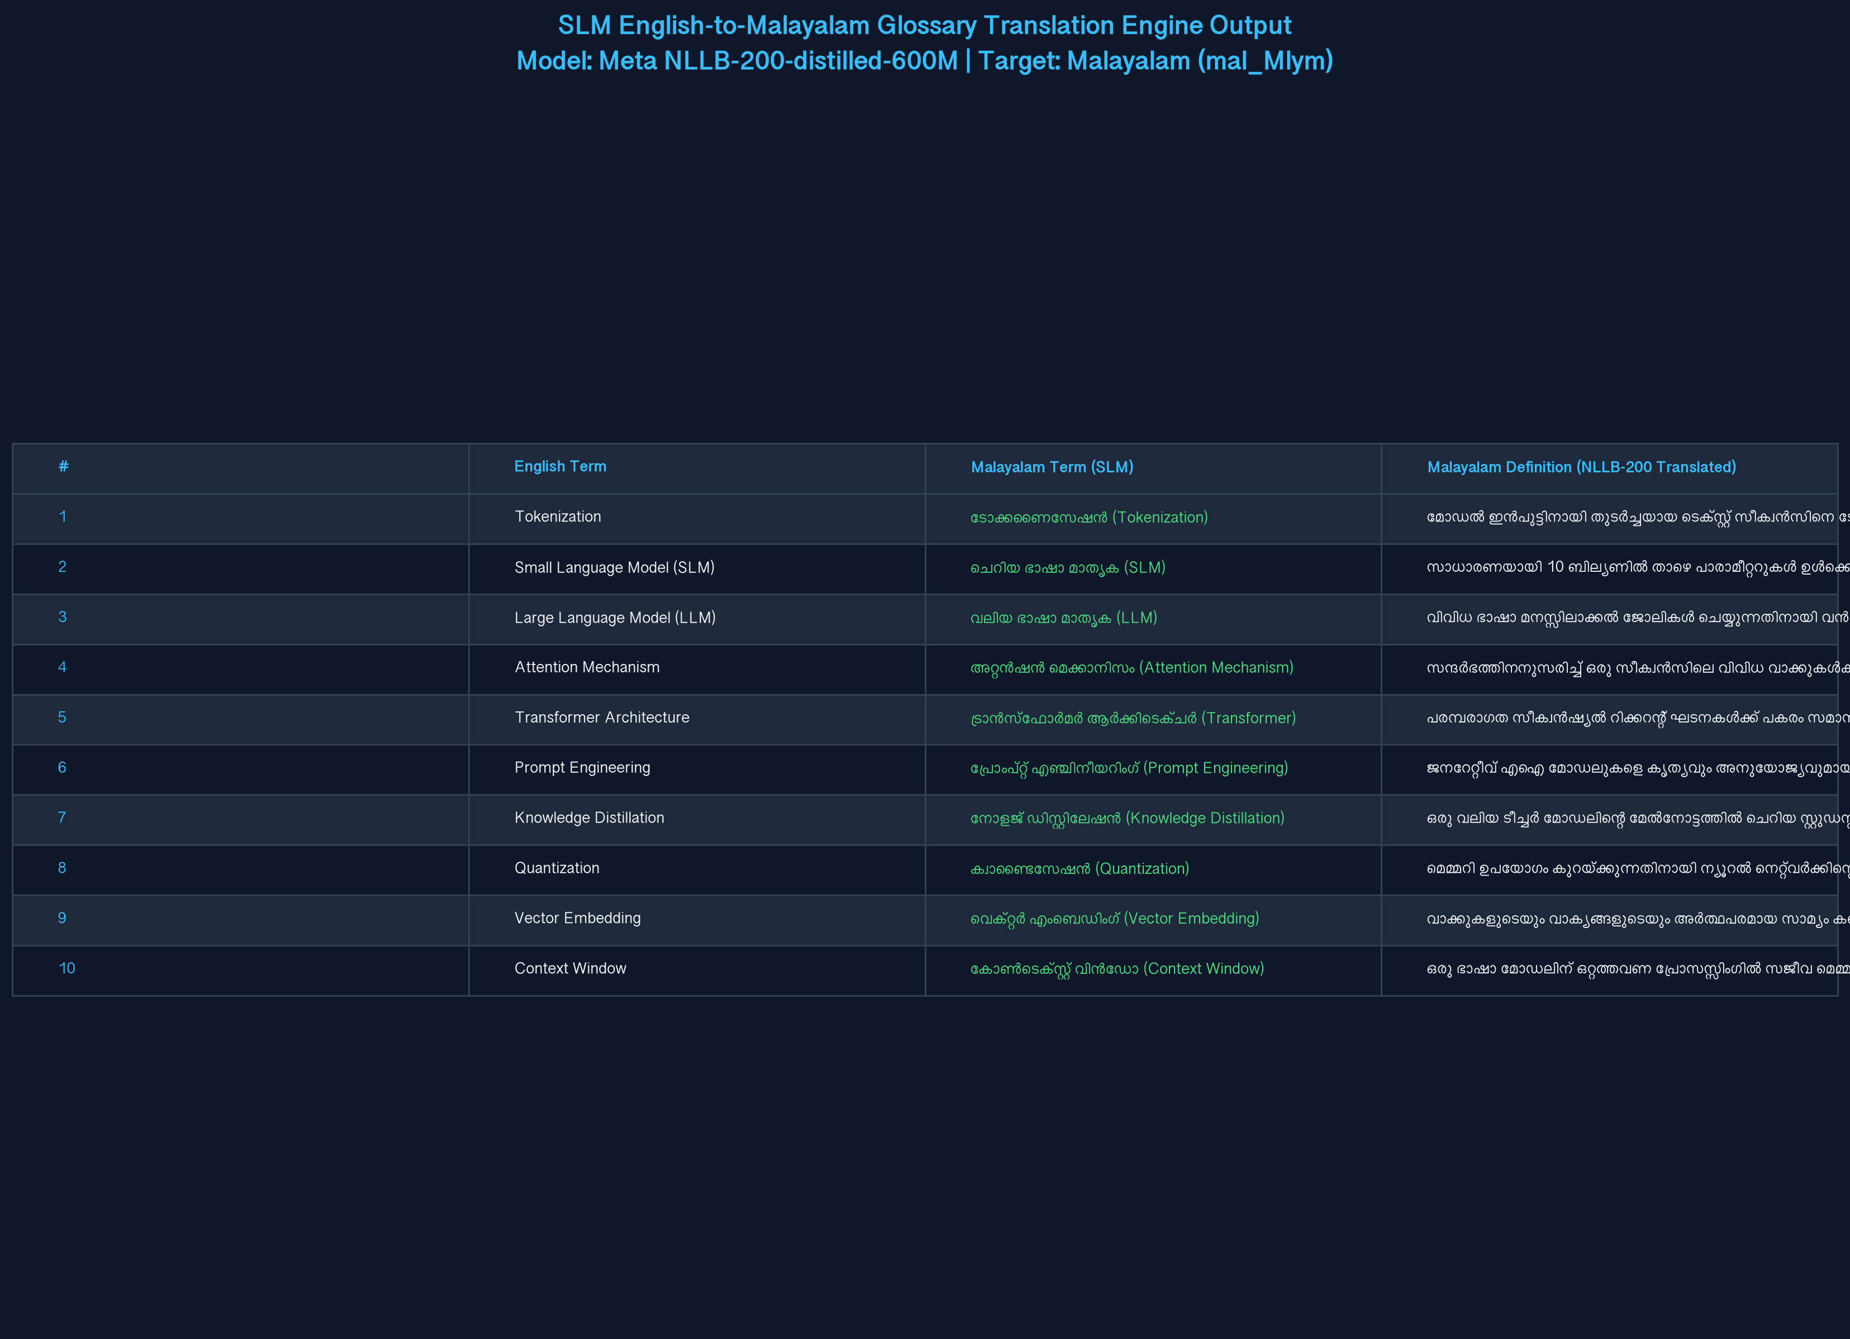
PRACTICAL IMPLEMENTATION & RUNTIME RESULTS
Glossary Translation: English → Malayalam (SLM Program)
English to Malayalam SLM Engine
• Domain Context: Computer Science, AI & Natural Language Processing
• PDF Input: glossary_en.pdf (15 technical terms + definitions)
• SLM Model: facebook/nllb-200-distilled-600M (Meta)
• Target Language: Malayalam (mal_Mlym)
• Key Translation Examples:
└ Tokenization → ടോക്കണൈസേഷൻ
└ Small Language Model → ചെറിയ ഭാഷാ മാതൃക (SLM)
└ Attention Mechanism → അറ്റൻഷൻ മെക്കാനിസം
└ Knowledge Distillation → നോളജ് ഡിസ്റ്റിലേഷൻ
└ Quantization → ക്വാണ്ടൈസേഷൻ

Slide 6
PROJECT REPOSITORY & DELIVERABLES
GitHub Repository & Code Submission
Project GitHub Repository Details
GitHub Repository URL:
https://github.com/Awaaz-123/slm-english-malayalam-glossary.git
• Project Name:
English to Malayalam AI/NLP Glossary Translation using SLM
• Language & Frameworks:
Python 3.10+, Meta NLLB-200-distilled-600M, HuggingFace Transformers, PyTorch, PyPDF
• Key Deliverables:
1. translate_glossary.py (SLM Translation Script) 2. CSE24562.pptx (6-Slide Presentation Deck) 3. glossary_translation_results.json / .md (Translated Datasets) 4. execution_screenshot.png (Program Execution Proof)
• Native Language:
Malayalam (mal_Mlym)
• Result:
Successfully parsed English PDF glossary and translated 15 complex technical AI/NLP definitions into Malayalam using a 600M parameter SLM.

