Slide 1
HDFS
Awadhesh Maurya

Slide 2
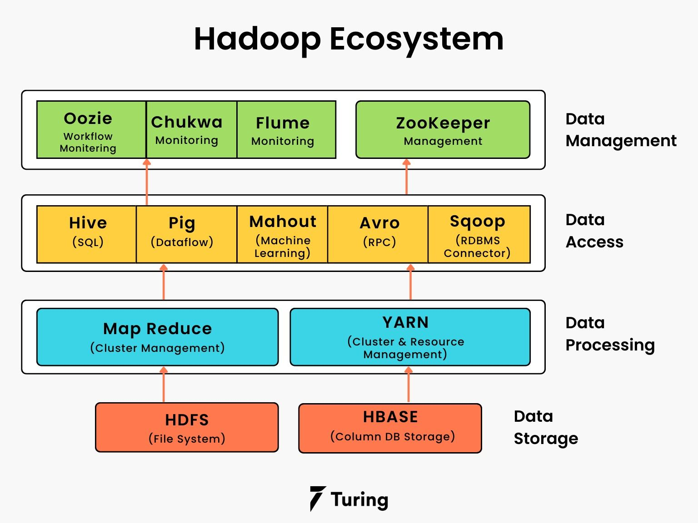
Introduction

Slide 3
Limitations of Traditional File System
Not able to store and process Big data.
Data is stored in centralized location.
Data need to be structured.
Not Scalable
Not fault Tolerant

Slide 4
HDFS
‘Hadoop distributed file system’ is a storage solution for the Big data in a very efficient way by dividing the huge files into small blocks.
It stores data in sequential manner unlike local file system for faster retrieval of data.

Slide 5
Why HDFS ?
It can store and process big data of size of Gigabyte and Terabyte.
Data is stored in distributed format.
HDFS can store structured and un-structured data.
It is highly scalable.
It is Fault-Tolerant as it keep number of of replicas which avoid the loss of data.

Slide 6
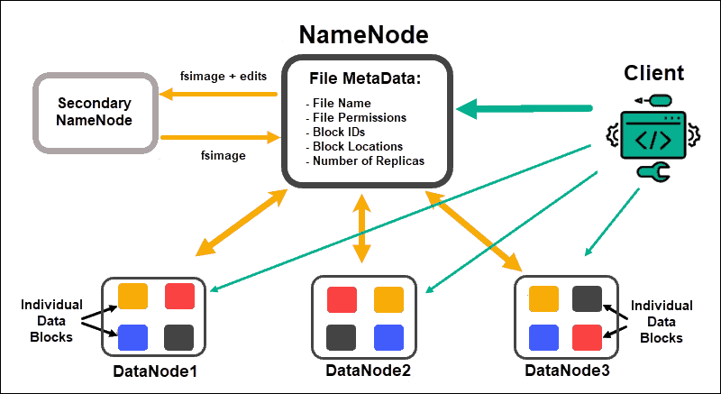
HDFS Architecture

Slide 7
HDFS Component
PRIMARY NAMENODE
It have all the metadata such as writing time, access time, modification time, delete time, address of data etc.
SECONDARY NAMENODE (Hadoop 2.x)
It is Standby name- node basically introduced to reduce the workload of Primary Name Node.
It also can be used incase PRIMARY NAME-NODE fails.
Primary name-node and secondary name node sync all the data with each other.

Slide 8
HDFS Component
NODES
Nodes are basically the machines which stores the data.
BLOCKS
Blocks are the multiple chunk of large dataset splitted and stored by HDFS.
The default size of each block is 64 or 128 MB or 256 MB.
BALANCER
Balancer in HDFS take care of positioning of blocks if some node storage is consumed below pre-defined threshold.

Slide 9
Properties of HDFS
HDFS divide the large files into multiple small blocks and store it.
Each block size is 64/128/256 MB by default and each block is stored in separate nodes.
HDFS also do data replication on various stages such as on same nodes, multiple nodes and even on different racks in case any node or any rack get destroyed.
Hadoop policies by default recommend at least 3 replicas of any data.

Slide 10
File Formats
Raw file Formats
csv, txt, json, xml etc
Hadoop Optimized File Formats
Avro, ORC, Parquet

Slide 11
AVRO
“.avro” extension.
Compression is up to 50%.
Avro has Schema Evolution Advantages.

Slide 12
ORC
“.orc” extension
Compression up to approx. 75%
It Store data in form of Stripes, and each stripes holds columns.
Each stripes also store column level aggregation.

Slide 13
Parquet
“.Parquet” Extension
Compression is 60-70%
Schema evolution is also possible but, it end up having multiple parquet file.

Slide 14
Thank You

