Slide 1
MapReduce
Awadhesh Maurya

Slide 2
Introduction
In Hadoop, MapReduce is a technique to process large amount of data in distributed and parallel manner.

Slide 3
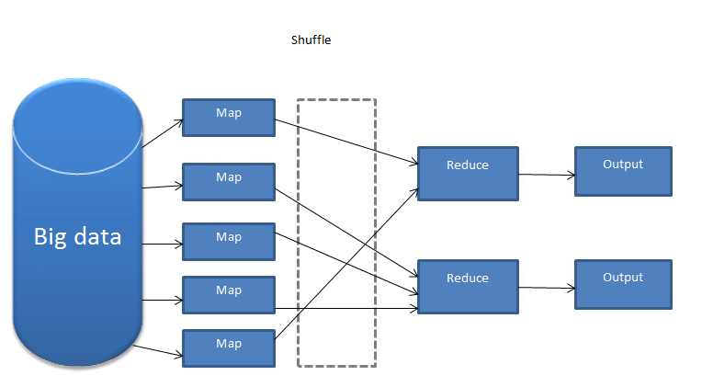
Working of MapReduce
It process the data by help of two distinct task: Map & Reduce.
The two important daemons in MapReduce is Job Tracker & Task Tracker.

Slide 4
Advantage
Highly scalable
Parallel Processing
Disadvantages
It is very complex to write map-reduce job manually.

Slide 5
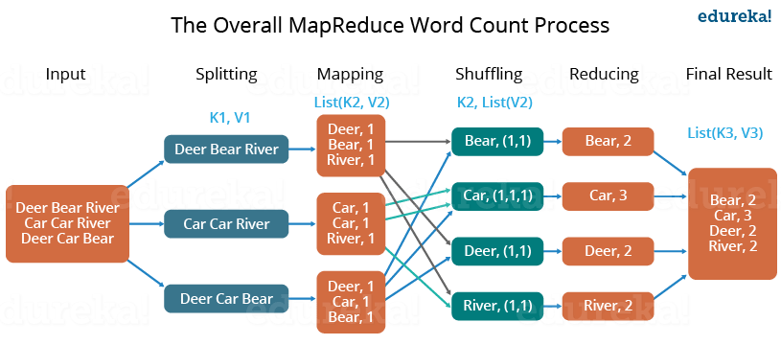
Example

Slide 6
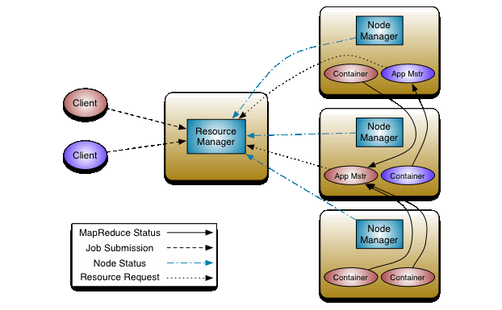
Yarn (MRv2)(Hadoop 2.0x)
Yarn is a Resource manager with take care of the resources required for the execution of the job.

Slide 7
Thank you

