Slide 1
Fully Automatic Egg incubator

Slide 2
Building the Future of Incubation
Student ID
Awais Asghar
Unique identifier for student participation in the project.
Student engineer leading the incubator project.
Electrical Engineering
NUST SEECS
Department
Engineering discipline focusing on electrical systems and technology.
Academic department fostering innovative engineering solutions.

Slide 3
Egg Incubator Contents
Objectives
Conclusion
Defining the goals of the project
Results
Summarizing the project
and its impact
Introduction
Presenting the outcomes
of the project
Overview of the project
Methodology
Problem Statement
Outlining the approach to achieve objectives
Identifying the need for the incubator
Flowchart
Visual representation of the process

Slide 4
Automated Egg Incubation Process
System Design
Microcontroller Integration
Sensor Implementation
Actuator Control
Real-time Feedback
Hatching Success
Initial planning and setup of the incubator
Incorporating the ATmega328P for control
Adding sensors for temperature and humidity
Using actuators to manage temperature and rotation
Displaying data and alerts on an LCD
Achieving high hatching rates through automation

Slide 5
Automated Egg Incubation Cycle
Achieve High Hatching Success
Monitor Temperature
Ensure a high rate of successful hatches
Continuously check and adjust temperature
4
1
3
2
Rotate Eggs
Control Humidity
Periodically turn eggs
for Even development
Maintain optimal humidity levels

Slide 6
Traditional egg incubators
Pros
Cons
Simple setup
1
1
Manual monitoring
Easy to understand and set up for beginners.
Requires constant attention and adjustments.
Low cost
2
2
Labour-intensive
Economical option for small-scale operations.
Demands significant time and effort.
3
Human error
Prone to mistakes affecting hatching success.
4
Suboptimal conditions
May not maintain ideal environmental conditions.
5
Reduced success
Lower hatching rates due to inconsistencies.

Slide 7
Incubator system features
Alert user
Monitor environment
Alert the user if environmental conditions fall outside the desired range.
Automatically monitor and control
temperature and humidity.
Display status
Rotate eggs
Provide real-time status updates via an LCD display.
Implement a mechanism to rotate the eggs periodically.

Slide 8
Incubator Control System
Buzzer
DHT11 Sensor
Alerts the user to any issues.
Measures humidity and temperature.
DS18B20 Sensor
Relay
Measures temperature
with high accuracy.
Controls the heating element.
Stepper Motor
Rotates the eggs.

Slide 9
Microcontroller Hierarchy
Display Update
Updates and manages LCD display
Data Processing
Processes and analyzes sensor data
Actuator Control
Manages and controls system actuators
Sensor Interface
Connects and reads data from sensors

Slide 10





Software Implementation
Achieving Optimal Environmental Control
Start
Optimal Condition Maintenance
4
Taking actions to maintain optimal environmental conditions.
Initialize Sensors
Continuous Monitoring
Read Sensor Data
Implementing a system to continuously monitor environmental conditions.
3
Library Integration
2
Incorporating libraries for sensor and LCD interfacing.
Optimal Conditions?
No
Yes
C++ Development
1
Writing the software in C++ to ensure efficiency and performance.
Maintain Current State
Adjust Environmental Controls

Slide 11
Environmental Monitoring and Control Cycle
Environmental Monitoring and Control Cycle
1
4
2
3
Analyze collected data for insights
Collect environmental data from sensors
Implement necessary adjustments
Display current conditions on LCD
Read Sensor Data
Process Data
Update LCD
Take Action

Slide 12
Environmental Monitoring and Control Cycle
1
Read Sensor Data
Collect environmental data from sensors
4
2
Update LCD
Process Data
Display current conditions on LCD
Analyze collected data for insights
3
Take Action
Implement necessary adjustments

Slide 13
Egg Incubator Components
Egg Incubator
Microcontroller
Miscellaneous
Stepper Motor
ATmega328P
Power Supply
Capacitors
Actuators
16x2 LCD
Resistors
DS18B20
Sensors
Display
DHT11
Buzzer
Wires
Relay
Egg Incubator
Components

Slide 14
Egg Incubator Components
Miscellaneous
Actuators
Resistors
Stepper Motor
Capacitors
Relay
Wires
Buzzer
Power Supply
Egg Incubator
Sensors
Microcontroller
DHT11
ATmega328P
DS18B20
Display
16x2 LCD

Slide 15
Egg Hatching Process
Observe the chick emerging from the egg
Successful Hatch
Conduct the hatching experiment
Choose a pigeon's egg for testing
Test Project
Select Egg
Egg Hatching Process

Slide 16
Egg Hatching Process
Select Egg
Test Project
Successful Hatch
Choose a pigeon's egg for testing
Conduct the hatching experiment
Observe the chick emerging from the egg

Slide 17
Hatching Process Steps
Hatching Process Steps
Continuously check temperature and humidity for optimal conditions.
3
4
5
2
6
1
Adjust humidity levels using a relay based on readings.
Show temperature and humidity on the LCD screen.
Gather temperature and humidity data from sensors.
Validate sensor readings for accuracy and connectivity.
Activate an alert if conditions deviate from the ideal range.
Display on LCD
Monitor Conditions
Check Data
Trigger Alert
Control Humidity
Read Sensors

Slide 18
Hatching Process Steps
Trigger Alert
Activate an alert if conditions deviate from the ideal range.
6
Monitor Conditions
Continuously check temperature and humidity for optimal conditions.
5
Control Humidity
Adjust humidity levels using a relay based on readings.
4
Display on LCD
3
Show temperature and humidity on the LCD screen.
2
Check Data
Validate sensor readings for accuracy and connectivity.
1
Read Sensors
Gather temperature and humidity data from sensors.

Slide 19
Setting Up and Running the Incubator
8
Controls the motor for egg turning and other functions.
Drive Motor
Updates the LCD with current status and sensor readings.
7
Display Information
Runs the hatching process if the hatch state is high.
Execute Hatch Function
6
Monitors the hatch pin to determine if hatching is in progress.
5
Check Hatch State
Activates temperature and humidity sensors.
4
Begin Sensors
Initializes the LCD screen for displaying information.
3
Start LCD
Sets up input and output pins for various components.
2
Configure Pins
Establishes communication with the serial port.
Initialize Serial
1

Slide 20
Setting Up and Running the Incubator
Drive Motor
8
Controls the motor for egg turning and other functions.
7
Display Information
Updates the LCD with current status and sensor readings.
Execute Hatch Function
6
Runs the hatching process if the hatch state is high.
5
Check Hatch State
Monitors the hatch pin to determine if hatching is in progress.
Begin Sensors
4
Activates temperature and humidity sensors.
3
Start LCD
Initializes the LCD screen for displaying information.
Configure Pins
2
Sets up input and output pins for various components.
1
Initialize Serial
Establishes communication with the serial port.

Slide 21
AVR microcontroller ensures precise environmental control.
Advanced sensors maintain optimal temperature and humidity.
Precise mechanisms adjust conditions for successful hatching.
LCD display and alerts provide real-time system feedback.
Ensuring consistent and accurate environmental conditions
Microcontroller- Based Control
Automated Egg Incubator
Actuation Mechanisms
Testing and Validation
Initial planning and setup of the incubator.
Real-Time Feedback
Sensor Technology
System Design
Unveiling the Automated Egg Incubator

Slide 22
Unveiling the Automated Egg Incubator
System Design
Initial planning and setup of the incubator.
Microcontroller- Based Control
AVR microcontroller ensures precise environmental control.
Sensor Technology
Advanced sensors maintain optimal temperature and humidity.
Automated Egg Incubator
Actuation Mechanisms
Precise mechanisms adjust conditions for successful hatching.
Real-Time Feedback
LCD display and alerts provide real-time system feedback.
Testing and Validation
Ensuring consistent and accurate environmental conditions

Slide 23
Incubation Timelines for Various Bird Species
18 days
21 days
28 days
30 days
Pigeon incubation period ends
Chicken incubation period ends
Peacock, Turkey, and Duck incubation periods end
Goose incubation period ends
Species | Days | Temperature (°C ±0.5) | Humidity (% RH) | Transfer Day | Hatcher Temperature (°C ±0.5) | Hatcher Humidity (% RH) | Weight (g)
Chicken | 21 | 38.0 | 55–70 | 18 | 37.5 | 65–85 | 50–60
Peacock | 28 | 37.8 | 60–75 | 24 | 37.3 | 65–85 | 100–120
Turkey | 28 | 37.7 | 60–75 | 25 | 37.2 | 65–85 | 75–80
Duck | 28 | 37.8 | 60–75 | 25 | 37.3 | 65–85 | 80–100
Goose | 30 | 37.6 | 65–80 | 25 | 37.1 | 65–85 | 100–120
Pigeon | 18 | 38.5 | 55–70 | 14 | 37.8 | 65–85 | 30–40
Pheasant | 22–28 | 38.2 | 55–70 | 20–25 | 37.7 | 65–85 | 30–40

Slide 24


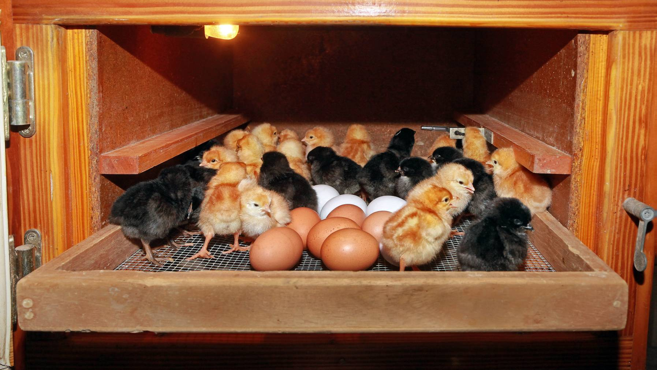
Demo Video Link
https://drive.google.com/file/d/1zMUQpWJ0FDDZAHrKOpszr6JmY7QB7Jmf/view?usp=sharing

Slide 25
Thank You!

