Slide 1

Smart Anti-Theft Car Security System

Slide 2
Problem Statement
Imagine someone buys a fancy new car, like a Porsche. It already has a built-in anti-theft system, but the owner is still worried that thieves might know how to disable it. So, our job was to design a smarter, hidden anti-theft system that’s harder to bypass — something only the owner knows how to deactivate.

Slide 3

Requirements
Automatically turns on after the driver leaves the car.
Detects if someone opens the car door.
Gives the real owner some time to start the car before sounding an alarm.
Triggers a loud siren if the car is being accessed wrongly.
Blocks the fuel pump secretly, so even if someone disables the siren, they can't drive away.

Slide 4
Major Features
Feature | Explanation
Auto-Arming | The system activates automatically after you turn off the car and close the doors.
Countdown Timer | If someone opens the door, a timer starts — you must start the car quickly to stop the alarm.
Siren Alarm | If the countdown ends and the car hasn’t been started, a loud alarm sounds.
LED Indicator | Shows the status of the system: blinking = armed, solid = countdown or alarm.
Fuel Pump Lock | A hidden trick — even if someone silences the alarm, the car won’t run unless the real owner presses a hidden switch + brake at the same time.
Custom Timings | You can set how long the delays are using switches — like programming how long the dog waits before barking.

Slide 5
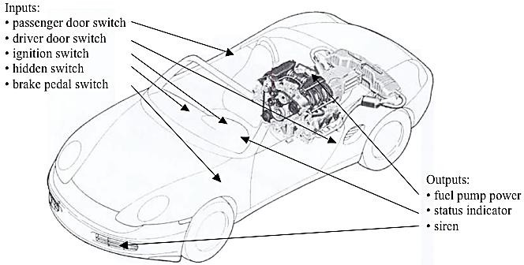
System Diagram

Slide 6
Default Timing Parameters
Interval Name | Symbol | Parameter Number | Default Time(sec) | Time Value
Arming Delay | T_ARM_DELAY | 00 | 6 | 0110
Countdown, driver’s door | T_DRIVER_DELAY | 01 | 8 | 1000
Countdown, passenger’s door | T_PASSENGER_DELAY | 10 | 15 | 1111
Siren ON time | T_ALARM_ON | 11 | 10 | 1010

Slide 7
Modules Hierarchy
Debouncer: Cleans up noisy signals from buttons and switches so the system doesn’t get confused.
Timer: Starts countdowns (e.g., wait 8 seconds before sounding alarm).
FSM (Anti-theft logic): Controls the whole behavior — like switching between “Armed”, “Triggered”, “Alarm” and “Disarmed” modes.
Fuel Pump Lock: Secret logic that only gives fuel when the hidden button + brake are pressed after ignition.
Siren Generator: Creates the actual alarm sound.
LED Controller: Blinks or lights up the status indicator based on system state.

Slide 8
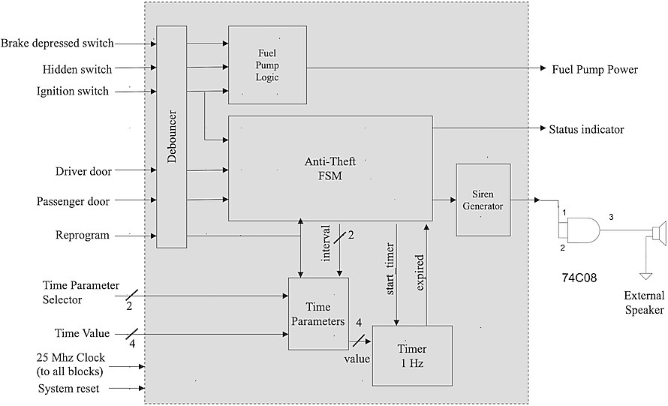
Block Diagram

Slide 9
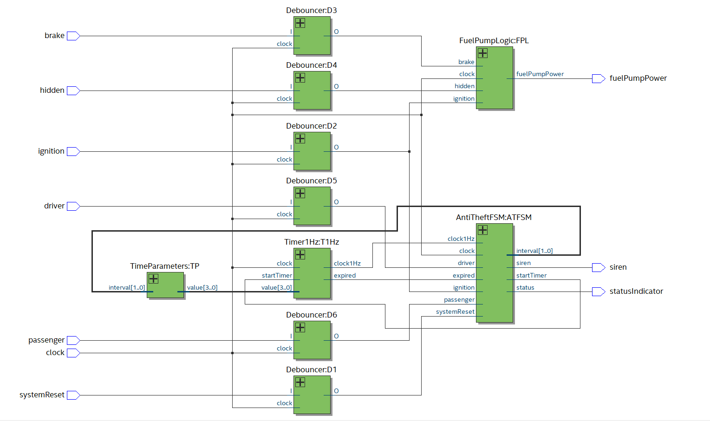
Implementation

Slide 10

Real-Life Scenarios
Case 1: Regular (Driver Only)
🔑 She turns off the ignition and exits the car.
⏱️ System waits 6 seconds (T_ARM_DELAY), then automatically arms.
🕵️ A thief opens the driver’s door — system starts an 8-second countdown (T_DRIVER_DELAY).
⏰ If the thief doesn’t turn on the ignition within 8 seconds, the siren sounds.
🔒 Even if the thief turns off the siren, the fuel pump stays disabled — they must press a hidden switch + brake after ignition, which only the owner knows.

Slide 11

Real-Life Scenarios
Case 2: Guest (Passenger Present)
🚪 The passenger door opens first (for a guest).
🚶 She walks around and closes both doors.
⏱️ After 6 seconds, the system arms itself.
🕵️ If the passenger door is opened again, the system starts a 15-second countdown (T_PASSENGER_DELAY) to give her more time to get in and start the car.
❗ If ignition isn’t turned on within that 15 seconds, the siren sounds, and again, the fuel pump remains locked unless the hidden trick is used.

Slide 12

Future Improvements
Add keypad or RFID authentication instead of just a hidden switch for fuel pump access
Integrate mobile app for remote arming/disarming and alerts
Include GPS tracking to locate the vehicle in case of theft
Add voice alert or recorded message instead of a basic siren
Use AI-based behavior monitoring to detect unusual access patterns
Log and store intrusion events with timestamps for later review
Connect to cloud or IoT platform for real-time monitoring and control

Slide 13
Conclusion
Successfully designed a smart car anti-theft system based on Finite State Machines (FSMs)
Implemented all modules using Verilog
System automatically arms/disarms based on door and ignition activity
Includes adjustable countdown timers for different scenarios (driver/passenger)
Triggers a siren if unauthorized access is detected
Secret fuel pump lock adds an extra layer of security — requires hidden switch + brake to activate
Demonstrates practical application of digital design principles in real-world car security

Slide 14

Thank you

