Slide 1
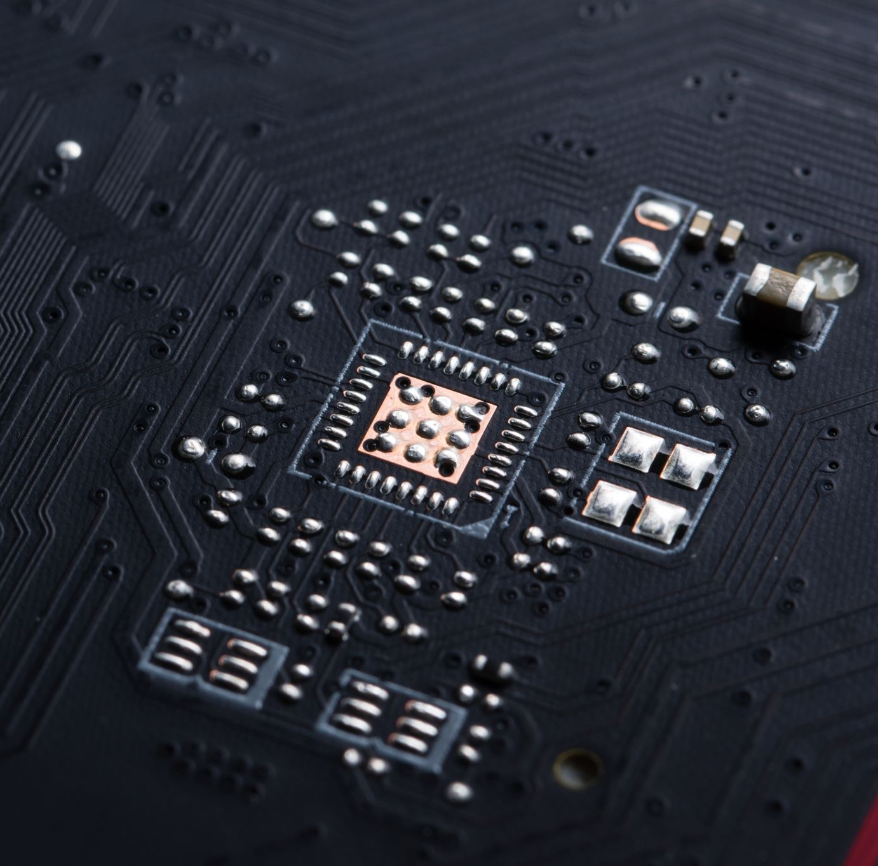


Single-Cycle RISC-V Processor Implemented on FPGA
Name | Awais Asghar
CMS ID | 427265
Supervisor | Mr. Musadiq Hussain

Slide 2

Abstract
Designed a Single-Cycle RISC-V (RV32I) Processor using SystemVerilog
Implemented and verified on Nexys A7 (Artix-7) FPGA using Xilinx Vivado
Supports all core instruction types (R, I, S, B, U, J)
Executes one instruction per clock cycle
Provides a hands-on platform for learning digital design and computer architecture

Slide 3
Project Objectives
Design a Single-Cycle RISC-V Processor supporting the full RV32I ISA
Implement using SystemVerilog and synthesize for FPGA
Create a modular design with key components (ALU, PC, Register File, etc.)
Verify functionality through testbenches and simulation
Gain practical experience in digital system design and hardware description languages

Slide 4

Tools & Technologies
Hardware
Nexys A7 FPGA (Artix-7 by Digilent)
Software
Xilinx Vivado (Design, Simulation, Synthesis)
SystemVerilog (HDL for all modules)

Slide 5

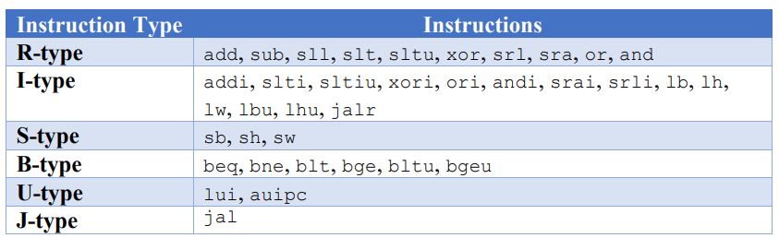
RISC-V ISA Overview
Open-source and modular instruction set architecture
Project targets RV32I (32-bit base integer ISA)
Designed for simplicity, scalability, and educational use

Slide 6
System Architecture
Single-cycle design: One instruction per clock cycle
Combines fetch, decode, execute, memory, and write-back in one cycle
Focuses on clarity and simplicity over performance

Slide 7
Instruction Execution Stages:
Fetch – Get instruction from memory
Decode – Parse opcode, registers, immediate
Execute – Perform ALU or address calculation
Memory Access – Load/store operations
Write Back – Store result in register

Slide 8
Key Components
Program Counter (PC) Holds address of current instruction
Instruction Memory Stores machine code (read-only)
Register File 32 general-purpose registers (x0–x31)
Immediate Generator Extracts and sign-extends immediate values
ALU (Arithmetic Logic Unit) Performs arithmetic and logical operations
Control Unit Generates control signals from opcode
Data Memory Load/store access for memory instructions
Branch Comparator Supports conditional branching

Slide 9

Program Counter (PC)
Holds the address of the current instruction
Updates every clock cycle (PC + 4 or branch/jump target)
Drives instruction fetch from memory
Handles both sequential flow and control transfers

Slide 10

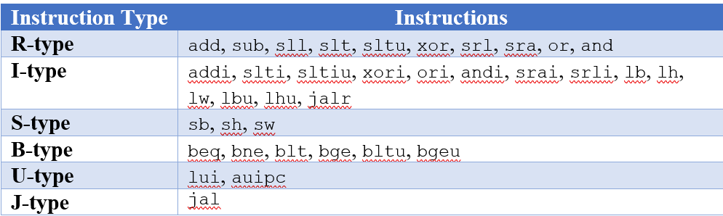
Instruction Memory
Stores all program instructions in machine code
Read-only memory accessed using PC value
Returns a 32-bit instruction each cycle
Preloaded from instructions.mem file

Slide 11
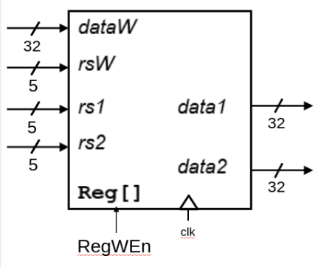
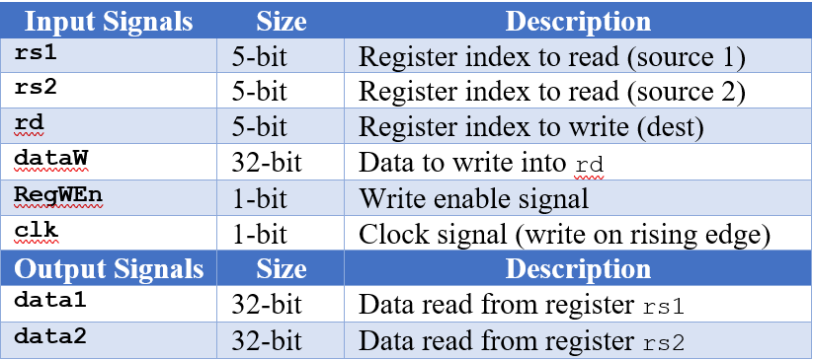
Register File
Contains 32 general-purpose 32-bit registers (x0–x31)
Supports 2 reads and 1 write per clock cycle
Register x0 is hardwired to zero
Preloaded from reg_init.mem during simulation

Slide 12

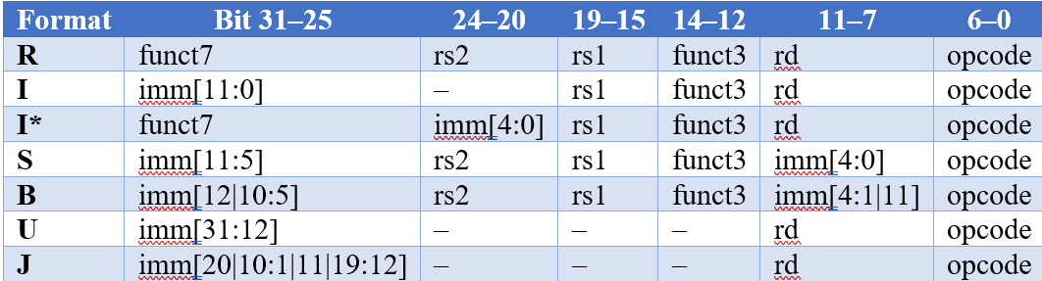
Immediate Generator
Extracts immediate values from instruction fields
Supports all formats: I, S, B, U, J
Performs sign-extension to 32 bits
Output used by ALU, branch logic, and memory access

Slide 13
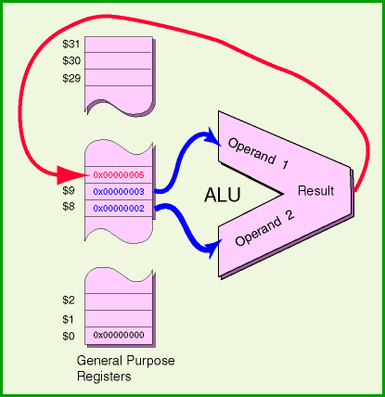
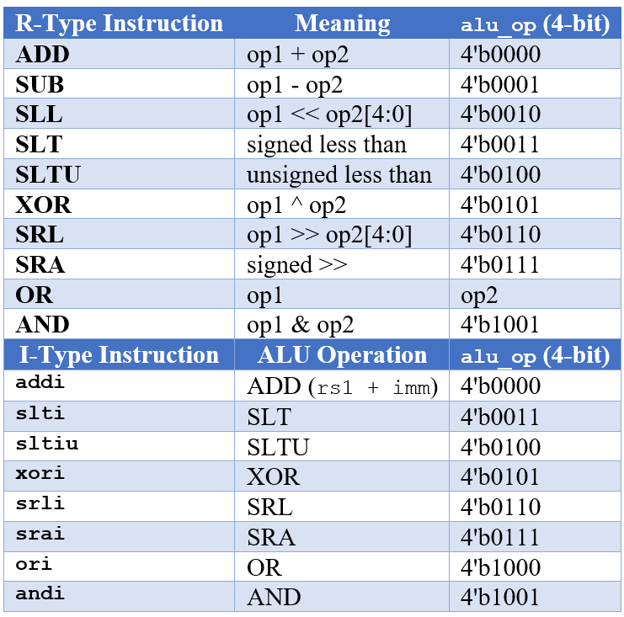
ALU (Arithmetic Logic Unit)
Executes arithmetic and logical operations
Takes two operands: from registers or immediate
Controlled by 4-bit ALU control signal

Slide 14

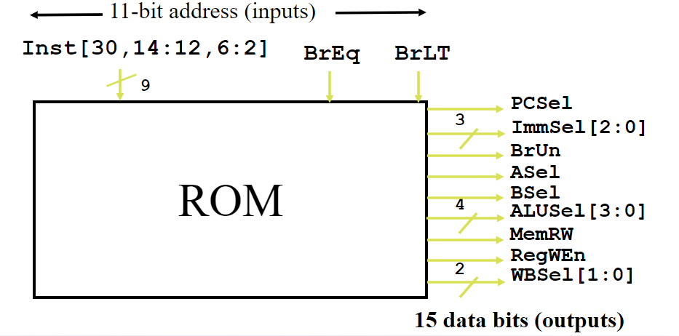
Control Unit
Decodes instruction opcode to generate control signals
Controls modules like ALU, memory, MUXes, and register file
Drives data path and control path behavior

Slide 15
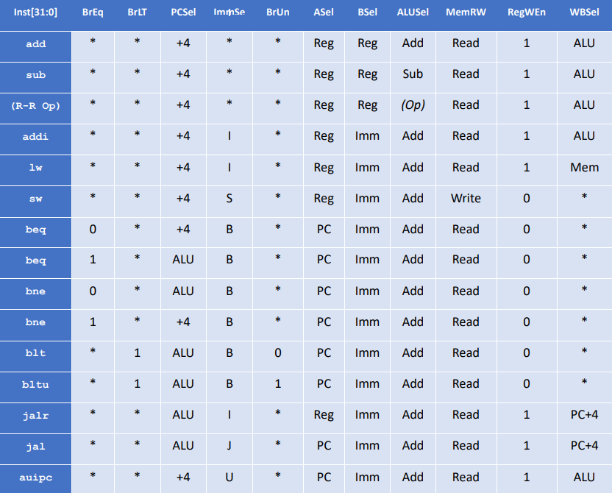
Control Signals

Slide 16
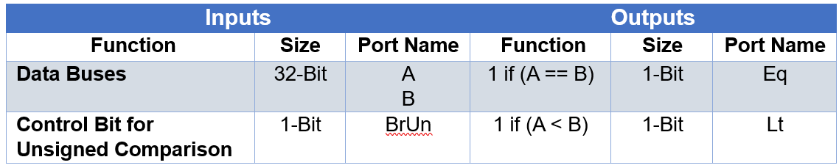
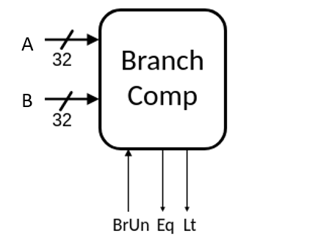
Branch Comparator
Compares two register values for branch decisions
Supports signed and unsigned comparisons
Guides PC update for instructions like beq, bne, blt, bge

Slide 17
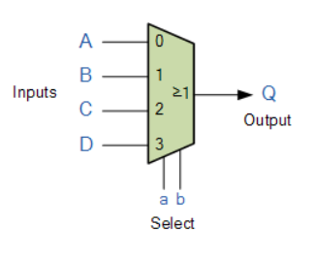
Multiplexers
Select between multiple inputs based on control signals
Choose between register or immediate for ALU input
Select ALU result or memory data for write-back
Decide next PC (sequential or branch/jump target)
Controlled by signals like ASel, BSel, WBSel, PCSel

Slide 18
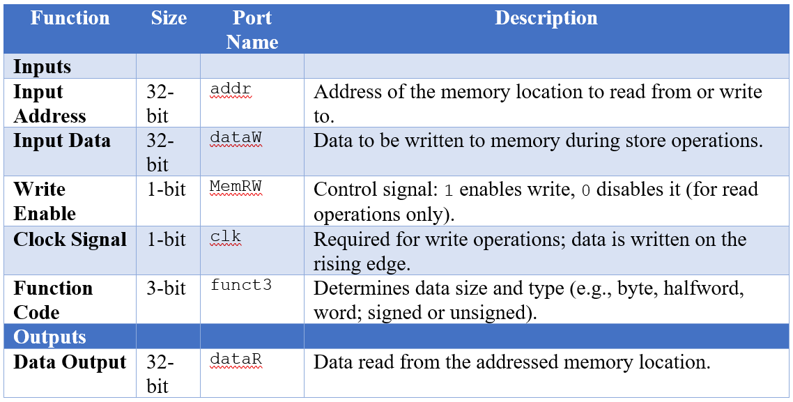
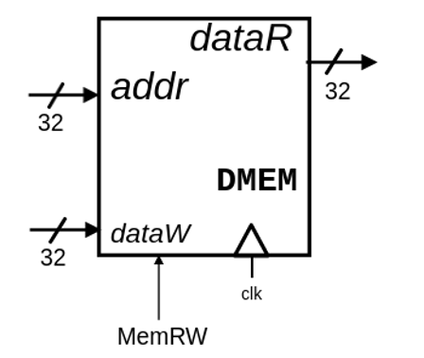
Data Memory

Slide 19
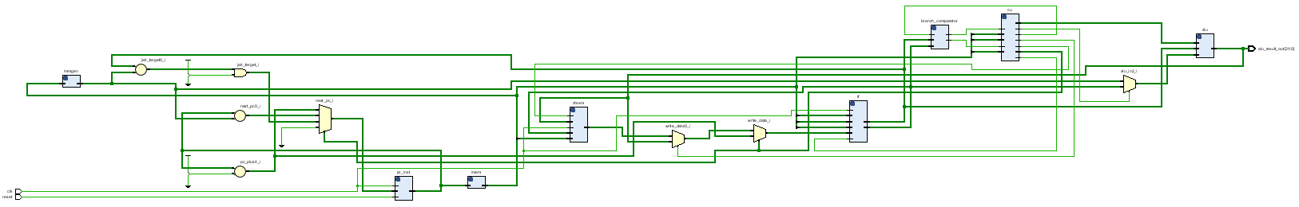
Top Module
Integrates all submodules (PC, ALU, Control Unit, Memories, etc.)
Manages signal routing across the entire processor
Controls program execution flow using PC updates and instruction decoding
Acts as the main system wrapper for simulation and synthesis

Slide 20
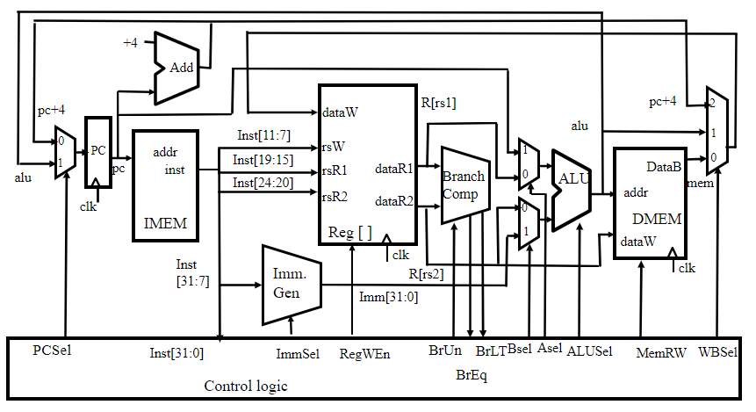
Datapath and Control Path

Slide 21
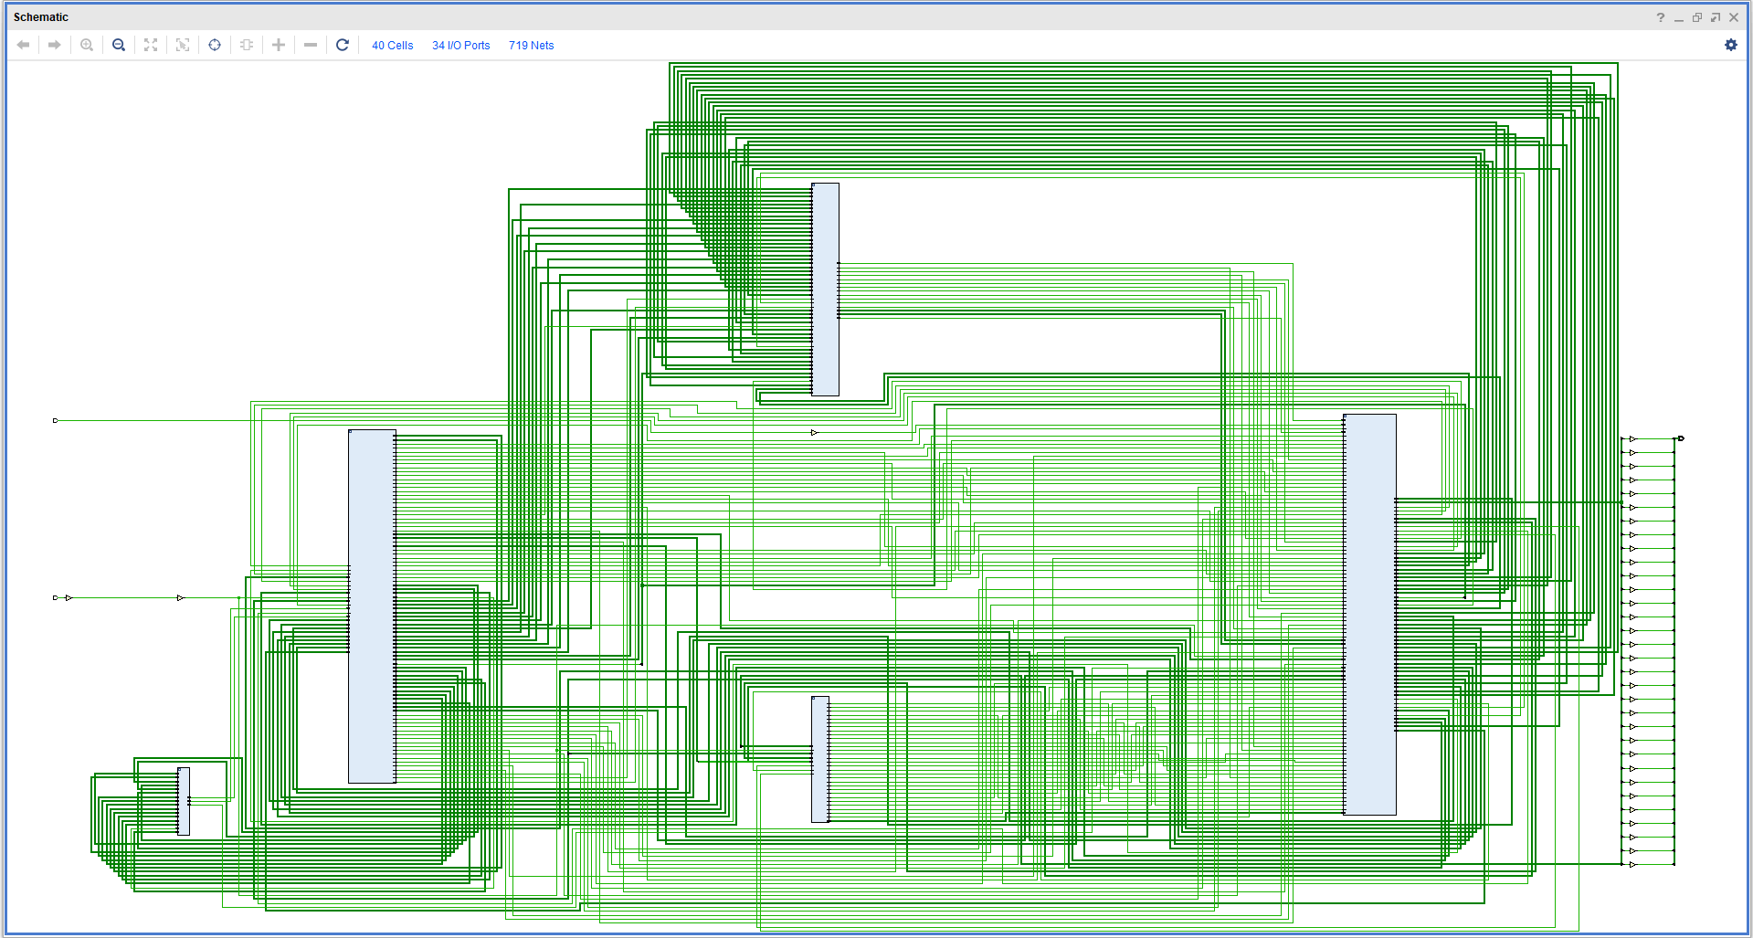
Implementation

Slide 22

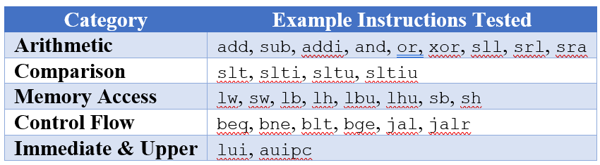
Testing and Results
The following categories of RISC-V instructions were tested:
Each instruction was validated by checking:
ALU result correctness
Register file updates
Branch decisions and PC updates
Data memory read/write behavior

Slide 23
Project Folder Structure
Sub-Folder | File Names
./rtl/ | program_counter.sv inst_mem.sv data_mem.sv reg_file.sv imm_gen.sv alu_logic.sv branch_comp.sv control_unit.sv top.sv
./tb/ | program_counter_tb.sv inst_mem_tb.sv data_mem_tb.sv reg_file_tb.sv imm_gen_tb.sv alu_logic_tb.sv branch_comp_tb.sv control_unit_tb.sv top_tb.sv
./mem/ | instructions.mem data_mem.mem reg_init.mem reg_out.mem

Slide 24
Conclusion
Successfully designed and simulated a Single-Cycle RISC-V (RV32I) Processor
Covered all core instruction types with accurate execution
Verified design through testbenches, waveforms, and RTL diagrams
Synthesized for FPGA with no timing issues

Slide 25
Future Improvements
Pipelining Improve performance by executing multiple instructions simultaneously
Hazard Handling Add support for data and control hazard resolution
Exception & Interrupt Support Handle errors, system calls, and external interrupts
Instruction Set Extensions Add support for RV32M (multiplication/division), RV32C (compressed), or RV32F (floating point)
Hardware Debug Interface Implement UART or LED-based debugging and I/O
Performance Monitoring Add cycle counters, instruction counters, or profiling support

Slide 26

Thank You

