Slide 1

Smart Health Tracking System
By: Awais Asghar, Muhammad Ashar Javid, Muhammad Hammad Sarwar

Slide 2

Problem Statement
Millions suffer from undiagnosed or late-detected health conditions, especially in remote areas
Cardiovascular issues, low SpO₂, fever, and inactivity often go unmonitored in real time
Traditional monitoring systems are:
Bulky and non-portable
Limited to hospital or clinical settings
Lack real-time alerting and data tracking
Expensive and impractical for long-term use

Slide 3

Project Overview
Project Monitors:
ECG (heart activity)
SpO₂ and Heart Rate
Body Temperature
Motion and Fall Detection
Built with ESP32/Arduino using embedded C/C++
Sends data via Bluetooth/Wi-Fi to mobile or desktop app
Provides instant alerts on abnormal readings
Designed for portability, affordability, and continuous use

Slide 4

Methodology
Sensor Selection & Integration
Data Acquisition & Processing
Wireless Communication
User Interface & Alerts
Testing & Calibration

Slide 5
Sensor Selection & Integration
AD8232 – ECG Module Captures heart’s electrical activity and outputs analog waveform for PQRST detection.
MAX30100 – SpO₂ & Heart Rate Sensor Measures blood oxygen saturation and pulse using infrared and red light absorption.
DS18B20 – Digital Temperature Sensor Provides accurate body temperature readings with minimal wiring and high reliability.
MPU6050 – Accelerometer & Gyroscope Tracks physical activity and detects falls by measuring real-time motion and orientation.

Slide 6
Data Processing
Noise Filtering: Removes environmental/biological noise
Signal Conditioning: Ensures smooth, clear output
Anomaly Detection: Real-time flagging of abnormal vitals
Processed on-device = no lag, low power

Slide 7

Communication System
Module: Bluetooth (HC-05)
Function: Sends real-time health data to mobile or PC
Reliable: Low power, <1% packet loss

Slide 8
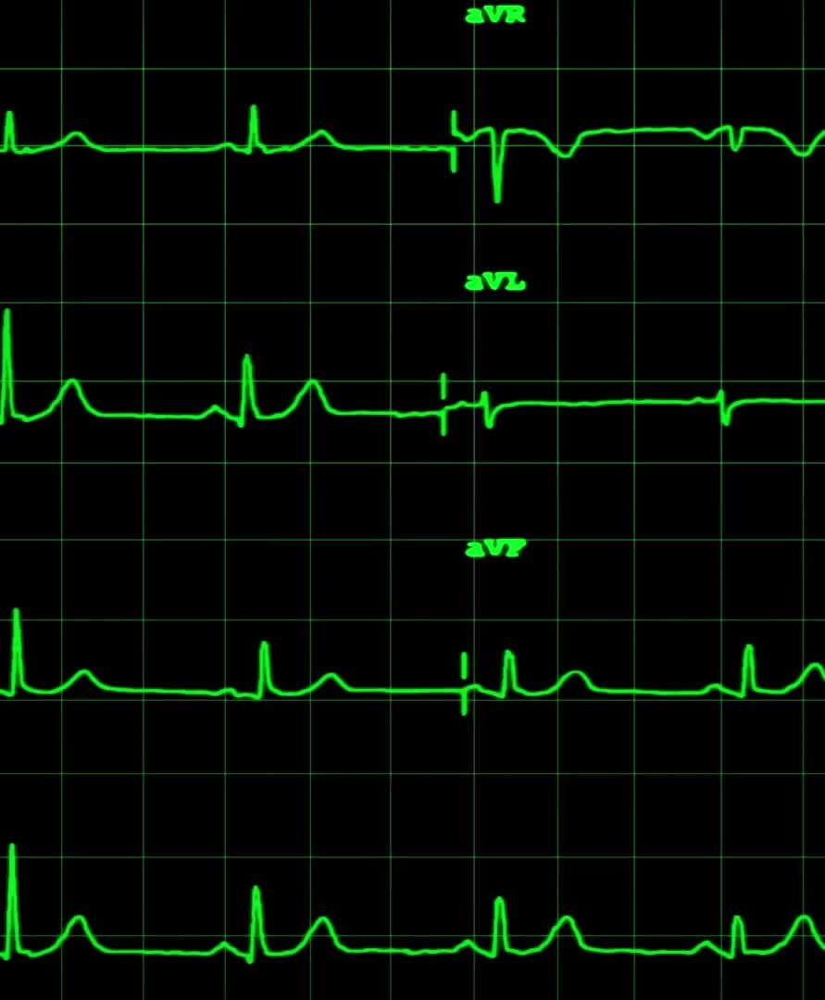
User Interface & Alerts
Display Platforms: Mobile phone, desktop/laptop, or serial plotter
Function:
Shows live data for ECG, SpO₂, Heart Rate, Temperature, and Motion
Highlights abnormal readings with alert messages

Slide 9
System Workflow
Sensors collect real-time data ECG, SpO₂, Heart Rate, Temperature, and Motion
Microcontroller processes signals Filters noise and detects abnormalities
Data transmitted wirelessly Sent via Bluetooth/Wi-Fi to connected device
Data displayed on external device Shown on mobile, laptop, or serial plotter
Alerts generated if thresholds crossed Notifies user instantly of any abnormal health readings

Slide 10
Testing & Results
AD8232 – ECG Module Captured clean PQRST waveform with ~98% accuracy compared to clinical ECG
MAX30100 – SpO₂ & Heart Rate SpO₂ accuracy: ~97%, Heart rate variation: ±2 bpm
DS18B20 – Temperature Sensor Deviation: ±0.2°C compared to a digital thermometer
MPU6050 – Motion Sensor Detected falls and activity changes with ~95% accuracy
Wireless Transmission Stable up to 15–20 meters, latency ~200 ms, <1% data loss

Slide 11

Future Work
Cloud Integration: Enable remote storage and access of patient data via cloud platforms
AI-Based Health Predictions: Use machine learning to detect early signs of diseases like arrhythmia
Battery Optimization: Improve power efficiency for longer continuous wearable use
Custom Mobile App: Develop a dedicated Android/iOS app with real-time graphs and notifications
Miniaturization & Enclosure: Design a compact, wearable casing for practical daily use

Slide 12

Conclusion
Successfully developed a wearable, real-time health monitoring system. Accurately tracks:
ECG (heart activity)
SpO₂ & Heart Rate
Body Temperature
Motion & Fall Detection
Validated through real-patient testing, showing reliable and accurate results
Enables early detection, remote monitoring, and improved accessibility

Slide 13

Thank You

