Slide 1

Smart Health Tracking System
By: Awais Asghar, Muhammad Ashar Javid, Muhammad Hammad Sarwar

Slide 2

Problem Statement
Millions suffer from undiagnosed or late-detected health conditions, especially in remote areas
Cardiovascular issues, low SpO₂, fever, and inactivity often go unmonitored in real time
Traditional monitoring systems are:
Bulky and non-portable
Limited to hospital or clinical settings
Lack real-time alerting and data tracking
Expensive and impractical for long-term use

Slide 3

Project Overview
Project Monitors:
ECG (heart activity)
SpO₂ and Heart Rate
Body Temperature
Motion and Fall Detection
Built with ESP32/Arduino using embedded C/C++
Sends data via Bluetooth/Wi-Fi to mobile or desktop app
Provides instant alerts on abnormal readings
Designed for portability, affordability, and continuous use

Slide 4

Methodology
Sensor Selection & Integration
Data Acquisition & Processing
Wireless Communication
User Interface & Alerts
Testing & Calibration

Slide 5
Sensor Selection & Integration
AD8232 – ECG Module Captures heart’s electrical activity and outputs analog waveform for PQRST detection.
MAX30100 – SpO₂ & Heart Rate Sensor Measures blood oxygen saturation and pulse using infrared and red light absorption.
DS18B20 – Digital Temperature Sensor Provides accurate body temperature readings with minimal wiring and high reliability.
MPU6050 – Accelerometer & Gyroscope Tracks physical activity and detects falls by measuring real-time motion and orientation.

Slide 6
Data Processing
Noise Filtering: Removes environmental/biological noise
Signal Conditioning: Ensures smooth, clear output
Anomaly Detection: Real-time flagging of abnormal vitals
Processed on-device = no lag, low power

Slide 7

Communication System
Module: Bluetooth (HC-05)
Function: Sends real-time health data to mobile or PC
Reliable: Low power, <1% packet loss

Slide 8
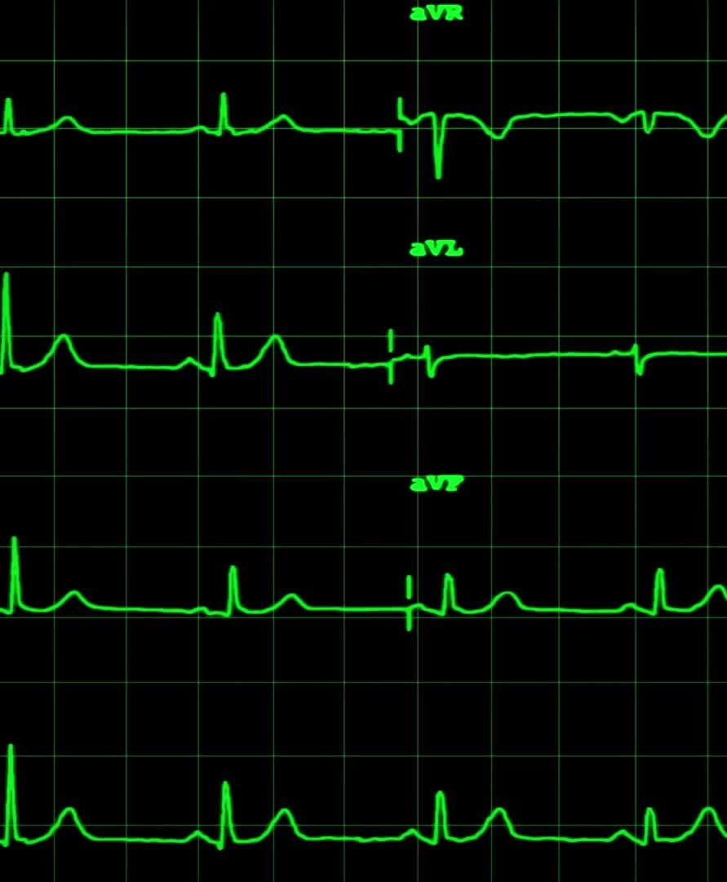
User Interface & Alerts
Display Platforms: Mobile phone, desktop/laptop, or serial plotter
Function:
Shows live data for ECG, SpO₂, Heart Rate, Temperature, and Motion
Highlights abnormal readings with alert messages

Slide 9
System Workflow
Sensors collect real-time data ECG, SpO₂, Heart Rate, Temperature, and Motion
Microcontroller processes signals Filters noise and detects abnormalities
Data transmitted wirelessly Sent via Bluetooth/Wi-Fi to connected device
Data displayed on external device Shown on mobile, laptop, or serial plotter
Alerts generated if thresholds crossed Notifies user instantly of any abnormal health readings

Slide 10
Testing
AD8232 – ECG Module Captured clean PQRST waveform with ~98% accuracy compared to clinical ECG
MAX30100 – SpO₂ & Heart Rate SpO₂ accuracy: ~97%, Heart rate variation: ±2 bpm
DS18B20 – Temperature Sensor Deviation: ±0.2°C compared to a digital thermometer
MPU6050 – Motion Sensor Detected falls and activity changes with ~95% accuracy
Wireless Transmission Stable up to 15–20 meters, latency ~200 ms, <1% data loss

Slide 11
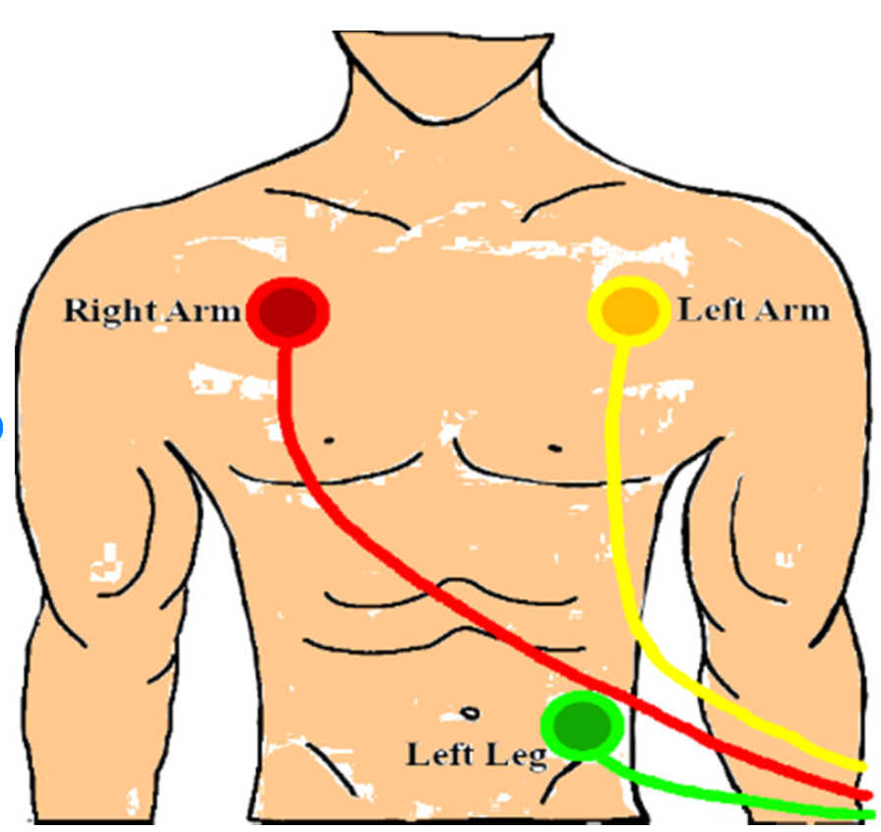
Testing
Electrode Placement
RA (Right Arm): Below the right collarbone (upper chest)
LA (Left Arm): Below the left collarbone (upper chest)
RL (Right Leg / Ground): Lower abdomen or inner right thigh

Slide 12
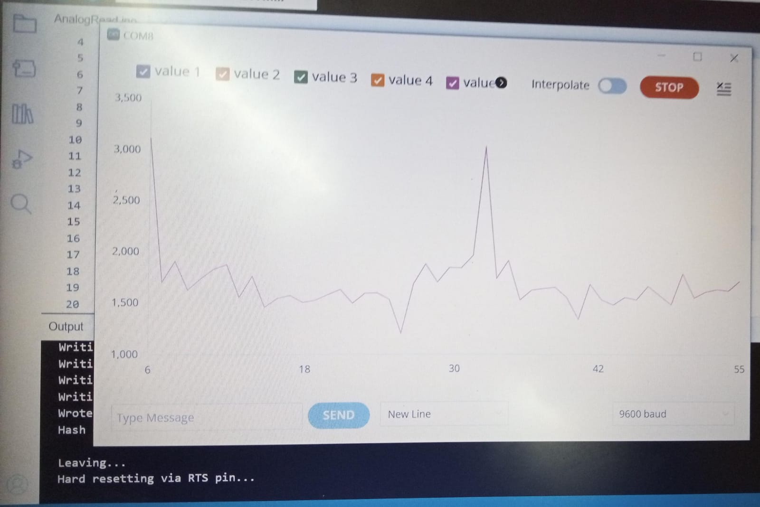
Results

Slide 13

Future Work
Cloud Integration: Enable remote storage and access of patient data via cloud platforms
AI-Based Health Predictions: Use machine learning to detect early signs of diseases like arrhythmia
Battery Optimization: Improve power efficiency for longer continuous wearable use
Custom Mobile App: Develop a dedicated Android/iOS app with real-time graphs and notifications
Miniaturization & Enclosure: Design a compact, wearable casing for practical daily use

Slide 14
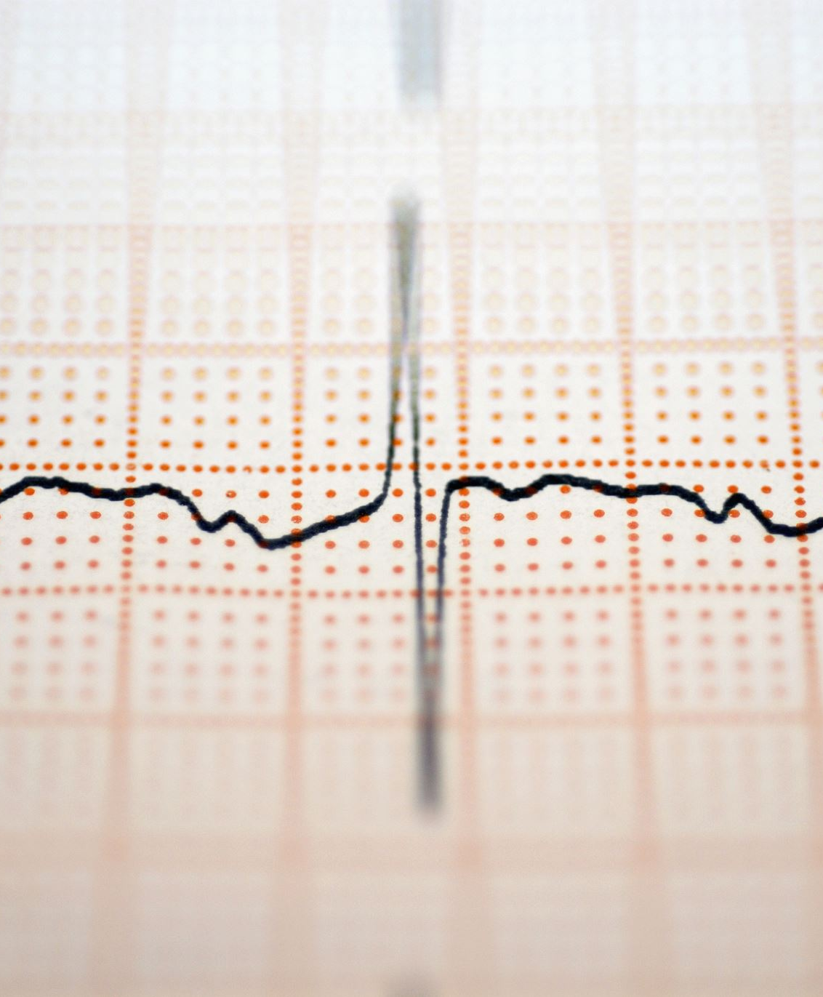
Conclusion
Successfully developed a wearable, real-time health monitoring system. Accurately tracks:
ECG (heart activity)
SpO₂ & Heart Rate
Body Temperature
Motion & Fall Detection
Validated through real-patient testing, showing reliable and accurate results
Enables early detection, remote monitoring, and improved accessibility

Slide 15

Thank You

