Slide 1

CUSTOMER INTELLIGENCE
Segmentation, anomaly exploration, dimensionality reduction, and calibrated default-risk modeling
ML PORTFOLIO CASE STUDY
github.com/Awais-Asghar/customer-intelligence-ml
Notes:
Open by explaining that this project demonstrates complete machine-learning reasoning, not only model training. The four methods answer separate questions and their outputs must not be mixed.

Slide 2
BUSINESS FRAMING
02
Four questions, four methods
01
02
03
04
PCA
K-Means
DBSCAN
Boosting
What structure explains most variation?
Which broad behaviors repeat?
Which records are locally sparse?
How uncertain is historical default?
ROLE
ROLE
ROLE
ROLE
Compression and visualization
Descriptive segmentation
Anomaly exploration
Calibrated risk estimation
Clusters are not risk classes. Density noise is not fraud. Predictions are probabilities, not decisions.
github.com/Awais-Asghar/customer-intelligence-ml
Notes:
Explain the boundary between the methods. PCA compresses data, K-Means describes broad groups, DBSCAN finds sparse behavior, and gradient boosting estimates a historical outcome probability.

Slide 3
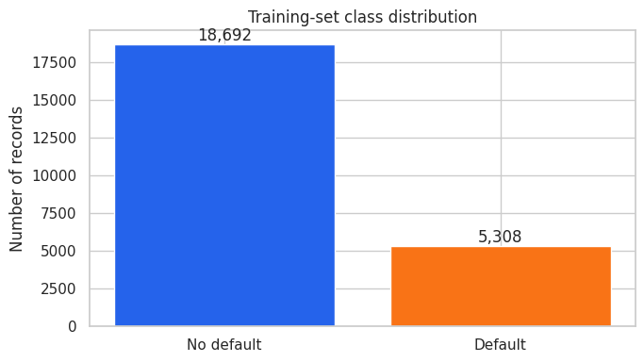
DATA
03
A realistic, imbalanced credit dataset
30,000
23
CUSTOMER RECORDS
RAW EXPLANATORY FEATURES
22.12%
0
HISTORICAL DEFAULTS
MISSING VALUES
WHY ACCURACY IS NOT ENOUGH
A model that predicts only the majority class would appear accurate while missing every historical default.
Source
UCI Default of Credit Card Clients, dataset 350, CC BY 4.0
Target prevalence
6,636 positive records
github.com/Awais-Asghar/customer-intelligence-ml
Notes:
The target is imbalanced but not extremely rare. Use balanced accuracy, precision, recall, F1, PR-AUC, and ROC-AUC alongside overall accuracy.

Slide 4
LEAKAGE CONTROL
04
The test set stays closed until the end
TRAIN
VALIDATION
TEST
24,000 records | 80%
3,000 records | 10%
3,000 records | 10%
Candidate selection
Three-fold stratified CV
Threshold selection
No candidate tuning
Opened once
Final evaluation only
AUDIT RESULTS
0
0.0742
10
21
IDENTIFIER OVERLAP
MAXIMUM ABSOLUTE SMD
TEST ROWS MATCHING A DEV PROFILE
PROFILES WITH CONFLICTING LABELS
github.com/Awais-Asghar/customer-intelligence-ml
Notes:
Candidate selection uses only training folds. Validation is reserved for threshold selection. The test set is opened once after the model and threshold are frozen. The conflicting labels explain why perfect classification is not credible.

Slide 5
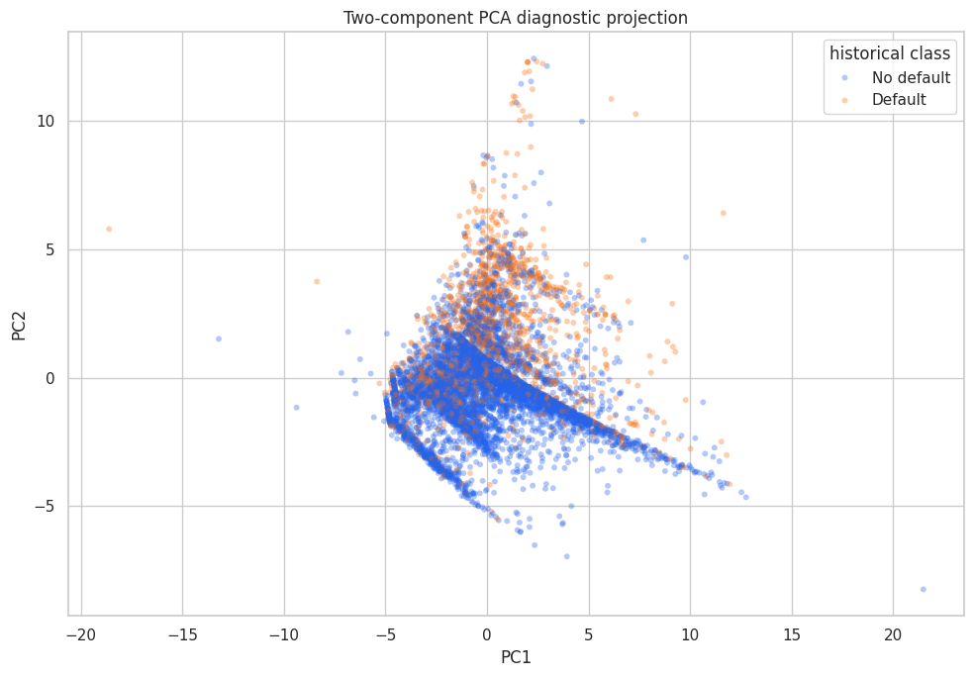
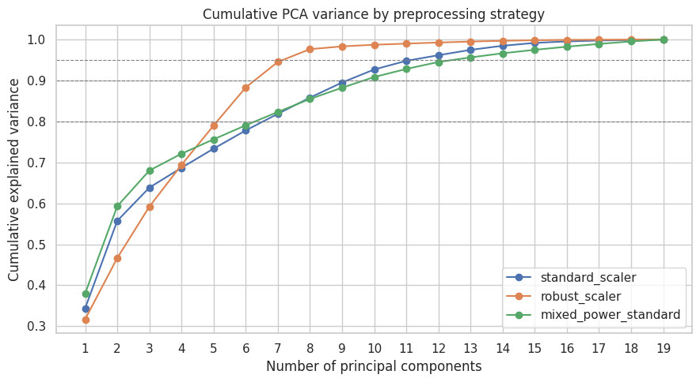
DIMENSIONALITY REDUCTION
05
PCA retains signal without inventing certainty
19
13
95.63%
59.29%
BEHAVIORAL INPUTS
COMPONENTS RETAINED
CUMULATIVE VARIANCE
FIRST TWO COMPONENTS
The 13-component representation supports PCA and clustering analysis. The supervised model uses 54 engineered behavioral features.
github.com/Awais-Asghar/customer-intelligence-ml
Notes:
Preprocessing and PCA were fitted on training data only. Two components are useful for visualization, while the retained representation supports unsupervised analysis. The supervised classifier does not use the PCA representation.

Slide 6
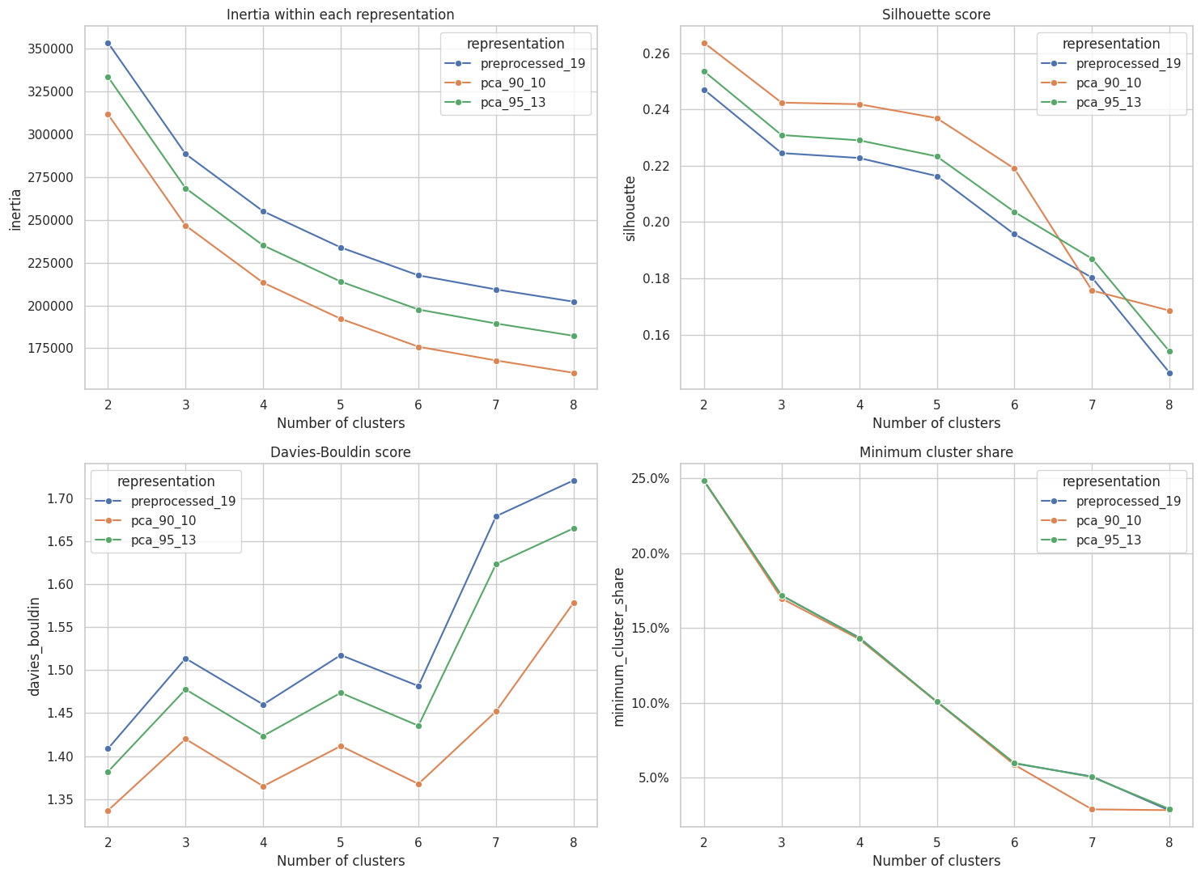
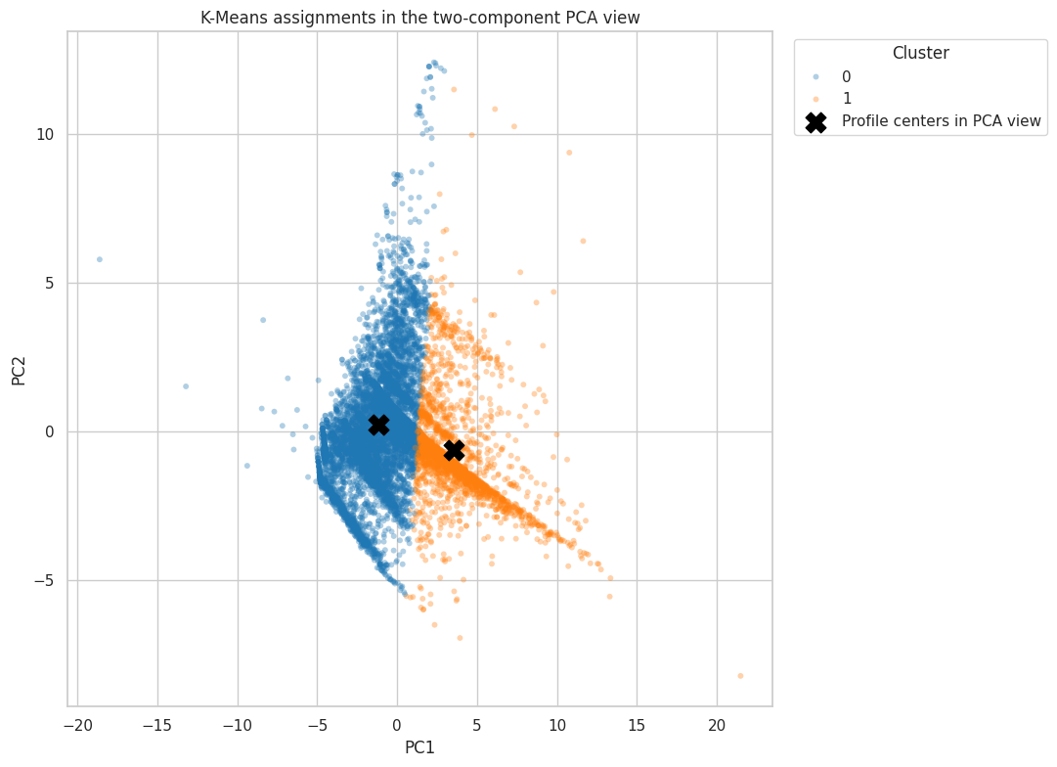
K-MEANS SEGMENTATION
06
Two stable groups, with meaningful overlap
2
0.2638
0.9960
24.66%
SELECTED CLUSTERS
SILHOUETTE SCORE
STABILITY ARI
SMALLEST CLUSTER
github.com/Awais-Asghar/customer-intelligence-ml
Notes:
The near-perfect stability ARI means repeated initializations find almost the same assignments. The moderate silhouette score shows overlap, so the groups should be presented as broad behavioral segments, not natural risk classes.

Slide 7
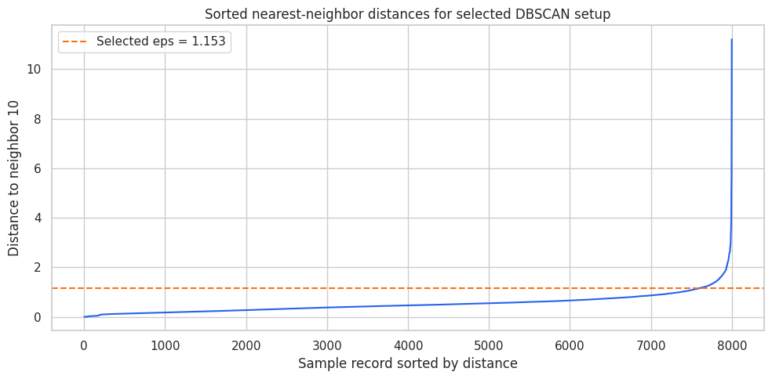
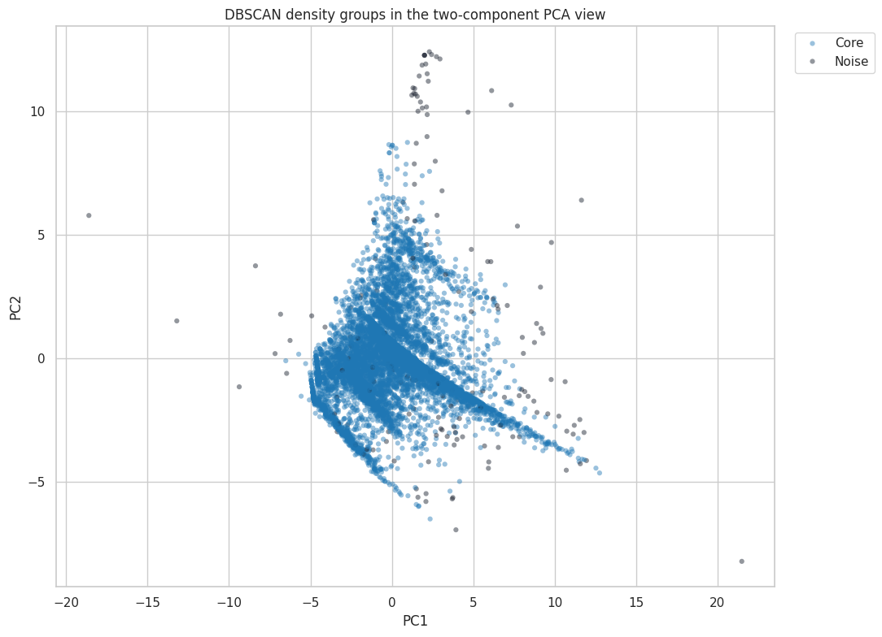
ANOMALY EXPLORATION
07
DBSCAN reveals sparse records, not new segments
SELECTED CONFIGURATION
• 5 whitened PCA components
• eps 1.1526 and min_samples 10
• One substantial core group
• 2.08% density-noise records
Interpretation: unusual multivariate behavior, not fraud, wrongdoing, or a guaranteed future outcome.
github.com/Awais-Asghar/customer-intelligence-ml
Notes:
No tested configuration produced multiple credible density clusters. Keeping the method as anomaly exploration is a scientifically useful negative result. Never call the noise points fraud.

Slide 8
GRADIENT BOOSTING
08
A supervised pipeline designed for honest comparison
01
02
03
04
Behavioral inputs
Feature engineering
Candidate search
Selection
19 non-demographic variables
54 deterministic features
10 HGB configurations
Three-fold stratified CV
MODEL SELECTION OBJECTIVE
PR-AUC
Selected because the positive class is 22.12% of the data
Demographics excluded from prediction
0.05
15
600
30
LEARNING RATE
MAX LEAF NODES
MAX ITERATIONS
EARLY-STOP PATIENCE
github.com/Awais-Asghar/customer-intelligence-ml
Notes:
The feature contract is deterministic. Demographic fields are excluded from prediction and reserved for aggregate auditing. Histogram gradient boosting uses gradient-based tree updates, not Adam or SGD.

Slide 9
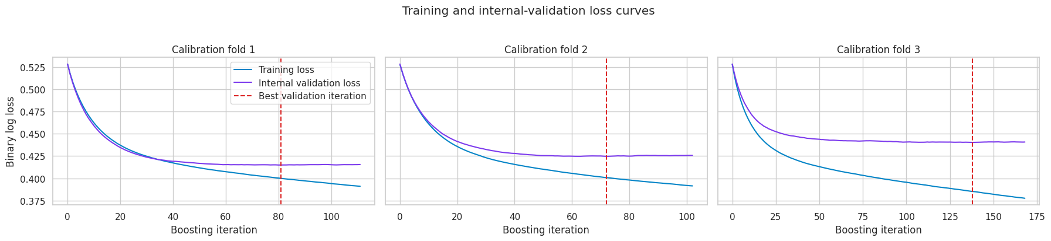
TRAINING DIAGNOSTICS
09
Early stopping controls unnecessary boosting
81
72
138
600
FOLD 1 BEST ITERATION
FOLD 2 BEST ITERATION
FOLD 3 BEST ITERATION
MAXIMUM CAP
Final calibrated estimators
116, 131, and 106 iterations
No fold reached the cap
github.com/Awais-Asghar/customer-intelligence-ml
Notes:
The real notebook curves are shown here. Validation loss plateaus while training loss keeps falling, especially in fold three. Raising the 600-iteration cap would not improve this run.

Slide 10
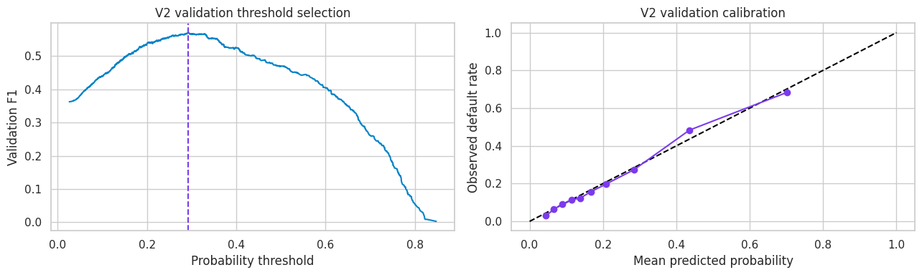
CALIBRATION
10
Threshold selection is an operating decision
0.2916
GAINS
TRADEOFF
VALIDATION-SELECTED THRESHOLD
Recall, balanced accuracy, and F1
Lower precision and overall accuracy
ROC-AUC and PR-AUC do not change when only the decision threshold changes.
github.com/Awais-Asghar/customer-intelligence-ml
Notes:
The chart is the actual validation result. The selected threshold maximizes validation F1. Lowering the threshold flags more positives, improving recall while increasing false positives.

Slide 11
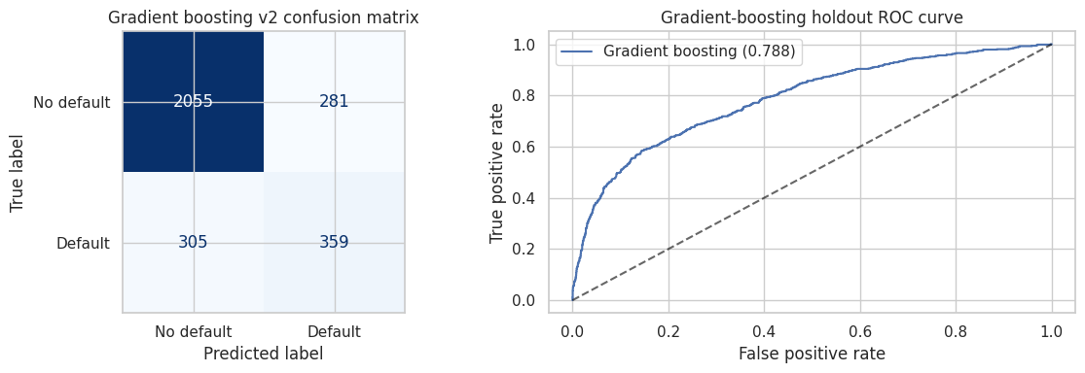
FINAL EVALUATION
11
The final test result is useful and honest
80.47%
71.02%
56.09%
54.07%
55.06%
ACCURACY
BALANCED ACCURACY
PRECISION
RECALL
F1 SCORE
github.com/Awais-Asghar/customer-intelligence-ml
Notes:
At the selected threshold, the confusion matrix contains 2,055 true negatives, 281 false positives, 305 false negatives, and 359 true positives. Compare this operating point with threshold 0.50 and explain the tradeoff.

Slide 12
RESPONSIBLE ML
12
What the project proves, and what it does not
LESSONS
LIMITS
• Prevent leakage before optimizing metrics
• Use separate methods for separate questions
• Tune the threshold on validation data only
• Treat negative results as useful evidence
• Communicate uncertainty and operating tradeoffs
• Conflicting labels prevent deterministic prediction
• Rare categories increase uncertainty
• Clusters are descriptive, not causal
• DBSCAN noise is not evidence of fraud
• Production use requires governance and monitoring
REPOSITORY
github.com/Awais-Asghar/customer-intelligence-ml
Notebook | Tests | Figures | Reproducibility
github.com/Awais-Asghar/customer-intelligence-ml
Notes:
Close with the main engineering lesson: trustworthy ML is not a contest for the largest metric. The project demonstrates leakage control, reproducibility, method selection, calibration, and honest communication of limitations.

