Slide 1

Prepared by Team Z
Nikitha Yarlagadda
Venkata Lalitha Kumari Emandi
Sandhya Lotla
Under the Guidance of:
Prof. Shivanjali Khare

Slide 2
Moves of the Machine:
Developing chess AI

Slide 3

How the game works:
It's one of the two-player strategy board games played on the 8 x 8 gridded board, which has 64 squares colored in an alternate pattern of light and dark. The objective of the game is to checkmate your opponent's king, which means that king is under attack and has no means to escape the attack while protecting your own king.
Requirements:
Programming language:
Version: Python 3.10 or newer.
Libraries and tools:
Pygame: Open source Python library .Used for developing games and other applications
Time Module: For measuring execution time

Slide 4
How the chess pieces move?
King : the King can move only in any direction but only one square. It can move horizontally , vertically or diagonally .
Queen: The queen is the most powerful piece in chess due to its ability to move any number of squares in any directions like horizontally , vertically or diagonally .
Rook : It is also the most powerful chess piece due to its ability to control both horizontal and vertical lines on the board.
Bishop : It has unique movement that means it is limited to squares of the same colour.
Knight : It moves in an L shape and has the special ability to jump over other pieces.
Pawns : Can move only one space forward unless its their first move it can move two squares.

Slide 5
Files included:
• assets folder : All of the game's graphics components that represent chess pieces are
centralized in the assets folder.
chess.py: The main program used to run the interface and game.
pieces.py: It defines the functionality and behavior of each chess piece.
board.py: This contains the board class and its methods. Also contains the alpha-beta pruning
method.
userInterface.py: Contains the user-interface class that is used to play the game and display
the game using pygame.

Slide 6
Objective
Our project aims to develop a robust chess AI that not only simulates strategic gameplay but also offers players an exciting and challenging experience.
In this we use various algorithms like alpha-beta Purning, A3C .In order to compare and get the best moves and accuracy ,

Slide 7
Algorithm and Methodology
Algorithms Used
Alpha-Beta Pruning:
Purpose: Enhances the Minimax algorithm by reducing the number of nodes evaluated in the game tree.
How it works:
It evaluates possible moves by alternating between maximizing and minimizing player advantages.
Uses two bounds:
Alpha: The best score for the maximizing player.
Beta: The best score for the minimizing player.
Prunes branches that cannot influence the final decision, optimizing computational efficiency.
Outcome: Allows the AI to compute moves faster while maintaining accuracy.
Asynchronous Advantage Actor-Critic (A3C):
Purpose: A reinforcement learning algorithm used to train the AI by simulating multiple game instances concurrently.
How it works:
Trains several agents (chess players) in parallel.
Creates value functions (to evaluate board positions) and policies (to guide moves).
Outcome: Speeds up the AI's learning process, enabling it to adapt better and make more strategic decisions.

Slide 8

Methodology
Objective:
Develop a robust chess AI capable of challenging players and simulating strategic gameplay.
Utilize Alpha-Beta Pruning and A3C to determine optimal moves and improve accuracy.
Approach:
Move Generation:
Define how chess pieces move (King, Queen, Rook, Bishop, Knight, Pawn) using object-oriented programming.
Game Tree Search:
Employ Alpha-Beta Pruning to explore possible moves up to a certain depth.
Reinforcement Learning:
Use A3C to train the AI in a self-play environment, refining its policies and strategies over time.

Slide 9

Evaluation:
Test adaptability through self-play and compare move accuracy between Alpha-Beta Pruning and A3C.
Measure user satisfaction with response time and AI decision-making efficiency.

Slide 10
Deliverables
Game Application
.
In this it will allow to select the best moves more quickly and optimize performance.
Documentation
Detailed documentation on the setup, training, and usage of the AI algorithms
Source Code Repository
Organized and commented source code hosted in a repository i.e., GitHub
Youtube Video Demo of the project

Slide 11
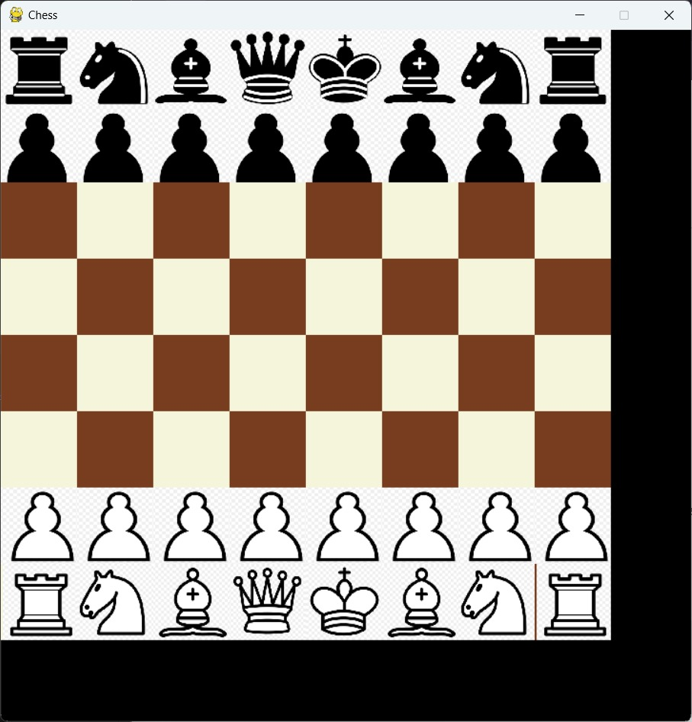
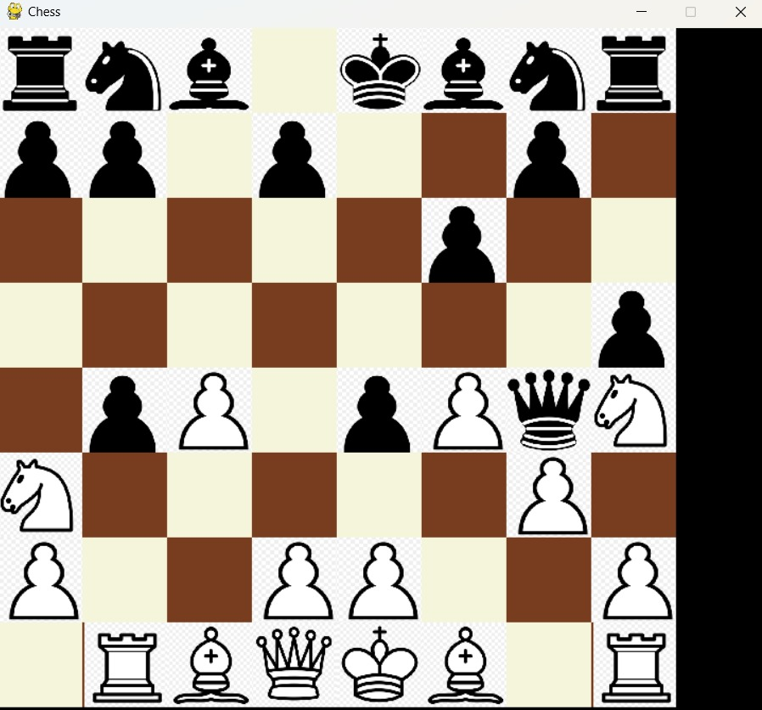
O
U
T
P
U
T

Slide 12
Thank you

