Slide 1
SALE AGENT WITH GOOGLE ADK
Awais Shakeel

Slide 2

project overview
AI assistant built using Google's Agent Development Kit (ADK), designed to collect user information respectfully and intelligently. It operates with a friendly tone, ensuring a smooth user experience while also handling consent and follow-up logic automatically.

Slide 3
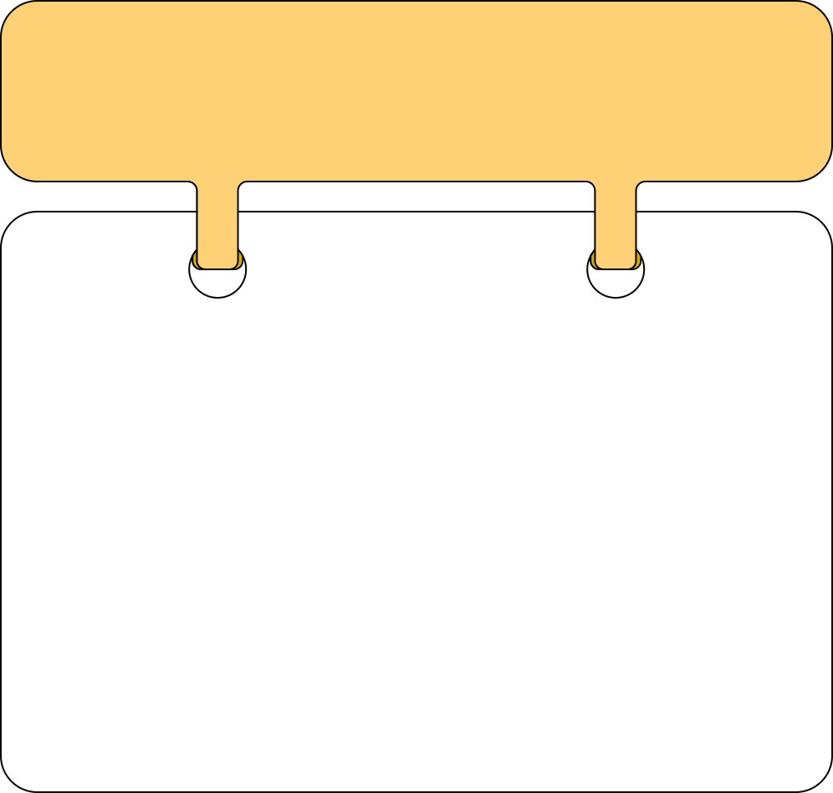
Lead Collection with Consent
Starts with a warm greeting and asks for consent to collect data.
If the user agrees, AS-AI collects:
Name
Country
Interests
The information is saved in a structured format to a CSV file with a unique lead_id.

Slide 4
Automatic Follow-Up System
If the user declines or doesn’t respond:
AS-AI records partial or no data with status: no.
Triggers a non-blocking timer to send a follow-up message like “Hi, are you still interested?” after a delay (e.g., 30 seconds).
Ensures other parts of the conversation remain responsive during the wait.

Slide 5
Multi-Agent Architecture
Built with LangGraph-style routing using:
root_agent: Handles greetings and routes messages.
csv_agent: Handles data collection and tool calls.
follow_up_agent: Handles "no" responses and delayed re-engagement.

Slide 6
Tool Integration
csv_tool: Appends collected data into a local CSV file.
start_timer: Delays sending a follow-up prompt without blocking the agent.

Slide 7
The UI already includes built-in session and memory handling, which is why no manual memory/session logic was added

Slide 8
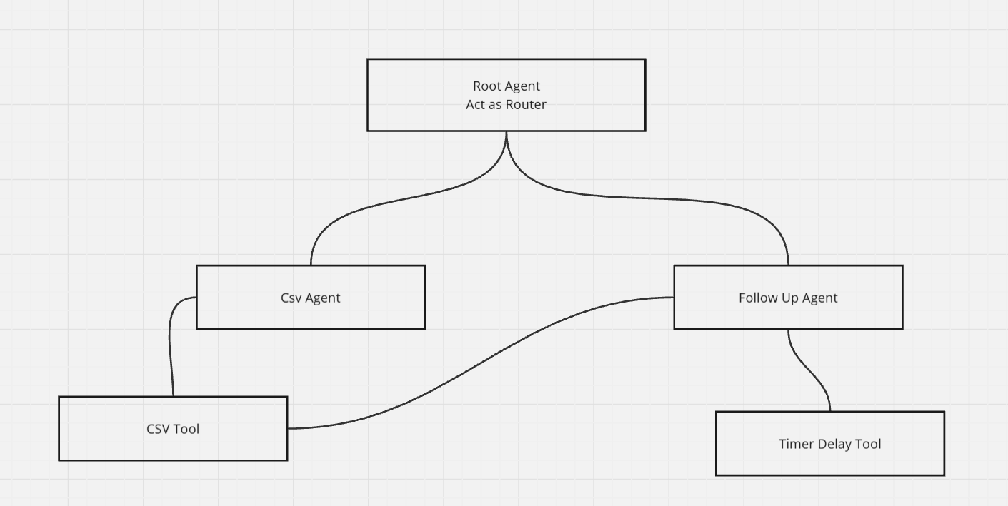

Slide 9
Problems
❗Note on Trigger Mechanism
⚠️ Important Clarification
This project does not automatically trigger the AI agent from a form submission as originally expected.
Instead:
A function is used to generate a random lead_id (via generate_lead_id()).
This lead_id is manually passed to the agent before it begins interacting with the user.
The agent starts only when the user initiates the conversation, rather than being automatically triggered by the form.

Slide 10



