Slide 1
Object-Oriented Programming (OOP)

Slide 2
Abstraction
Abstraction is a way to cope with complexity.
Principle of abstraction:
“Capture only those details about an object that are relevant to current perspective”

Slide 3
Example – Abstraction
Frank is a PhD student and teaches BS students
Attributes
- Name - Employee ID
- Student Roll No - Designation
- Year of Study - Salary
- CGPA - Age

Slide 4
Example – Abstraction
Frank is a PhD student and teaches BS students
behaviour
- Study - DevelopExam
- GiveExam - TakeExam
- PlaySports - Eat
- DeliverLecture - Walk

Slide 5
Example – Abstraction
Student’s Perspective
Attributes
- Name - Employee ID
- Student Roll No - Designation
- Year of Study - Salary
- CGPA - Age

Slide 6
Example – Abstraction
Student’s Perspective
behaviour
- Study - DevelopExam
- GiveExam - TakeExam
- PlaySports - Eat
- DeliverLecture - Walk

Slide 7
Example – Abstraction
Teacher’s Perspective
Attributes
- Name - Employee ID
- Student Roll No - Designation
- Year of Study - Salary
- CGPA - Age

Slide 8
Example – Abstraction
Teacher’s Perspective
behaviour
- Study - DevelopExam
- GiveExam - TakeExam
- PlaySports - Eat
- DeliverLecture - Walk

Slide 9
Example – Abstraction
A cat can be viewed with different perspectives
Ordinary Perspective
A pet animal with
Four Legs
A Tail
Two Ears
Sharp Teeth
Surgeon’s Perspective
A being with
A Skeleton
Heart
Kidney
Stomach

Slide 10
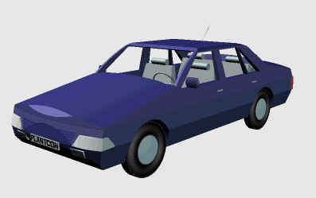
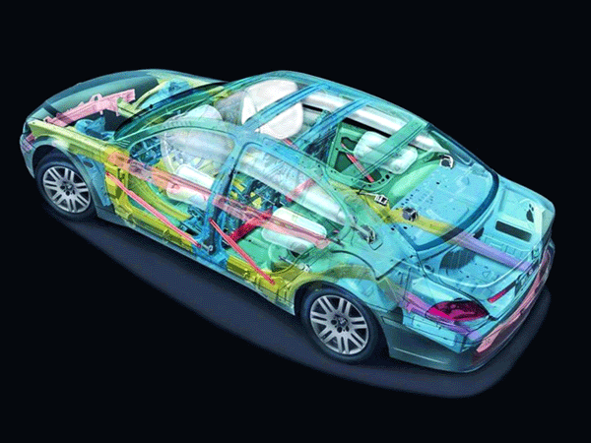
Example – Abstraction
Engineer’s View
Driver’s View

Slide 11
Abstraction – Advantages
Simplifies the model by hiding irrelevant details
Abstraction provides the freedom to defer implementation decisions by avoiding commitment to details

Slide 12
Classes
In an OO model, some of the objects exhibit identical characteristics (information structure and behaviour)
We say that they belong to the same class

Slide 13
Example – Class
Frank studies mathematics
Aditi studies physics
Aamir studies chemistry
Each one is a Student
We say these objects are instances of the Student class

Slide 14
Example – Class
John teaches mathematics
Ibrahim teaches computer science
Vijay teaches physics
Each one is a teacher
We say these objects are instances of the Teacher class

Slide 15
Graphical Representation of Classes
(Class Name)
(Class Name)
(attributes)
(operations)
Suppressed Form
Normal Form

Slide 16
Example – Graphical Representation of Classes
Circle
center
radius
Circle
draw
computeArea
Suppressed Form
Normal Form

Slide 17
Example – Graphical Representation of Classes
Person
name
age
gender
Person
Suppressed Form
eat
walk
Normal Form

Slide 18
Inheritance
A child inherits characteristics of its parents
Besides inherited characteristics, a child may have its own unique characteristics

Slide 19
Inheritance in Classes
If a class B inherits from class A then it contains all the characteristics (information structure and behaviour) of class A
The parent class is called base class and the child class is called derived class
Besides inherited characteristics, derived class may have its own unique characteristics

Slide 20
Example – Inheritance
Person
Student
Doctor
Teacher

Slide 21
Example – Inheritance
Shape
Line
Triangle
Circle

Slide 22
Inheritance – “IS A” or “IS A KIND OF” Relationship
Each derived class is a special kind of its base class

Slide 23
Example – “IS A” Relationship
Person
name
age
gender
eat
walk
Student
Teacher
Doctor
program
studyYear
designation
salary
designation
salary
study
heldExam
teach
takeExam
checkUp
prescribe

Slide 24
Example – “IS A” Relationship
Shape
color
coord
draw
rotate
setColor
Triangle
Circle
radius
Line
angle
draw
computeArea
length
draw
computeArea
draw

Slide 25
Inheritance – Advantages
Reuse
Less redundancy
Increased maintainability

Slide 26
Reuse with Inheritance
Main purpose of inheritance is reuse
We can easily add new classes by inheriting from existing classes
Select an existing class closer to the desired functionality
Create a new class and inherit it from the selected class
Add to and/or modify the inherited functionality

Slide 27
Example Reuse
Shape
color
coord
draw
rotate
setColor
Triangle
Circle
radius
Line
angle
draw
computeArea
length
draw
computeArea
draw

Slide 28
Example Reuse
Person
name
age
gender
eat
walk
Student
Teacher
Doctor
program
studyYear
designation
salary
designation
salary
study
heldExam
teach
takeExam
checkUp
prescribe

Slide 29
Example Reuse
Person
name
age
gender
eat
walk
Student
Teacher
Doctor
program
studyYear
designation
salary
designation
salary
study
heldExam
teach
takeExam
checkUp
prescribe

