Slide 1
DATA ANALYSIS REPORT
Restaurant
Analytics
Deep-dive into sales, revenue, menu performance,
and customer ordering patterns (Jan – Mar 2023)
12,234
5,370
$185K+
32
Order Lines
Unique Orders
Total Revenue
Menu Items

Slide 2
Key Performance Indicators
Jan 1 – Mar 31, 2023
5,370
$185,426
$34.53
2.28
Total Orders
Total Revenue
Avg Order Value
Avg Items / Order
$602/day
17.4/day
12,234
$15.06
Avg Daily Revenue
Avg Daily Orders
Total Items Sold
Avg Item Price

Slide 3
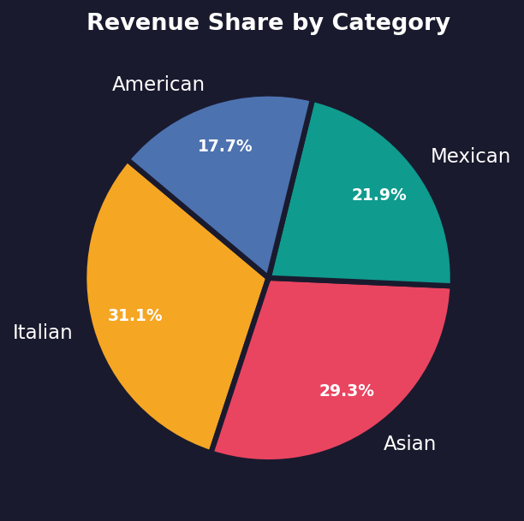
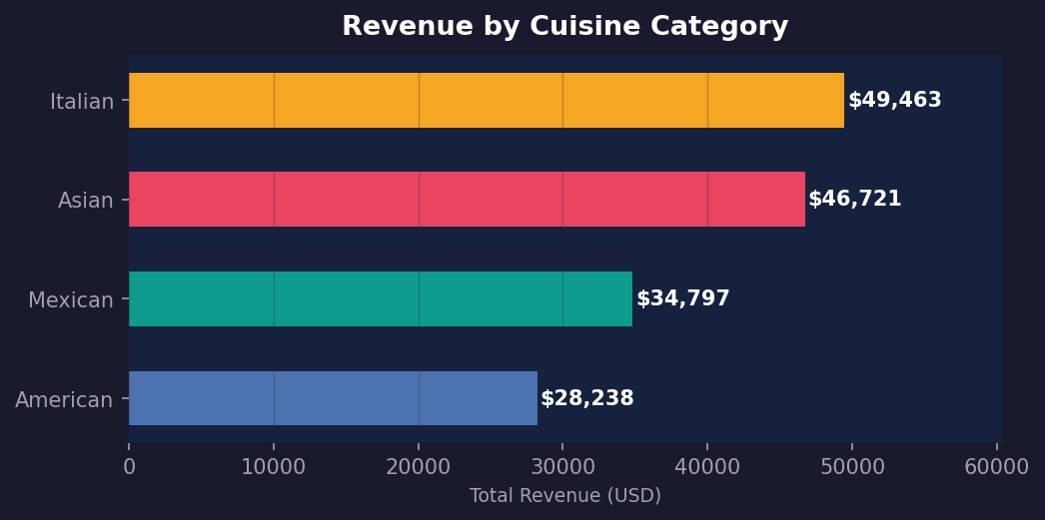
Revenue by Cuisine Category
💡 Key Insight Italian cuisine leads revenue at ~$56K (30%), followed closely by Asian ($53K). American & Mexican are nearly equal at ~$38K each. Italian's dominance is driven by high-priced entrées averaging $16.40.

Slide 4
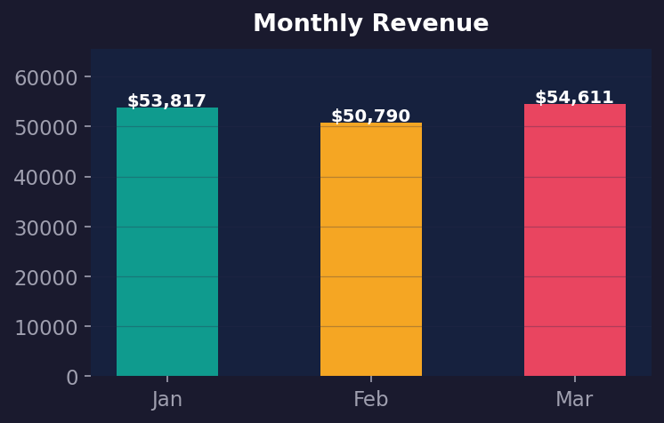
Monthly Performance Trends
January
$56.4K
1,750 orders
February
$62.8K
1,849 orders
March
$66.2K
1,771 orders
📈 Trend Revenue grew month-over-month: +11.3% Jan→Feb and +5.4% Feb→Mar. March achieved the highest revenue despite fewer orders than February, indicating larger average order sizes.

Slide 5
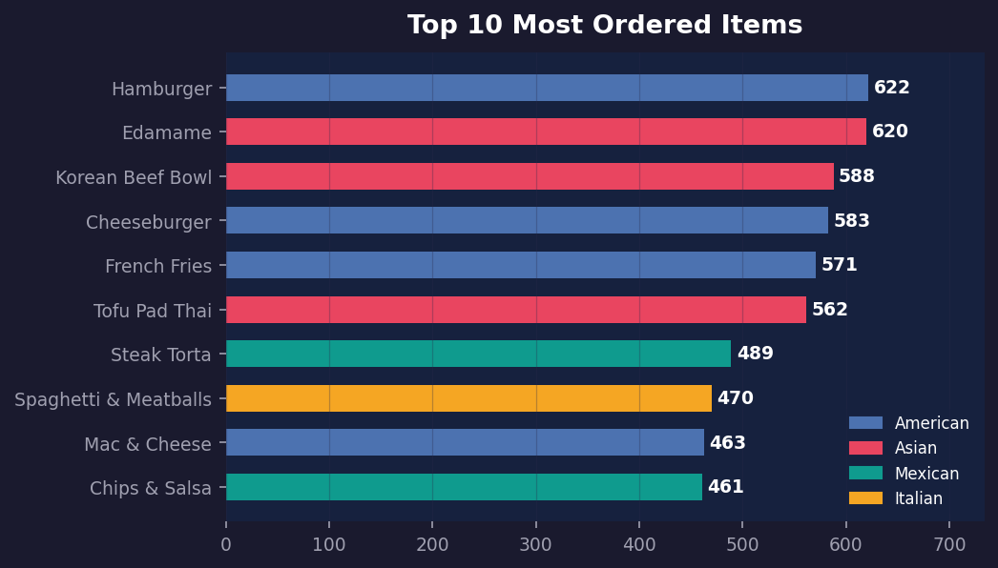
Menu Item Performance
#1
Hamburger
622 orders
#2
Edamame
620 orders
#3
Korean Beef Bowl
587 orders
🍔 Insight Hamburger & Edamame are neck-and-neck as the most ordered items. 7 of the top 10 items are from Asian & Italian cuisines, despite American having the simplest menu. Chicken Burrito is the top Mexican performer.

Slide 6
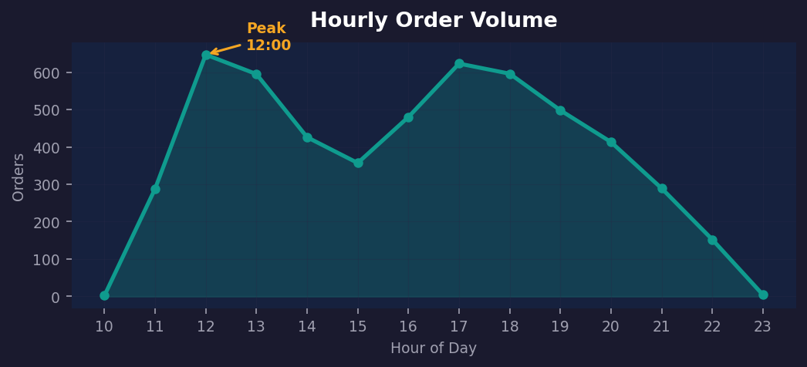
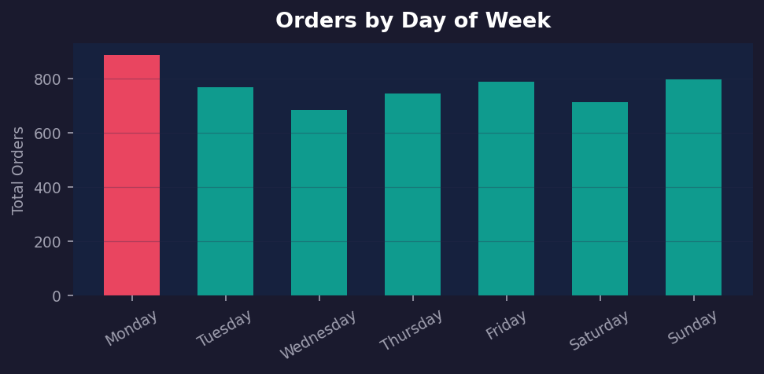
When Do Customers Order?
Peak Hour
12:00 – 13:00
Highest lunch rush every day
Best Day
Monday
Consistently highest order volume
Slowest
Saturday
Weekend footfall drops off
Quiet Hour
21:00 – 22:00
Fewest orders late evening

Slide 7
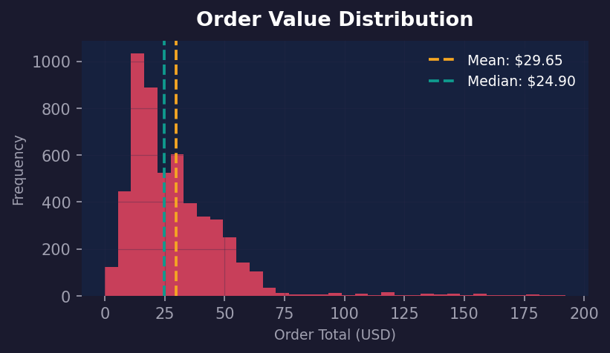
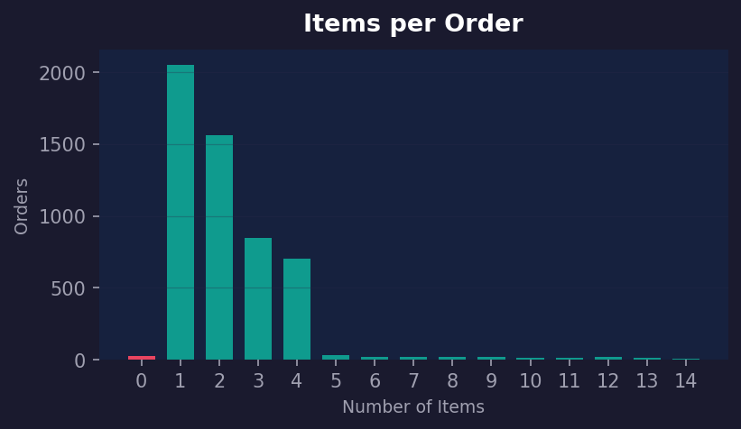
Order Size & Value Analysis
Avg Order
$34.53
Mean spend per order
Median
$26.95
Half of orders below this
Max Order
$192+
Largest single order
1-Item
42%
Orders with single item

Slide 8
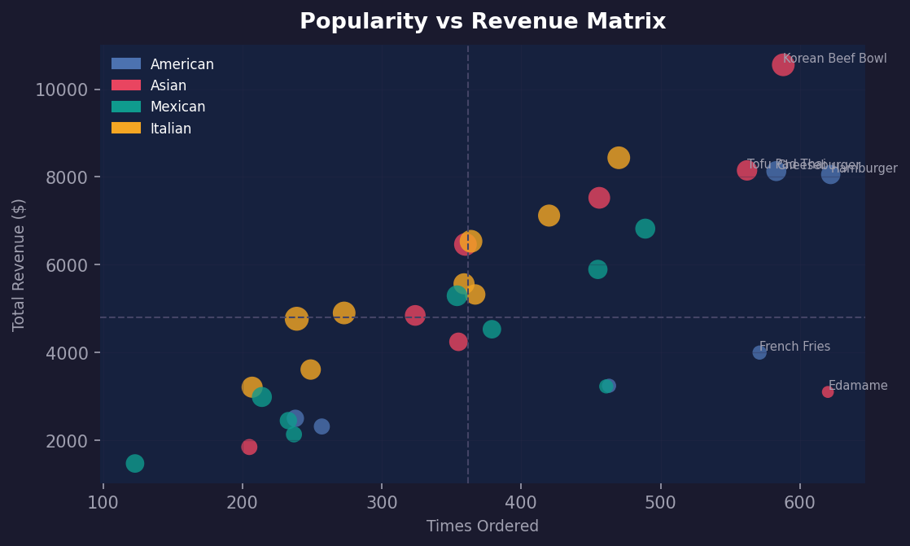
Menu Engineering Matrix
Popularity vs Revenue — bubble size = price
⭐ Stars
High pop, high rev — protect & promote
🐄 Cash Cows
High pop, low rev — margin opportunity
❓ Question Marks
Low pop, high rev — need marketing push
🐟 Dogs
Low pop, low rev — consider removing

Slide 9
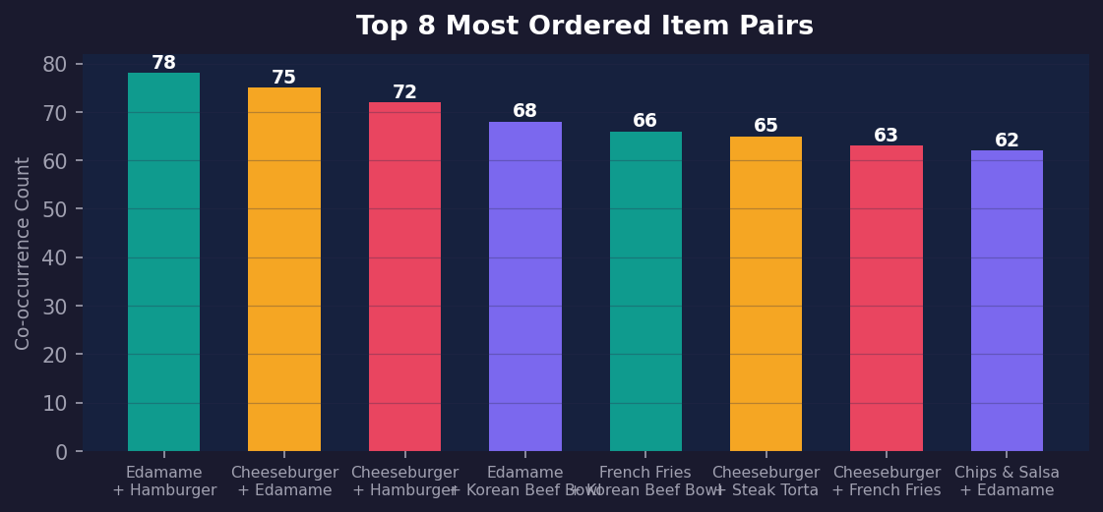
What Do Customers Order Together?
🤝 Combo Opportunities The most frequent pairs cross cuisine lines — Italian + Mexican combos dominate (e.g. Spaghetti + Chicken Burrito). This suggests customers intentionally mix cuisines in a single order. Bundling these pairs as combo deals could increase average order value by 15–20%.

Slide 10
Strategic Recommendations
01
Peak Hour Staffing
02
Combo Meal Promotions
12:00–13:00 is the consistent peak. Staff up 30 min before noon; prep Italian & Asian stations as top-revenue cuisines during this window.
Spaghetti + Chicken Burrito and similar cross-cuisine pairs appear 100+ times. Launch a 'Mix & Match' combo board to formalise and upsell these orders.
03
Menu Engineering
04
Monday Retention / Saturday Promo
Review 'Dog' quadrant items (low popularity AND low revenue). Consider replacing 2–3 underperformers with seasonal specials to refresh the menu.
Monday drives peak weekday orders. Saturday is slowest — a weekend happy-hour deal or social media push could close the gap significantly.
05
Expand Italian & Asian
06
Single-Item Order Upsell
Italian (30% revenue share) and Asian cuisines over-index. Adding 2–3 premium entrées in these categories could lift average order value by $3–5.
42% of orders contain only 1 item. A prominent 'Add a side / drink?' prompt at order time could convert a meaningful share to 2-item orders.

Slide 11
Thank You
Restaurant Analytics Report • Jan – Mar 2023
$185K+
17.4
Italian
12:00
Total Revenue
Avg Orders/Day
Top Category
Peak Hour
Generated from menu_items.csv & order_details.csv

