Slide 1
Mitra App : AI Companion
Manish Kumar
2001cs45
Supervisor professor – Dr. Rajiv Mishra

Slide 2
Project Overview
I have created flutter based mobile application with the following features
AI Chatbot: Conversational assistance for user queries.
AI Image Creator: Generate AI-powered artistic visuals.
Language Translator: Real-time text translation for communication.
AQI Calculator: Real-time air quality analysis based on location and compared with your current location Air Quality Index.

Slide 3
Technical Stack
Frontend Framework: Flutter (cross-platform compatibility).
Programming Language: Dart.
Gemini API: For the AI chatbot.
LEXICA API: For the AI Image Creator.
Translation APIs: For Language Translator.
AQI API: For Air Quality Index data.

Slide 4
Gemini-Powered AI Chatbot
Feature Description:
Conversational assistant powered by Gemini AI, providing intelligent and human-like responses.
Personalized help based on user queries and context.
Core Functionality:
Handles natural language input for daily tasks, FAQs, and interactive conversations.
Technical Implementation:
Integrated Gemini API for NLP and conversational intelligence.
Adaptive responses trained on large datasets.

Slide 5
AQI Calculator
Feature Description:
Tracks real-time Air Quality Index (AQI) using location data.
Provides actionable health insights based on air pollution levels.
Core Functionality:
Fetches data using AQI API and presents it in an easy-to-read format.
Includes weather-based pollution predictions.

Slide 6
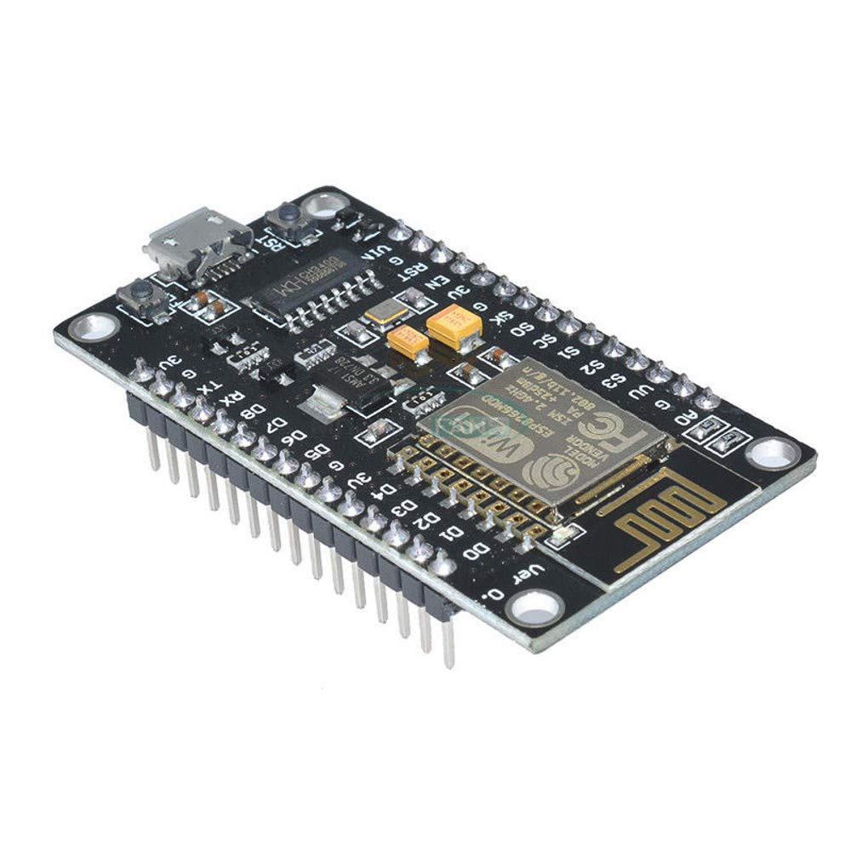
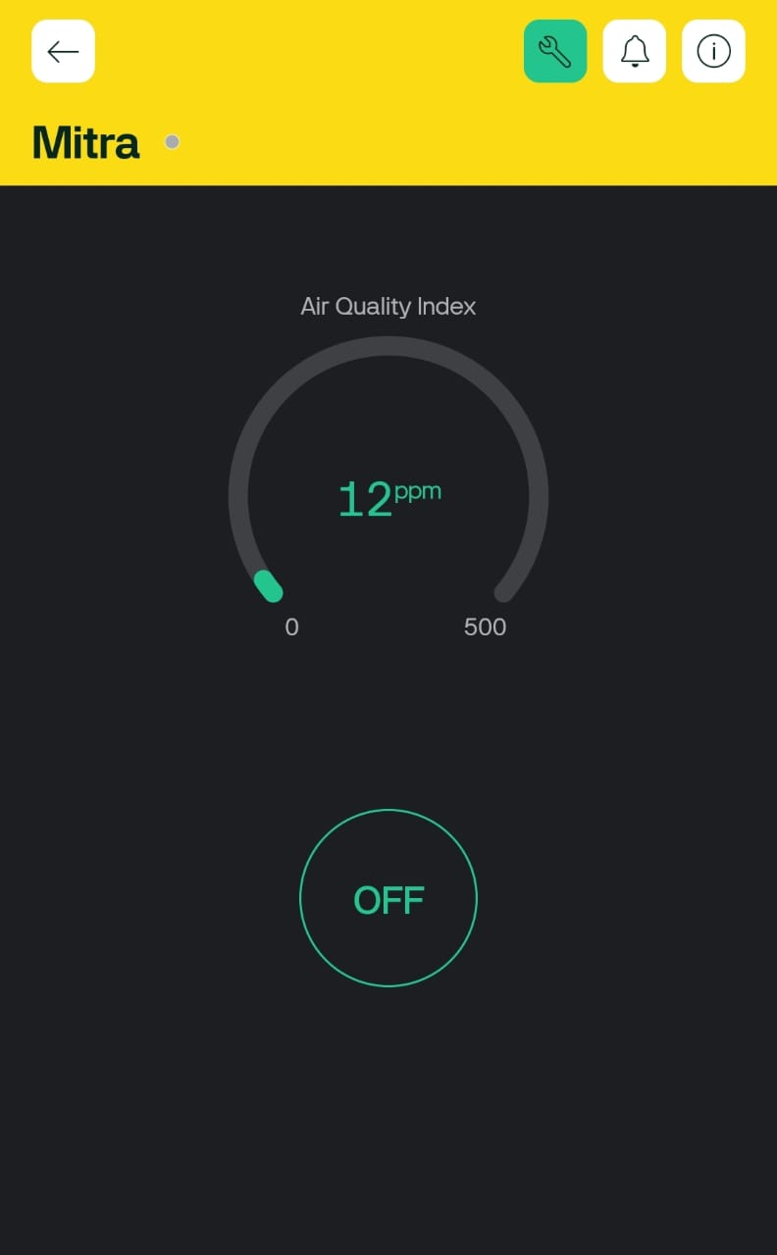
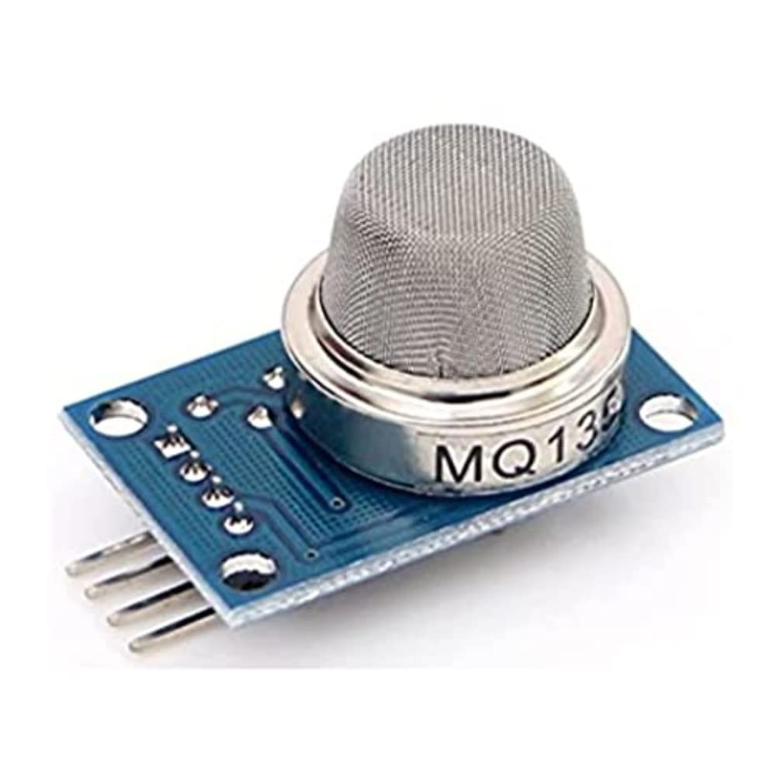
NodeMCU ESP8266 Wi-Fi SoC
Blynk IoT App
MQ-135 Air Quality Sensor

Slide 7
Supporting Features
AI Image Creator:
Generates images based on user prompts using Lexica AI
Use cases: Design, creativity, and art generation.
Language Translator:
Real-time translations in multiple languages using translation APIs.
Bridges communication gaps across regions.

Slide 8
Future Scope
Voice Assistant Integration: Add speech-to-text and voice response.
Predictive Features: Health Widget including Step Counts & Screen Time.
IoT Integration: Expand AQI monitoring using IoT sensors.
Movement Tracking: If user is sitting for long then app will notify.

