Slide 1
Artificial Intelligence
Manish Kumar
B.Tech. 4th Year
CSE Dept, IIT Patna
Academic Manager,
K12 Techno Service Pvt. Ltd

Slide 2
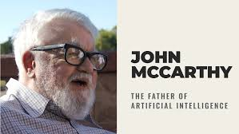
WHAT IS AI?
AI (Artificial Intelligence) is the field of computer science that focuses on creating machines capable of performing tasks that typically require human intelligence. These tasks include reasoning, learning, problem-solving, perception, and language understanding

Slide 3
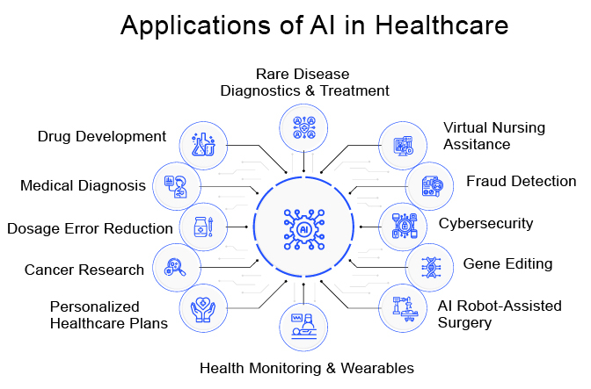
Application of AI

Slide 4
History & Evolution of AI
1950: Alan Turing introduced the Turing Test to determine if a machine can exhibit human-like intelligence.
1956: John McCarthy coined the term Artificial Intelligence at the Dartmouth Conference. This marked AI as a field of study.
1958: Frank Rosenblatt developed the Perceptron, an early form of a neural network.
1960s-70s: The first AI programs were developed, including early rule-based systems and simple problem-solving programs like ELIZA (chatbot).

Slide 5
History & Evolution of AI
1997: IBM’s Deep Blue
defeated world chess champion Garry Kasparov
2006: Geoffrey Hinton & team made deep learning mainstream with the rise of neural networks.
2011: IBM Watson defeated human contestants in Jeopardy!
2012: Breakthrough in Deep Learning – AlexNet won the ImageNet competition, demonstrating AI’s power in computer vision.
2014: Google’s DeepMind created AlphaGo, which defeated world Go champion.

Slide 6
History & Evolution of AI
2016: AI-powered assistants (Siri, Alexa, Google Assistant) became widely used.
2018: OpenAI's GPT models showed breakthroughs in Natural Language Processing (NLP).
2020s: AI in daily life – self-driving cars, AI-generated art, ChatGPT, and real-world AI applications across industries.

Slide 7
Types of AI – On Basis of scope of automation and intelligence.
1. Narrow AI (Weak AI)
2. General AI (AGI)
3. Super AI (ASI)

Slide 8
Narrow AI (Weak AI)
Also known as Weak AI, this type is designed for specific tasks.
It cannot think or perform beyond its programmed function.
Most AI systems today fall into this category.
Examples:
Voice Assistants (Siri, Alexa, Google Assistant)
Recommendation Systems (Netflix, YouTube, Amazon)
Spam Filters in Email
AI-based Chess Programs (Deep Blue)
Image Recognition Systems
📌 Narrow AI performs exceptionally well in its domain but lacks general intelligence.

Slide 9
General AI (AGI)
Also known as Strong AI, this type can perform any intellectual task that a human can do.
It possesses self-awareness, reasoning, problem-solving skills, and adaptability.
Still theoretical – No AI system today has achieved General AI.
If developed, it could:
Understand multiple domains
Learn and reason like a human
Adapt to new situations without additional training
Current Research Efforts in General AI:
OpenAI’s GPT models
DeepMind’s efforts in Reinforcement Learning
IBM Watson
📌 General AI remains a long-term goal in AI research and has not yet been achieved

Slide 10
Super AI (ASI)
Theoretical AI that surpasses human intelligence in all aspects.
It would be capable of self-awareness, emotions, and decision-making beyond human capabilities.
Potential Threats & Concerns:
Could outperform humans in all cognitive tasks.
Might make decisions that are uncontrollable.
Ethical concerns about AI surpassing human control.
Often depicted in sci-fi movies like Terminator (Skynet), Her, Ex Machina.
📌 Super AI remains a speculative concept and is not yet a reality.

Slide 11
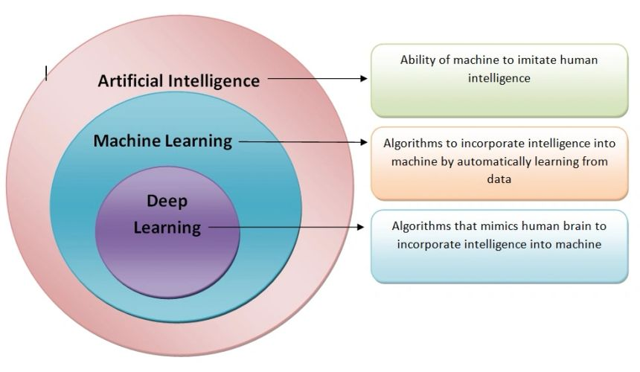
AI vs. Machine Learning vs. Deep Learning

Slide 12
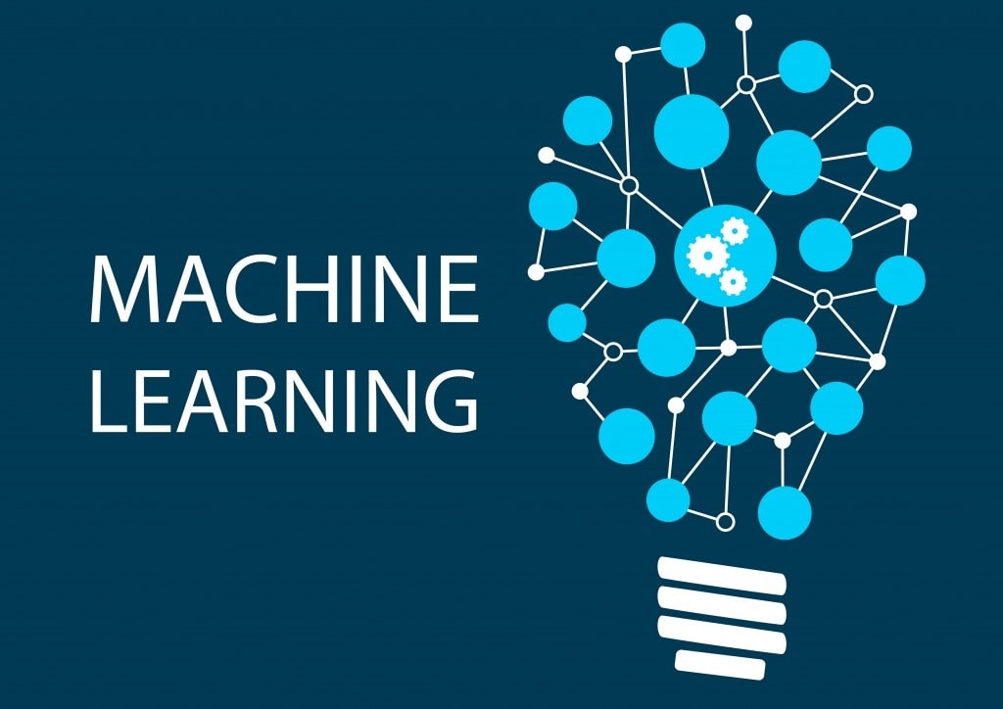
Machine Learning (ML)
ML is a subset of AI that allows machines to learn from data and improve their performance without being explicitly programmed. Instead of relying on hard-coded rules, ML models identify patterns in data and make predictions.

Slide 13
How Machine Learning Works:
1️⃣Data Collection – Collects large datasets.
2️⃣ Feature Selection – Identifies key features affecting the outcome.
3️⃣ Model Training – Uses algorithms to learn patterns in data.
4️⃣ Evaluation & Prediction – Tests model accuracy and applies it to new data.

Slide 14
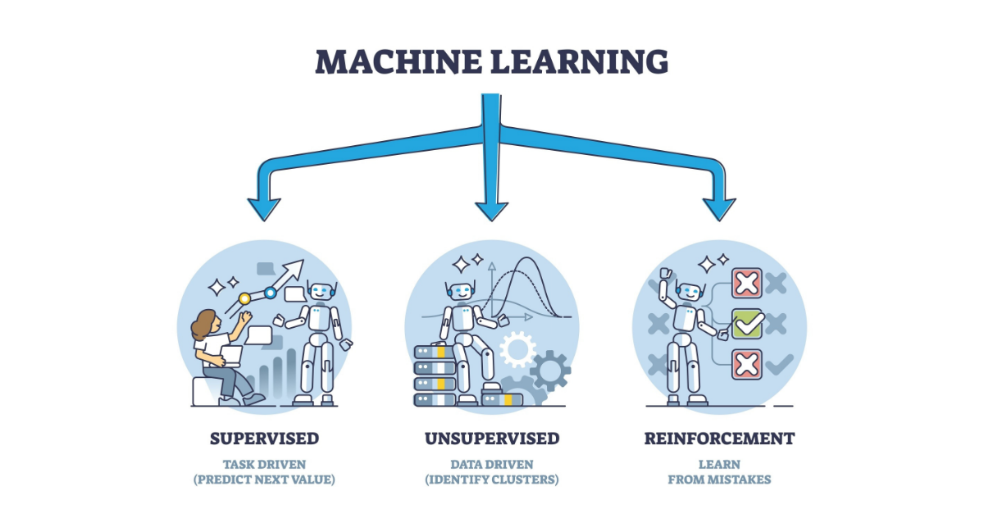
Types of Machine Learning:

Slide 15
Supervised Learning
Supervised Learning is a type of ML where the model learns from labeled data. Each input data point is paired with a corresponding correct output (label). The model identifies patterns in the data and makes predictions for unseen inputs based on past learning.
How It Works:
1️⃣ A dataset with input features (X) and output labels (Y) is provided. 2️⃣ The model learns the relationship between inputs and outputs during training. 3️⃣ After training, the model is tested on new data to check its accuracy.

Slide 16
Supervised Learning
Examples:
📩 Spam Detection: An email classification model learns from labeled emails (spam or not spam) to identify spam messages.
🛍️ Price Prediction: A model predicts house prices based on labeled data (e.g., square footage, location, number of rooms).
🔡 Speech Recognition: Converts spoken words into text by learning from labeled audio data.

Slide 17
Unsupervised Learning
Unsupervised Learning is a type of ML where the model is trained on unlabeled data. The system tries to discover hidden patterns or structures in the dataset without predefined outputs.
How It Works:
1️⃣ The algorithm receives raw, unstructured data. 2️⃣ It explores the data, finding similarities, differences, and groupings. 3️⃣ The model organizes data based on patterns it discovers.

Slide 18
Unsupervised Learning
Examples:
🛒 Customer Segmentation: E-commerce platforms group customers based on purchase behavior for personalized marketing.
📊 Anomaly Detection: Banks detect fraudulent transactions by identifying unusual spending patterns.
🎨 Image Clustering: Google Photos categorizes images by recognizing similar faces or objects.

Slide 19
Reinforcement Learning
Reinforcement Learning is an ML approach where an agent interacts with an environment to achieve a goal. The agent learns through trial and error, receiving rewards for correct actions and penalties for mistakes. The objective is to maximize cumulative rewards over time.
How It Works:
1️⃣ The agent takes an action in the environment.
2️⃣ The environment provides feedback (reward or penalty) based on the action.
3️⃣ The agent updates its strategy (policy) to maximize long-term rewards.
4️⃣ The process repeats, improving the agent’s decision-making over time.

Slide 20
Reinforcement Learning
Examples:
♟️ AI Playing Chess (AlphaZero): AI learns to play chess by playing millions of games against itself, improving strategies with each iteration.
🚗 Self-Driving Cars: AI models learn safe driving by simulating different road conditions and getting feedback.
🎮 Video Game AI: AI bots in games improve their skills by learning from repeated plays.
🤖 Robotics: Robots learn how to pick up and move objects through reinforcement learning.

Slide 21
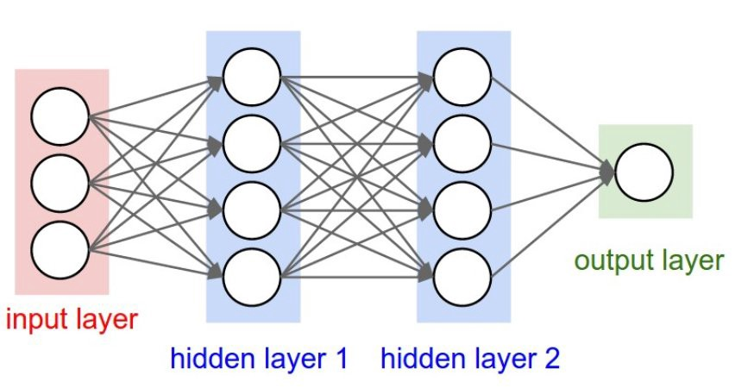
Deep Learning
Deep Learning is a specialized branch of Machine Learning (ML) that mimics the human brain using artificial neural networks.
It is capable of learning patterns from large amounts of data without explicit programming and is especially effective in tasks like image recognition, speech processing, and natural language understanding.

Slide 22
How Does Deep Learning Work?
🔹 Mimics the Human Brain using Artificial Neural Networks (ANNs). 🔹 Has Multiple Layers (Input, Hidden, Output) for learning complex patterns. 🔹 Learns Features Automatically from raw data (e.g., images, text, audio). 🔹 Uses Backpropagation to adjust weights and improve accuracy.
🔹 Requires Large Data & High Computing Power (GPUs, TPUs). 🔹 Popular Architectures: CNNs (images), RNNs (sequences), Transformers (NLP). 🔹 Applications: Face recognition, chatbots, medical diagnosis, self-driving cars.

Slide 23
Real-Life Applications of Deep Learning 🌍
✔ Computer Vision: Face recognition, medical image diagnosis.
✔ Voice Assistants: Alexa, Google Assistant, Siri.
✔ Self-Driving Cars: Tesla's AI for detecting obstacles.
✔ Chatbots & Language Models: GPT-4, Google Bard, Gemini.
✔ Fraud Detection: Analyzing financial transactions.

Slide 24
Challenges in AI 🤖
Data Challenges 📊
🔹 Data Quality & Bias – AI learns from data, but poor-quality or biased data leads to inaccurate models.
🔹 Data Privacy & Security – Handling sensitive data (e.g., medical or financial) raises ethical concerns.
🔹 Data Availability – AI needs vast amounts of labeled data, which is not always accessible.

Slide 25
Challenges in AI 🤖
Computational & Hardware Limitations 💻
🔹 High Computing Power – AI models (especially deep learning) require expensive GPUs/TPUs.
🔹 Energy Consumption – AI training consumes huge amounts of power, raising environmental concerns.
🔹 Scalability Issues – AI systems struggle with handling large-scale real-time applications.

Slide 26
Challenges in AI 🤖
Generalization & Adaptability 🔄
🔹 Narrow AI – Most AI is designed for specific tasks and struggles with new situations.
🔹 Lack of Common Sense – AI lacks human-like reasoning and adaptability.
🔹 Robustness – AI systems can fail with slight variations in input data.

Slide 27
NLP (Natural Language Processing)
📌 What is NLP?
NLP (Natural Language Processing) is a branch of AI that enables computers to understand, interpret, and generate human language.
📌 Why is NLP Important?
Helps machines interact with humans through speech and text.
Powers applications like chatbots, translation, and sentiment analysis.

Slide 28
Applications of NLP
✅ Chatbots & Virtual Assistants (e.g., ChatGPT, Siri, Alexa)
✅ Machine Translation (Google Translate, DeepL)
✅ Speech Recognition (Voice assistants, dictation software)
✅ Sentiment Analysis (Customer feedback analysis)
✅ Text Summarization (News aggregation, content summarization)
✅ Spam Filtering (Email spam detection)

Slide 29
Challenges in NLP
⚠ Ambiguity & Context Understanding (e.g., "I saw a bat" 🦇 vs 🏏)
⚠ Multilingual Processing (Handling different languages and dialects)
⚠ Bias in AI Models (AI models learning human biases)
⚠ Lack of Common Sense (Struggles with implicit knowledge)

Slide 30
Transition – From NLP to LLMs
📌 Why Do We Need LLMs?
Traditional NLP models struggle with context, reasoning, and large-scale understanding
Large Language Models (LLMs) leverage deep learning and transformers to overcome these challenges
🚀 LLMs improve NLP by: ✅ Understanding complex queries ✅ Generating human-like text ✅ Handling multiple languages ✅ Learning from vast datasets

Slide 31
What are Large Language Models (LLMs)?
LLMs are AI models trained on massive text datasets using deep learning architectures like transformers
📌 Examples of LLMs:
ChatGPT
Gemini
DeepSeek
LLaMA

Slide 32
Applications of LLMs
✅ Chatbots & Virtual Assistants (ChatGPT, Gemini, Claude)
✅ Content Generation (Article writing, creative stories)
✅ Code Generation & Debugging (GitHub Copilot, OpenAI Codex)
✅ Medical & Legal Document Processing
✅ Automated Customer Support

