Slide 1
Database Design Transform ER data models into relational designs ( ER Translation)

Slide 2
Phases of Database Design
Review of the previous slide:
In the next slide (this session), we will learn about ER Translation (transform E-R data models into relational designs) as a part of Logical Design phase.
1.
Conceptual Design
e.g ER Model
2.
Logical Design
e.g Relational Model
3.
Physical Design

Slide 3
ER Translation
Lecture Objective:
Learn how to transform E-R data models into relational designs
Learn how to represent weak entities with the relational model
Know how to represent 1:1, 1:N, and N:M binary relationships
Know how to represent 1:1, 1:N, and N:M recursive relationships

Slide 4
Representing Relationships
The maximum cardinality determines how a relationship is represented
1:1 relationship
The key from one relation is placed in the other as a foreign key
It does not matter which table receives the foreign key

Slide 5
A One-to-One Relationship Example
LOCKER
EMPLOYEE
1:1

Slide 6
One Representation of a One-to-One Relationship
Locker
Employee
Primary Key
LockerID
EmpID
LockerDesc
LockerID
Foreign Key
Location
EmpName

Slide 7
Another Representation of a One-to-One Relationship
Locker
Employee
Primary Key
LockerID
EmpID
EmpID
EmpName
LockerDesc
Foreign Key
Location

Slide 8
One-to-Many Relationships
Like a 1:1 relationship, a 1:N relationship is saved by placing the key from one table into another as a foreign key
However, in a 1:N the foreign key always goes into the many-side of the relationship

Slide 9
A One-to-Many Relationship Example
DEPARTMENT
EMPLOYEE
1:N

Slide 10
Representing a One-to-Many Relationship
Department
Employee
Primary Key
DeptID
EmpID
DeptName
DeptID
Location
Foreign Key
EmpName

Slide 11
Representing Many-to-Many Relationships
To save a M:N relationship, a new relation is created. This relation is called an intersection relation
An intersection relation has a composite key consisting of the keys from each of the tables that formed it

Slide 12
A Many-to-Many Relationship Example
SKILL
EMPLOYEE
N:M

Slide 13
Representing a Many-to-Many Relationship
Employee
Skill
Primary Key
EmpID
SkillID
Primary Key
EmpName
SkillDesc
Emp_Skill
SkillID
Foreign Key
EmpID
Foreign Key

Slide 14
Representing Recursive Relationships
A recursive relationship is a relationship that a relation has with itself.
Recursive relationships adhere to the same rules as the binary relationships.
1:1 and 1:M relationships are saved using foreign keys
M:N relationships are saved by creating an intersecting relation

Slide 15
A Recursive Relationship Example
EMPLOYEE
1:N
Manages

Slide 16
Representing a Recursive Relationship
Employee
EmpID
ManagerID
ManagerID is a
Foreign Key referencing
the Primary Key EmpID
EmpName

Slide 17
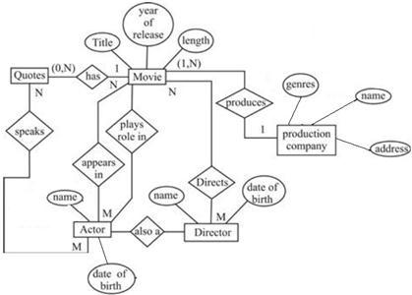
Exercise
Translasikanlah ERD berikut ke dalam skema basisdata relasional.

Slide 18

THANKS!
Any questions?

