Slide 1

NATIONAL UNIVERSITY OF COMPUTER AND EMERGING SCIENCES
CS3005 · DATA MINING
Smart Discount
Targeting System
Olist Brazilian
E-Commerce Dataset
~100,000
Transactions
Customer Discount Sensitivity Analysis in E-Commerce
2016 – 2018
Rabbi Awan · 23L-2554
Emad Rafique · 23L-2604
Usaid Chaudhry · 23L-2538
April 2026

Slide 2
Table of Contents
01
02
03
Problem Statement
Dataset Overview
Data Preprocessing
Why targeted discounting matters
Olist multi-table e-commerce data
Cleaning, merging & integration
04
05
06
Feature Engineering
K-Means Clustering
Cluster Profiles & Tiers
25+ customer behavioural features
Optimal k & cluster selection
Segment interpretation & mapping
07
08
09
Cluster Visualisations
Association Rule Mining
Sensitivity Score Design
PCA, scatter plots & distributions
Apriori & co-purchase analysis
Weighted behavioural composite
10
11
12
Model Training & Selection
Model Performance
Results & Business Insights
Random Forest + Decision Tree
Confusion matrix & metrics
Segment strategies
13
14
15
Key Findings
Limitations
Conclusion & Future Work
Top insights from the analysis
Assumptions & data constraints
Summary & next steps

Slide 3
Problem Statement & Dataset
01 — 02
Research Question: "How can data mining techniques identify customer discount sensitivity and recommend suitable discount tiers based on purchasing behaviour?"
The Problem
Olist Dataset — 5 Tables
Uniform discounts applied to all customers erode profit margins
Table | Records | Key Information
Customers | 99,441 | Customer IDs & location
Orders | 99,441 | Order status & timestamps
Order Items | 112,650 | Product-level price & quantity
Products | 32,951 | Category metadata
Payments | 103,886 | Payment type & transaction value
Price-insensitive customers buy regardless — no discount needed
Price-sensitive customers respond strongly — discounts convert them
Current approach: one-size-fits-all. Better: data-driven targeting

Slide 4
Data Preprocessing & Integration
03
1
2
3
4
5
Load
Merge
Filter
Clean
Save
Read 5 CSV files
Inspect schema & nulls
Join on customer_id
order_id, product_id
Delivered orders only
Parse timestamps
Fill nulls with medians
Drop duplicates
Intermediate CSV
for downstream use
Key Cleaning Steps
99,441
5
25+
Retained only delivered orders for complete transaction records
Orders cleaned
Tables merged
Features built
Converted all timestamp columns to datetime format
Filled missing product category names with placeholder 'unknown'
Pipeline Output
Imputed remaining numerical nulls with column medians
The cleaned, merged dataset is aggregated into one row per customer — a single unified behavioural record ready for feature engineering and modelling.
Removed duplicate rows and records missing payment data

Slide 5
Feature Engineering
04
Recency / Frequency
Monetary Value
Price Sensitivity
Promotional Behaviour
Payment Preferences
recency (days since last order)
total_spent
cheap_order_ratio (bottom 25th %tile)
promo_month_order_ratio (Nov/Dec orders)
preferred_payment_type (one-hot)
total_orders
avg_order_value
high_installment_ratio (≥6 installments)
seasonal_purchase_flag
credit_card_ratio
orders_per_month
avg_item_price
avg_installments
boleto_ratio
avg_days_between_orders
max_order_value
voucher_ratio
Scaling: StandardScaler for clustering · MinMaxScaler for sensitivity scoring · One-Hot Encoding for payment type

Slide 6
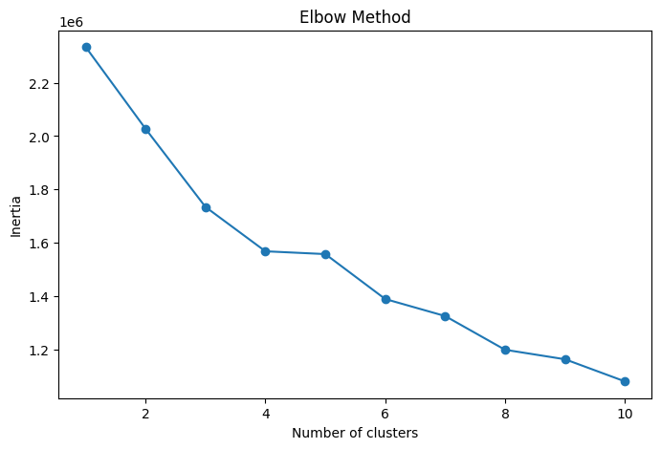
K-Means Clustering — Selecting Optimal k
05
Fig 1. Elbow Method — Inertia vs. k (inflection at k=3)
Fig 2. Silhouette scores — k=3 selected for business interpretability
Why k=3? k=2 (silhouette 0.373) is statistically optimal but yields only 2 tiers — insufficient for actionable discount strategy. k=3 (silhouette 0.350) provides three distinct, interpretable segments aligned to High / Medium / Low discount tiers. Scores decline sharply beyond k=3, confirming additional clusters add noise.

Slide 7
Cluster Profiles & Discount Tier Mapping
06
Cluster 1
Cluster 0
Cluster 2
High Discount
Medium Discount
Low Discount
74,308 customers · 79.5%
16,172 customers · 17.3%
2,855 customers · 3.1%
Low avg order value
Moderate spending levels
High total_spent & avg_order_value
High cheap_order_ratio
Mixed payment behaviour
Low cheap_order_ratio
High promo_month_order_ratio
Occasional promotional activity
Minimal promo dependency
Frequent installment use
Average recency
Recent purchase activity (low recency)
Regular purchase cadence
Lower installment dependency
Premium buyer profile

Slide 8
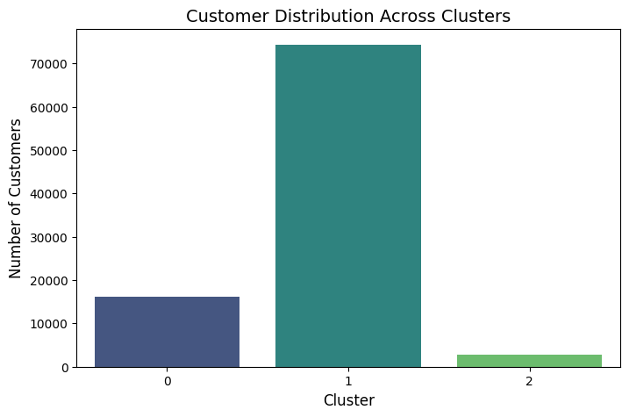
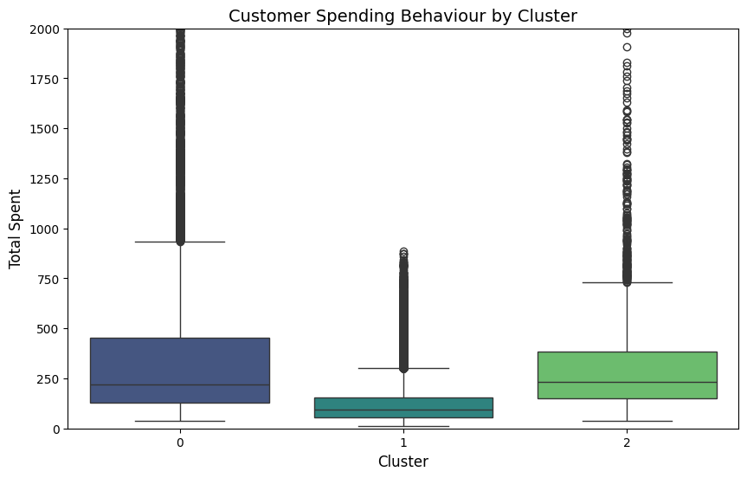
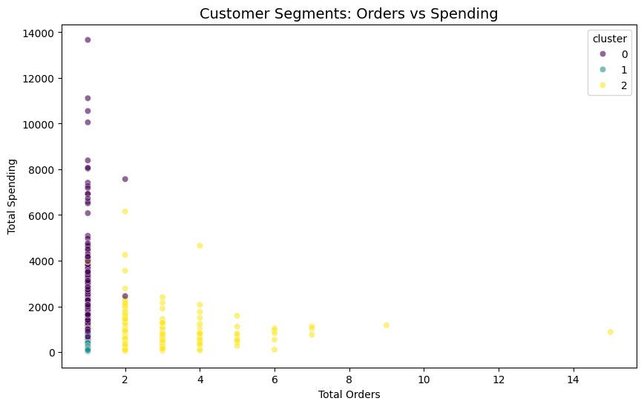
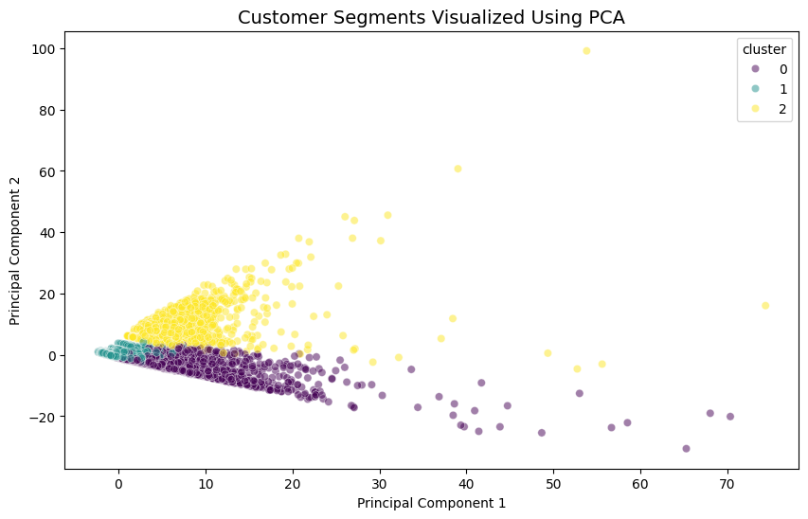
Cluster Visualisations
07
Fig 3. Customer distribution across clusters
Fig 4. Spending behaviour by cluster
Fig 5. Orders vs. Total Spending (scatter)
Fig 6. PCA — 2D cluster separation

Slide 9
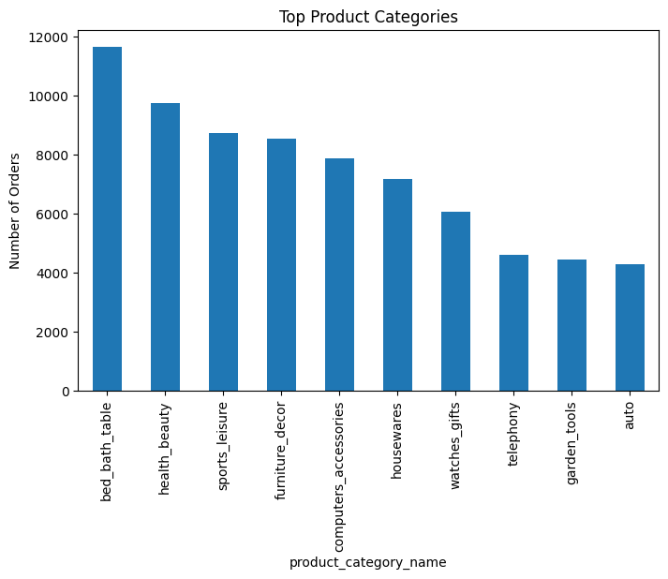
Association Rule Mining — Apriori Algorithm
08
Approach: Order-category basket matrix (one row per order) · min_support = 0.01 · Product categories translated to English via Olist translation table
Findings
Sparse Baskets
>98% of orders contain items from a single product category only, resulting in highly sparse basket data.
No Multi-Category Rules
Only single-item frequent itemsets generated. No meaningful cross-category association rules emerged at any support level.
Top Categories
bed_bath_table, health_beauty, and sports_leisure dominate all transaction volume across the dataset.
Business Implication
Cross-category bundling is not viable. Discount campaigns should target high-demand individual categories.
Fig 7. Top 10 Product Categories by Order Volume

Slide 10
Behaviour-Based Sensitivity Score Design
09
Rather than predicting cluster labels directly, a novel behaviour-based discount sensitivity score was engineered as a more meaningful, continuous target variable. This score is a weighted composite of five normalised behavioural indicators, then quantile-binned into Low / Medium / High Discount tiers for classification.
30%
Promo Month Order Ratio
Strongest direct signal of price responsiveness
25%
High Installment Ratio
Indicates financial caution & price sensitivity
20%
Average Installments
Reflects depth of payment deferral behaviour
15%
Recency (inverted)
Lapsed customers more likely to need incentives
10%
Avg Order Value (inv.)
Lower AOV correlates with price-conscious behaviour
Score binned into 3 equal tiers using pd.qcut — producing a balanced Low / Medium / High Discount class distribution for classification training.

Slide 11
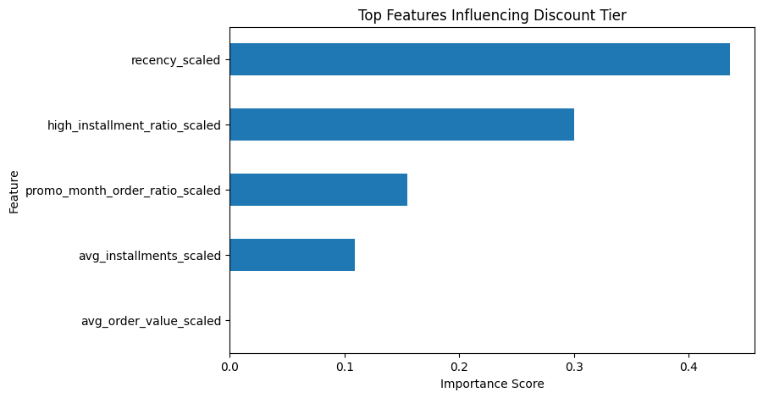
Feature Selection & Model Training
10
Modelling Pipeline
Feature Importance
1
Sensitivity Score
Compute weighted composite score for each customer from 5 normalised features
2
Tier Labelling
pd.qcut discretizes score into 3 equal-size tiers: Low / Medium / High Discount
3
Feature Ranking
Random Forest trained on all features; feature_importances_ ranks predictors
4
Top 5 Selected
Top 5 most important features selected to reduce noise and improve interpretability
Fig 8. Top features — recency & installment behaviour dominate model importance
5
Decision Tree
Classifier trained with max_depth=5 on an 80/20 stratified train-test split
Model Config
Algorithm: Decision Tree Classifier · max_depth = 5 · Split: 80% train / 20% test · Stratified by tier

Slide 12
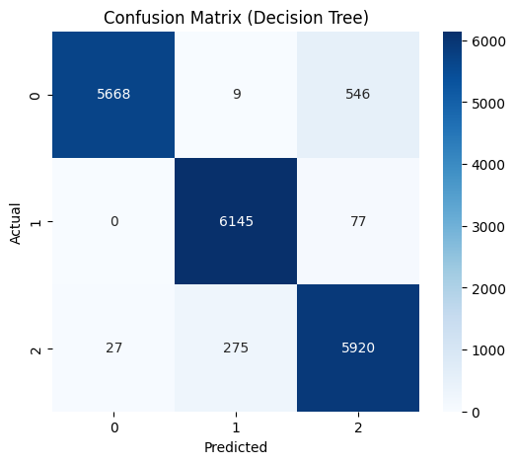
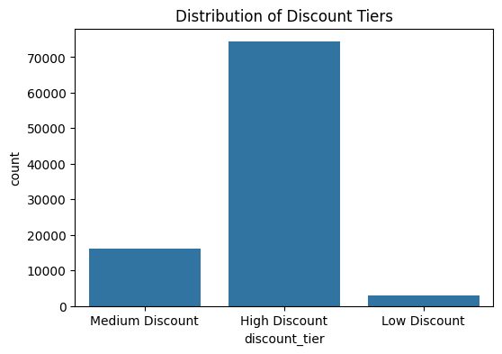
Model Performance
11
Confusion Matrix
Discount Tier Distribution
Performance Summary
Low Discount
Highest precision, near-zero misclassification rate
High Discount
Strong accuracy; minor overlap with Medium tier only
Fig 9. Confusion matrix — Decision Tree Classifier
Medium Discount
Expected boundary confusion with adjacent tiers (continuous sensitivity)

Slide 13
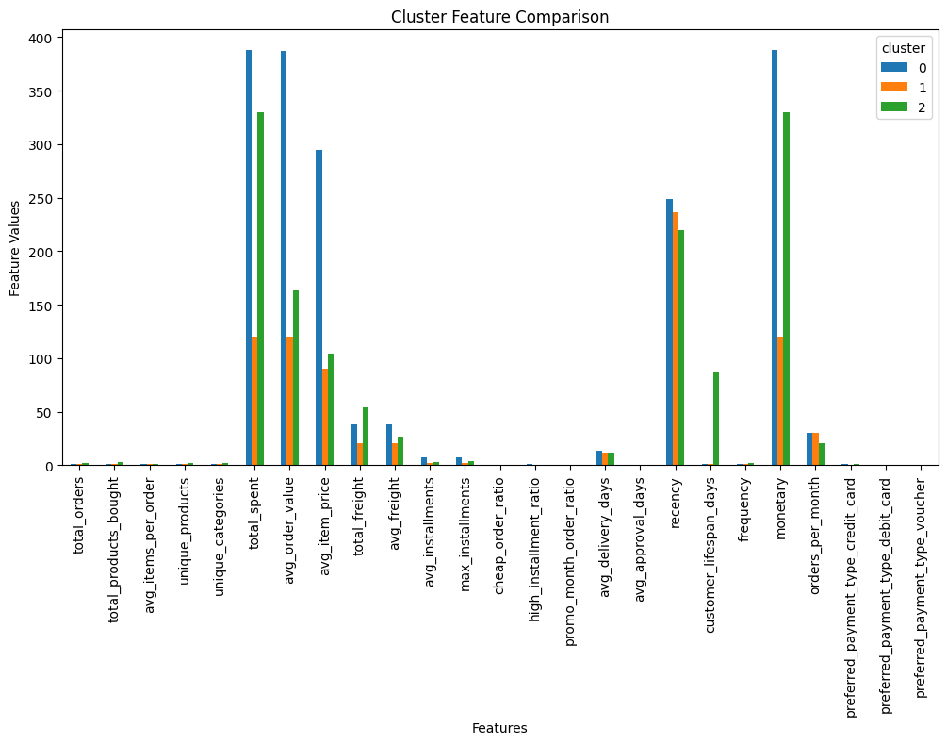
Results & Business Insights
12
79.5%
17.3%
3.1%
High Discount
Medium Discount
Low Discount
of the customer base
occasional buyers
high-value premium buyers
Recommended Discount Strategy
Segment | Strategy
High Discount (79.5%) | Seasonal promotions, loyalty rewards during Nov/Dec peaks, re-engagement campaigns for lapsed buyers
Medium Discount (17.3%) | Personalised moderate discounts, targeted email campaigns to nudge purchase frequency
Low Discount (3.1%) | Preserve margins — offer premium perks, early product access, exclusive memberships instead of blanket discounts
Fig 10. Cluster Feature Comparison — avg feature values per segment

Slide 14
Key Findings & Limitations
13 — 14
Key Findings
Limitations
01
Majority Price-Sensitive
Proxy Labels
79.5% of customers show high discount sensitivity — targeted discounting essential to avoid margin loss
Discount tiers derived from behavioural proxies — no actual coupon redemption or click-through data used for ground truth
02
Recency is #1 Predictor
Days since last purchase is the single strongest predictor of discount sensitivity above all other features
Dataset Geography
Olist data covers Brazil 2016-2018 only, limiting generalisability to other markets or more recent periods
03
Installments = Sensitivity
High installment usage is a reliable proxy for financial price sensitivity — second only to recency
Basket Sparsity
Single-category basket structure prevents extraction of meaningful cross-category association rules
04
Seasonal Signal Confirmed
Nov/Dec purchase concentration confirms seasonal discount behaviour as a meaningful segmentation signal
Class Imbalance
05
No Cross-Category Bundling
79.5% High Discount dominance may affect model generalization; cost-sensitive learning not yet explored
98%+ single-category baskets — association mining confirms bundling is not viable for this dataset

Slide 15
Conclusion & Future Work
A complete end-to-end data mining pipeline was built — from raw relational Olist e-commerce data to a deployable Smart Discount Targeting System. K-Means clustering, behaviour-based scoring, Apriori association mining, and a Decision Tree classifier work in combination to enable precision-targeted promotional strategies. The system directs offers to genuinely price-sensitive customers while protecting margins for loyal, high-value buyers.
Technology Stack
Future Directions
Data Processing
Machine Learning
Association Mining
A/B test with real coupon/click-through data for ground-truth model training
Python · Pandas · NumPy
Scikit-learn · XGBoost
mlxtend Apriori
Visualisation
Dashboard
Dataset
Live Streamlit data ingestion pipeline for real-time discount recommendations
Matplotlib · Seaborn
Streamlit
Olist (Kaggle)
Customer embeddings via deep learning to capture latent behaviour patterns
Temporal analysis of how sensitivity evolves across customer lifecycle
NUCES · CS3005 Data Mining · Rabbi Awan · Emad Rafique · Usaid Chaudhry · April 2026

