Slide 1
NATIONAL UNIVERSITY OF COMPUTER AND EMERGING SCIENCES
CS3005 — Data Mining
Smart Discount
Targeting System
A Data Mining Project for Customer Discount Sensitivity Analysis in E-Commerce
Rabbi Awan 23L-2554 Emad Rafique 23L-2604 Usaid Chaudhry 23L-2538
May 2026
NUCES Data Mining Project • May 2026

Slide 2
Table of Contents
01
Affidavit
09
Association Rule Mining
02
Introduction & Project Overview
10
Predictive Modelling
03
Dataset — Olist E-Commerce
11
Model Performance & Results
04
Data Mining Pipeline & Methodology
12
Key Findings
05
Data Preprocessing & Feature Engineering
13
Results & Business Insights
06
Customer Segmentation — K-Means Clustering
14
Limitations & Future Directions
07
Cluster Interpretation & Discount Tier Mapping
15
Conclusion
08
PCA Visualization
Smart Discount Targeting System | NUCES CS3005 | 1

Slide 3
Affidavit
Academic Integrity Declaration
ACADEMIC INTEGRITY AFFIDAVIT
We, as the undersigned members, hereby certify and solemnly pledge that this term project — Smart Discount Targeting System — has been developed solely for the purpose of fulfilling the requirements of CS3005: Data Mining at the National University of Computer and Emerging Sciences (NUCES), Lahore Campus.
We further confirm that this project has not been submitted, presented, or used in any other course, subject, or academic program, either in whole or in part, at any time. All work presented herein is our own original contribution. Any external sources, libraries, datasets, or references have been appropriately acknowledged within the report.
We understand that any violation of academic integrity policies may result in disciplinary action as per university regulations.
May 2026 • NUCES — CS3005: Data Mining
Smart Discount Targeting System | NUCES CS3005 | 2

Slide 4
Introduction & Project Overview
Why targeted discounting matters
The Problem
Research Question
Uniform discounts are inefficient — some customers buy regardless of promotions while others are highly price-sensitive. Blanket discounting erodes profit margins without proportional business value.
How can data mining techniques identify customer discount sensitivity and recommend suitable discount tiers based on purchasing behaviour?
Our Solution
A Smart Discount Targeting System using data mining on the Olist Brazilian E-Commerce dataset. The system classifies customers into actionable discount tiers using clustering, association rule mining, and predictive modelling.
Olist Dataset
99,441 Customers
2016–2018
Smart Discount Targeting System | NUCES CS3005 | 3

Slide 5
Project Objectives
Six core goals driving the system
01
02
Analyze customer purchasing behaviour from multi-table transactional e-commerce data
Engineer 25+ meaningful behavioral features capturing price sensitivity, recency & payment patterns
03
04
Segment customers into discount sensitivity groups using K-Means clustering
Apply association rule mining to discover product co-purchase patterns
05
06
Build a predictive classification model to assign new customers to discount tiers
Develop an interactive Streamlit dashboard for real-time discount tier prediction
Smart Discount Targeting System | NUCES CS3005 | 4

Slide 6
Dataset — Olist Brazilian E-Commerce
Publicly available Kaggle dataset covering 2016–2018 transactions
Table | Records | Key Information
Customers | 99,441 | Customer IDs and location details
Orders | 99,441 | Order status and timestamps
Order Items | 112,650 | Product-level price and quantity
Products | 32,951 | Category metadata
Payments | 103,886 | Payment type and transaction values
99K+
112K+
5
Customers
Order Items
Relational Tables
Smart Discount Targeting System | NUCES CS3005 | 5

Slide 7
Data Mining Pipeline & Methodology
End-to-end structured workflow
1
2
3
4
5
6
Data
Integration
Preprocessing
& Cleaning
Feature
Engineering
K-Means
Clustering
Association
Rule Mining
Predictive
Modelling
Data Integration
Feature Engineering
Segmentation
5 relational tables merged via customer_id, order_id & product_id. Filters: delivered orders only.
25+ behavioral features per customer: recency, frequency, monetary, price sensitivity, payment patterns.
K-Means (k=3) on standardized features. Elbow + Silhouette analysis determined optimal k.
ARM
Classification
Dashboard
Apriori on order-category baskets. Single-category dominance found — no cross-category rules emerged.
Behavior-based sensitivity score → quantile thresholds → Decision Tree (max_depth=5) classifier.
Streamlit app for real-time discount tier prediction for new customer inputs.
Smart Discount Targeting System | NUCES CS3005 | 6

Slide 8
Data Preprocessing & Integration
Cleaning and merging five relational tables
Step 1
Merge 5 tables on customer_id, order_id, product_id
Step 2
Retain only delivered orders for completed transaction records
Step 3
Parse & convert all timestamp columns to datetime format
Step 4
Fill missing product category names with placeholder 'unknown'
Step 5
Remove duplicate records & drop rows with missing payment info
Step 6
Impute remaining numerical missing values with column medians
Output
Cleaned dataset saved as intermediate CSV for downstream processing
Smart Discount Targeting System | NUCES CS3005 | 7

Slide 9
Feature Engineering
25+ behavioral features aggregated per customer
Feature Group
Examples
Relevance
Recency / Frequency
recency (days), total_orders, orders_per_month
Purchase activity patterns
Monetary
total_spent, avg_order_value, avg_item_price
Spending behavior
Price Sensitivity
cheap_order_ratio, avg_installments, high_installment_ratio
Discount responsiveness proxies
Promotional Behavior
promo_month_order_ratio (Nov/Dec)
Seasonal discount activity
Payment Preferences
preferred_payment_type (one-hot encoded)
Payment method tendencies
Smart Discount Targeting System | NUCES CS3005 | 8

Slide 10
Customer Segmentation — K-Means Clustering
Silhouette analysis & elbow method to determine optimal k
Why k = 3?
k=2
Only 2 tiers; not actionable for business
k=3
0.350 — Selected ✓
k=4
More fragments; reduced interpretability
k=5+
Diminishing returns; over-segmentation
Features standardized with
StandardScaler before clustering
Smart Discount Targeting System | NUCES CS3005 | 9

Slide 11
Cluster Interpretation & Discount Tier Mapping
3 distinct customer behavioral segments identified
HIGH Discount
Cluster 1 • 74,308 customers
79.5%
Low spenders · Frequent budget purchases · High cheap_order_ratio
MEDIUM Discount
Cluster 0 • 16,172 customers
17.3%
Moderate spenders · Mixed payment behavior
LOW Discount
Cluster 2 • 2,855 customers
3.1%
High value · Low promo dependency · Premium buyers
Smart Discount Targeting System | NUCES CS3005 | 10

Slide 12
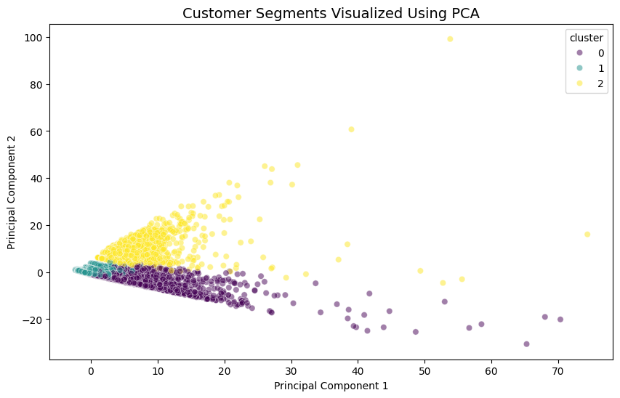
PCA Visualization of Customer Segments
Dimensionality reduction confirms cluster separability
Clear Separation
Three clusters form distinct regions in the PCA space, validating that engineered features capture meaningful behavioral differences.
Feature Quality
The 25+ behavioral features compress well into 2 principal components with visible cluster separation.
Boundary Analysis
Clusters 0 and 1 show some boundary overlap — consistent with adjacent discount tiers having similar behaviors.
Smart Discount Targeting System | NUCES CS3005 | 11

Slide 13
Association Rule Mining
Apriori algorithm on order-category baskets
Method: Apriori algorithm applied to order-category basket matrix (one row = one order, one column = product category)
Key Finding
98%+ of orders contain products from a single category only.
No meaningful multi-category association rules emerged — cross-category bundling is NOT viable for this dataset.
Recommendation: Focus discount campaigns on individual high-demand categories, not bundles.
Smart Discount Targeting System | NUCES CS3005 | 12

Slide 14
Predictive Modelling — Sensitivity Score
Behavior-based composite score drives classification
Rather than predicting cluster labels directly, a novel behaviour-based discount sensitivity score was engineered as a more meaningful, continuous target variable.
Promotional Month Order Ratio
0.30 (30%)
Strongest signal of price responsiveness
High Installment Ratio
0.25 (25%)
Indicates financial price sensitivity
Average Installments
0.20 (20%)
Reflects payment flexibility preference
Recency (inverted)
0.15 (15%)
Inactive customers more likely to need discounts
Avg Order Value (inverted)
0.10 (10%)
Lower AOV correlates with price-conscious behavior
Smart Discount Targeting System | NUCES CS3005 | 13

Slide 15
Model Training & Feature Importance
Decision Tree Classifier (max_depth=5) on top-5 RF-selected features
Model Configuration
Algorithm:
Decision Tree
Max Depth:
5
Train / Test:
80 / 20 split
Strategy:
Stratified split
Features Used:
Top 5 (RF selected)
Target Classes:
Low · Medium · High
Key Insight: Recency is the most powerful predictor (42% importance) — spending amount alone is insufficient to characterize discount sensitivity.
Smart Discount Targeting System | NUCES CS3005 | 14

Slide 16
Model Performance & Results
Decision Tree classification report
Metric / Tier | Precision | Recall | F1-Score | Notes
Low Discount | 1.00 | 0.91 | 0.95 | Minimal misclassifications
Medium Discount | 0.96 | 0.99 | 0.97 | Boundary confusion with adjacent tiers
High Discount | 0.90 | 0.95 | 0.93 | Minor overlap with Medium Discount
Overall Accuracy: 95.00% • Validated via Classification Report
Error Pattern
Model Validation
Prediction errors occur primarily between adjacent tiers (Medium ↔ High or Medium ↔ Low) — expected given the continuous nature of discount sensitivity.
The model successfully captures key behavioral boundaries separating discount tiers. Confusion matrix confirms high diagonal density.
Smart Discount Targeting System | NUCES CS3005 | 15

Slide 17
Key Findings
01
79.5% of e-commerce customers exhibit high discount sensitivity — validating the need for targeted over uniform discounting.
02
Recency is the most powerful predictor (42% importance) — re-engagement campaigns should be the primary use case.
03
Payment behavior (installment usage) is a reliable proxy for financial price sensitivity, second only to recency.
04
Promotional purchase patterns during November–December confirm seasonal discount behavior is a meaningful signal.
05
Association rule mining confirmed cross-category bundling is not viable — focused category-level discounts are recommended.
Smart Discount Targeting System | NUCES CS3005 | 16

Slide 18
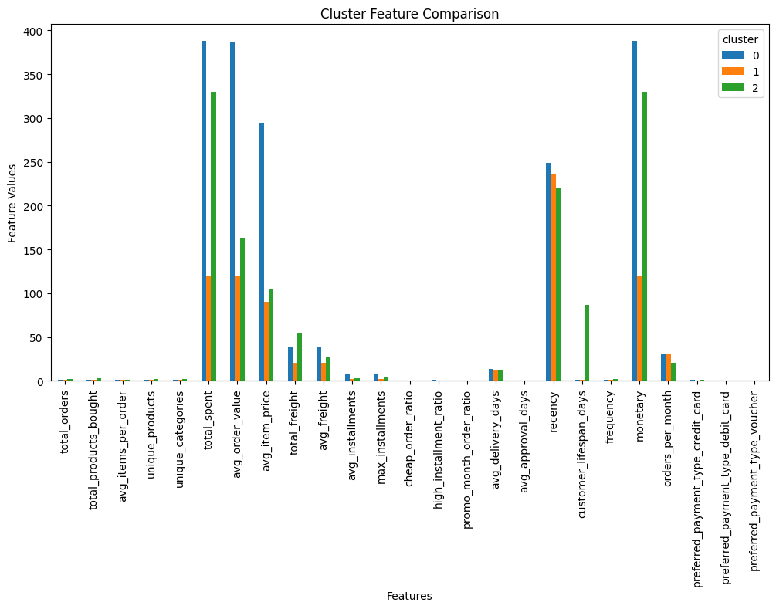
Results & Business Insights
Segment distribution and recommended discount strategies per customer tier
79.5%
17.3%
3.1%
High Discount
of the customer base
Medium Discount
occasional buyers
Low Discount
high-value premium buyers
Recommended Discount Strategy
Segment Strategy
High Discount (79.5%) Seasonal promotions, loyalty rewards during Nov/Dec peaks, re-engagement campaigns for lapsed buyers
Medium Discount (17.3%) Personalised moderate discounts, targeted email campaigns to nudge purchase frequency
Low Discount (3.1%) Preserve margins — offer premium perks, early product access, exclusive memberships instead of blanket discounts
Figure : Cluster Feature Comparison — avg feature values per segment
Smart Discount Targeting System | NUCES CS3005 | 17

Slide 19
Limitations & Future Directions
Current constraints and next steps
Current Limitations
Future Directions
Discount tiers derived from engineered behavioral proxies — not actual campaign response data (click-through rates, coupon redemption).
Ground Truth Training
Incorporate actual A/B test results and coupon usage data for ground-truth-based model training.
Real-time Pipeline
Olist dataset is from the Brazilian market (2016–2018) — may limit generalizability to other geographies or time periods.
Extend Streamlit dashboard with live customer data ingestion for real-time recommendations.
Deep Learning
Sparse basket data prevented meaningful multi-category association rules from being generated.
Explore customer embeddings and deep learning approaches to capture latent behavioral patterns.
Temporal Analysis
Track how discount sensitivity evolves across a customer's lifecycle using time-series modeling.
Smart Discount Targeting System | NUCES CS3005 | 18

Slide 20
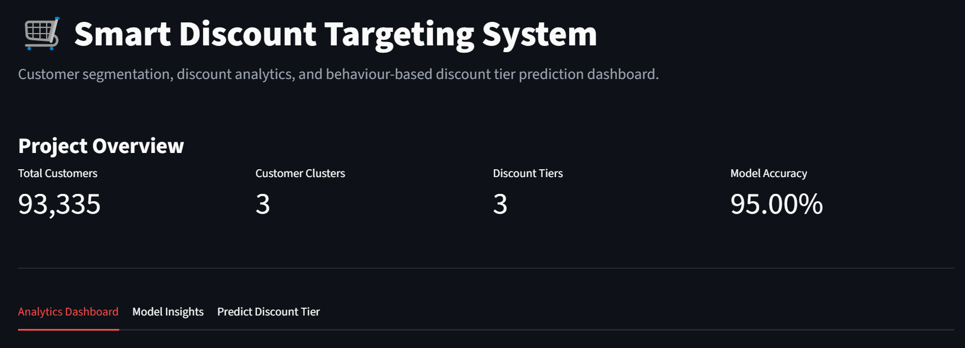
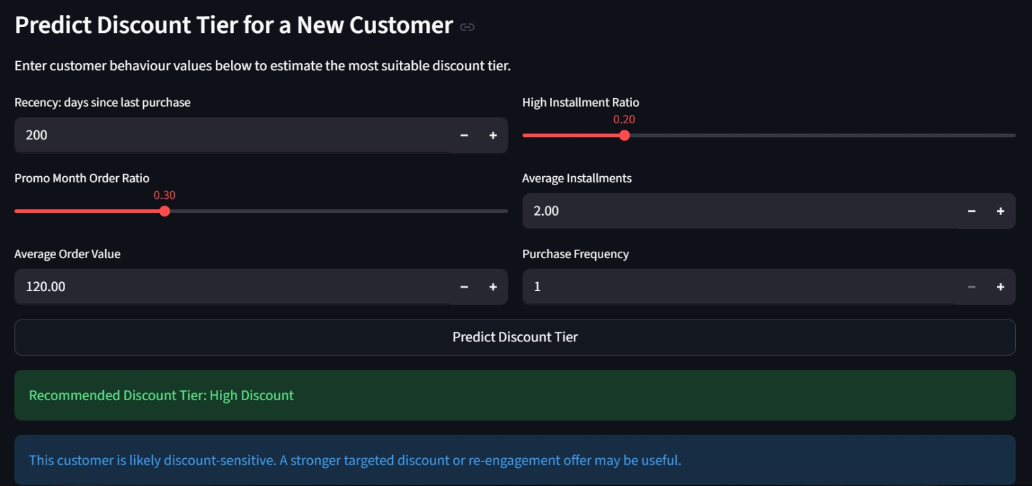
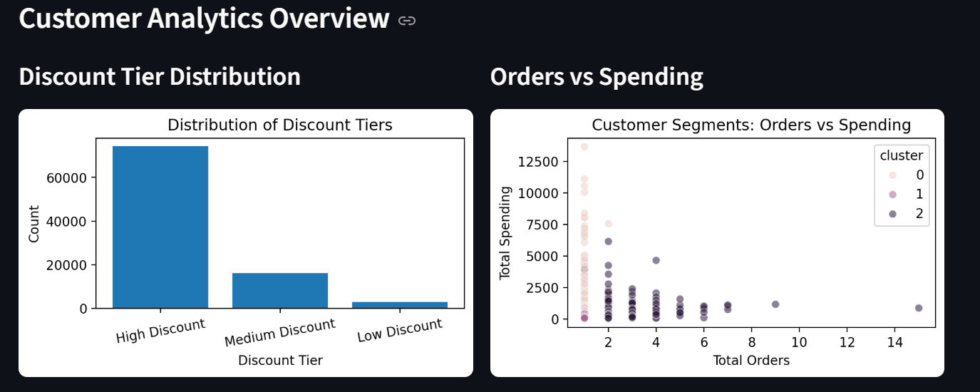
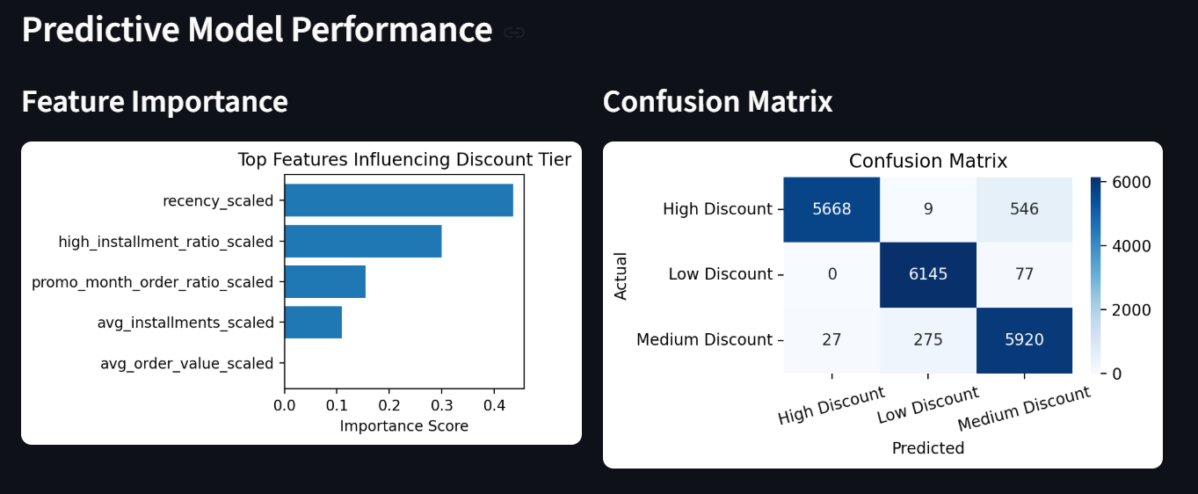
Streamlit Dashboard
Interactive real-time discount tier prediction for new customers
Smart Discount Targeting System | NUCES CS3005 | 19

Slide 21
Conclusion
This project develops a complete data mining pipeline for a Smart Discount Targeting System. Raw e-commerce data is cleaned and transformed into meaningful customer-level behavioural features, enabling a deeper understanding of purchasing patterns. A Decision Tree model predicts behaviour-based discount tiers with 95% accuracy, with recency and payment behaviour emerging as key drivers. The interactive Streamlit dashboard bridges analysis and deployment, showing how businesses can use customer data to make informed, personalised discount decisions.
◆
Raw multi-table relational data transformed into 25+ meaningful customer behavioral features
◆
K-Means clustering discovers 3 natural discount sensitivity segments from 99K+ customers
◆
Decision Tree classifier assigns new customers to actionable discount tiers in real time
◆
Association rule mining confirms category-focused campaigns over cross-category bundling
◆
Streamlit dashboard bridges analysis and deployment for business-ready predictions
Smart Discount Targeting System | NUCES CS3005 | 20

Slide 22
Thank You
Smart Discount Targeting System — CS3005: Data Mining, NUCES Lahore
Rabbi Awan 23L-2554 Emad Rafique 23L-2604 Usaid Chaudhry 23L-2538
Questions & Discussion
NUCES Data Mining Project | May 2026

