Slide 1
Crimes in Baltimore
Team:4
Josh Berner, Awantika Shah, Kaylan Sheally
AIT(580)-Big Data to information
Dr. Zhang
George mason university
October 10,2021

Slide 2
Introduction
Crime is an issue that should be studied thoroughly and taken seriously throughout the world. Our dataset deals with analyzing Baltimore crime patterns from the years 2012-2017.
The main purpose of analyzing this dataset is to compare trends in crimes from the years 2012-2017.
For each year, we plan to find the total number of crimes, the count of each type of weapon used, how many crimes occurred inside and outside, and the premise for each crime.
Looking at trends for each of these variables will help in future prediction of crime trends in Baltimore for these variables. These trends will help alert safety officials such as police officers, FBI agents and citizens throughout Baltimore to be more prepared on how to be protected from and deal with crime in the future.
To answer the problem areas addressed in the question, we plan to plot histograms, bar plots, line charts for the column variables to look at patterns and trends of these variables that will help in prediction of future trends for crime in Baltimore.

Slide 3
Objectives
To find frequency of crimes in each District of Baltimore and to find whether the crime were committed inside or outside.
To find frequency of crimes by weapon types and years (2012-2017).
To find which are the top 10 crimes in Baltimore.
To find number of crimes by daytime, months , weekday and year wise.
To find number of incidents by weekdays and hours for years (2012-2017).

Slide 4
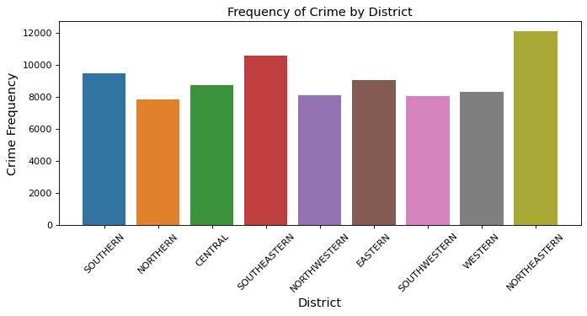
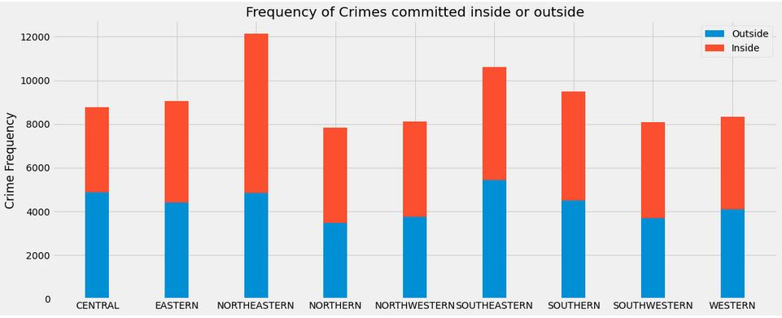
Frequency of Crimes in each District and crimes committed either Inside or Outside
Frequency of crime is more at northeastern and southeastern side of Baltimore.
Western and Eastern side of Baltimore has less frequency of crime.
Districts like central and southeastern had more outside crimes.
Northeastern district had more inside crimes than outside.

Slide 5
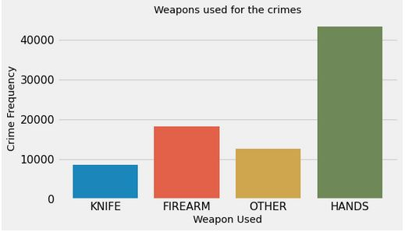
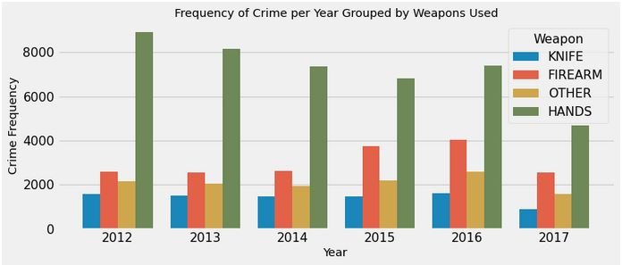
Frequency of crimes by weapon types and years (2012-2017).
Most of the crimes are committed by Hands.
Crimes committed by firearms are significantly higher than crimes committed by knife
Crimes committed by hands were constant through 2012 to 2016 and then dropped in 2017
Crimes committed by firearms increased in 2015 and 2016 then again dropped in 2017

Slide 6
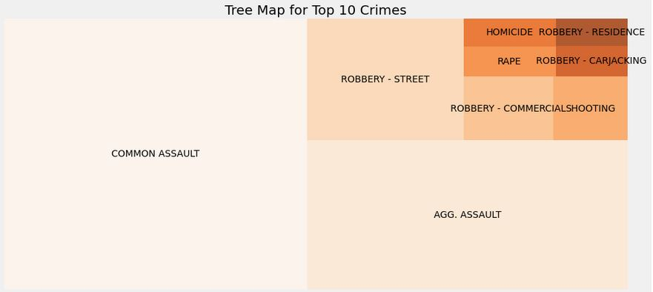
Top 10 crimes in Baltimore.
Common assault and aggravated assault are top two categories of crime categories
Number of crimes for carjacking robbery and residence robbery is least compared to all other crime categories.

Slide 7
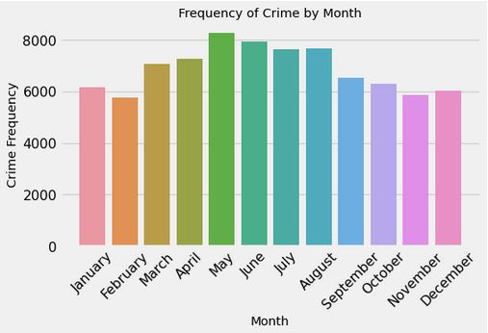
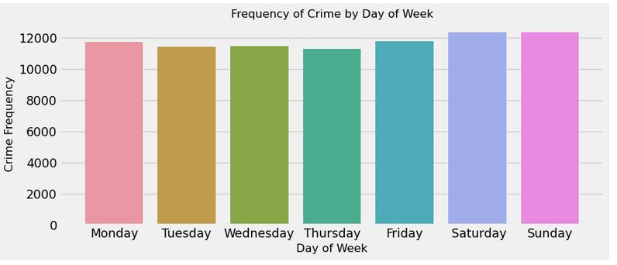
Number of Crimes by Months and Weekday.
Crimes tend to increase during late spring or peak summer whereas reporting of crime is less during fall and winter.
Number of crimes is almost constant during all weekdays, and it tends to increase during weekends.

Slide 8
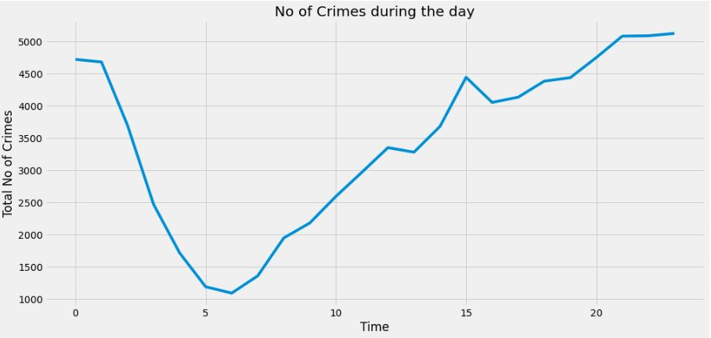
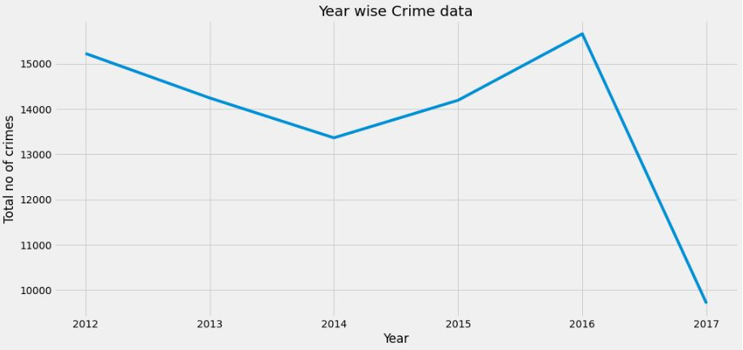
Number of Crimes by daytime and Year wise.
Number of crimes drops significantly from midnight to early morning.
Crimes tends to happen in increasing pattern from early morning to midnight.
Number of Crimes in Baltimore decreased from 2012 to 2014.
Crimes increased slightly from 2014 to 2016 and dropped massively in 2017.

Slide 9
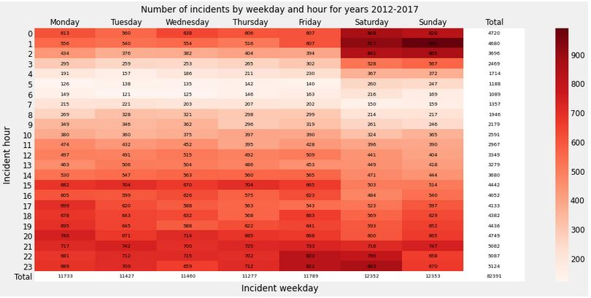
Incidents by weekdays and hour for years (2012-2017).
Reporting of crimes is very less from 4 am to 8 am compared to other times of the day.
Crime frequency is very high from 5 pm onwards till midnight.
Weekend nights shows occurrence of most crimes during and after midnight

Slide 10
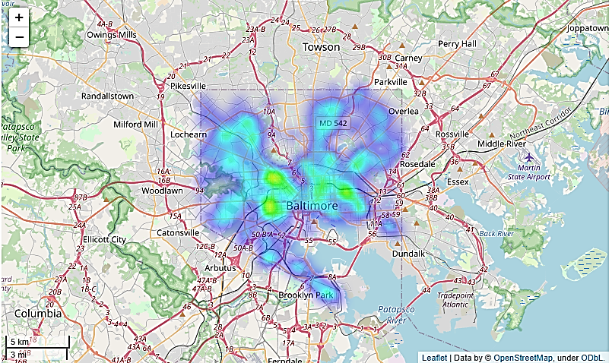
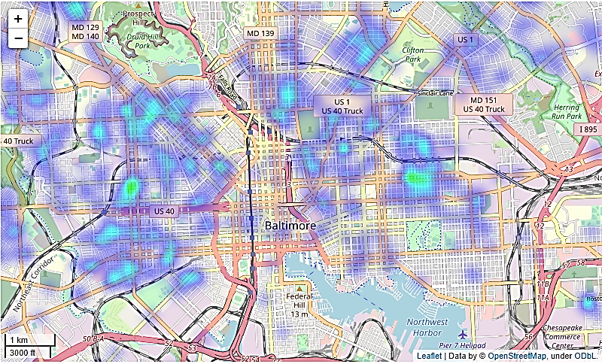
Baltimore Crimes Heat Map

Slide 11
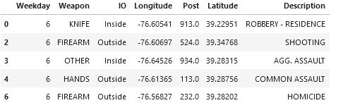
Classification
In classification , we have use KNN Classification.
Predictor variable :
Weekday
Weapon
Inside/Outside
Longitude
Latitude
Target Variable:
1. Description

Slide 12
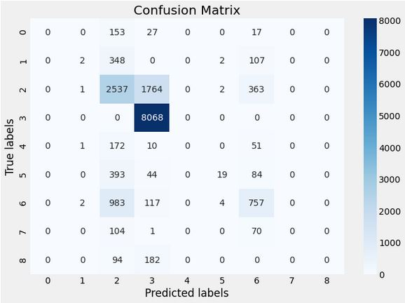
Confusion Matrix
Accuracy of the model is 69% using KNN Classification method.
To improve accuracy of the model, Random forest method is used.
After using random forest method accuracy of the model improved:
Training set- 79%
Testing set-77%

Slide 13
Conclusion
We were able to find the following key characteristics in Baltimore Crime:
More crimes are committed at Northeastern and Southeastern side of Baltimore.
Hands are the most popular weapon used in Baltimore crimes.
More crimes are committed in the months of May through August.
Saturday and Sunday hold the highest crime rate per week.
The highest number of crimes occurs at evening time that is from 5PM to 8PM, while the least number of crimes are committed at night hours between 2 A.M. and 6 A.M.
Starting in 2017, Baltimore’s crime rate has seen a significant drop compared to 2015 and 2016.

Slide 14

Any Questions?

