Slide 1
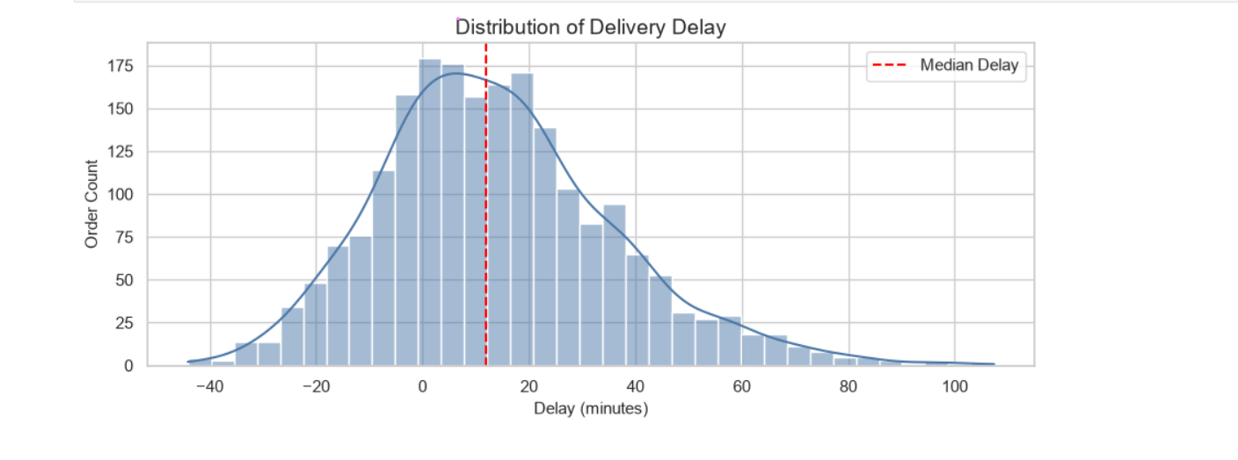
MiniHack: AI Data Intelligence Challenge
"Executive Summary"
Peak-hour orders experience 3x higher delays.
Fog and rain are the biggest external delay drivers.
Rider experience has minimal impact.
City-level operational planning affects performance more than rider tenure.
Peak-hour staffing + weather-aware dispatching is the biggest operational fix.
Made by:
Awantika Tripathi
B.Tech

Slide 2
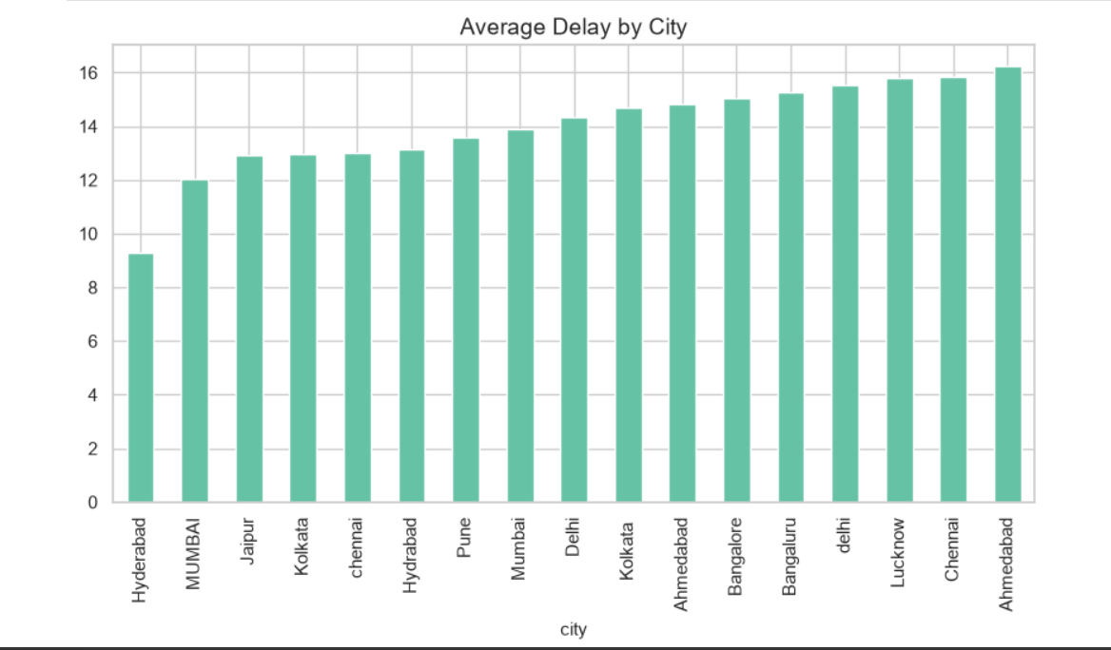
Last Mile Delivery Delay
Root Cause Analysis
City Ranking
AI Data Intelligence solution using Python, EDA, statistics,
dashboarding, and machine learning.
Dataset
2,080 orders
10 Indian cities
Full-year simulation
Goal
Find delay root causes and recommend one practical operational fix.
Deliverables
Notebook, dashboard, ML model, PPT, and repository README.
MiniHack AI Data Intelligence Challenge | 1

Slide 3
Solution Workflow
From raw delivery data to operational decision-making
Load & Inspect
Clean
EDA
Read CSV, check rows, columns, data types
Handle missing values, standardize categories, fix city spelling
Analyze peak hours, weather, city, vehicle and monthly trends
Statistics
ML Model
Recommendation
Use tests to confirm meaningful differences
Predict delayed vs on-time delivery
Convert findings into a practical dispatch action
MiniHack AI Data Intelligence Challenge | 2

Slide 4
Q1: Peak-Hour Delay Pattern
8-10 AM and 5-8 PM show the strongest operational pressure
Peak Avg Delay
Off-Peak Avg Delay
Extra Delay
23.25 minutes
7.38 minutes
Peak orders add about 15.86 minutes.
Statistical test: p-value < 0.05, so peak-hour delay is significant.
Action: add rider capacity and route support during peak windows.
MiniHack AI Data Intelligence Challenge | 3

Slide 5
Q2: Weather Impact
Fog and rain are major external delay drivers
Highest Median Delay
Fog: 37.9 minutes
Rain Impact
Rain: 29.4 minutes median delay
Hardest-Hit Rain Order
Medicine: 34.65 minutes median delay
MiniHack AI Data Intelligence Challenge | 4

Slide 6
Q3: Rider Experience and City Performance
Experience is not the main root cause; city operations vary more
Under 2 Years
Over 4 Years
Conclusion
Average delay: 13.75 minutes
Average delay: 14.35 minutes
Difference is small; operational conditions matter more.
City insight: Hyderabad performs best among shown cities, while Bangalore needs stronger dispatch planning.
MiniHack AI Data Intelligence Challenge | 5

Slide 7
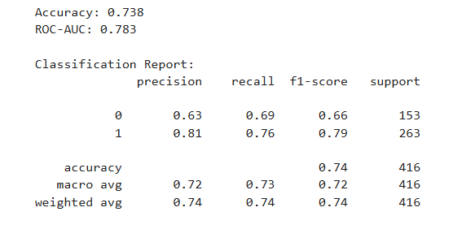
Basic Machine Learning Model
A baseline classifier predicts delayed vs on-time orders
Target Variable
Features Used
Model
Delayed vs On-Time delivery status
City, zone, vehicle, order type, weather, distance, hour, peak flag, rider metrics
Logistic Regression baseline with preprocessing pipeline
Why this matters
The ML model turns historical patterns into a decision
-support tool. It can flag high-risk orders before dispatch
and support proactive rider allocation.
MiniHack AI Data Intelligence Challenge | 6

Slide 8
Final Operational Recommendation
Use a risk-based dispatch plan
1. Peak-Hour Staffing
2. Weather-Aware Priority
Add rider capacity during 8-10 AM and 5-8 PM.
During rain and fog, prioritize Medicine orders.
3. City-Level Rebalancing
4. Vehicle Assignment
Track city on-time rates weekly and rebalance supply.
Assign faster vehicles to high-risk city/weather combinations.
Single biggest fix: combine peak-hour staffing with weather-aware dispatching.
MiniHack AI Data Intelligence Challenge | 7

