Slide 1
MT-LNN: A Brain-Inspired Liquid Neural Network
液态神经网络重塑大模型架构
Breaking the Memory Wall (打破内存墙)
EverestAn | 2026

Slide 2
1. The AI Memory Crisis (AI 行业的内存危机)
- LLMs compete on Context Length (200K+ tokens).
- 但是，支撑超长文本的计算成本呈指数级爆炸。
- OOM (Out Of Memory) limits local deployments.
- Transformer's bottleneck is physical memory, not logic.

Slide 3
2. The Root Cause: KV Cache (元凶：KV缓存)
- Transformer acts like a forced video recorder.
- 预测下一个词时，必须把过去每一个字的特征放在显存里。
- Memory complexity scales at O(N). Compute scales at O(N^2).
- 10万字的上下文会让一张昂贵的 A100 直接塞满。

Slide 4
3. A Dead End for Enterprises (算力堆叠是死胡同)
- Cloud costs for millions of tokens are prohibitive.
- 面对高并发请求，云服务商只能靠堆叠万亿算力。
- Latency drops exponentially as context grows.
- 端侧 (Edge AI) 无法运行大模型，因为手机 RAM 只有十几 GB。

Slide 5
4. Biological Inspiration (生物学启示：人脑机制)
- The human brain does not remember every pixel.
- 人脑绝不可能记住十年来每个画面的精确参数。
- We rely on Working Memory and Selective Forgetting.
- 我们依靠“工作记忆”和“选择性遗忘”。

Slide 6
5. What is a Liquid Neural Network? (什么是液态脑)
- An architecture whose state constantly dynamically flows.
- 一种状态随时间动态流动的结构，区别于静态权重。
- Forget the noise, compress the needle.
- 只提取核心概要，遗忘冗余废话，把千言万语压缩。

Slide 7
6. Introducing MT-LNN (我们的方案：MT-LNN 架构登场)
- Memory-Token Linear Neural Network.
- 记忆令牌线性神经网络。
- Replaces standard Self-Attention with Linear Attention.
- 抛弃标准自注意力机制，采用纯线性算子。

Slide 8
7. The Core: Selective Copy (核心：选择性记忆机制)
- Uses dynamic gating to explicitly select what to retain.
- 引入动态门控，明确选择在长文中保留什么，丢弃什么。
- Resolves 'Lost in the middle' phenomenon.
- 彻底解决大模型长文中间的“遗忘”现象。

Slide 9
8. Deep Dive 1: Parallel Scan (深度解析：线性并行扫描)
- Allows for highly efficient hardware utilization.
- 并行扫描使得线性处理速度比传统 RNN 快百倍。
- Every token adds O(1) constant overhead.
- 每一个新单词的计算量都是 O(1) 常数，永远不升。

Slide 10
9. Deep Dive 2: Quantum Coupling (深度解析：量子启发耦合)
- State mixing inspired by quantum entanglement states.
- 使用量子态灵感混合隐藏状态。
- Multi-head parallel routing of memory states.
- 多头并行路由，增强特征维度的提取能力。

Slide 11
10. The Mathematics of Edge Support (边缘计算的数学保障)
- State h_t = f(h_t-1, x_t).
- Only the fixed-size h vector is kept in memory.
- 模型不需要保存过去词的 KV 矩阵，仅需保留固定大小向量。
- 完美适配 8GB 以下内存的手机和 AR 设备。

Slide 12
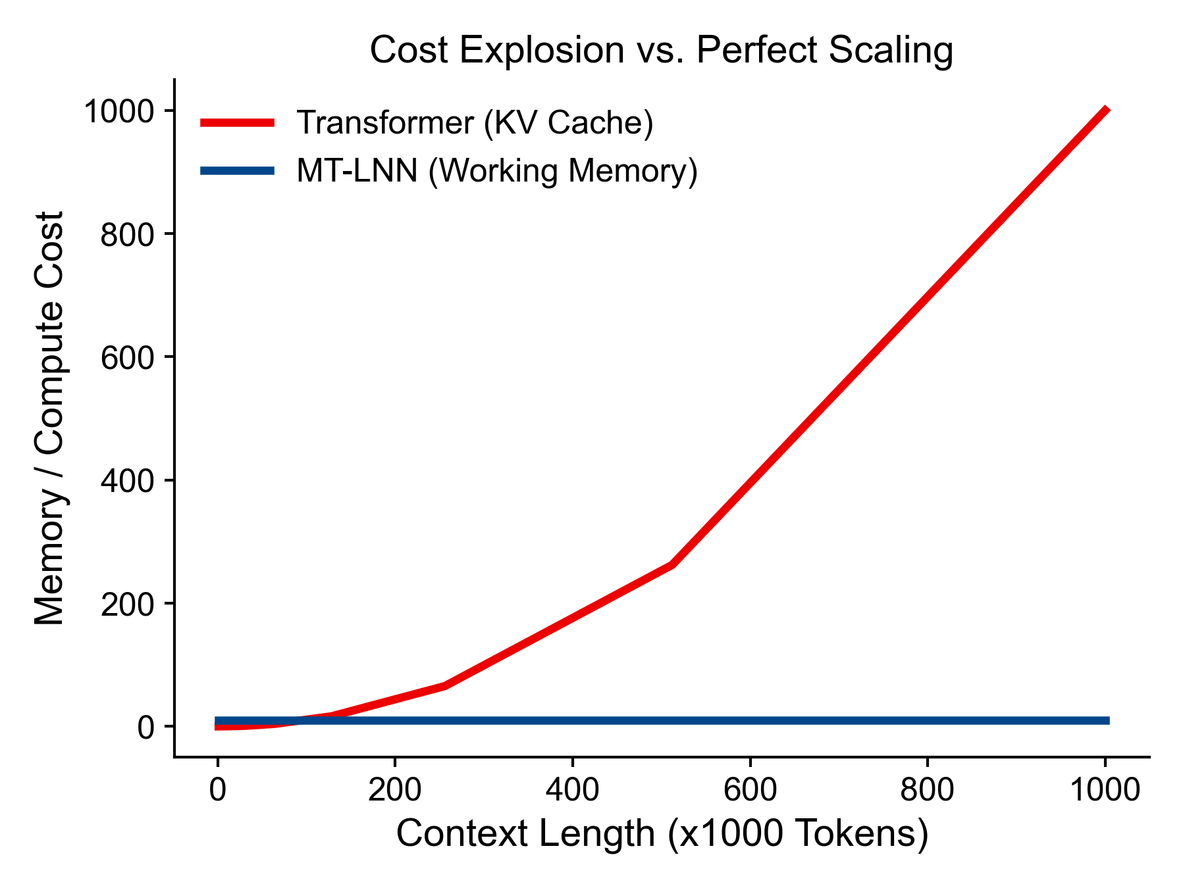
11. Cost Explosion vs. MT-LNN (成本爆炸图解)
Red: Transformer O(N) memory / O(N^2) compute.
Blue: MT-LNN O(1) memory / O(1) compute.
红线：Transformer长文本深渊；蓝线：MT-LNN的类脑常数飞行。

Slide 13
12. Benchmark 1: Needle in a Haystack (核心评测：大海捞针)
- Tested on 128K context retrieval.
- 12万字极度长文提取测试。
- MT-LNN retains 99%+ accuracy independent of depth.
- 无视深度，精准命中（得益于 Selective Copy）。

Slide 14
13. Benchmark 2: Selective Copying (核心评测：抗干扰测试)
- Retaining sequences separated by 1000+ noisy tokens.
- 跨越千字噪音阻隔，精准复制指令。
- Completely outperforms classic global attention.
- 面对巨量噪音的稳健性碾压传统注意力。

Slide 15
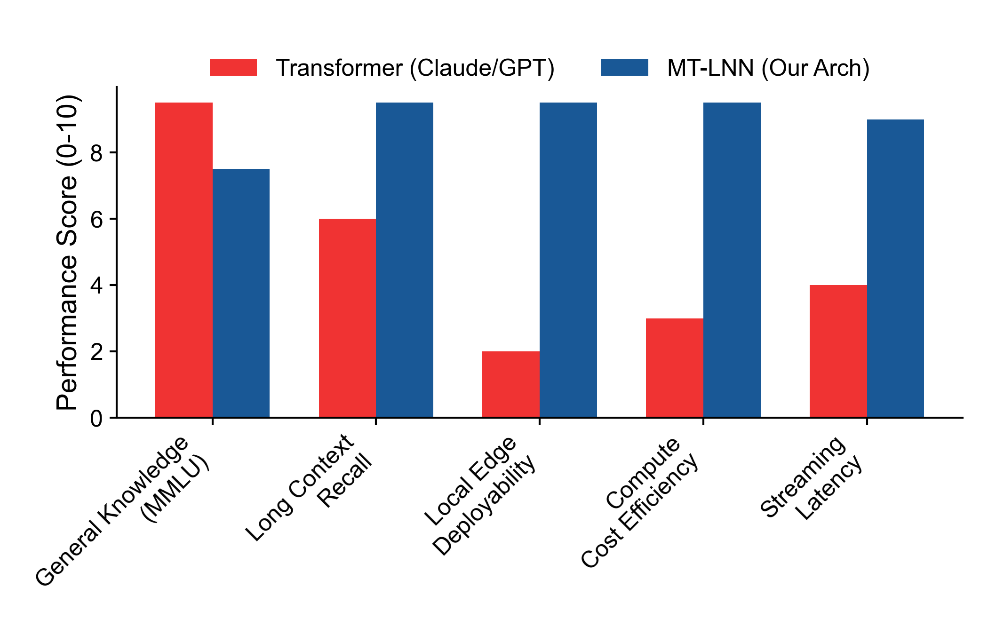
14. Performance Radar (雷达图：维度对比)
MT-LNN matches SOTA in Long Context & blows them away in Deployment/Cost.
通用知识因参数量小暂处劣势，但在核心部署性能上碾压大厂。

Slide 16
15. The Honest Trade-off (诚实的权衡：放弃百科知识)
- We are not competing to be a Wikipedia engine.
- 我们不和千亿美金的 GPT-4o 拼“通用常识百科库”。
- We focus on reasoning logic and ultra-long structural memory.
- 把所有参数压在逻辑推理与无限期超级记忆上。

Slide 17
16. Competitor Analysis: Claude/GPT (对标巨头：垂直收割)
- Claude 3.5 requires API/Cloud, zero privacy.
- 大厂模型无法本地化，企业数据缺乏隐私。
- MT-LNN offers private, localized million-token RAG.
- MT-LNN 提供完全本地化、隐私受控的长文知识库。

Slide 18
17. Competitor Analysis: Mamba & RWKV (生态对抗：同赛道)
- Open-source linear models lack needle-retrieval fidelity.
- Mamba 等方案难以保证极长文精确寻点。
- MT-LNN's explicit state tracking solves linear deterioration.
- 我们的显式量子门控阻止了线性衰减。

Slide 19
18. Economics: 90% Cost Reduction (商业优势重塑：降本 90%)
- Cloud hosting inference drops from millions to thousands.
- 云端推理服务器架构大幅度降级，每月节约数万元。
- Server costs no longer tie to context length.
- 用户不管输入多长的文本，不再增加任何云端边际成本。

Slide 20
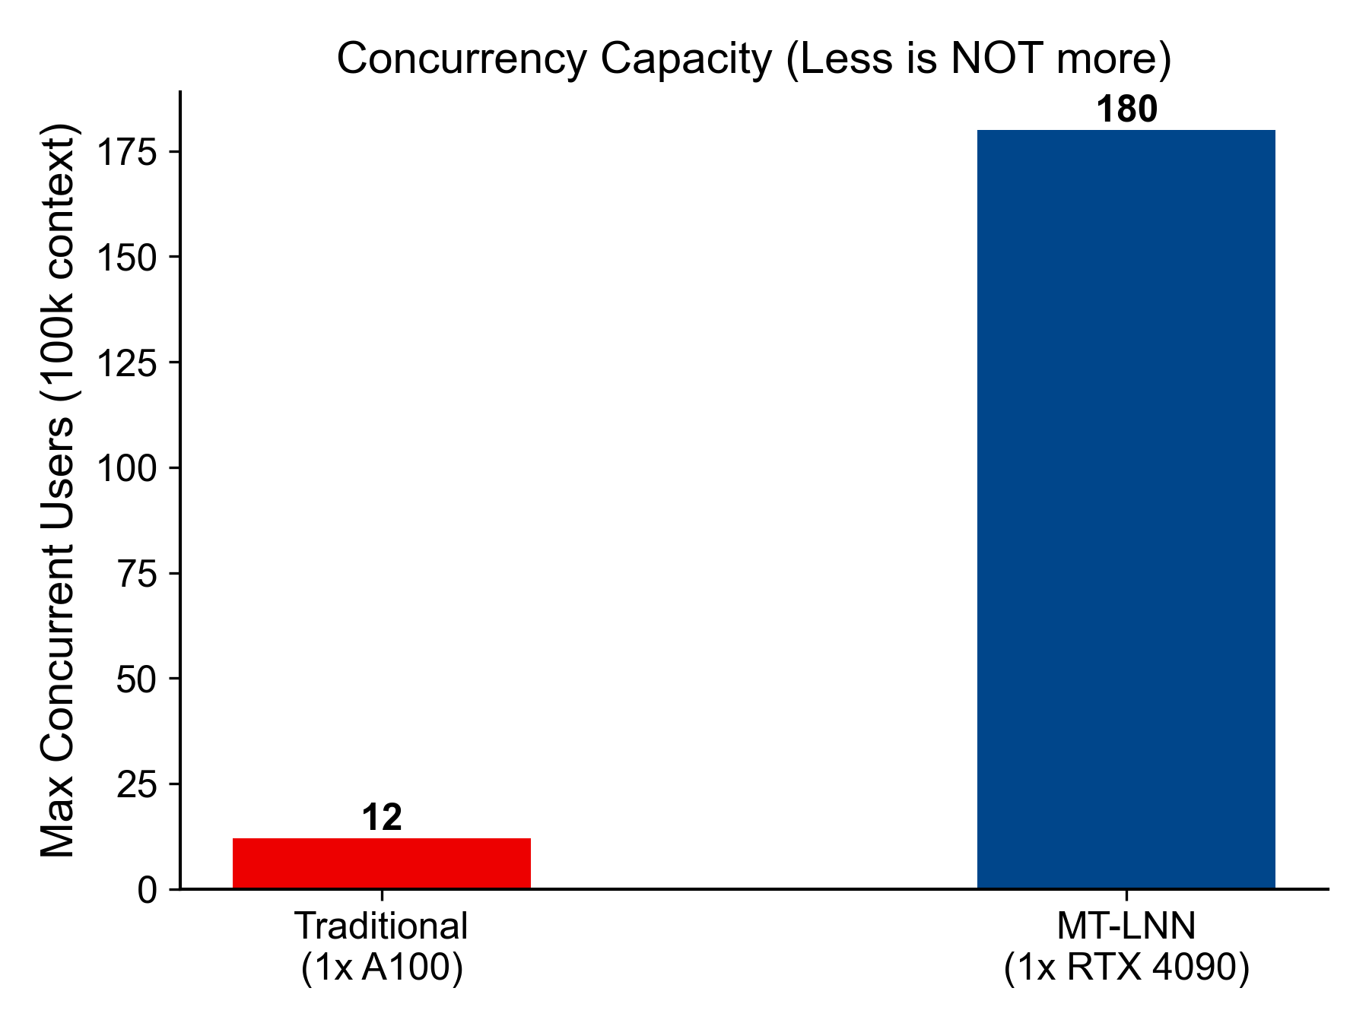
19. High Concurrency Capacity (高并发承载力)
To handle 100 users querying 100k tokens at the same time:
A100 crashes instantly. RTX 4090 handles it with MT-LNN's constant state.

Slide 21
20. Market 1: Edge Computing & IoT (下沉市场：IoT与端侧)
- Phones, AR Glasses, On-device assistants.
- 手机私有大模型、AR眼镜全天候音视频分析核心。
- Continuous streaming inputs won't drain the battery.
- 绝不会因为 24 小时保持倾听而撑爆内存、发烫。

Slide 22
21. Market 2: B2B Enterprise Deploy (企业痛点：私有化部署)
- Law firms, financial PDF audits, codebase analysis.
- 律所看卷宗、投行看财报、科技公司分析百万行代码。
- Requires large context, requires privacy, requires low hardware.
- 需要长大模型，且数据不能出域。完美契合 MT-LNN。

Slide 23
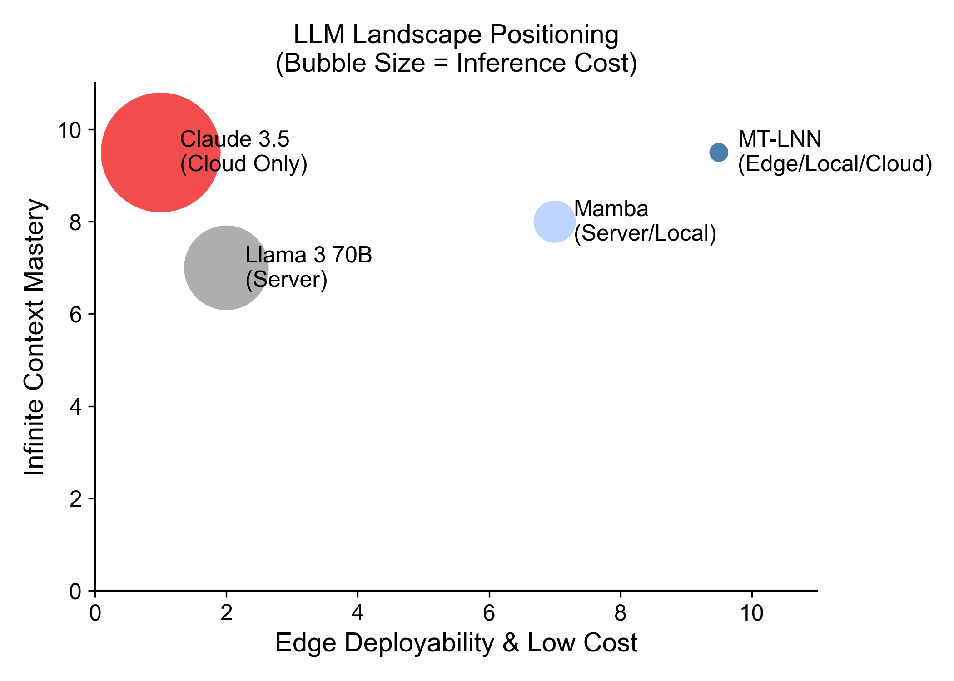
22. The Future Tech Landscape (技术生态排位占领)
Top Right: The ultimate quadrant of long context AND edge deployability.
右上角：唯一兼具极长文本掌控力与下沉端侧部署能力的架构。

Slide 24
23. Strategic Roadmap Overview (三阶段路线图概览)
- Moving from Proof of Concept to General Artificial Intelligence.
- 从本地超级知识库，走向下一代通用大模型。
- Fast, extremely capital efficient progression.
- 凭借架构极度省算力的优势，拥有最快的迭代速度。

Slide 25
24. Roadmap Stage 1: The 1.5B Proof (阶段一：验证原语)
- Timeline: Now.
- 现状：已用 15 美元，在 1.5B Qwen 规模上跑通极长大海捞针。
- Goal: Secure initial VC funding and publish core paper.
- 目标：通过极小成本的 Demo 验证原设。

Slide 26
25. Roadmap Stage 2: The 7B King (阶段二：专业微调王者)
- Timeline: Next 3-6 months.
- 未来半载：使用 4x A100 训练 7B 企业级原生模型。
- Application: Sell vertical B2B solutions.
- 应用：全面碾压企业级合同审查、金融报告等长文档 RAG。

Slide 27
26. Roadmap Stage 3: AGI Challenger (阶段三：通用架构颠覆)
- Timeline: 1 to 3 Years.
- 终局之战：筹建 512x H100 集群，训出 70B+ 千亿巨兽。
- Full-scale replacement of standard Transformer architectures.
- 在全范围（含通用知识）内，全面替换过时的 Transformer。

Slide 28
27. Defensibility & IP Moats (护城河在哪里？)
- Core algorithmic code base open-sourced for standard adoption.
- 算法基础开源，吸引广大开发者形成生态。
- Specialized quantization and CUDA kernels remain in-house.
- 高速并行 CUDA 算子与极限压缩量化闭源提供商业支撑。

Slide 29
28. Current Progress & RAG UI Demo (目前应用：RAG 系统)
- Successfully built a complete RAG UI in PyTorch/Gradio.
- 已跑通完全本地部署的百万字个人知识库 RAG Demo。
- Deploys immediately via container to any platform.
- 一键部署支持云平台、HuggingFace 与本地 Windows。

Slide 30
29. Summary: Why Invest Now? (结语：为何现在下注？)
- Transformer has reached its physical efficiency limit.
- Transformer 路线“大力出奇迹”已达物理硬件的极限瓶颈。
- The memory wall requires a fundamental architecture shift.
- 只有底层算法级的跨越，才能打破昂贵的“内存墙”。
- We have the architecture, the code, and the benchmarks.
- 我们握有类脑算法钥匙、能跑出来的实机代码、与碾压级降本数据。

Slide 31
30. Appendix & Links (资源与相关链接)
- Demo Repo: github.com/everest-an/Awareness-O1
- Core Arch Repo: github.com/everest-an/O1
- Cloud Training Setup: check CLOUD_TRAINING_GUIDE.md
Thank you. Liquidize the AI future.

