Slide 1
Angular
Notes:
https://www.smashingmagazine.com/2019/02/angular-application-bootstrap/
https://thinkster.io/tutorials/learn-angular-2
https://www.typescriptlang.org/docs/handbook/classes.html
https://codecraft.tv/courses/angular/built-in-directives/ngstyle-and-ngclass/
https://mytechnetknowhows.wordpress.com/2017/03/05/angular-2-nested-routing/

Slide 2
Angular Topics
What is Angular?
Setup: How to get started?
Component Architecture & Data Binding
Component Life Cycle Hooks
Nested Components
Component Intercommunication
Inbuilt Directives
Dependency Injection & Services
Handling Http Communication
Routing
Forms
Notes:
Applications
Some of the popular website using Angular Framework are listed below −
Weather.com − It is one of the leading forecasting weather report website.
Youtube − It is a video and sharing website hosted by Google.
Netflix − It is a technology and media services provider.
PayPal − It is an online payment system.

Slide 3
Directives
Notes:
https://angular.io/tutorial/toh-pt1

Slide 4
Directives
Directives are instructions in the DOM!
Directives enables logic to be included in the Angular templates
Components are directives with view-template
Directives are components without template.
Angular directives can be classified into three categories and they are as follows −

Slide 5
Attribute directives
Used to add new attributes for the existing HTML elements to change its look and behavior.
<HTMLTag [attrDirective]='value' />
For example,
<p [showToolTip]='Tips’ />
Here, showToolTip refers an example directive, which when used in a HTML element will show tips while user hovers the HTML element.

Slide 6
Custom Attribute Directive
ng generate directive highlight
import { Directive, ElementRef } from '@angular/core';
@Directive({
selector: '[appHighlight]'
})
export class HighlightDirective {
constructor(private el: ElementRef) {
this.el.nativeElement.style.backgroundColor = 'yellow';
}
}
use custom attribute directive in html template as below:-
<p app:Highlight>This is invalid</p>
Angular creates an instance of the HighlightDirective class and injects a reference to the <p> element into the directive's constructor, which sets the <p> element's background style to yellow.

Slide 7
Custom Directive – Handle User Events
Add two event handlers that respond when the mouse enters or leaves, each with the @HostListener() decorator to highlight.directive.ts file
@HostListener('mouseenter') onMouseEnter() {
this.highlight('yellow');
}
@HostListener('mouseleave') onMouseLeave() {
this.highlight('');
}
private highlight(color: string) {
this.el.nativeElement.style.backgroundColor = color;
}

Slide 8
Custom Directive – how to handle User Events
@HostListener:-
Decorator that declares a DOM event to listen for, and provides a handler method to run when that event occurs.
Angular invokes the supplied handler method when the host element emits the specified event, and updates the bound element with the result.
If the handler method returns false, applies preventDefault on the bound element.
Passing values into an attribute directive
Use @Input to pass value to directive same like component

Slide 9
Using @ViewChild
@ViewChild :-
@ViewChild and @ViewChildren are the types of decorators used to access the child component class/child directive and its different properties into the parent component.
We can also access any specific template element by using @ViewChild instead of referencing the whole component
It's similar to the inheritance., and if a new child matches the selector, the property is updated.
We have to use ngAfterViewInit() hook in parent component to access the ViewChild ref properties. ( When the application loads, the child element may not be loaded completely, and if we try to access the component, it returns undefined. To resolve this, we use that lifecycle hook which allows us to access any element after the view is initialized.)
https://angular.io/api/core/ViewChild
Why do we use @ViewChild in Angular?
The ViewChild can get be used to get reference of template elements, so you can see all the associated attributes.
A common example would be if there were to be a custom component in a template a ViewChild could be used to pull values out of that component when needed.
https://www.pluralsight.com/guides/querying-the-dom-with-@viewchild-and-@viewchildren

Slide 10
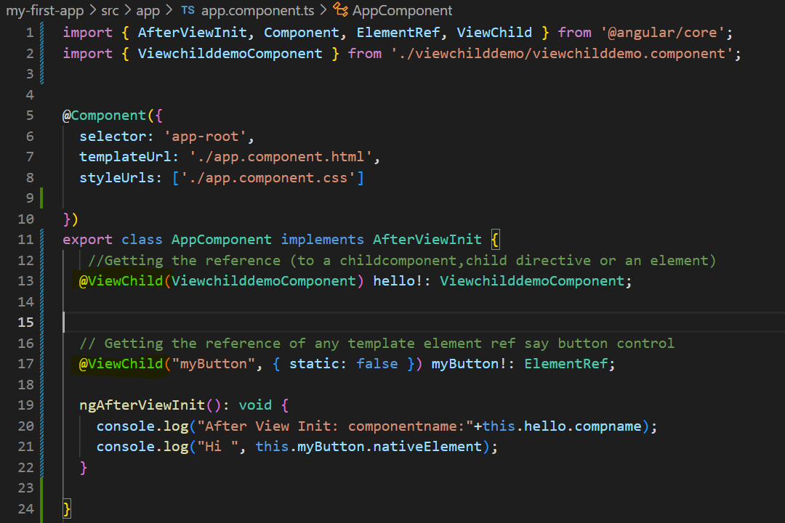
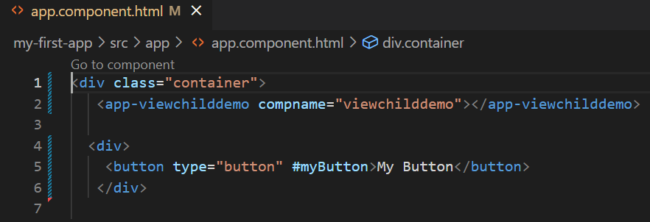
Using @ViewChild

Slide 11
Using Renderer2
The Renderer2 allows us to manipulate the DOM elements, without accessing the DOM directly.
It provides a layer of abstraction between the DOM element and the component code.
Using Renderer2 we can create an element, add a text node to it, append child element using the appendchild method., etc.
We can also add or remove styles, HTML attributes, CSS Classes & properties, etc.
We can also attach and listen to events etc.

Slide 12
Using Renderer2
this.renderer.setAttribute(this.inputElement.nativeElement, 'value', this.name );
this.renderer.removeAttribute(this.inputElement.nativeElement, 'value');
this.renderer.setProperty(this.divHello.nativeElement,'innerHTML',"Hello Angular")
const text = this.renderer.createText('Example of Create Text');
//this.renderer.appendChild(this.divCreateText.nativeElement, text);
const div = this.renderer.createElement('div');
const text1 = this.renderer.createText('Example of Create Text');
this.renderer.appendChild(div, text1);
this.renderer.appendChild(this.divCreateText.nativeElement, div);
const div = this.renderer.createElement('div');
const text = this.renderer.createText('Inserted at bottom');
this.renderer.appendChild(div, text);
this.renderer.appendChild(this.el.nativeElement, div);

Slide 13
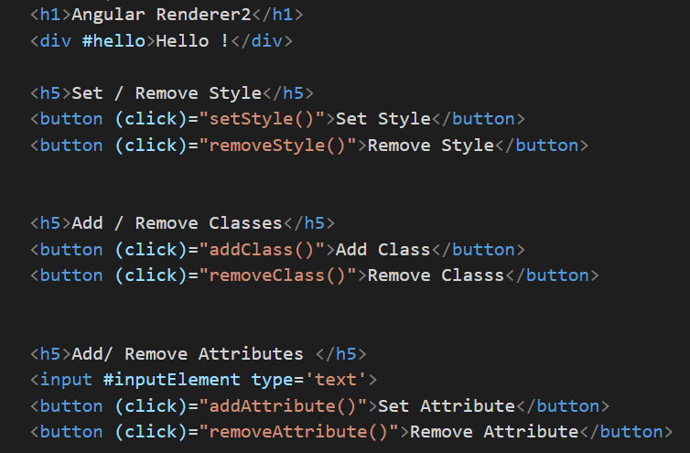
Using Renderer2
Renderer2.component.html

Slide 14
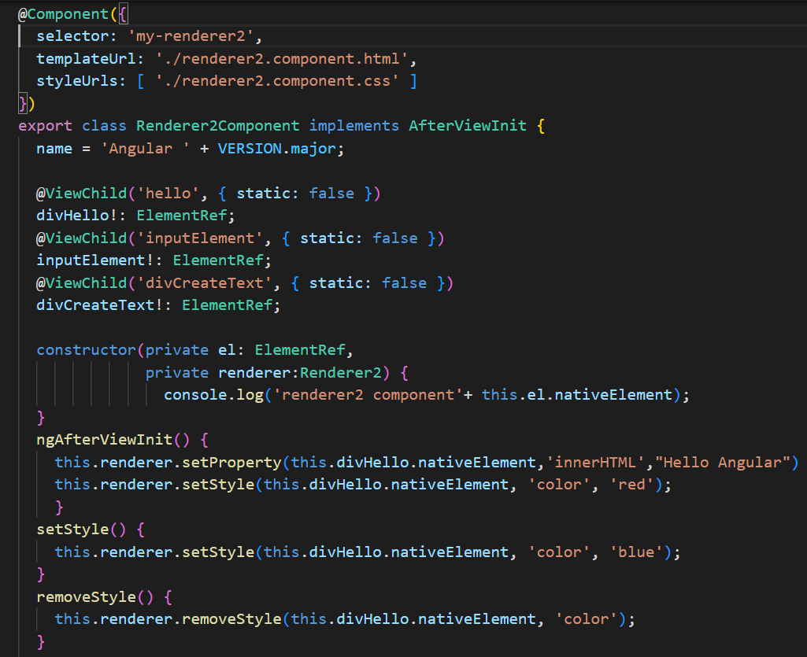
Using Renderer2
Renderer2.component.ts

Slide 15
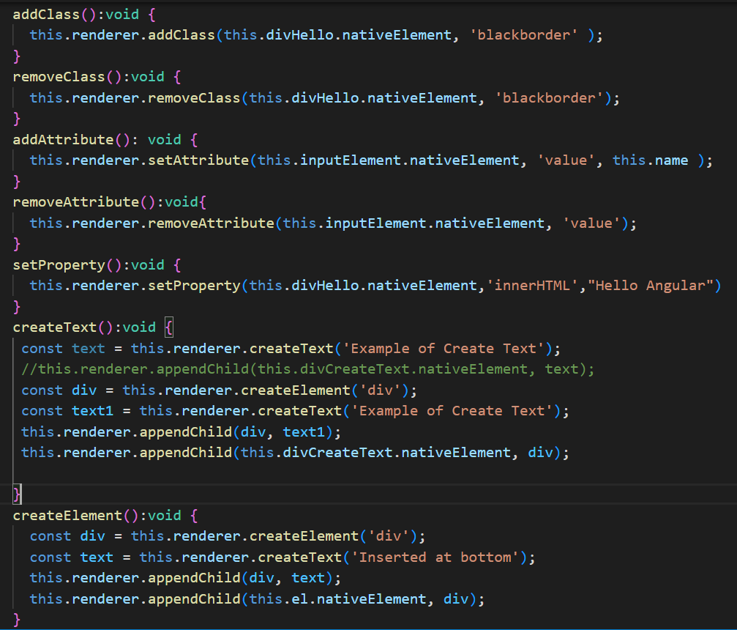
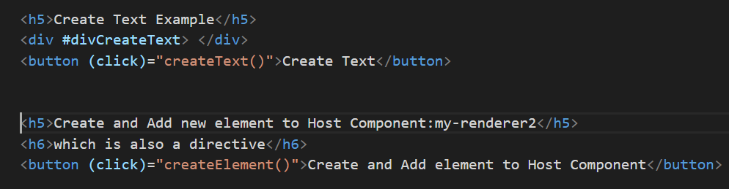
Using Renderer2
Renderer2.component.ts
Renderer2.component.html

Slide 16
Built-In Directives - *ngIf
*ngIf - NgIf is a behavioral directive that allows us to toggle a template based on a conditional statement.
This conditional statement would be evaluated similar to our JavaScript If statement. If(condition) {}.
* here denotes that it’s a structural directive that modifies the DOM whenever the if-template gets conditionally added/removed.
<div *ngIf = 'bookCreationStatus!=false’ >
<p>New Book is Created, bookname is : {{bookname}} !</p>
</div>
Run & inspect the app, check the DOM – for new template that got added/removed based on conditional evaluation.
Adding ‘else’ condition to ‘*ngIf’ – use ‘ng-template’ as below to mark html-template that should get added when if condition is false.
Add the ng-template marker in else condition of ngIf directive to mark which template should get added if condition is false.
<div *ngIf = 'bookCreationStatus!=false; else noBook' >
<p>New Book is Created, bookname is : {{bookname}} !</p>
</div>
<ng-template #noBook>
<p>No, new Book Created !</p>
</ng-template>

Slide 17
Built-In Directives - styling elements dynamically with ngStyle
ngStyle is used to style elements dynamically.
ngStyle is attribute directive and they only change the element they are placed on (unlike structural directive)
ngStyle can update styles dynamically. For e.g.: if bookname in below code changes then it would update the backgroundColor CSS style accordingly.
app.component.html
<div … >
<p [ngStyle]="{backgroundColor:getColor()}">
New Book is Created, bookname is : {{bookname}} !
</p>
</div>
app.component.ts
public getColor()
{
this.bookname = this.bookname.toUpperCase();
return this.bookname === 'ANGULAR'? 'dodgerblue':'orange';
}
Notes:
Note:ngStyle is attribute directive in this case is also using property binding to bind to ngStyle attribute of same directive

Slide 18
Built-In Directives - applying css classes dynamically with ngClass
ngClass is used to apply CSS class dynamically.
ngClass is attribute directive and it only changes the element it’s placed on (unlike structural directive)
Syntax: <element [ngClass]={ css_class_name: condition}>..</element>
ngClass will only apply CSS class if condition evaluates to true.
app.component.html
<div … >
<p [ngStyle]="{backgroundColor:getColor()}"
[ngClass]="{bookcreated:bookCreationStatus === true}">
New Book is Created, bookname is : {{bookname}} !
</p>
</div>
app.component.css
.bookcreated {
color :magenta;
}
app.component.ts
export class AppComponent implements OnInit {
bookCreationStatus:boolean;
bookname:string;
constructor() { }
ngOnInit() {
this.bookname="";
this.bookCreationStatus = false;
}
public bookdetail(ele:HTMLInputElement)
{
this.bookCreationStatus = false;
console.log(ele.value);
if(ele.value!=null && ele.value!='')
{
this.bookCreationStatus = true;
this.bookname = ele.value;
}
}
Notes:
Note:ngStyle is attribute directive in this case is also using property binding to bind to ngStyle attribute of same directive

Slide 19
Built-In Directives - using *ngFor for iterating/looping through set of values!
*ngFor is used for looping/iterating through set of values and displaying them on UI at runtime.
*ngFor is structural directive as it changes DOM when iterated values are added/removed from UI at runtime
Syntax:
<element *ngFor=‘let var of set’>
{{var}}
</element>
app.component.html
Usage1:
<div *ngFor='let b of booklist’>
{{b}}
</div>
Usage2:
<app-book
*ngFor = 'let b of booklist'
[bookName]=b>
</app-book>
Notes:
Note:ngStyle is attribute directive in this case is also using property binding to bind to ngStyle attribute of same directive

Slide 20
Custom Directive
Notes:
https://angular.io/tutorial/toh-pt1

Slide 21
Creating Custom Directive & Using Renderer
import { Directive,ElementRef,Renderer2 } from '@angular/core';
@Directive({
selector: '[appGreet]'
})
export class GreetDirective {
WhatsUp = 'How Are You?';
constructor(elem: ElementRef, renderer: Renderer2) {
let greet = renderer.createText('Hello, ');
renderer.appendChild(elem.nativeElement, greet);
}
}
Using Renderer is a recommended way to make changes to DOM.
The Renderer2 class is an abstraction provided by Angular in the form of a service that allows to manipulate elements of your app without having to touch the DOM directly.

Slide 22
Creating Custom Directive & @HostListener, @HostBinding
import { Directive,ElementRef,Renderer2 } from '@angular/core';
@Directive({
selector: '[appGreet]'
})
export class GreetDirective {
WhatsUp = 'How Are You?';
constructor(elem: ElementRef, renderer: Renderer2) {
let greet = renderer.createText('Hello, ');
renderer.appendChild(elem.nativeElement, greet);
}
}

Slide 23
Custom Property & Events
Notes:
https://namitamalik.github.io/ViewChild-in-Angular2/
http://learnangular2.com/lifecycle/

Slide 24
Property & Event Binding
HTML Elements
Directives
Components
Native Properties & Events!
Custom Properties & Events!
Custom Properties & Events!
Notes:
Note:ngStyle is attribute directive in this case is also using property binding to bind to ngStyle attribute of same directive

Slide 25
Custom Input & Output Event
book.component.ts
…
export class BookComponent implements OnInit {
book:Book=new Book();
@Output() out_book_evnt:EventEmitter<Book>
= new EventEmitter<Book>();
constructor() { }
ngOnInit(): void { }
createBook()
{
this.out_book_evnt.emit(this.book);
}
}

Slide 26
Custom Input & Output Event
app.component.html
<div class="container">
<app-book (out_book_evnt)="createBook($event)">
</app-book>
<app-book-list [books]="booklist"></app-book-list>
</div>

Slide 27
Custom Input & Output Event
book-list.component.ts
…
export class BookListComponent implements OnInit,OnChanges {
@Input() books : Book[] =[];
…
}

Slide 28
Custom Input & Output Event - using *ngFor with component binding
2nd way..
Using ngFor with nested component.
app.component.html
<div class="container">
<app-book (out_book_evnt)="createBook($event)"></app-book>
<hr>
<app-book-list
*ngFor = "let b of booklist"
[book] = b
>
</app-book-list>
</div>

Slide 29
Custom Input & Output Event
book.component.ts
…
export class BookComponent implements OnInit {
book:Book=new Book();
@Output() out_book_evnt:EventEmitter<Book>
= new EventEmitter<Book>();
constructor() { }
ngOnInit(): void { }
createBook()
{
this.out_book_evnt.emit(this.book);
}
}

Slide 30
Custom Input & Output Event
book-list.component.ts
…
export class BookListComponent implements OnInit,OnChanges {
@Input() book : Book;
…
}
book-list.component.html
<div>
<p>{{book.id}}</p>
<p>{{book.name}}</p>
<p>{{book.price}}</p>
<p>{{book.description}}</p>
</div>
<hr>

Slide 31
Custom Input & Output Event – assigning alias
book-list.component.ts
…
export class BookListComponent implements OnInit {
@Input('newbook') book : Book;
…
}
app.component.html
<app-book (out_book_evnt)="createBook($event)"></app-book>
<hr>
<app-book-list
*ngFor = "let b of booklist"
[newbook]=b
>
</app-book-list>

Slide 32
Angular Directives
Using inbuilt directives like <ng-content>

Slide 33
Projecting Content Into Component – using <ng-content>
app.component.html
<app-book-list *ngFor = "let b of booklist"> -- (<app-book-list> is selector of book-list component)
<div>
<p>{{b.id}}</p>
<p>{{b.name}}</p>
<p>{{b.price}}</p>
<p>{{b.description}}</p>
<button class="btn btn-primary" (click)="selectBook(b)"> Show details</button>
</div>
<hr>
</app-book-list>
book-list.component.html
<ng-content></ng-content>
All content inside <app-book-list> opening and closing tag will be projected from parent app-component onto child book-list component due to <ng-content> tag.
<ng-content> marks the place in child component where the content should get projected.
Without <ng-content> tag all content passed between opening and closing <app-book-list> nested component tag will be lost.

Slide 34
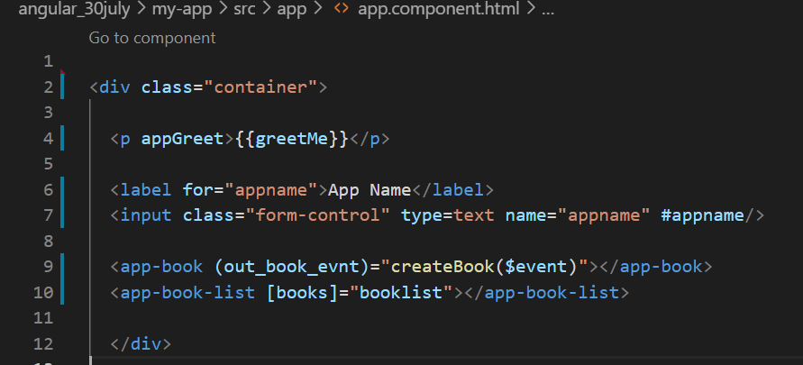
Accessing DOM element, directive, component from Parent
If you wish to gain access to a DOM element, directive or component from a parent component class then you rely on Angular ViewChild.
Notes:
https://stackoverflow.com/questions/34364880/expression-has-changed-after-it-was-checked

Slide 35
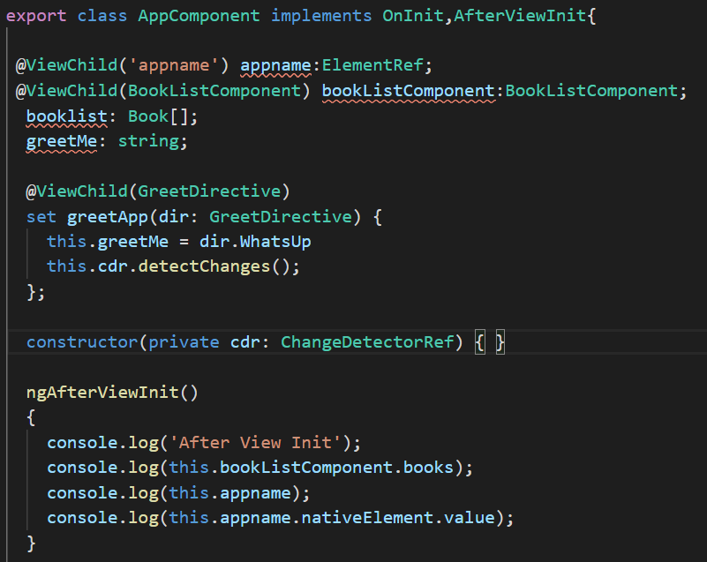
Accessing DOM element, directive, component from Parent
If you wish to gain access to a DOM element, directive or component from a parent component class then you rely on Angular ViewChild.
Notes:
https://stackoverflow.com/questions/34364880/expression-has-changed-after-it-was-checked

Slide 36
Accessing projected content in child component using @ContentChild
app.component.html
<app-book-list *ngFor = "let b of booklist">
<div #projContnt>
<p>{{b.id}}</p>
<p>{{b.name}}</p>
<p>{{b.price}}</p>
<p>{{b.description}}</p>
<button class="btn btn-primary" (click)="selectBook(b)"> Show details</button>
</div>
<hr>
</app-book-list>
book-list.component.html
<ng-content></ng-content>
Notes:
On any Update, the log would show another OnChanges and two more triplets of DoCheck, AfterContentChecked and AfterViewChecked. Clearly these three hooks fire often. Keep the logic in these hooks as lean as possible!

Slide 37
Accessing projected content in child component using @ContentChild
book-list.component.ts
export class BookListComponent implements AfterContentInit {
// @Input('newbook') book : Book;
@ContentChild('projContnt') projectedContent:ElementRef;
…
ngAfterContentInit()
{
console.log('book-list-component:ngAfterContentInit called');
console.log('inside book-list component content init:'+
this.projectedContent.nativeElement.innerText);
}
…
}
Notes:
On any Update, the log would show another OnChanges and two more triplets of DoCheck, AfterContentChecked and AfterViewChecked. Clearly these three hooks fire often. Keep the logic in these hooks as lean as possible!

