Slide 1
Angular
Notes:
https://www.smashingmagazine.com/2019/02/angular-application-bootstrap/
https://thinkster.io/tutorials/learn-angular-2
https://www.typescriptlang.org/docs/handbook/classes.html
https://codecraft.tv/courses/angular/built-in-directives/ngstyle-and-ngclass/
https://mytechnetknowhows.wordpress.com/2017/03/05/angular-2-nested-routing/

Slide 2
Angular Topics
What is Angular?
Setup: How to get started?
Component Architecture & Data Binding
Component Life Cycle Hooks
Nested Components
Component Intercommunication
Inbuilt Directives
Dependency Injection & Services
Handling Http Communication
Routing
Forms
Notes:
Applications
Some of the popular website using Angular Framework are listed below −
Weather.com − It is one of the leading forecasting weather report website.
Youtube − It is a video and sharing website hosted by Google.
Netflix − It is a technology and media services provider.
PayPal − It is an online payment system.

Slide 3
Routing

Slide 4
Client-Side Routing Advantages
Gives better User Experience
Doesn’t reload the page - Works faster
Doesn’t restart the app every-time link is navigated - so it helps to preserve/maintain the app-state

Slide 5
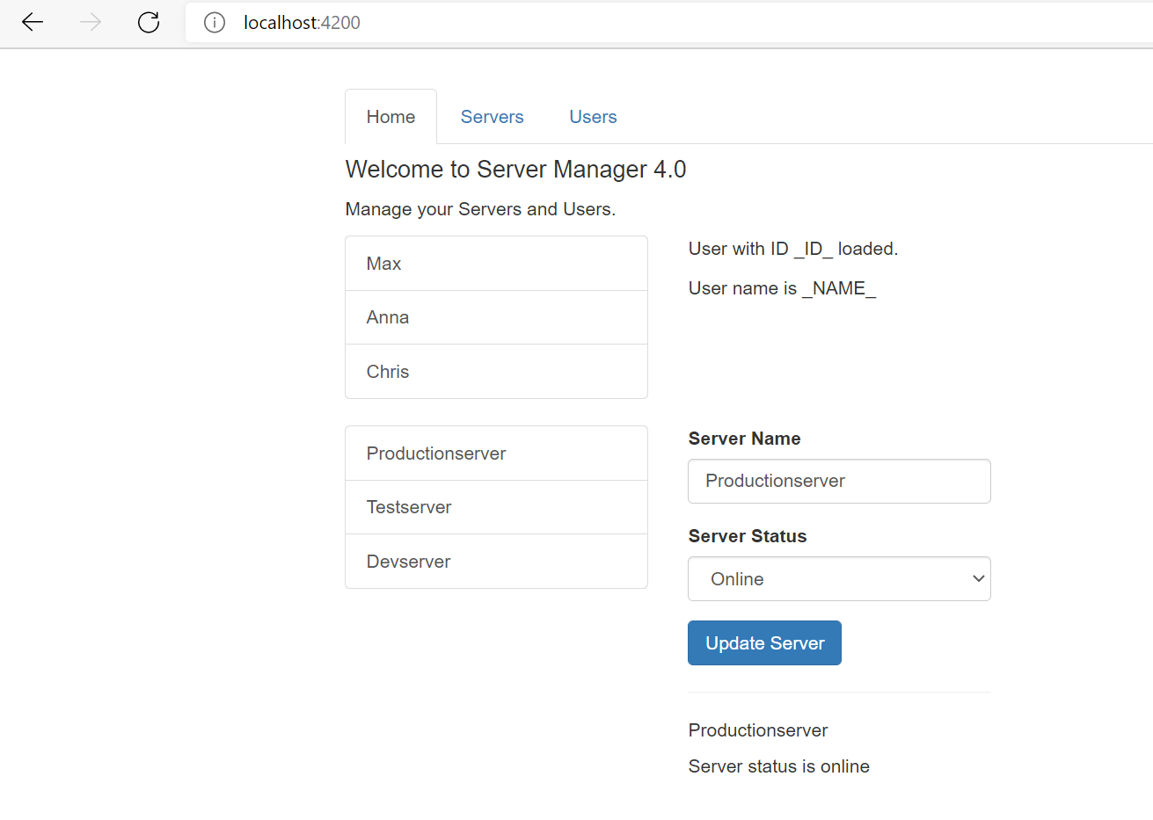
Without Routing…

Slide 6
Routing Example
In our app, we got three sections:
Home
Servers
View and Edit Servers
A Service is used to load and update Servers
Users
View Users
This app will be improved by adding routing but definitely feel free to play around with it - besides routing, everything should be working fine.

Slide 7
Routing Example
In our app, we got three sections:
Home
Books
View and Edit Books
A Service is used to load and update Books
Users
View Library Users
This app will be improved by adding routing but definitely feel free to play around with it - besides routing, everything should be working fine.

Slide 8
Registering Routes – Basic Syntax
const appRoutes: Routes = [
{ path: '', component: HomeComponent },
{ path: 'users', component: UsersComponent},
{ path: 'servers’, component: ServersComponent }
{ path: 'not-found', component: PageNotFoundComponent},
{ path: '**', redirectTo: '/not-found’ } ];
@NgModule({
imports: [
RouterModule.forRoot(appRoutes)
],
exports: [RouterModule]
})
export class AppRoutingModule {}

Slide 9
Navigating & Loading Routes
<router-outlet></router-outlet> - add this directive in component html at location where you want to load routed page
How to give hyper-links to routes – using routerLink attribute directive.
routerLinkActive – is used for Styling Active Router Links.
routerLinkActive tracks whether the linked route of an element is currently active, and allows you to specify one or more CSS classes to add to the element when the linked route is active.
<ul class="nav nav-tabs">
<li role="presentation"
routerLinkActive="active"
[routerLinkActiveOptions]="{exact: true}">
<a routerLink="/">Home</a>
</li>
<li role="presentation"
routerLinkActive="active">
<a routerLink="servers">Servers</a>
</li>
<li role="presentation"
routerLinkActive="active">
<a [routerLink]="['users']">Users</a>
</li>
</ul>

Slide 10
Relative and Absolute Path
Relative path doesn’t start with ‘/’ and it appends to current path
Current path depends on which component you are currently on
Relative path – ‘../servers’ – go up one path relative to current path

Slide 11
Navigating Programmatically
Use inside function - this.router.navigate(['/servers’]);
onLoadServer(id: number) {
this.router.navigate(['/servers', id, 'edit’])
}
onLoadServer(id: number) {
this.router.navigate(['/servers', id, 'edit’],
{queryParams: {allowEdit: ’1’}}
)//end of navigate
}//end of function
onLoadServer(id: number) {
this.router.navigate(['/servers', id, 'edit’],
{queryParams: {allowEdit: ’1’}, fragment: 'loading’}
) //end of navigate
}//end of function
Note: import ‘Router’ from @angular/router and inject ‘Router’ service in component constructor so that it can be used in ‘onLoadServer’ function.

Slide 12
Navigating Programmatically
Home.component.html
<button class="btn btn-primary" (click)="onLoadServer(1)">Load Server 1</button>
Home.component.ts
onLoadServer(id: number) {
// complex calculation
this.router.navigate
(
['/servers', id, 'edit’], {queryParams: {allowEdit: '1’},
fragment: 'loading’
}
);
}

Slide 13
Using Relative Paths in Programmatic Navigation
constructor(private serversService: ServersService, private router: Router, private route: ActivatedRoute) {
}
onReload() {
this.router.navigate(['servers'], {relativeTo: this.route});
}

Slide 14
Passing & Fetching Route Parameters
Passing Route Parameters:-
const appRoutes: Routes = [
{ path: '', component: HomeComponent },
{ path: 'users', component: UsersComponent},
{ path: 'users/:id/:name', component: UserComponent }
] },
<a [routerLink]="['/users’, 20, ’John']">Load John (20)</a>
Fetching Route parameters:-
ngOnInit() {
this.user = {
id: this.route.snapshot.params['id'],
name: this.route.snapshot.params['name']
};
this.paramsSubscription = this.route.params -- fetching route parameters reactively
.subscribe(
(params: Params) => {
this.user.id = params['id'];
this.user.name = params['name'];
}
);
}

Slide 15
Route Observables Un-Subscription
Route Params Observable are unsubscribed by angular automatically
import { Subscription } from 'rxjs/Subscription';
export class UserComponent implements OnInit, OnDestroy {
paramsSubscription: Subscription;
ngOnInit() {
//store the subscription in some var
this.paramsSubscription = this.route.params.subscribe(.. )}
//unsubscribe as below although not needed
ngOnDestroy() {
this.paramsSubscription.unsubscribe();
}

Slide 16
Passing & Retrieving Query Params & Fragments
Passing Query Params & Fragments:-
<div class="list-group">
<a
[routerLink]="['/servers', server.id]"
[queryParams]="{allowEdit: server.id === 3 ? '1' : '0'}"
fragment="loading"
href="#"
class="list-group-item"
*ngFor="let server of servers">
{{ server.name }}
</a>
</div>

Slide 17
Passing & Retrieving Query Params & Fragments
Retrieving Query Params & Fragments:-
ngOnInit() {
console.log(this.route.snapshot.queryParams);
console.log(this.route.snapshot.fragment);
this.route.queryParams
.subscribe(
(queryParams: Params) => {
this.allowEdit = queryParams['allowEdit'] === '1' ? true : false;
}
);
this.route.fragment.subscribe();
}

Slide 18
Setting Up Child or Nested Routes
app-routing.module.ts
const appRoutes: Routes = [
{ path: '', component: HomeComponent },
{ path: 'users', component: UsersComponent, children: [
{ path: ':id/:name', component: UserComponent }
] },
{
path: 'servers',
// canActivate: [AuthGuard],
canActivateChild: [AuthGuard],
component: ServersComponent,
children: [
{ path: ':id', component: ServerComponent, resolve: {server: ServerResolver} },
{ path: ':id/edit', component: EditServerComponent, canDeactivate: [CanDeactivateGuard] }
] },
// { path: 'not-found', component: PageNotFoundComponent },
{ path: 'not-found', component: ErrorPageComponent, data: {message: 'Page not found!'} },
{ path: '**', redirectTo: '/not-found' }
];

Slide 19
Loading Child or Nested Routes
Users.component.html
<div class="row">
<div class="col-xs-12 col-sm-4">
<div class="list-group">
<a
[routerLink]="['/users', user.id, user.name]"
href="#"
class="list-group-item"
*ngFor="let user of users">
{{ user.name }}
</a>
</div>
</div>
<div class="col-xs-12 col-sm-4">
<!--<app-user></app-user>-->
<router-outlet></router-outlet>
</div>
</div>

Slide 20
Preserving/Merging Query Params During Navigation
Inside server.component.ts
onEdit() {
this.router.navigate(['edit'], {relativeTo: this.route, queryParamsHandling: 'preserve'});
}
While navigating from ‘server’ component to ‘edit-server’ component want query params to be preserved and not lost

Slide 21
Redirection Path Matching & Wild Card Routes
const appRoutes: Routes = [ …
{ path: 'not-found', component: ErrorPageComponent,
data: {message: 'Page not found!'} },
{ path: '**', redirectTo: '/not-found' }
];
Suppose you only want to get redirected to error-page component if entire path is empty or nothing ‘’ after base path.
Since the default matching strategy is "prefix" , Angular checks if the path you entered in the URL does start with the path specified in the route. Since every path starts with ‘’prefix it will not redirect correctly.
To fix this use path match strategy as full: { path: '', redirectTo: '/somewhere-else', pathMatch: 'full’ } – use path matching strategy is ‘full’

Slide 22
Outsourcing Route Configuration
App-routing.module.ts
const appRoutes: Routes = [
{ path: '', component: HomeComponent },
...];
@NgModule({
imports: [
RouterModule.forRoot(appRoutes)
],
exports: [RouterModule]
})
export class AppRoutingModule {}
app.module.ts
@NgModule({
declarations: [ … ],
imports: [ …,
AppRoutingModule ],
providers: […],
bootstrap: [AppComponent]
})
export class AppModule { }

Slide 23
Lazy Loading
Step 1: App-routing.module.ts
const appRoutes: Routes = [
{ path: "", redirectTo: "/recipes", pathMatch: "full" },
{
path: "recipes",
loadChildren: () =>
import("./recipes/recipes.module").then(m => m.RecipesModule)
},…]
Step 2: Recipes-routing.module.ts
const routes: Routes = [
{
path: '',
component: RecipesComponent
},
…]
@NgModule({
imports: [RouterModule.forChild(routes)],
exports: [RouterModule]
})
export class RecipesRoutingModule {}
Step 3: Recipes.module.ts :- import ‘RecipesRoutingModule’ under ‘RecipesModule’ (@NgModule/imports array)

