Slide 1
Pipes
Notes:
https://medium.com/lapis/where-is-your-orderby-pipe-angular-11e617ce2a3d

Slide 2
Angular Pipes
Pipes are referred as filters.
It helps to transform data and manage data within interpolation, denoted by {{ | }}.
It accepts data, arrays, integers and strings as inputs which are separated by ‘|’ symbol.

Slide 3
Date Pipe
<div>
Today's date :- {{presentDate}}
Today's date :- {{presentDate | date }}
short date :- {{presentDate | date:'shortDate' }} <br/>
Full date :- {{presentDate | date:'fullDate' }} <br/>
Formatted date:- {{presentDate | date:'M/dd/yyyy'}} <br/>
Hours and minutes:- {{presentDate | date:'h:mm'}}
</div>
export class AppComponent {
presentDate = new Date();
}
Date object is converted into easily readable format by DatePipe
Parameters in Date
We can add parameter in pipe using : character.
We can show short, full or formatted dates using this parameter.
Notes:
https://www.angularjswiki.com/angular/angular-date-pipe-formatting-date-times-in-angular-with-examples/

Slide 4
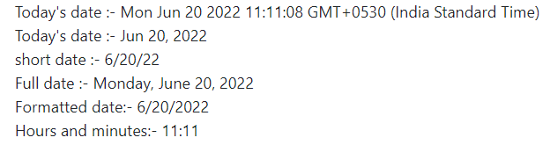
Date Pipe

Slide 5
Chained pipes
We can combine multiple pipes together. This will be useful when a scenario associates with more than one pipe that has to be applied for data transformation.
<div>
<p>Pipe Chaining</p>
Date with uppercase :- {{presentDate | date:'fullDate' | uppercase}} <br/>
Date with lowercase :- {{presentDate | date:'medium' | lowercase}} <br/>
</div>
In the above example, if you want to show the date with uppercase letters, then we can apply both Date and Uppercase pipes together.
You could see the below response on your screen −
Date with uppercase :- MONDAY, JUNE 15, 2020 Date with lowercase :- jun 15, 2020, 12:00:00 am

Slide 6
Built-in Pipes: Async Pipe
Angular 8 supports the following built-in pipes. We will discuss one by one in brief.
AsyncPipe:-
If data comes in the form of observables, then Async pipe subscribes to an observable and returns the transmitted values.
timeChange = new Observable<string>(
(observer: Observer<string>) => {
setInterval(() => observer.next(new Date().toString()), 1000);
});
Main advantage is that, we don’t need to call subscribe on our timeChange and don’t worry about unsubscribe, if the component is removed.
Add the below code inside your **.component.html.
<div>
Seconds changing in Time: {{ timeChange | async }}
</div>

Slide 7
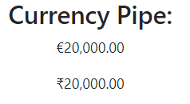
Built-in Pipers: Currency Pipe
<h3> Currency Pipe:</h3>
<p>{{ price | currency:'EUR':true}}</p>
<p>{{ price | currency:'INR' }}</p>
Define price in **.component.ts file
price : number = 20000;
Output visible on screen:

Slide 8
Slice Pipe
Slice pipe is used to return a slice of an array. It takes index as an argument.
<div>
<h3> Slice Pipe:</h3>
<p>Start index:- {{Fruits | slice:2}}</p>
<p>Start and end index:- {{Fruits | slice:1:4}}</p>
<p>Negative index:- {{Fruits | slice:-2}}</p>
<p>Negative start and end index:- {{Fruits | slice:-4:-2}}</p>
</div>
Builtin-pipes.component.ts
export class BuiltinPipesComponent {
Fruits = ["Apple","Orange","Grapes","Mango","Kiwi","Pomegranate"];
}

Slide 9
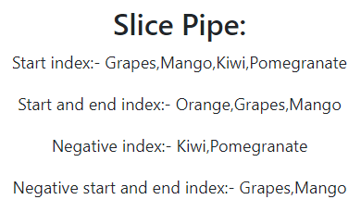
Slice Pipe

Slide 10
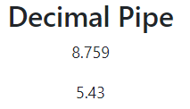
Decimal Pipe
It is used to format decimal values.
<div>
<h3>Decimal Pipe</h3>
<p> {{decimalNum1 | number}} </p>
<p> {{decimalNum2 | number}} </p>
</div>
Define in component’s .ts file:-
decimalNum1: number = 8.7589623;
decimalNum2: number = 5.43;
Output:

Slide 11
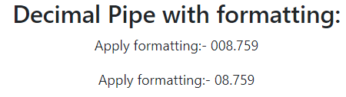
Decimal Number Pipe With Formatting
Formatting values : We can apply string format inside number pattern.
It is based on the below format −
number:"{minimum Int Digits before decimal point}.{minimumFractionDigits} - {maximumFractionDigits}“
<div>
<h3>Decimal Number Pipe with formatting:</h3>
<p> Apply formatting:- {{decimalNum1 | number:'3.1'}} </p>
<p> Apply formatting:- {{decimalNum1 | number:'2.1-4'}} </p>
</div>
{{decimalNum1 | number:’3.1’}} means three decimal place and minimum of one fraction but no constraint about maximum fraction limit. It returns the following output
{{decimalNum1 | number:’2.1-4’}} means two decimal places and minimum one and maximum of four fractions allowed so it returns the below output −

Slide 12

Decimal Percent Pipe
It is used to format number as percent.
Formatting strings are same as DecimalPipe concept.
<div>
<h3>Decimal Percent Pipe</h3>
<p> {{decimalNum3 | percent:'2.2'}} </p>
</div>
Define as below in associated component.ts file:-
decimalNum3: number = 0.8178;

Slide 13
Json Pipe
It is used to transform a JavaScript object into a JSON string.
<div>
<h3>Json Pipe</h3>
<p>{{ jsonData | json }}</p>
</div>
Put the following code in .ts file
jsonData = { id: 'one', name: { username: 'user1' }}

Slide 14
Creating Custom Pipe
As we have seen already, there is a number of pre-defined Pipes available in Angular 8 but sometimes, we may want to transform values in custom formats. This section explains about creating custom Pipes.
Create a custom Pipe using the below command −
ng g pipe custompipe

Slide 15
Creating Custom Pipe
import { Pipe, PipeTransform } from '@angular/core';
@Pipe({
name: 'custompipe'
})
export class CustompipePipe implements PipeTransform {
transform(val: number): number {
return val.toString().length;
}
}
PipeTransform interface has single method transform with signature as below:-
interface PipeTransform {
transform(value: any, ...args: any[]): any
}

Slide 16
Creating Custom Pipe
App.component.html:-
<div>
<p> DigitCount Pipe </p>
<h1>{{ digits | custompipe }}</h1>
</div>
App.component.ts
digits : number = 100;

